Slide 1
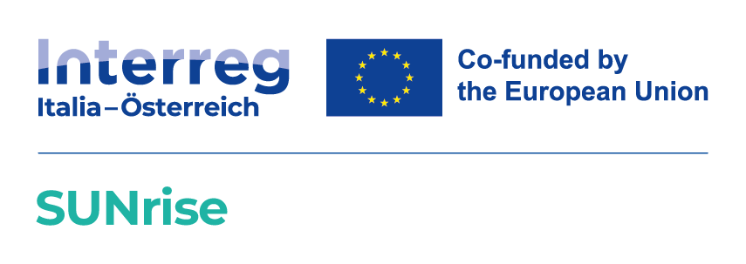
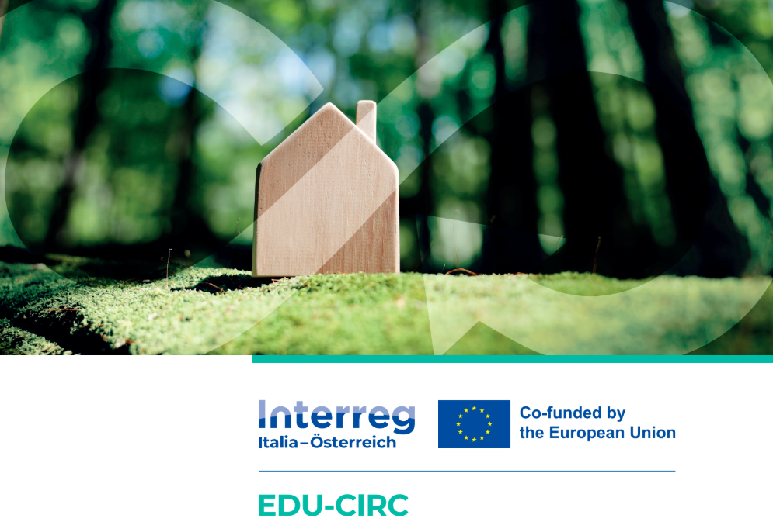
Sustainable Business Model Canvas - introduction
SUNRISE
Train the trainer Activity :
Sustainable Business Model Canvas

Slide 2



THE PURPOSE OF SUSTAINABLE BUSINESS MODELS
Developing innovative models
Analyze existing models
Facilitating communication
Creating business approaches that balance profit with social and environmental responsibility.
Identify areas for improvement by assessing the impact of business operations on sustainability
Foster clarity among team members and enable effective communication between stakeholders

Slide 3







A HOLISTIC APPROACH TO BUSINESS
General objective: maximize positive impacts and minimize negative impacts on society and nature.
Ecological
Minimize environmental footprint and preserve natural resources
Economic
Focus on financial sustainability and long-term profit
Social
Creating a positive impact on communities and workers

Slide 4
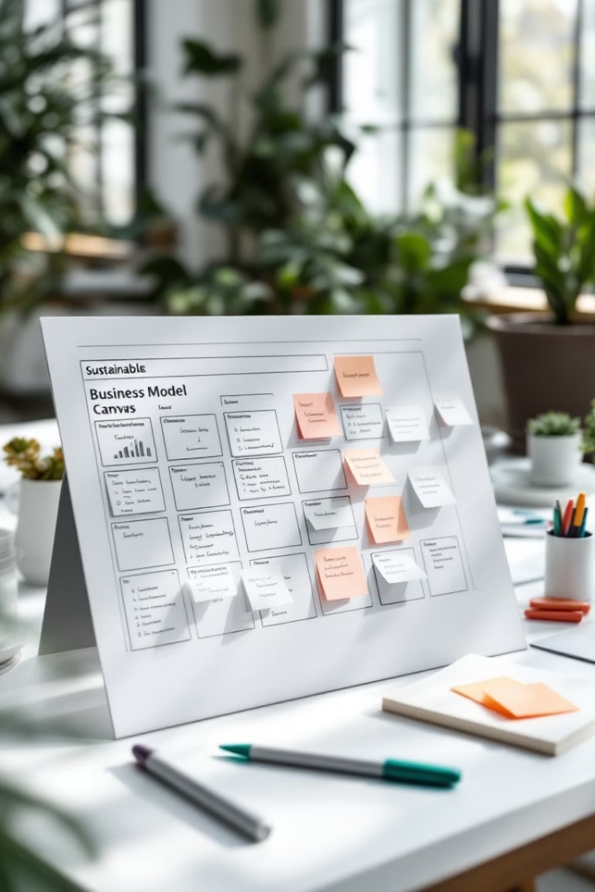
WHY USE SUSTAINABLE BUSINESS MODELS?
A visual approach to strategic transitions and development.
Visual structure
Visualizing complex business relationships
Quickly identify connections between different elements
Strategic focus
Focus on strategic priorities
Address all critical aspects of business activity
Supporting the transition to sustainability
Helps identify sustainable practices
Iterative development
continuous improvement through feedback loops and prototyping

Slide 5
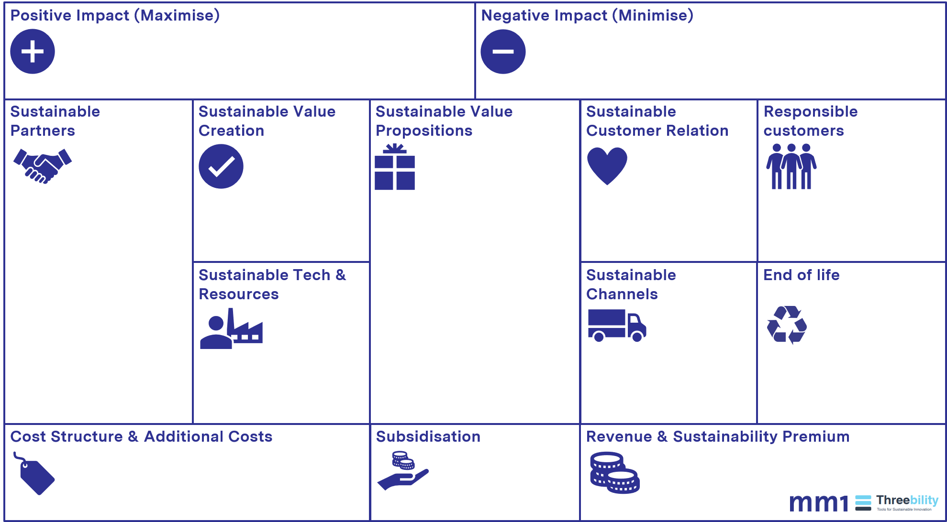
SUSTAINABLE BUSINESS MODEL
OFFER
INFRASTRUCTURE
CUSTOMER
PROFIT MODEL
Source: https://www.projektmagazin.de/methoden/sustainable-business-model-canvas

Slide 6
Recommendations for use
Start with a value proposition / OFFER
  A clear understanding of the offerings as a starting point
PUSH vs. PULL approach
  Define whether your business is market-oriented (PULL) or not (PUSH)
  PULL: Start with the customer segment
  PUSH: Start with the infrastructure segment
Work on all elements
  Define the other elements of the model
Conclude with + and – as a summary of the main results
  reflection

Slide 7
QUESTIONS for further information
1. Value proposition
Basic questions:
What value do we provide to the customer?
What problem of our client are we helping to solve ?
What product and service packages do we offer to each customer segment?
What customer needs are we fulfilling?
Questions about sustainability:
Objective: Understand how sustainability is integrated into offerings.
How does your value proposition address sustainability issues (e.g., eco-friendly products, social impact)?
What percentage of your value proposition is focused on environmental or social benefits?
How important is sustainability to your customers and how does this influence your offerings?
Have you identified areas where your value proposition could better align with sustainability trends or customer expectations?
How do you measure the success of your sustainability-oriented proposals?
OFFER

Slide 8
In-depth questions
2. Sustainable partners
Basic questions:
Who are your main partners and suppliers?
What resources do they provide?
What activities do they do for you ?
What is their motivation for the partnership?
Targeted questions on sustainability:
Objective: To understand how sustainability impacts partnerships and supply chains
How do your current partnerships contribute to your sustainability goals (sourcing green materials, reducing emissions)?
Are your key suppliers and partners aligned with your environmental and social impact goals? If not, what measures could be taken?
How do you assess the environmental and social impact of your partners?
Could you benefit from engaging with new partners who focus on sustainable practices?
What external resources (e.g., certifications, audits) could help your partners become more sustainable?
INFRASTRUCTURE

Slide 9
In-depth questions
3. Sustainable value creation / key
Basic questions:
What activities are needed to deliver the value proposition?
What needs to be done to ensure the business model works?
What activities are essential for distribution, channels, customer relationships, revenue streams, etc.?
In-depth questions on sustainability:
Objective: Focus on sustainable processes and operations.
Which of your main activities are currently aligned with your sustainability goals?
How have you integrated waste reduction, energy efficiency, or other eco-friendly practices into your operations?
What challenges do you face to make your core businesses more sustainable?
Are there activities that could be relocated or automated to improve sustainability?
How do you measure the environmental and social impact of your core activities?
INFRASTRUCTURE

Slide 10
FURTHER INFORMATION QUESTIONS
4. SUSTAINABLE TECHNOLOGY AND KEY RESOURCES
Basic questions:
What resources does the startup need to operate?
What resources are needed to realize the value proposition?
What resources are needed for distribution, channels, customer relationships, revenue streams, etc.?
What resources are available?
Key questions about sustainability:
Objective: To assess the sustainability of critical resources.
What percentage of your key resources (e.g., materials, energy, infrastructure) are renewable or sustainable?
Are there specific sustainability goals related to resource use that you would like to achieve?
What obstacles do you encounter in sourcing more sustainable resources?
How do you ensure the long-term sustainability of your resource supply chain?
Are there untapped opportunities to use recycled or reused materials in your operations?
INFRASTRUCTURE

Slide 11
FURTHER INFORMATION QUESTIONS
5. SUSTAINABLE CUSTOMER RELATIONSHIPS
Basic questions:
How to acquire, retain and grow your customer base?
What kind of relationship does the customer expect?
How should this relationship be established?
How can you integrate these expectations into your business in terms of cost and format?
Targeted questions on sustainability:
Objective: To explore the impact of sustainability on customer engagement.
How do you communicate your sustainability initiatives to customers ?
How does sustainability influence the way you build and maintain customer trust?
What feedback have you received from customers regarding your sustainability initiatives ?
Are there opportunities to more actively engage customers in your sustainability journey (e.g. through co-creation or feedback loops)?
How do you measure the impact of your sustainability-focused customer relationships?
CUSTOMER

Slide 12
FURTHER INFORMATION QUESTIONS
6. RESPONSIBLE CUSTOMERS (SEGMENTS)
Basic questions:
Who are we creating value for?
Who are our most important customers?
Targeted questions on sustainability:
Objective: To evaluate how sustainability impacts the target markets
Which customer segments most value sustainability, and how do you address their needs?
Are there unreached customer segments that prioritize sustainability?
How does sustainability influence your segmentation strategy (e.g. niche or mass markets)?
What are the obstacles you encounter in marketing to sustainability-conscious customers?
How do you measure the value of sustainability for your key customer segments?
CUSTOMER

Slide 13
In-depth questions
7. Sustainable channels
Basic questions: ( consider the sectors of logistics , communications, sales, etc.)
How to reach your customers?
Through which channels does the customer want to be reached?
What are the most effective channels?
How much will it cost?
How can they best be integrated into your and your customers' habits?
Targeted questions on sustainability:
Objective: To examine the role of sustainability in delivery mechanisms
How do your current channels (e.g., distribution, sales, communications) reflect your sustainability values?
Are there more sustainable options for delivering your products and services to customers?
How do you measure the environmental impact of your distribution and communication channels?
What obstacles prevent you from adopting more sustainable channels?
Are there opportunities to use digital channels to improve sustainability (e.g., reduction of printed materials, remote services)?
CUSTOMER

Slide 14
In-depth questions
SPECIAL – END OF CYCLE
Targeted questions on sustainability:
Objective: Address sustainability aspects in the final stages of a product or service
How will your product be disposed of at the end of its life cycle?
What measures can you take to extend the life of your product?
How can you ensure that the materials in your product are reintroduced into the production cycle ?
What are the environmental and social impacts at the end of the life cycle?
How can you motivate customers to dispose of or return your product sustainably?
CUSTOMER

Slide 15
FURTHER INFORMATION QUESTIONS
PROFIT
8. COST STRUCTURE
Basic questions:
How to reach your customers?
Through which channels does the customer want to be reached?
What are the most effective channels?
How much will they cost?
How can they best be integrated into your and your customers' habits?
Targeted questions on sustainability:
Objective: To analyze the financial impact on sustainability.
How do sustainability initiatives affect your cost structure (e.g., higher upfront costs, long-term savings)?
Are there opportunities for savings through more sustainable practices (e.g., energy efficiency, waste reduction)?
How do you allocate resources for sustainability initiatives in your budget?
What challenges do you face in balancing sustainability goals with cost management?
How do you measure the ROI (return on investment) of sustainability initiatives?

Slide 16
FURTHER INFORMATION QUESTIONS
PROFIT
9. SOURCES OF REVENUE
Basic questions:
How will you generate revenue?
What value is the customer willing to pay?
How would they prefer to pay?
How much does each source of income contribute to total income?
Do the revenue forecasts indicate an increase in profitability by the end of the projection period?
Targeted questions on sustainability:
Objective: To explore how sustainability contributes to profitability
What percentage of your revenue comes from sustainability-oriented products or services?
How do your customers perceive the value of sustainability in your offerings, and are they willing to pay a premium for it?
Have you explored new revenue streams based on sustainable practices (e.g. circular economy models, eco-services)?
What obstacles do you encounter in monetizing sustainability initiatives?
How do you measure the impact of sustainability on your overall revenue growth?

Slide 17
FURTHER INFORMATION QUESTIONS
PROFIT
SPECIAL - SUBSIDY
Targeted questions on sustainability:
Objective: Identify funding and support opportunities, including sustainability as a strategic advantage
What government or private funding programs can you leverage to support sustainable innovations in your business model?
How can you establish partnerships with organizations or institutions that promote sustainability projects?
What internal resources can be mobilized to promote sustainability in your business model?
How can you actively engage your customers and suppliers in promoting sustainability goals?
What communication strategies can you use to highlight the benefits of your sustainable business practices and gain support?

Slide 18
REFLECTION & CONCLUSION
SUMMARY
Focus on key topics on how to maximize the positive impact and minimize the negative impact of your business
Thank you
For further information and materials, access the platform at: https://www.edu-circ.eu/platform/
The EDU-CIRC E-learning platform is a virtual learning space that promotes circular economy and decarbonisation. It offers training for young people, students, teachers and employees on the principles, methods and best practices of the circular economy, with a focus on the wood processing, construction and automotive industries. The platform provides educational resources developed through the analysis of existing materials, study visits to circular economy companies and cross-border hackathons. The content is tailored to different target groups and supports skills development and sustainable innovation.

