Slide 1


EDU-CIRC
Rete transfrontaliera per la formazione sull’economia circolare e la decarbonizzazione nella produzione
Grenzübergreifendes Netzwerk zur Aus- und Weiterbildung in Kreislaufwirtschaft und Dekarbonisierung in der Produktion
Interreg VI – A Italia - Österreich
Europa noch näher
Un’Europa più vicina

Slide 2
Digital Twins and
Sustainability
Notes:
Today, I would like to show you what a digital twin is—and how it relates to sustainability.

Slide 3
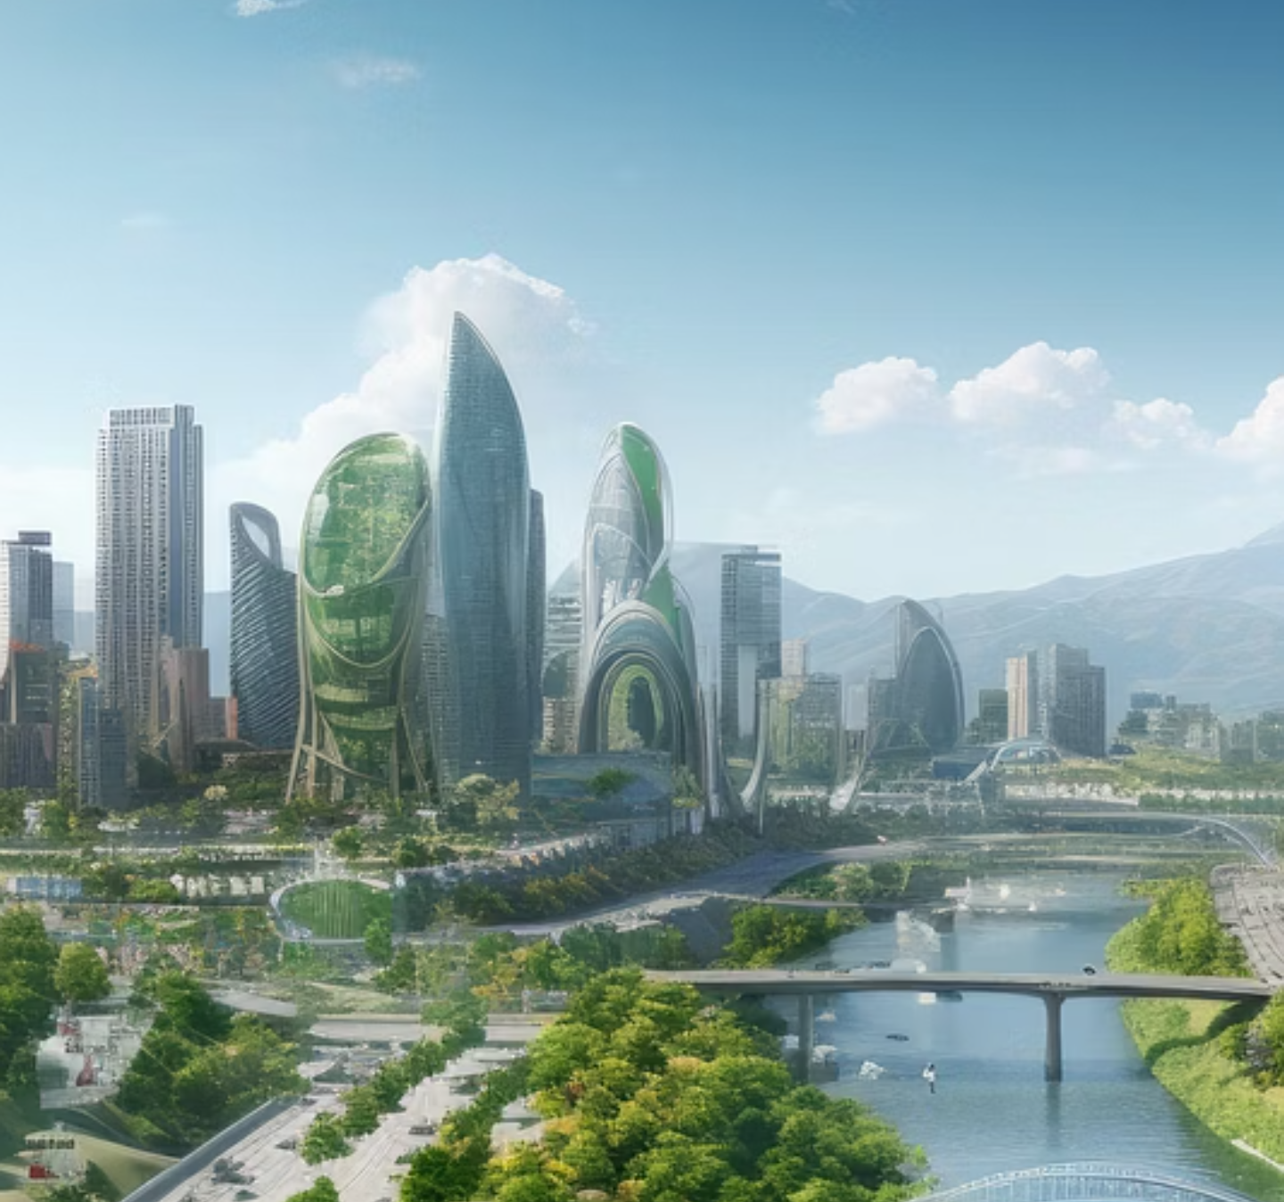
WHY SUSTAINABILITY MATTERS?
Notes:
Ask applicants what is sustainability and why it matters?

Slide 4
WHY SUSTAINABILITY MATTERS?
1
Limited Natural Resources
Meeting the needs of growing global population.
Notes:
Our population and living standards keep rising, which increases demand for energy, materials, water, and land. That pressure challenges how we design and use products. Sustainability isn’t just ethical; it’s a design constraint that affects cost, risk, and resilience.
Those needs have historically been met by fossil fuels

Slide 5
WHY SUSTAINABILITY MATTERS?
1
2
Limited Natural Resources
Environmental Challenges
Meeting the needs of growing global population.
Combating climate change, pollution, and biodiversity loss.
Notes:
Climate change, air pollution, and biodiversity loss are outcomes of how we produce and consume. Engineering choices—materials, processes, and product use—directly influence these impacts. Small improvements at scale can yield large benefits.

Slide 6
WHY SUSTAINABILITY MATTERS?
1
2
3
Limited Natural Resources
Environmental Challenges
Engineering’s
Role
Meeting the needs of growing global population.
Combating climate change, pollution, and biodiversity loss.
Designing for long-term viability and ecological balance.
Notes:
Our job is to deliver function with less energy and fewer resources over the full lifecycle—manufacture, use, and end-of-life. That means efficiency, durability, reparability, and circularity.

Slide 7
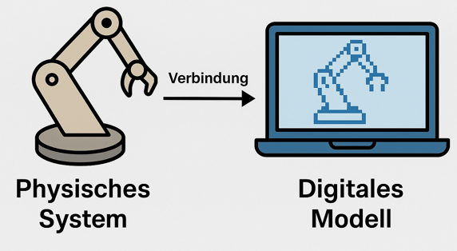
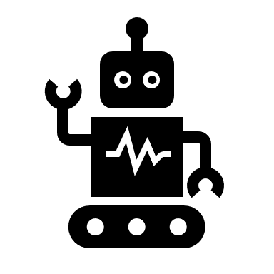


What is a Digital Twin?
A digital representation of a real system or product.
Consists of:
  Physical system (e.g., machine, robot)
  Digital model (computer simulation)
  Connection (e.g., via control system, sensors)
Changes in the real system are immediately visible in the digital twin.
Connection
Source: Own representation, created with ChatGPT (OpenAI, 2025)
Notes:
A digital twin is basically a digital replica of a real system.
This could be a machine, a robot, or even an entire factory.
So on the one hand, you have the real system – for example, a robot –
and on the other hand, you have a digital model that behaves as similarly as possible to the real one.
The two are connected to each other, for example via a control system and/or sensors.
So if I change something in the real system, you can see it immediately in the digital twin – and vice versa.

Slide 8



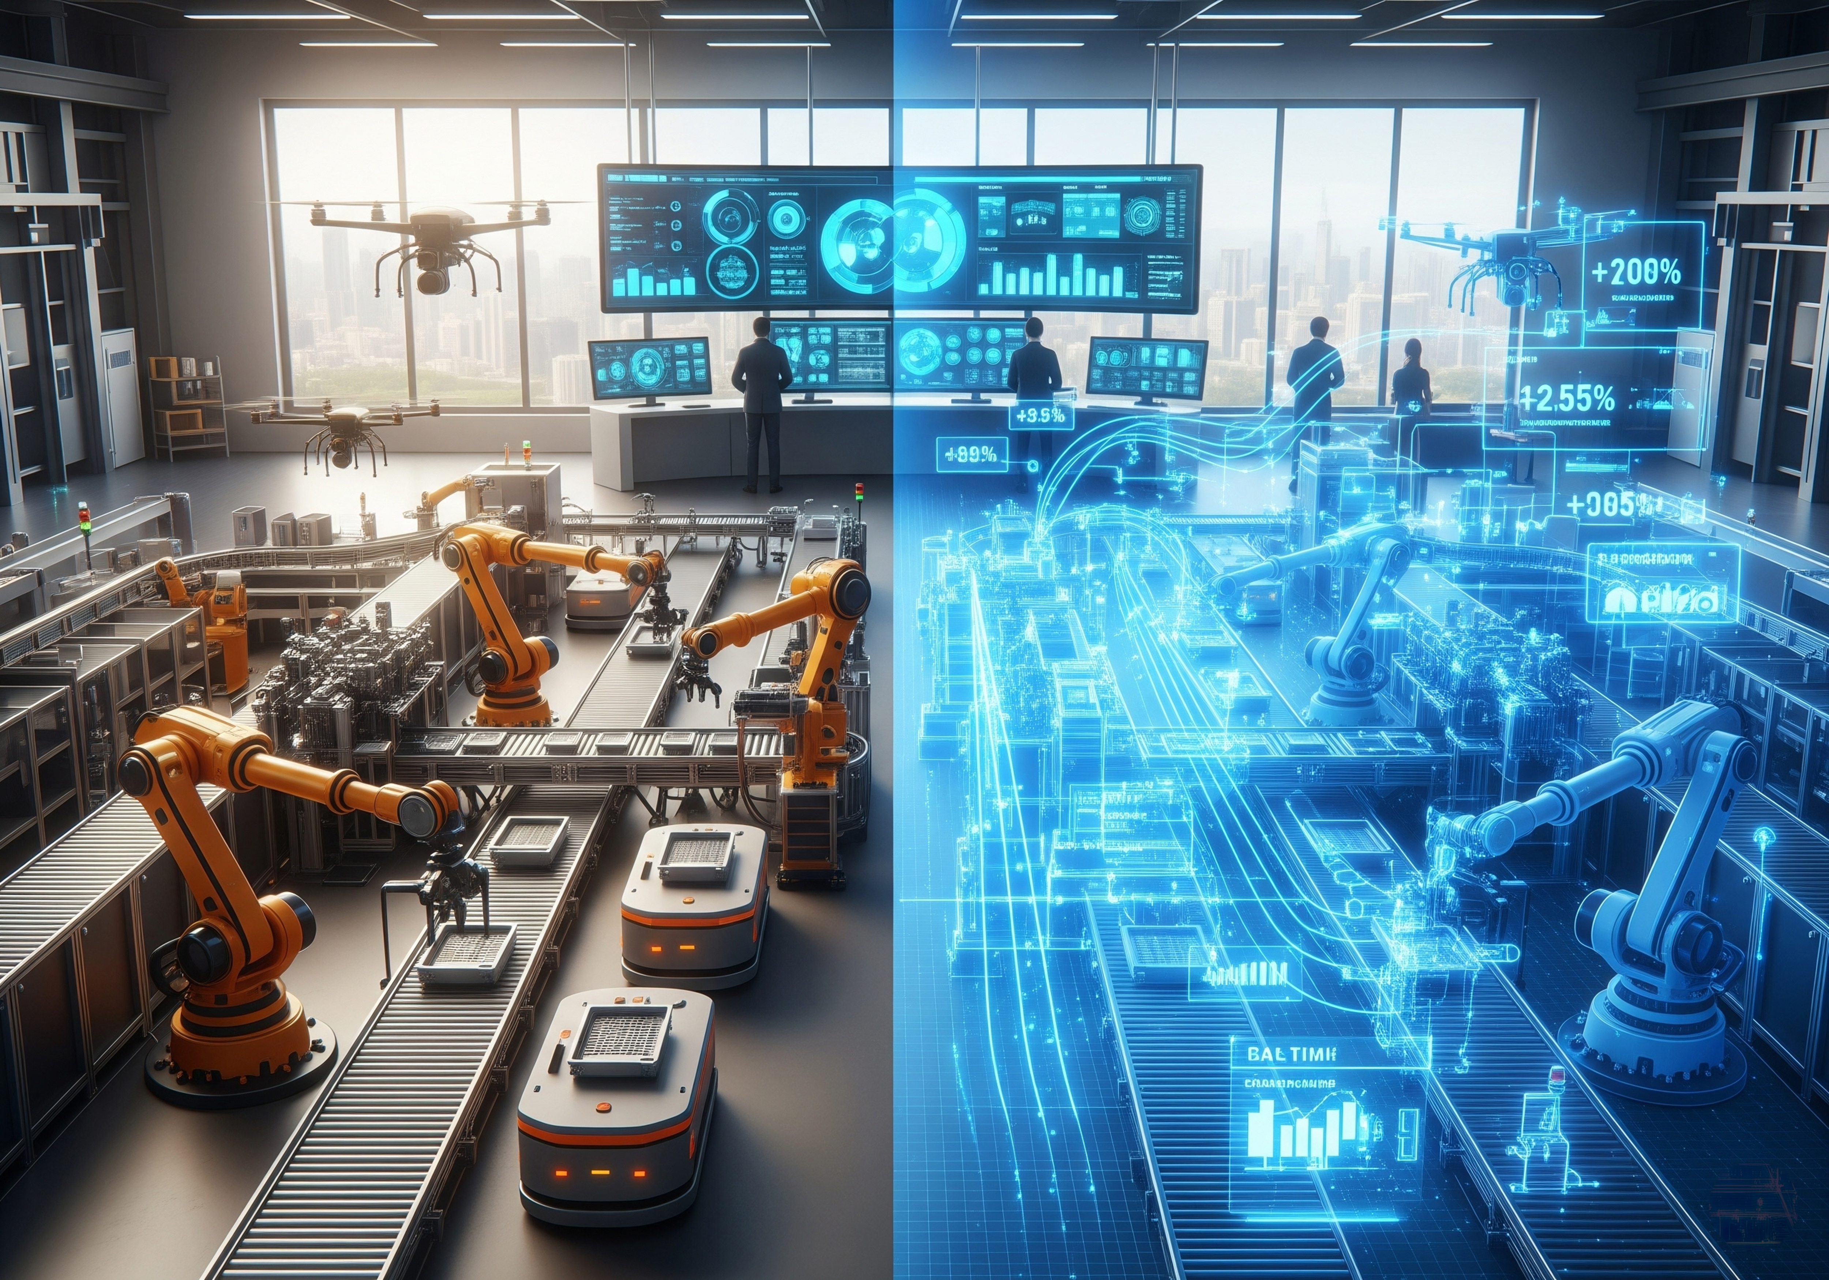
Where is a Digital Twin used?
Virtual testing is faster, safer, and more resource-efficient
Systems can be improved without wasting materials, energy, or time
In industry:
  Less waste
  Shorter development times
  Lower energy consumption
Notes:
The big advantage is that you can test virtually
without consuming materials, energy, or time.
In industry, digital twins are used, for example,
to optimize machines and processes,
detect errors early on, or simulate new processes.
Machine downtime always involves high costs, so if a machine has to be shut down to carry out tests, it is usually not productive during this time and costs money.
However, the use of simulations not only saves costs but also resources—
i.e., electricity, raw materials, and time—and thus makes a clear contribution to sustainability.

Slide 9
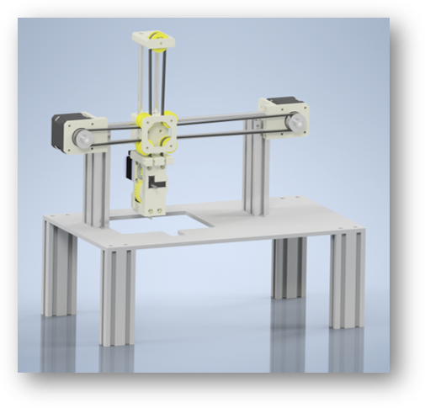
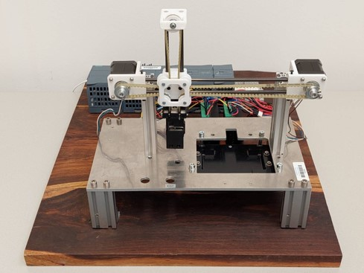
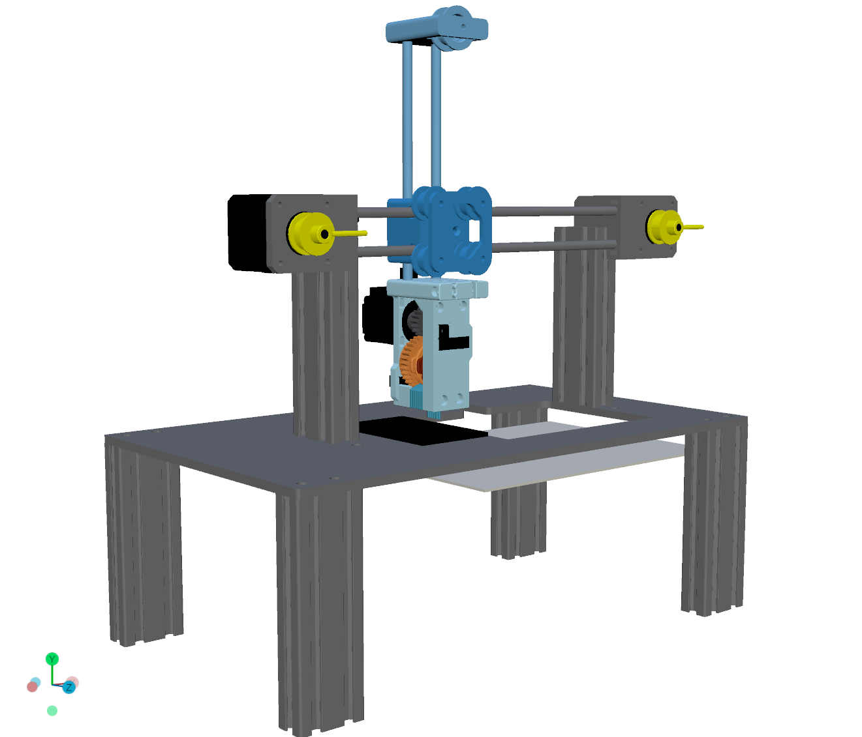
Example: SmartPrintAutomation
CAD Model
Physical Demonstrator
Digital Twin

Slide 10
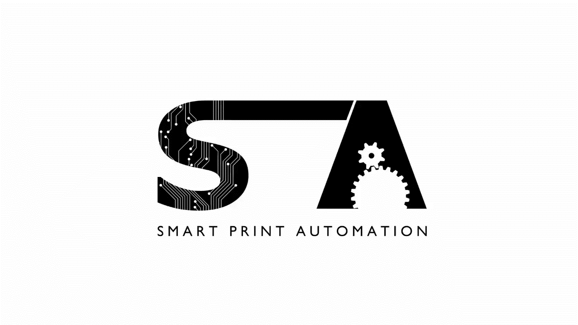
Source: Hohenberger, Pierre; Heindl, Benjamin; Smoly, Valentin (2023). Smart Print Automation: Project video, Bachelor’s thesis, FH Kärnten. Reuse and distribution permitted with proper source citation.

Slide 11
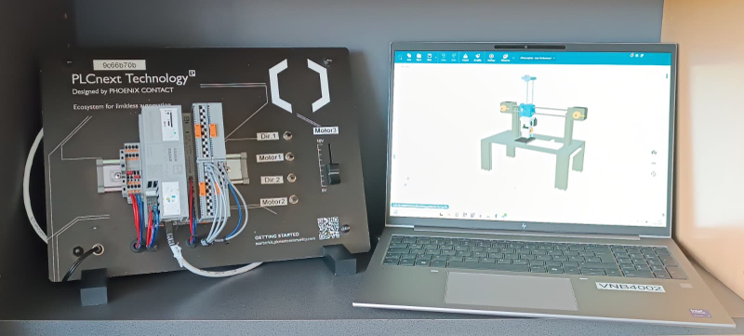
Example: SmartPrintAutomation
Control via a PLC (programmable logic controller) with 4 buttons and 1 slider –
Link to the digital model on the laptop
Features:
Button 1: Direction of motor1
Button 2: Activation of motor1
Button 1: Direction of motor2
Button 2: Activation of motor2
Slider: Control of motor3 (camshaft)
Everything that is pressed or moved on the PLC is displayed in real time in the digital twin.
Notes:
An example we created:
It consists of a PLC controller connected to my laptop.
The PLC has four buttons and a slider.
Two buttons determine the direction of two motors,
the other two activate or stop the motors,
and the slider controls a third motor – which in turn drives a camshaft.
Everything that happens on the real PLC can be seen immediately in the digital model on the laptop.
This is a simplified simulation – but the principle is the same as in industry."

Slide 12



Digital Twins in Education
Students can learn and experiment on virtual systems.
Saves:
  Costs
  Space
  Resources
Safety: No risk to people or machines
Anyone can practice programming and control on their own laptop
💬 Example:
“In robotics, a robotic arm costs tens of thousands of euros.
With digital twins, every student can still learn to program it – virtually, safely, and sustainably.”
Notes:
Digital twins are also used in training and teaching.
At many universities, students can learn on virtual machines,
without the need for a real machine for each person or a complex schedule for when each student is allowed to work with the machine.
This not only saves money, but also space and energy.
An example:
In robotics, a robot arm often costs tens of thousands of euros.
It also requires a lot of space and safety precautions.
With a digital twin, students can practice control and programming
on a laptop – without any risk and with the same learning outcomes.
This way, everyone can learn, regardless of how many devices are actually available.

Slide 13
Connection to Sustainability
Area | Contribution to sustainability
Environment | Less energy and material consumption
Economy | Shorter development times, lower costs
Education | Equal learning opportunities for all, no expensive equipment required
Security | No danger from machines or incorrect operation
Notes:
Digital twins promote sustainability on several levels:
•Environment: Less energy and material consumption
•Economy: Faster development, less waste
•Education: Equal opportunities for all – even without expensive equipment
•Safety: No danger from machines
So you see, it's not just about technology,
but also about how we use resources –
whether that's materials, energy, or learning opportunities.

Slide 14

Discussion
How can a digital twin help us work or learn more sustainably?
Why is this also interesting for schools or universities?
Where else could digital twins be used?
Imagine you could develop a digital twin for something in everyday life.
What would you choose—and why?
Notes:
1.
“That whatever you press on the PLC immediately moves on the screen!”
“That everything is really connected – real and virtual.”
“That you can use it without having a real machine.”
“That you can make mistakes without breaking anything.”
“How realistic the simulation looks!”
2.
“You don't have to build anything real before you know if it works.”
“It saves electricity, materials, and time.”
“You can optimize processes before they start.”
“You can show how something works without wasting resources.”
“There are fewer mistakes and less waste.”
3.
“Because you can try out the latest devices without having to buy them.”
“You can try things out in class that would otherwise be too dangerous.”
“Because you can learn more virtually without breaking anything.”
“You need less space and money.”
“This way, everyone can learn at the same time, not just one person at a time.”
“Everyone can learn at their own pace.”
4.
“In medicine—for example, to practice surgery.”
“In agriculture—to control plant growth or irrigation.”
“In transportation—for better traffic light timing or electric cars.”
“In cities – to optimize energy and waste.”
“In space travel – before sending real devices into space.”
“At school – to do experiments digitally.”
5.
“My room – so I can see if it's tidy before I get home.”
“My cell phone battery – to see how long it really lasts.”
“My bus schedule – so I know when it's worth walking instead of waiting.”
“My body – to see when I've had enough sleep or eaten enough.”
“Our school – to save energy when no one is there.”
“A soccer game – to test strategies before playing.”

Slide 15
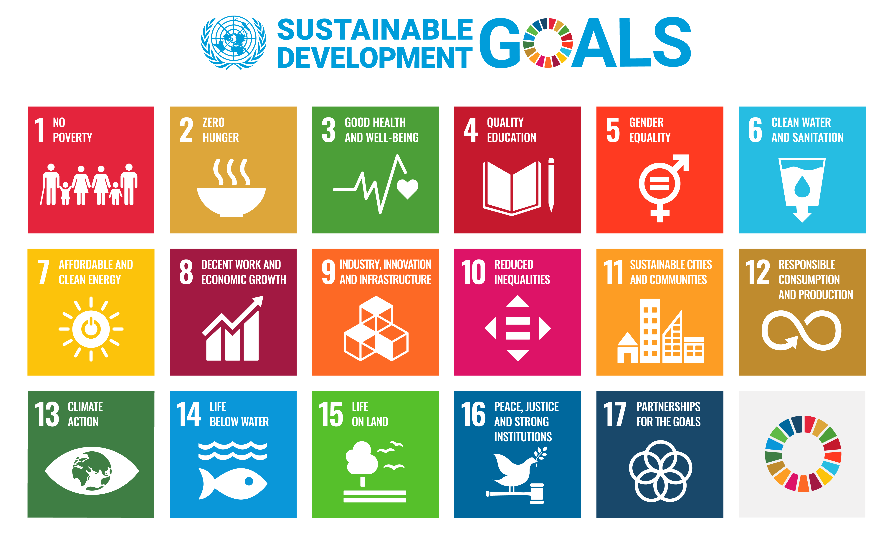

The 17 Sustainable Development
How does the digital twin contribute to these goals?
Notes:
Finally, I would like to take you one step further in your thinking.
Here you can see the 17 Sustainable Development Goals of the United Nations –
they describe how we want to make our world more equitable, environmentally friendly, and livable by 2030.
I would like to think about this together with you:
Which of these goals could the digital twin contribute to – and why?
•Goal 4 – Quality Education:
Digital twins enable learning on virtual models without having to purchase a lot of expensive equipment.
•Goal 9 – Industry, Innovation and Infrastructure:
They promote new, sustainable production methods and optimize industrial processes.
•Goal 12 – Responsible Consumption and Production:
Simulations can save materials and energy and help avoid mistakes.
•Goal 13 – Climate Action:
Virtual tests help reduce emissions and develop climate-friendly solutions.
●

Slide 16
Conclusion
Digital twins = combining technology and sustainability
Learning, testing, and optimizing without wasting resources
Realistic training—even without real machines
An important step toward a sustainable digital future
Notes:
To summarize once again:
A digital twin connects the real and digital worlds.
It helps us plan, test, and improve things
without wasting unnecessary resources.
This makes it not only technically exciting,
but also an important tool for a sustainable future.

Slide 17
Thank you!

