Slide 1


EDU-CIRC
Rete transfrontaliera per la formazione sull’economia circolare e la decarbonizzazione nella produzione
Grenzübergreifendes Netzwerk zur Aus- und Weiterbildung in Kreislaufwirtschaft und Dekarbonisierung in der Produktion
Europa noch näher
Un’Europa più vicina

Slide 2
The Journey of a Juice Box
🪵🪚♻️
THEME: WOOD
Notes:
Welcome everyone! Today, we’ll explore how sawdust can become something valuable in a circular economy.
This workshop is all about rethinking waste, learning about the 9Rs, trying out a Life Cycle Assessment, and getting hands-on by making our own bio-composite products from sawdust.
By the end, you’ll be “Eco Designers” who see wood waste in a whole new light.

Slide 3

Workshop Objectives
Circular Economy: Learn the principles and the 9Rs.
Life Cycle Assessment: Evaluate environmental impact.
Activity: Recycling Relay - Separate juice box layers.
Reflect on Sustainability: Improve sustainability.
Notes:
We’ll start with a quick introduction to the circular economy and the 9Rs principles.
Then, we’ll look at Life Cycle Assessment (LCA): a way to measure environmental impact.
Our hands-on activity: making a product from sawdust and silicone.
We’ll end with a reflection: how can we make our design even more sustainable?

Slide 4
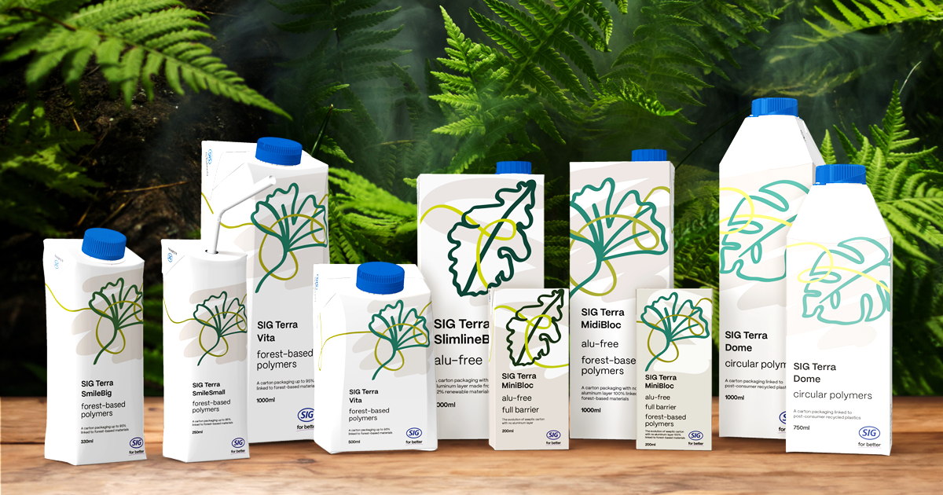
Aseptic Cardboard Container: Juice Boxes
Aseptic containers are a multi-layered barrier that keeps products fresh without refrigeration.
📽️The pack that protects: Aseptic Containers
Source: www.sig.biz
Notes:
Here are some real wood samples for you to touch and inspect.
Can you guess which ones have real wood grain and which are engineered products?
Remember: wood products can be natural, like solid oak, or processed, like MDF or bamboo panels.
Feeling the textures will help you later when we talk about materials.

Slide 5
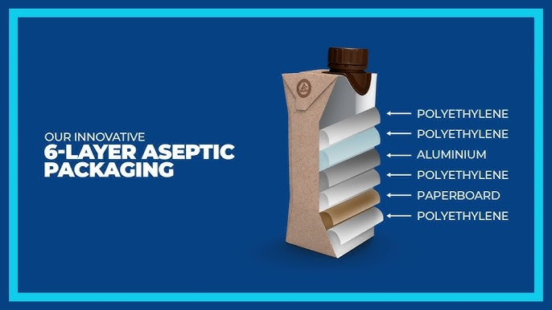
Aseptic Cardboard Container
Can you guess what materials make up an Aseptic Pack?
📽️Six Layered Freshness
Source: www.tetrapak.com
Notes:
Here are some real wood samples for you to touch and inspect.
Can you guess which ones have real wood grain and which are engineered products?
Remember: wood products can be natural, like solid oak, or processed, like MDF or bamboo panels.
Feeling the textures will help you later when we talk about materials.

Slide 6
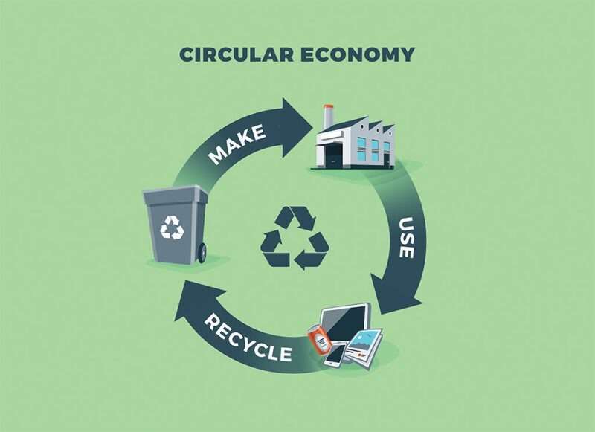
What is Circular Economy (CE)?
Definition:
A system where products, materials, and resources are kept in use for as long as possible.
📽️ Circular Economy
Source: https://jpt.spe.org/
Notes:
CE is about keeping products, materials, and resources in use for as long as possible.
Instead of throwing things away, we reuse, repair, refurbish, and recycle.
We’ll watch a short video: pay attention to how the “linear” system wastes resources compared to the “circular” system.
After the video, I’ll ask you: how did they show the difference visually?

Slide 7
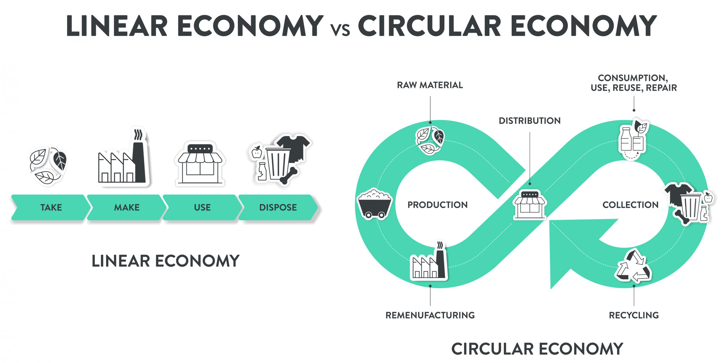
Linear vs Circular Economy:
How does the video illustrate the difference between a linear and a circular economy?
Source: https://www.technikum-wien.at/
Notes:
In a linear economy, it’s “take, make, dispose.”
In a circular economy, it’s “make, use, reuse, recycle”—closing the loop so nothing is wasted.

Slide 8
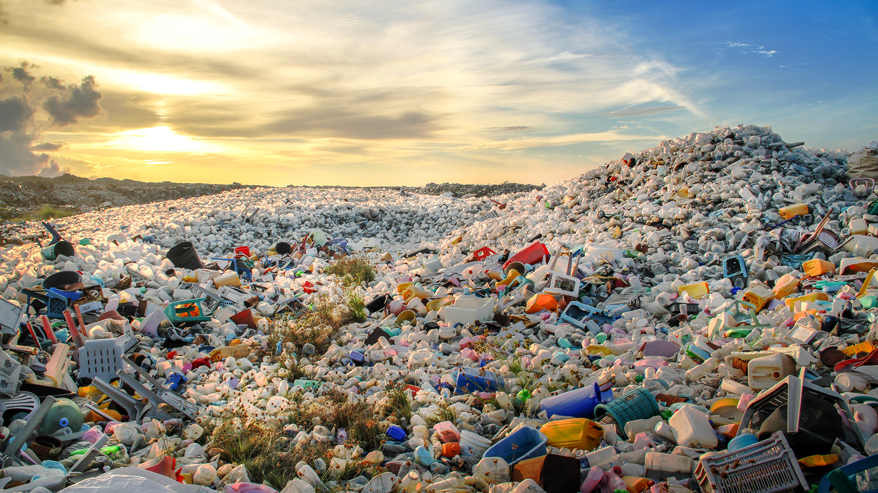
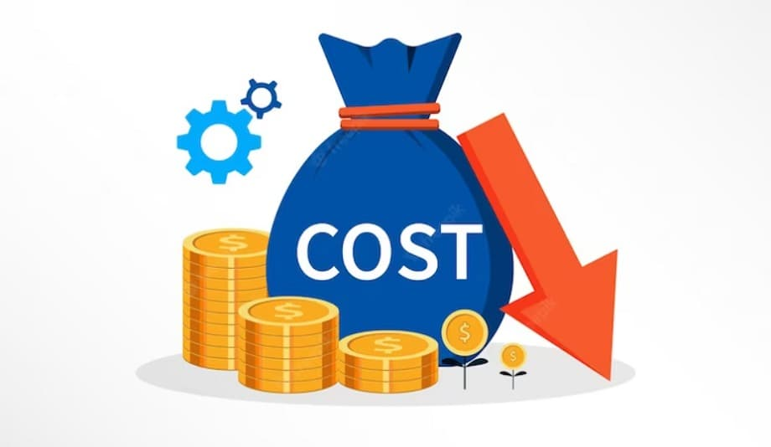
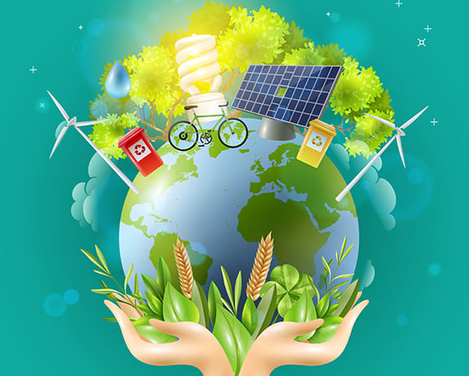
Why Circular Economy Matters
Environmental Impact: Waste, pollution, depletion of resources
Economic Benefits: Reduced costs, innovation, job creation
Social Impact: Sustainable living, waste reduction
Source: https://www.innovationnewsnetwork.com/
Source: https://cashflowinventory.com/blog/
Source: https://radiant.edu.np/
Notes:
Environment: Less waste, less pollution, less resource depletion.
Economy: Saves money, creates jobs, sparks innovation.
Society: Encourages sustainable living and better habits.
Even small changes in product design can have a big impact.

Slide 9
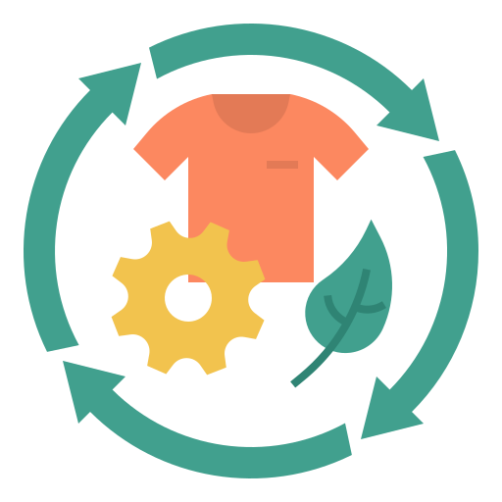
9Rs of Circular Economy
Overview : Set of principles designed to reduce environmental impact and maximize the reuse of resources throughout the lifecycle of products and materials
Focus : The key principles for sustainable production and consumption
Notes:
The 9Rs are like a toolbox for sustainability—from Refuse all the way to Recover.

Slide 10

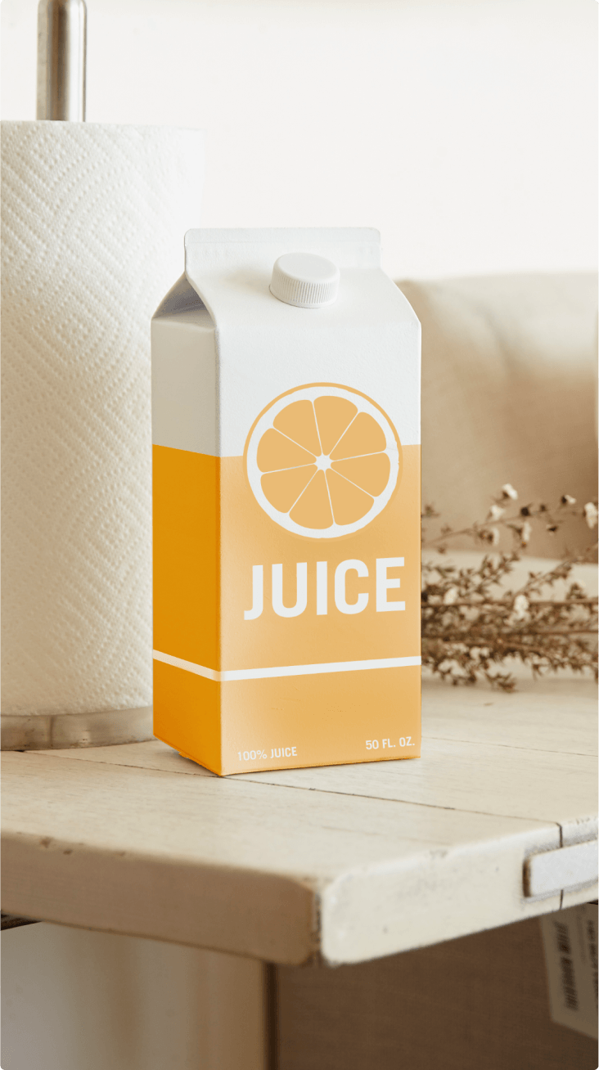
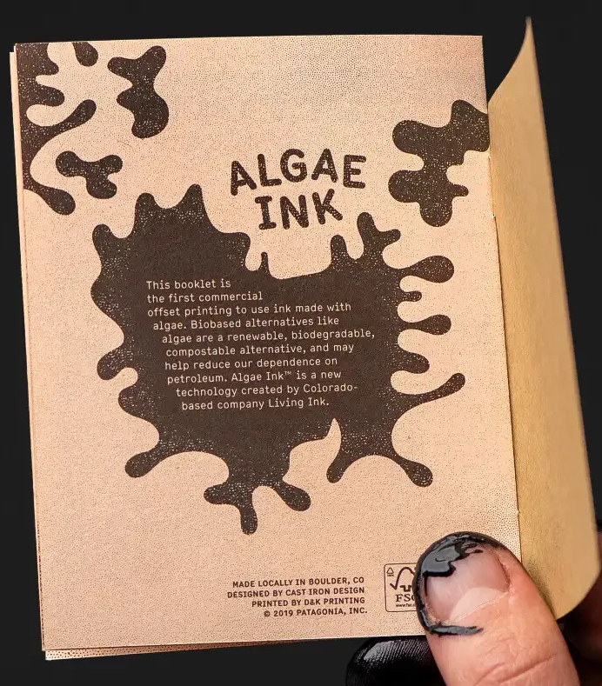
CE of Aseptic Cardboard Container
R0 - Refuse: Say no to single-use packs when possible.
R1 - Rethink: Design cartons for easier recycling.
R2 – Reduce: Minimize packaging layers and inks.
Source: foodhealthlegal.eu
Source: recyclecartons.com
Source: blog.fordeercommerce.io
Notes:
R0 Refuse: Avoid virgin wood—use sawdust instead.
R1 Rethink: Design for disassembly so parts can be reused.
R2 Reduce: Use less resin, less energy in production.

Slide 11
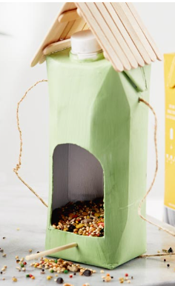

CE of Aseptic Cardboard Container
R3 – Reuse: Crafts, storage, planters, wallets.
R4 – Redesign: Improve carton materials for sustainability.
R5 – Remanufacture: Turn used cartons into paperboard again.
Notes:
R3 Reuse: Use whole MDF panels again without breaking them down.
R4 Repair: Fix damage rather than discard.
R5 Refurbish: Give old MDF a facelift—paint, sand, or add veneers.

Slide 12
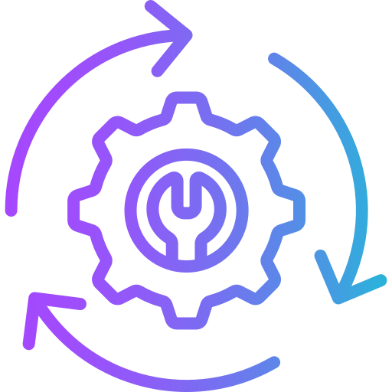
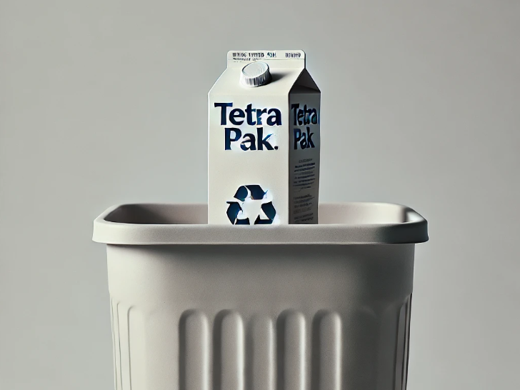
CE of Aseptic Cardboard Container
R6 – Repurpose: Creative upcycling projects.
R7 – Recycle: Separate paper, plastic, aluminum in recycling plants.
R9 – Recover: Energy recovery from non-recyclable waste.
Notes:
R6 Remanufacture: Rebuild products from old MDF parts.
R7 Repurpose: Turn MDF scraps into new things, like shelves or decorations.

Slide 13
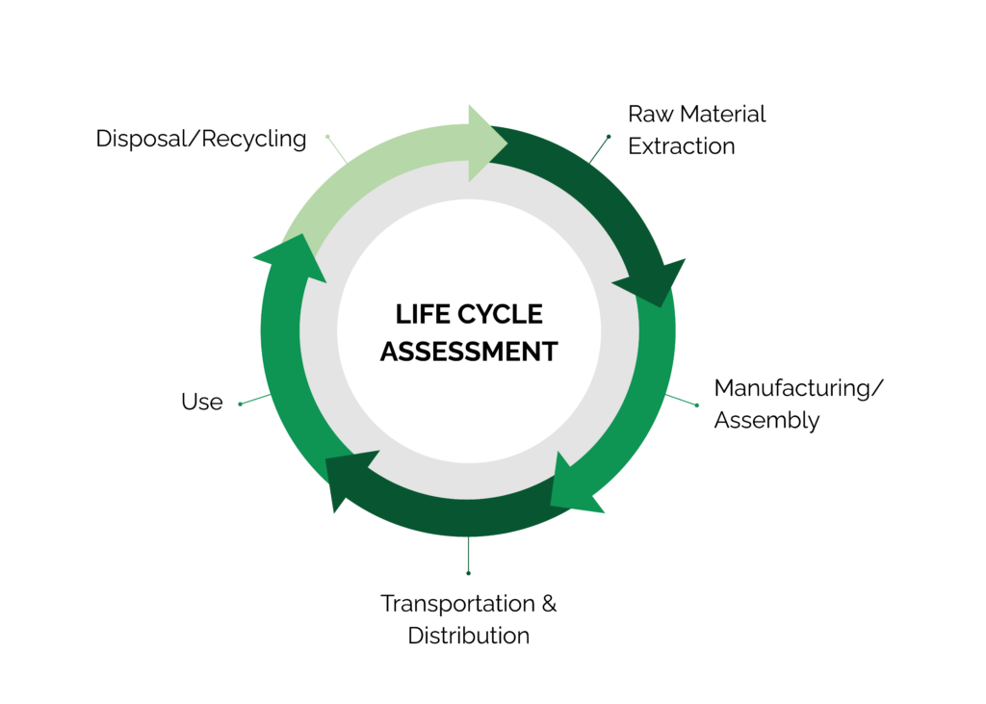
Life Cycle Assessment (LCA) – Introduction
What is LCA? : A method to assess the environmental impacts of a product throughout its life cycle
Source: www.stich.culturalheritage.org
Notes:
LCA helps us see the full environmental story of a product—from raw material to disposal.
It shows where the biggest environmental impacts happen, so we can target improvements.

Slide 14
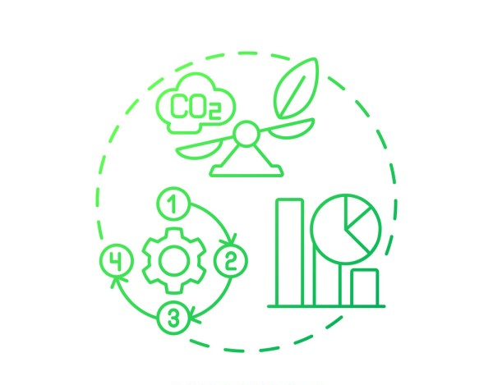
Importance of LCA
Purpose: Helps identify areas to reduce environmental footprint
Application: Guides design choices for more sustainable products
Source: https://www.list.lu/fileadmin/files
Notes:
LCA guides better design choices.
It’s like an “eco-report card” for a product.
We’ll use it to reflect on our sawdust creations later.

Slide 15
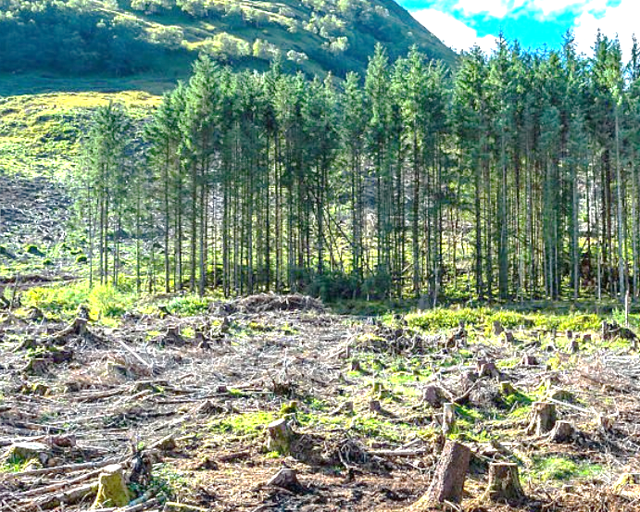
LCA Example : Aseptic Cardboard Container
1. Raw Material Extraction
  Wood from forests is pulped into cardboard.
  Polymers and aluminum are extracted from non-renewable sources.
  Environmental Impact
  Deforestation and habitat disruption.
  CO2 emissions from fossil fuel extraction
Source: www.istockphoto.com
Notes:
Raw Materials: Sawdust + resin; CO₂ from collection and resin production.

Slide 16
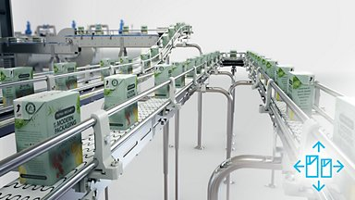
LCA Example : Aseptic Cardboard Container
2. Manufacturing
Cardboard, polymers, and aluminum are laminated together.
The material is printed, sterilized, and formed into a container
  Environmental Impact
  High energy consumption for manufacturing processes.
  Air and water pollution from production facilities.
www.tetrapak.com
Notes:
Manufacturing: Energy use + chemical emissions.

Slide 17

LCA Example : Aseptic Cardboard Container
3. Transportation & Distribution
The finished, empty containers are shipped to filling plants,
then the filled products are distributed to retailers
  Environmental Impact
  Fuel consumption and greenhouse gas emissions from
  trucks, trains, and ships
Source: https://www.flaticon.com/
Notes:
Transport: CO₂ from trucks and ships.

Slide 18
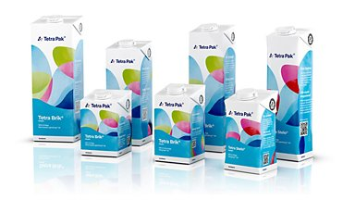
LCA Example : Aseptic Cardboard Container
4. Use
Consumers buy and use the product.
The sealed container can be stored at room temperature
  Environmental Impact
  Energy savings as the product doesn't require refrigeration
www.tetrapak.com
Notes:
Use: Minimal energy, possible VOC emissions.

Slide 19
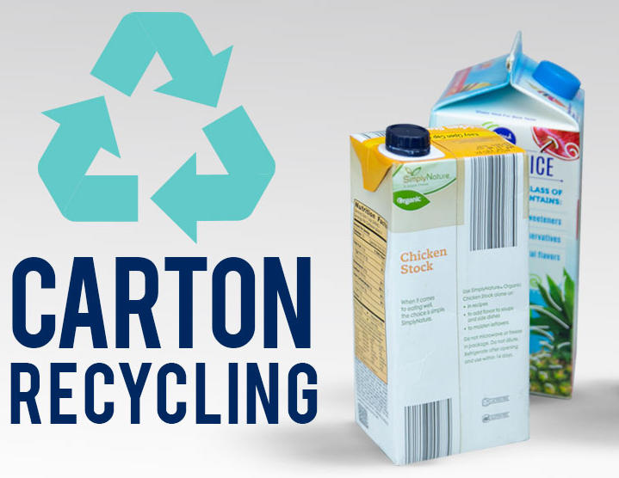
LCA Example : Aseptic Cardboard Container
5. Disposal/Recycling
The container is either collected for recycling or discarded
  Environmental Impact
  Recycling is complex and often inefficient, leading to high-energy use
  Landfilling of multi-layer materials that don't easily decompose
https://mydisposal.com/
Notes:
Disposal/Recycling: Landfill = waste; recycling is tricky but improving; incineration can recover energy.

Slide 20
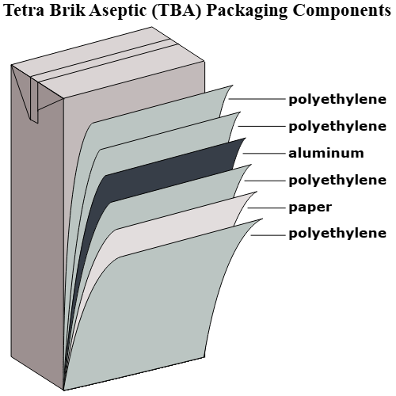
Understanding the Recycling Layers
Juice Box: The Recycling Layers
Paper: Provides the main structure and shape.
Polyethylene: Creates a waterproof seal and inner lining.
Aluminum: A thin layer that acts as a barrier against light and oxygen, preventing spoilage.
https://commons.wikimedia.org
Notes:
Disposal/Recycling: Landfill = waste; recycling is tricky but improving; incineration can recover energy.

Slide 21
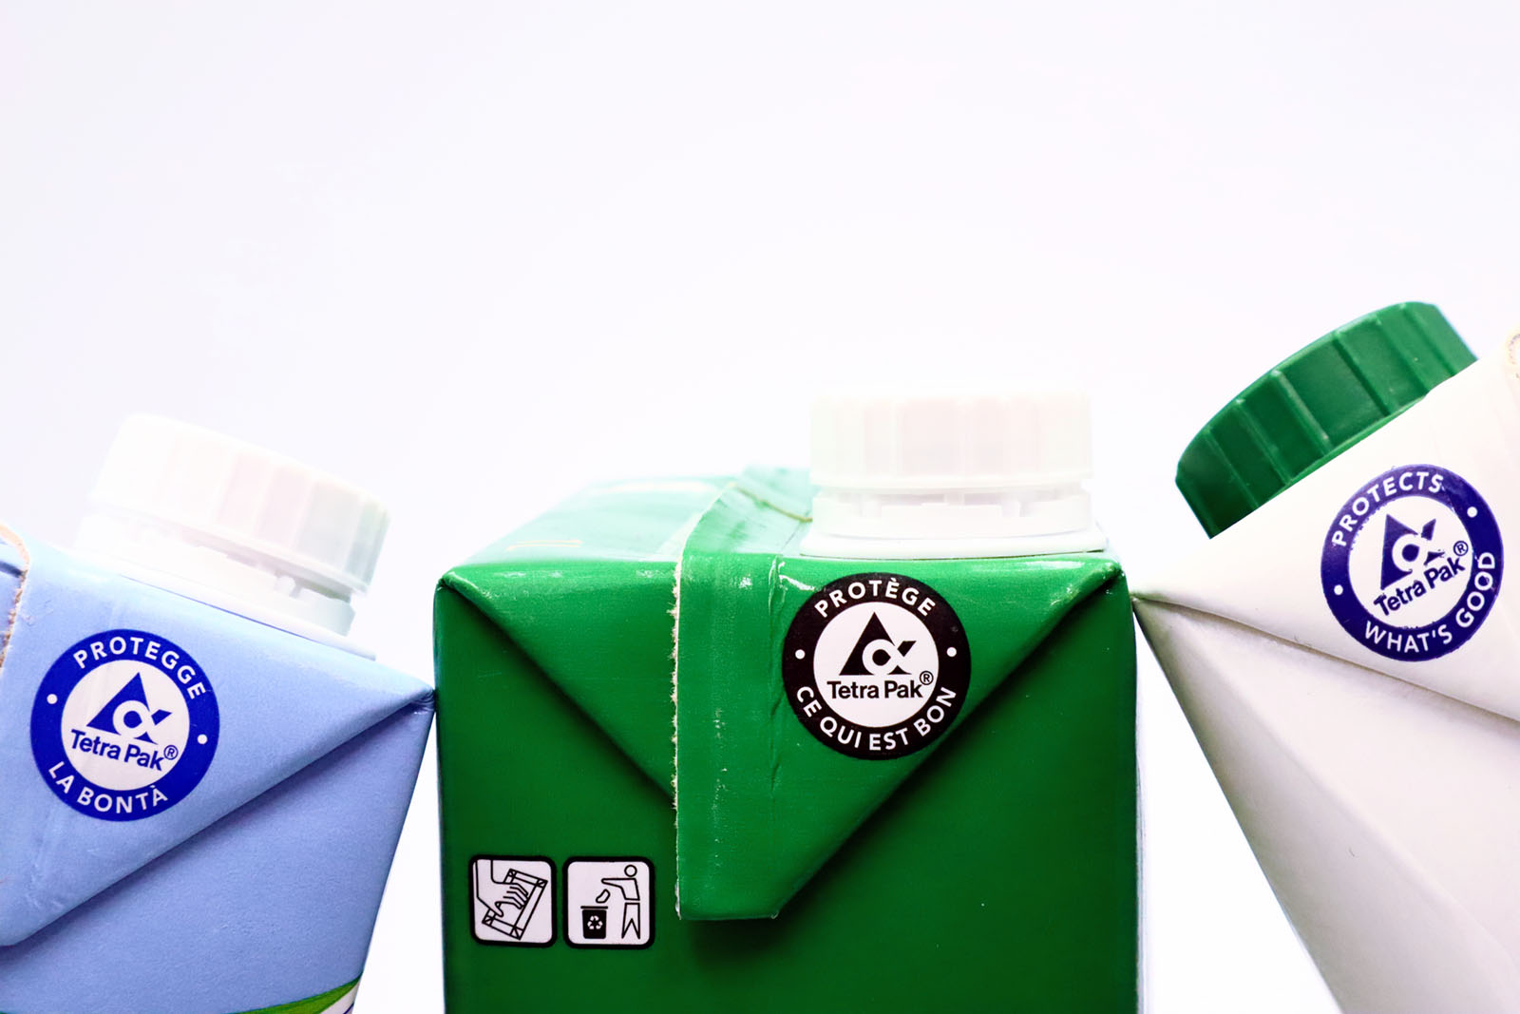
Why these materials are difficult to separate?
  Laminated Layers: The paper, plastic, and aluminum are tightly bonded together.
  Difficult to Separate: This tight lamination makes mechanical separation extremely challenging.
  Specialized Machinery: Requires specialized, energy-intensive equipment not common at most recycling centers.
https://youtu.be/xRzLEriZaEo
Source: www.ins-news.com
Notes:
Disposal/Recycling: Landfill = waste; recycling is tricky but improving; incineration can recover energy.

Slide 22
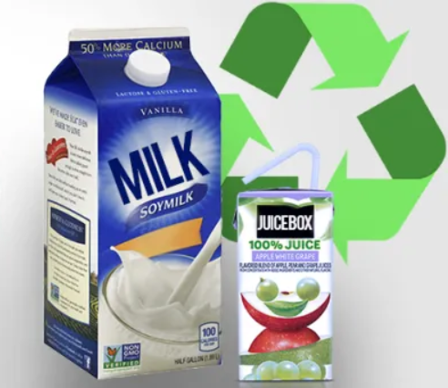
Introduction to Hands-on Activity
Objective: The Juice Box Recycling Challenge
📽️ A Recycling Challenge
Materials Needed
  Empty beverage cartons
  Mixer
  Warm water
  Tray and sieve
  Mold frame with mesh
  Scissors
  Iron
  Kitchen towels
Source: https://mydisposal.com/
Notes:
We’ll make a biocomposite product from sawdust and silicone.
We’ll follow a step-by-step guide and reflect on sustainability while it cures.

Slide 23
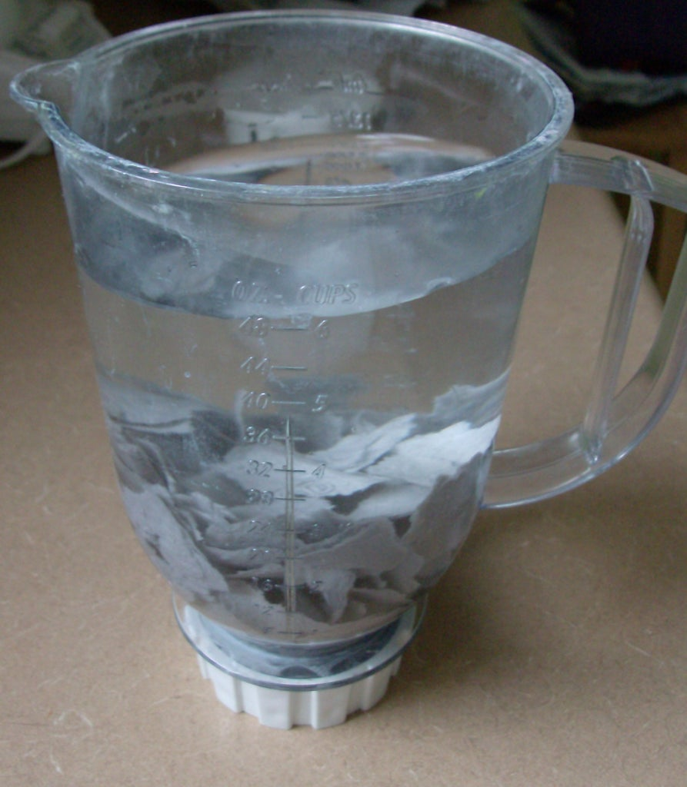
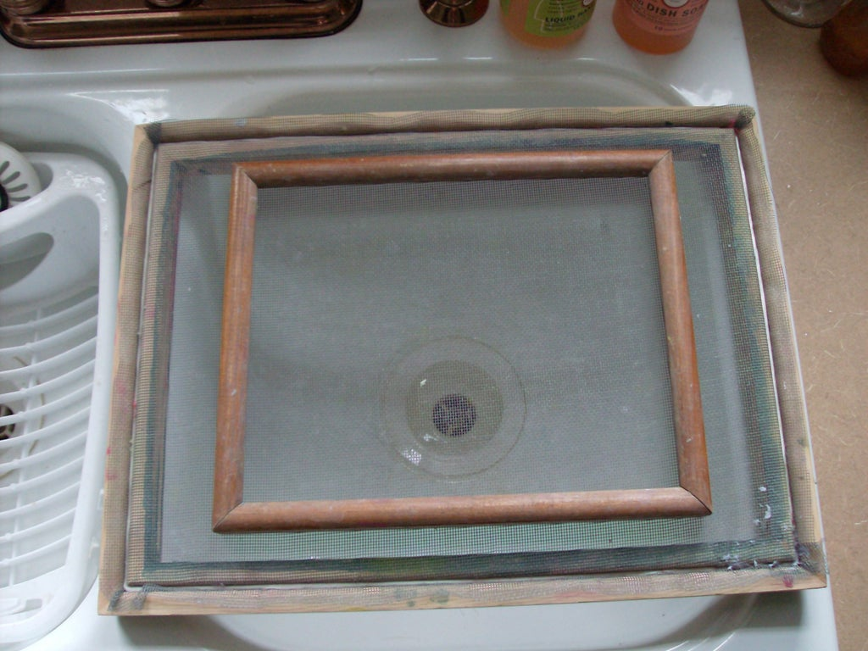
Step-by-Step Instructions
Step 1: Cut the beverage cartons into small pieces (2x2 cm)
Step 2: Soak the pieces in warm water for 5 min.
Step 3: Blend to create a pulp
Step 4: Hold the sieve over a shallow tray
Source: https://content.instructables.com/
Source: https://content.instructables.com/
Notes:
Step 1: Mix EcoFlex A + B quickly.
Step 2: Add sawdust until it’s thick.
Step 3: Fill molds.
Step 4: Let cure ~20 min (fan optional).
Step 5: While curing, start your LCA reflection.

Slide 24
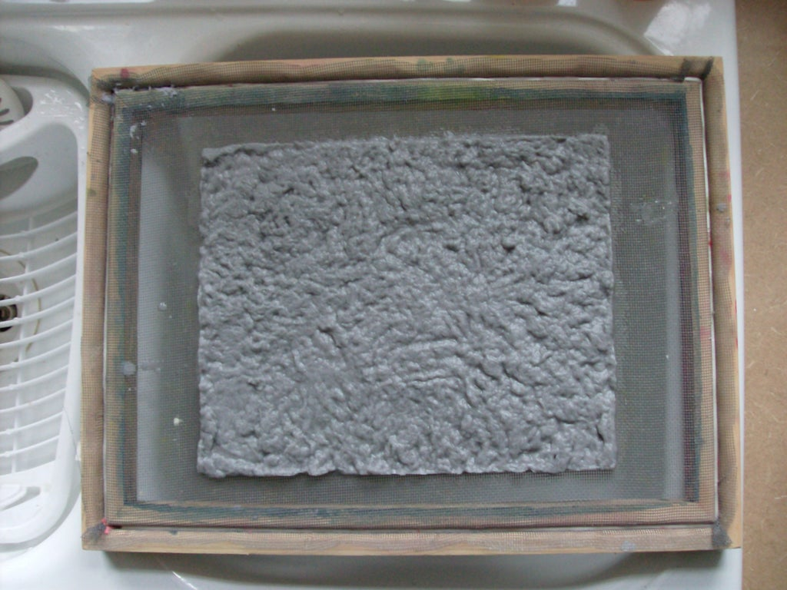
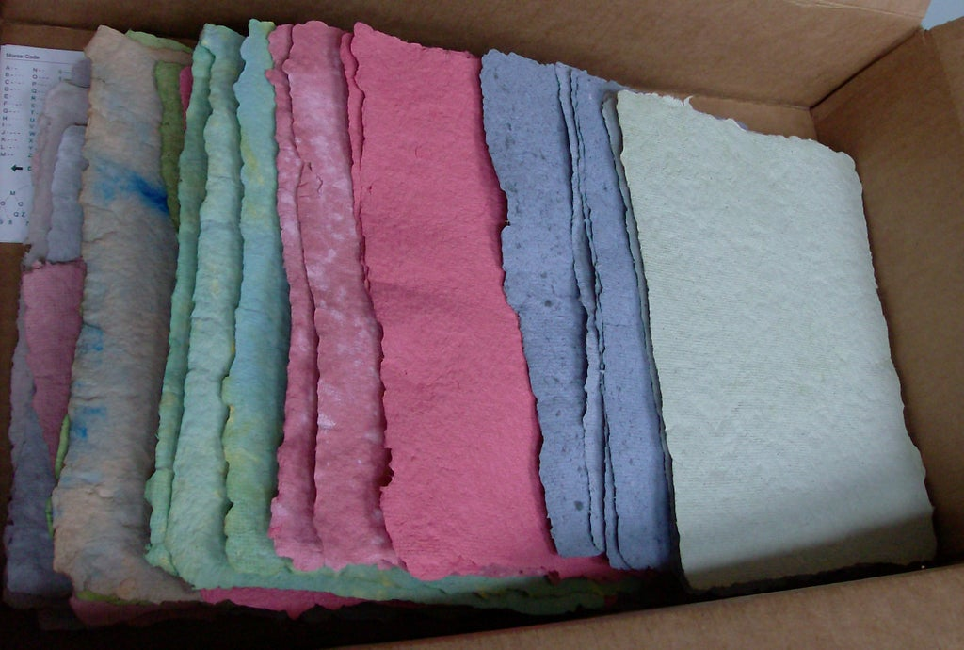
Step-by-Step Instructions
Step 5: Pour the pulp into sieve
Step 6: Scoop up the pulp using mesh and let it drain
Step 7:Wipre excess water and put it on a towel
Step 8:Iron until dry
Source: https://content.instructables.com/
Source: https://content.instructables.com/
Notes:
Step 1: Mix EcoFlex A + B quickly.
Step 2: Add sawdust until it’s thick.
Step 3: Fill molds.
Step 4: Let cure ~20 min (fan optional).
Step 5: While curing, start your LCA reflection.

Slide 25
Activity- Fill LCA Table: Recycled Paper
Stage | Material Used | Energy Used | Environmental Impact | Improvements
1. Raw Materials | Used cartons | Low (manual) |  | Collect locally, clean cartons
2. Manufacturing |  |  | Water use, minor waste
3. Use Phase | Handmade paper |  | Reusable, no extra energy | Reuse paper before discarding
4. End of Life | Used paper | Low (recycle/compost) | Breaks down naturally
5. Disposal/Recycling | Final paper | Low (if composted) |  | Avoid chemicals, educate disposal
Notes:
Here’s an example for a desk organizer.
Fill in your own version—list the materials, LCA stages, and one way to improve sustainability.

Slide 26
LCA Table: Recycled Paper
Stage | Material Used | Energy Used | Environmental Impact | Improvements
1. Raw Materials | Used cartons | Low (manual) | Diverts waste from landfill | Collect locally, clean cartons
2. Manufacturing | Pulp + water | Medium (blender) | Water use, minor waste | Use hand tools, blend in batches
3. Use Phase | Handmade paper | None or very low | Reusable, no extra energy | Reuse paper before discarding
4. End of Life | Used paper | Low (recycle/compost) | Breaks down naturally | Reuse scraps, compost if clean
5. Disposal/Recycling | Final paper | Low (if composted) | Low impact if composted | Avoid chemicals, educate disposal
Notes:
Here’s an example for a desk organizer.
Fill in your own version—list the materials, LCA stages, and one way to improve sustainability.

Slide 27

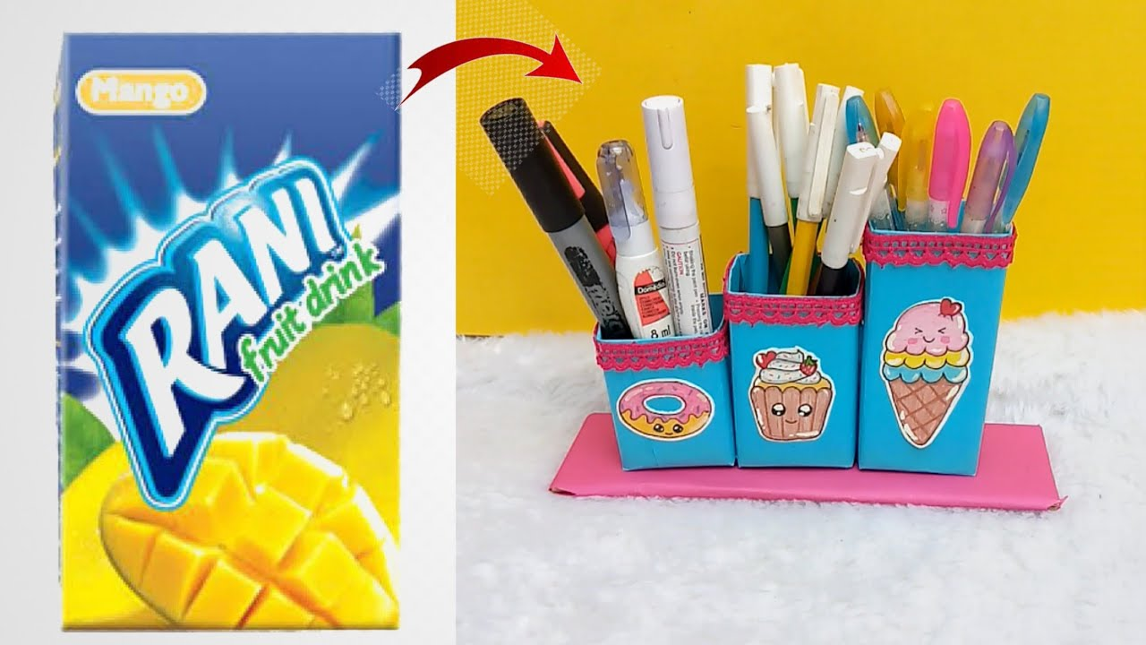
Preparing for Presentations
Present your recycled papers
Filled LCA table
How your product supports the Circular Economy
What happened to the remaining materials?
One idea to improve sustainability further
Source: www.shutterstock.com
Source: www.youtube.com
📽️She Created this from a Juice Carton
Notes:
✅ 1. How your product supports the Circular Economy
Example Answer:
Our handmade paper supports the Circular Economy by reusing beverage cartons, which would otherwise become waste. Instead of discarding the material, we extended its life cycle through upcycling into a new, usable product—paper. This reduces the need for virgin resources and minimizes landfill waste.
💡 2. One idea to improve sustainability further
Example Idea:
To improve sustainability, we could introduce natural dyes or plant-based additives instead of synthetic ones for coloring or decoration. Also, collecting used cartons through a community program can increase impact and raise awareness.
♻️ 3. What happened to the remaining materials?
Example Answer:
The remaining materials, such as plastic and aluminum layers in the beverage cartons (non-paper parts), were separated during the pulping process. These can be:
Collected and sent to specialized recycling centers, where they are used to make items like roofing sheets or plastic lumber.
If not recoverable, they should be disposed of responsibly to avoid environmental harm.
In our activity, leftover pulp or water can also be used for composting (if natural materials only) or disposed of with care to avoid waste.

Slide 28
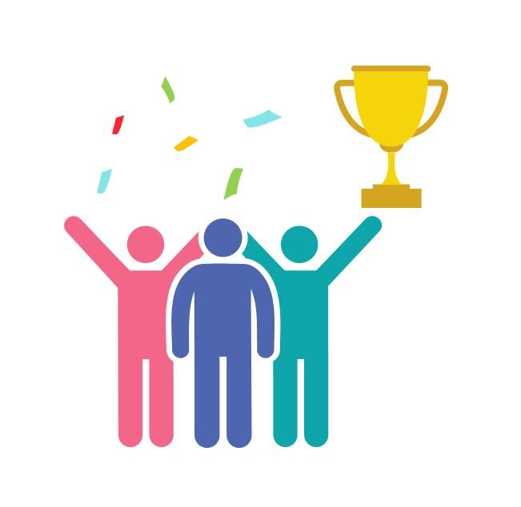
Awards
📊 Best LCA Reflection
🤝 Best Team Collaboration
💡 Most Innovative Circular Economy Idea
Source: https://www.slideteam.net/
Notes:
Four awards up for grabs

Slide 29
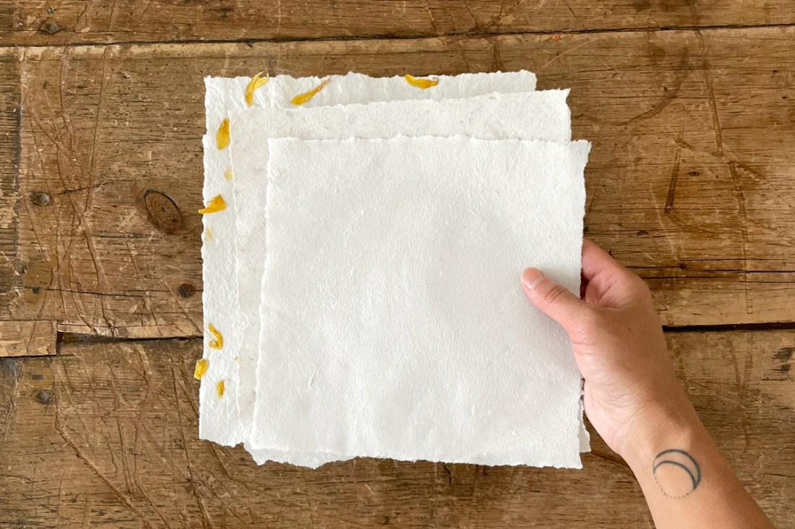
Any Questions? Let’s Discuss!
❓ Ask about anything unclear in the LCA or CE concepts
💭 Share your ideas for improving the activity or your product
Source: https://woodlarkblog.com/
Notes:
Ask anything unclear about CE or LCA.
Share your improvement ideas.
Bonus challenge: If not EcoFlex, what sustainable material would you use instead?

Slide 30
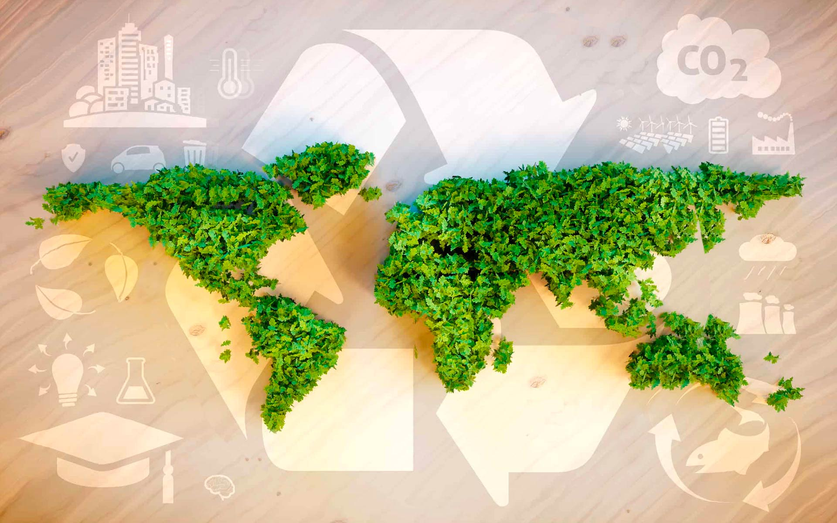
Thank You & Goodbye!
You are now an Eco Designer!
Keep thinking about trees, materials, and the planet
Source: www.fedongroup.com
Notes:
Keep thinking about the journey from tree to product to recycling.
Remember: waste is just a resource in the wrong place.

