Slide 1


EDU-CIRC
Rete transfrontaliera per la formazione sull’economia circolare e la decarbonizzazione nella produzione
Grenzübergreifendes Netzwerk zur Aus- und Weiterbildung in Kreislaufwirtschaft und Dekarbonisierung in der Produktion
Europa noch näher
Un’Europa più vicina

Slide 2
Closing the Loop:
Sawdust in a Circular World
🪵🪚♻️
THEME: WOOD
Notes:
Welcome everyone! Today, we’ll explore how sawdust can become something valuable in a circular economy.
This workshop is all about rethinking waste, learning about the 9Rs, trying out a Life Cycle Assessment, and getting hands-on by making our own bio-composite products from sawdust.
By the end, you’ll be “Eco Designers” who see wood waste in a whole new light.

Slide 3

Workshop Objectives
Circular Economy: Learn the principles and the 9Rs.
Life Cycle Assessment: Evaluate environmental impact.
Activity: Create a Bio composite product by using sawdust and silicone.
Reflect on Sustainability: Improve design and sustainability.
Notes:
We’ll start with a quick introduction to the circular economy and the 9Rs principles.
Then, we’ll look at Life Cycle Assessment (LCA): a way to measure environmental impact.
Our hands-on activity: making a product from sawdust and silicone.
We’ll end with a reflection: how can we make our design even more sustainable?

Slide 4
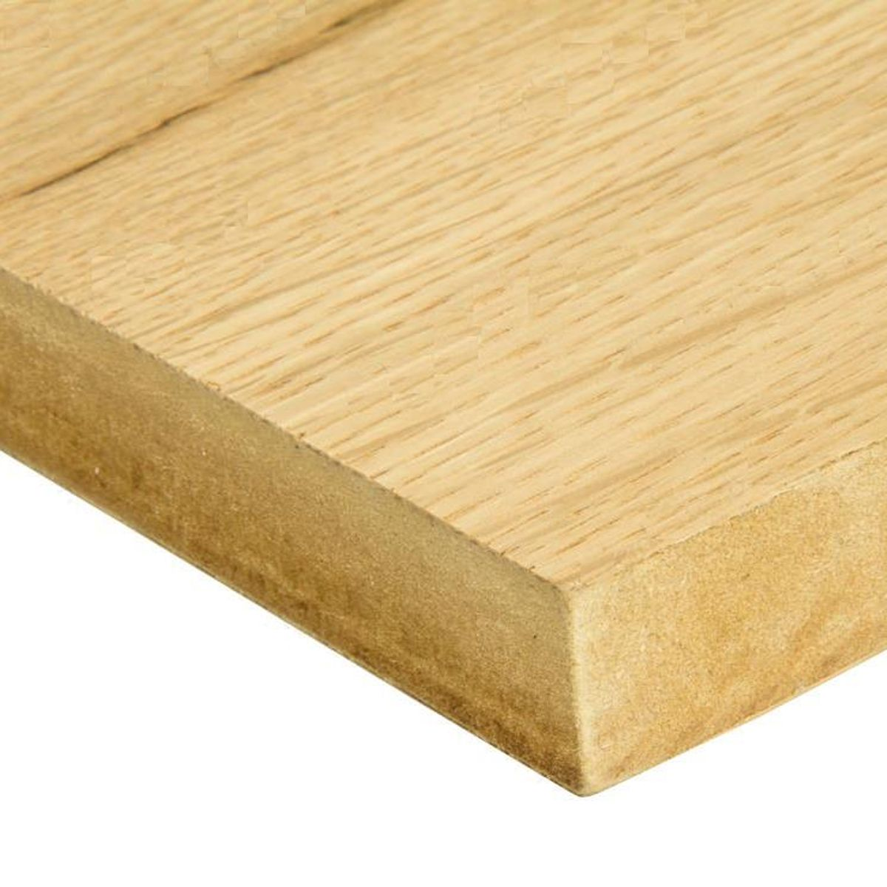
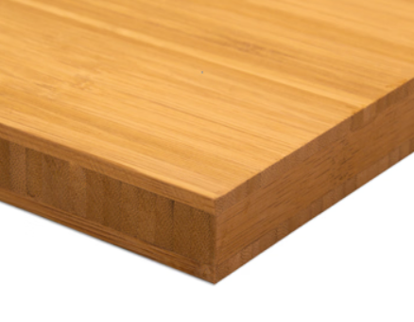
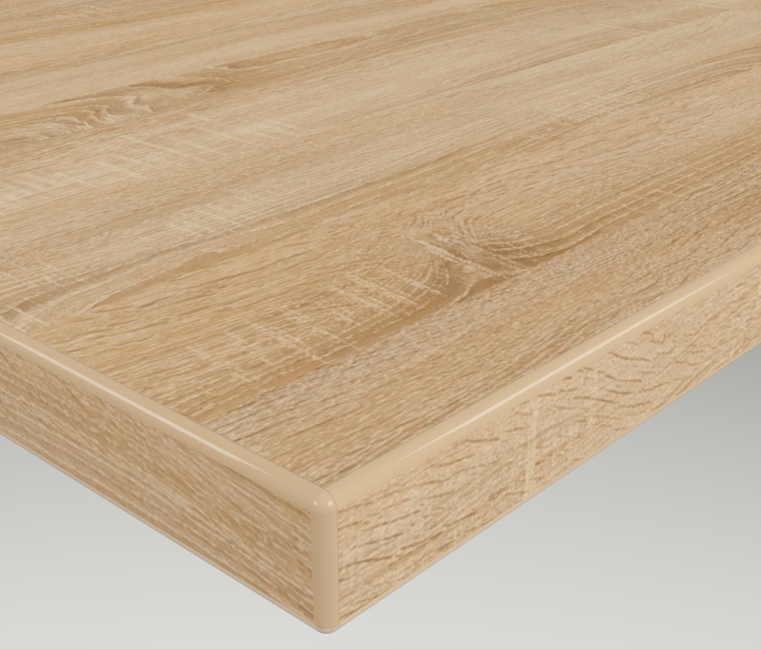
Feel the Wood Samples
Can replace images with real wood sample photos
Can you guess which ones contain sawdust or wood fibers?
Source: https://www.laver.co.uk/
Source: https://holzplatte.de/
Source: https://holzplatte.de/
MDF Fire Retardant Oak Mix Veneer
Bamboo Tiger
Solid Three Layers Panel Oak
Notes:
Here are some real wood samples for you to touch and inspect.
Can you guess which ones have real wood grain and which are engineered products?
Remember: wood products can be natural, like solid oak, or processed, like MDF or bamboo panels.
Feeling the textures will help you later when we talk about materials.

Slide 5
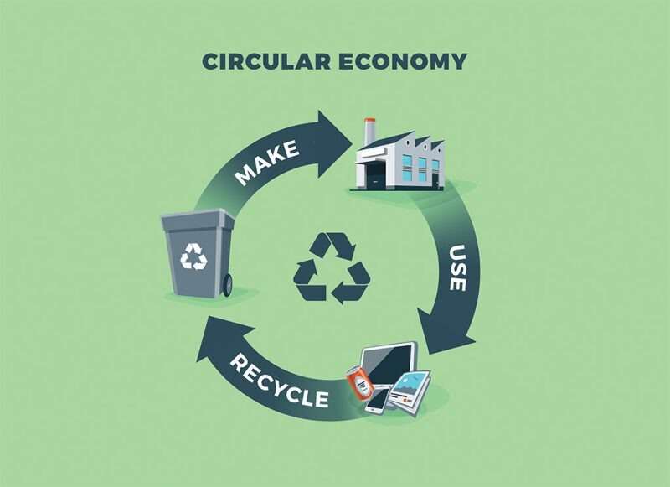
What is Circular Economy (CE)?
Definition:
A system where products, materials, and resources are kept in use for as long as possible.
📽️ Circular Economy
Source: https://jpt.spe.org/
Notes:
CE is about keeping products, materials, and resources in use for as long as possible.
Instead of throwing things away, we reuse, repair, refurbish, and recycle.
We’ll watch a short video: pay attention to how the “linear” system wastes resources compared to the “circular” system.
After the video, I’ll ask you: how did they show the difference visually?

Slide 6
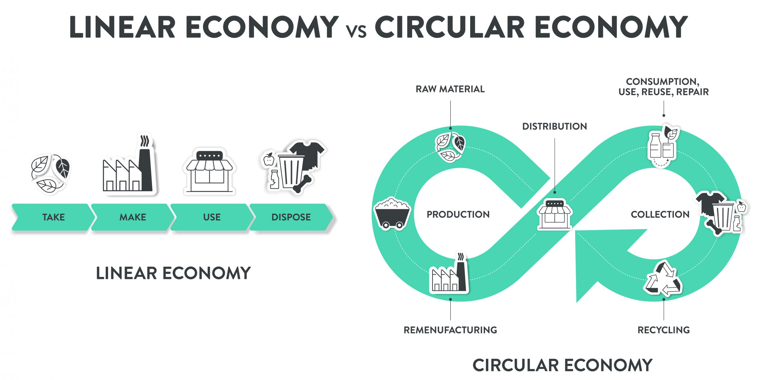
Linear vs Circular Economy:
How does the video illustrate the difference between a linear and a circular economy?
Source: https://www.technikum-wien.at/
Notes:
In a linear economy, it’s “take, make, dispose.”
In a circular economy, it’s “make, use, reuse, recycle”—closing the loop so nothing is wasted.

Slide 7
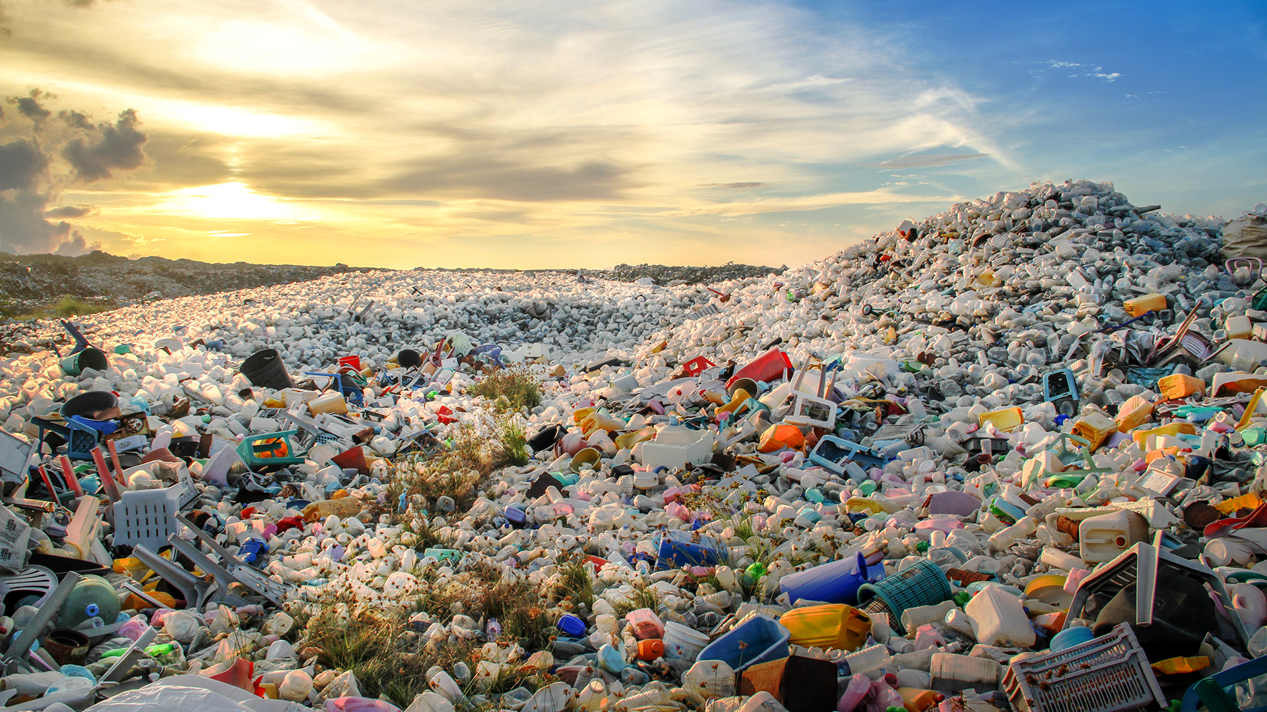
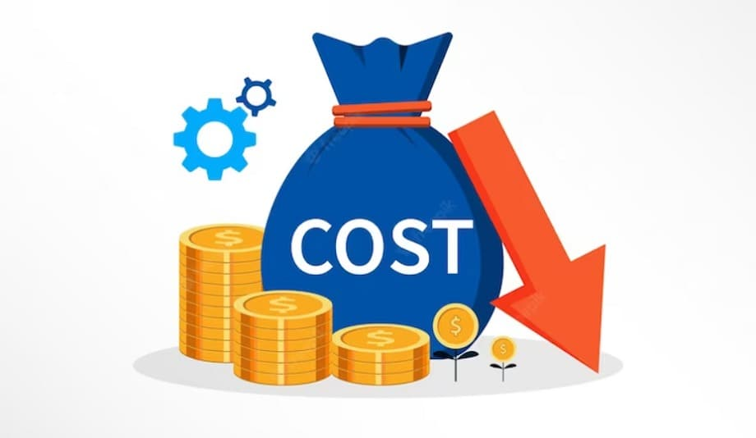

Why Circular Economy Matters
Environmental Impact: Waste, pollution, depletion of resources
Economic Benefits: Reduced costs, innovation, job creation
Social Impact: Sustainable living, waste reduction
Source: https://www.innovationnewsnetwork.com/
Source: https://cashflowinventory.com/blog/
Source: https://radiant.edu.np/
Notes:
Environment: Less waste, less pollution, less resource depletion.
Economy: Saves money, creates jobs, sparks innovation.
Society: Encourages sustainable living and better habits.
Even small changes in product design can have a big impact.

Slide 8
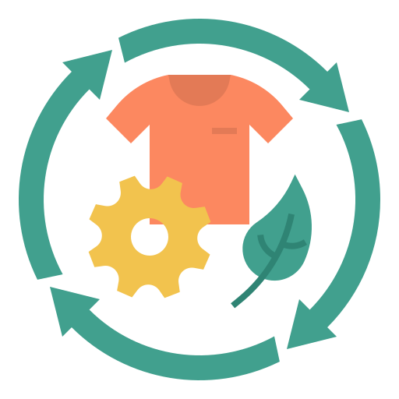
9Rs of Circular Economy
Overview : Set of principles designed to reduce environmental impact and maximize the reuse of resources throughout the lifecycle of products and materials
Focus : The key principles for sustainable production and consumption
Notes:
The 9Rs are like a toolbox for sustainability—from Refuse all the way to Recover.

Slide 9
9Rs of Circular Economy
R | Principle | Description
R0 | Refuse | Avoid unnecessary use or products
R1 | Rethink | Use items more efficiently (e.g., sharing)
R2 | Reduce | Use fewer resources and minimize waste
R3 | Reuse | Use products again without major changes
R4 | Repair | Fix products to extend their life
R5 | Refurbish | Restore products to good condition
R6 | Remanufacture | Use parts to create new, similar products
R7 | Repurpose | Use products/parts for a different purpose
R8 | Recycle | Process items into new raw materials
R9 | Recover | Recover energy/materials from waste (e.g., incineration with energy recovery)
Notes:
The 9Rs are like a toolbox for sustainability—from Refuse all the way to Recover.
We’ll focus on MDF (Medium-Density Fiberboard) to see how each R can apply in real life.

Slide 10
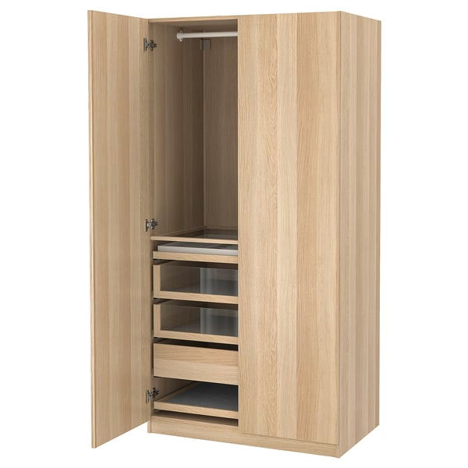
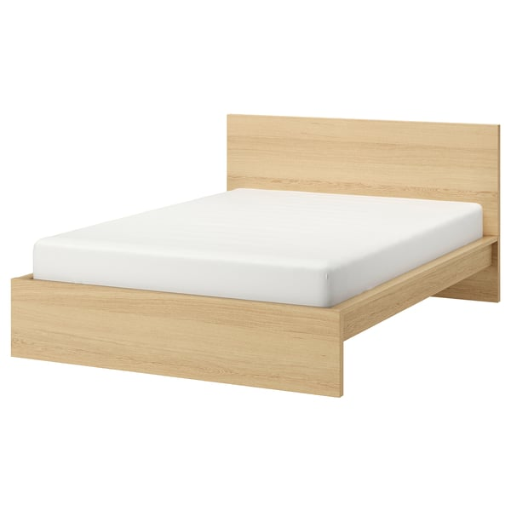
MDF (Medium-Density Fiberboard)
What is MDF?
  Engineered wood made from wood fibers, wax, and resin.
Why is it Special?
Smooth surface, dense, easy to shape.
Uses:
Furniture, Cabinets, Flooring.
Source: https://www.ikea.com/
Source: https://www.ikea.com/
Notes:
MDF is engineered wood made from wood fibers, wax, and resin.
It’s smooth, dense, and easy to shape—great for furniture and cabinets.
The cool thing? We can make it from sawdust, reducing waste.

Slide 11

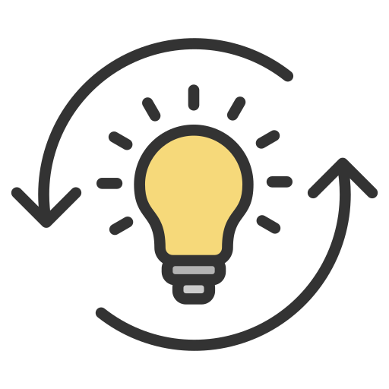

CE of MDF (Medium-Density Fiberboard)
R0 - Refuse: Avoid making MDF from virgin wood fibers by choosing
sawdust (a waste by-product) as the main feedstock.
R1 - Rethink: Design MDF products for easy disassembly so the boards
or panels can be reused or repurposed later.
R2 – Reduce: Optimize manufacturing to use less resin/binder and
reduce energy use in pressing and curing.
Notes:
R0 Refuse: Avoid virgin wood—use sawdust instead.
R1 Rethink: Design for disassembly so parts can be reused.
R2 Reduce: Use less resin, less energy in production.

Slide 12


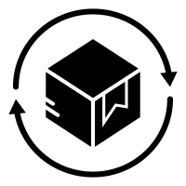
CE of MDF (Medium-Density Fiberboard)
R3 – Reuse: Reuse intact MDF panels in new furniture or construction
without reprocessing.
R4 – Repair: Fix damaged MDF furniture (patching, recoating) instead
of discarding.
R5 – Refurbish: Restore old MDF items with sanding, painting, or new
veneers to extend their lifespan.
Notes:
R3 Reuse: Use whole MDF panels again without breaking them down.
R4 Repair: Fix damage rather than discard.
R5 Refurbish: Give old MDF a facelift—paint, sand, or add veneers.

Slide 13
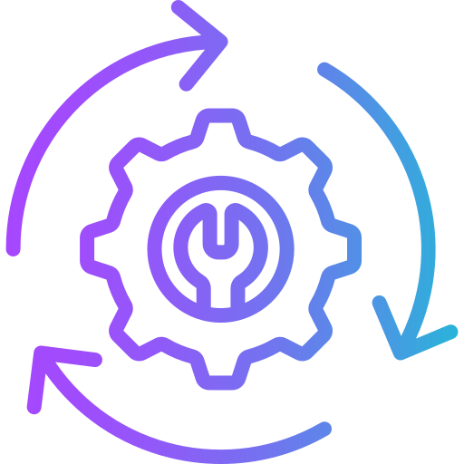
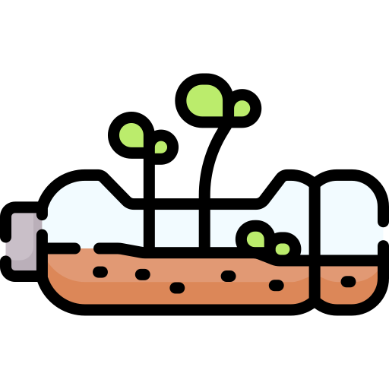
CE of MDF (Medium-Density Fiberboard)
R6 – Remanufacture: Take apart old MDF furniture and use the panels
to make new, similar products.
R7 – Repurpose: Turn used MDF boards into other items
e.g., shelving, workshop jigs, decorative wall panels.
Notes:
R6 Remanufacture: Rebuild products from old MDF parts.
R7 Repurpose: Turn MDF scraps into new things, like shelves or decorations.

Slide 14


CE of MDF (Medium-Density Fiberboard)
R8 – Recycle: Process waste MDF into fiber for new composite
boards or as filler material in other composites.
R9 – Recover: Recover energy from MDF off-cuts or damaged
boards via biomass incineration with energy capture
(only if reuse/recycling isn’t possible).
Notes:
R8 Recycle: Process waste MDF into fibers for new boards.
R9 Recover: If nothing else works, burn it for energy—but only as a last step.

Slide 15
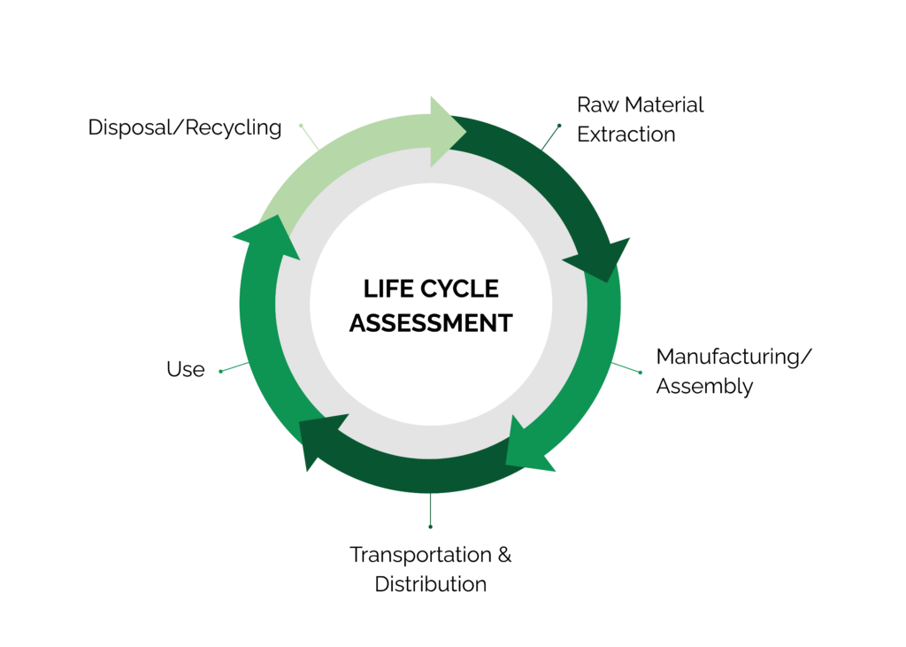
Life Cycle Assessment (LCA) – Introduction
What is LCA? : A method to assess the environmental impacts of a product throughout its life cycle
Source: www.stich.culturalheritage.org
Notes:
LCA helps us see the full environmental story of a product—from raw material to disposal.
It shows where the biggest environmental impacts happen, so we can target improvements.

Slide 16
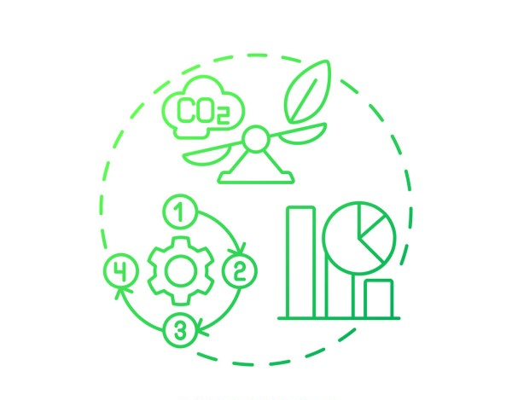
Importance of LCA
Purpose: Helps identify areas to reduce environmental footprint
Application: Guides design choices for more sustainable products
Source: https://www.list.lu/fileadmin/files
Notes:
LCA guides better design choices.
It’s like an “eco-report card” for a product.
We’ll use it to reflect on our sawdust creations later.

Slide 17
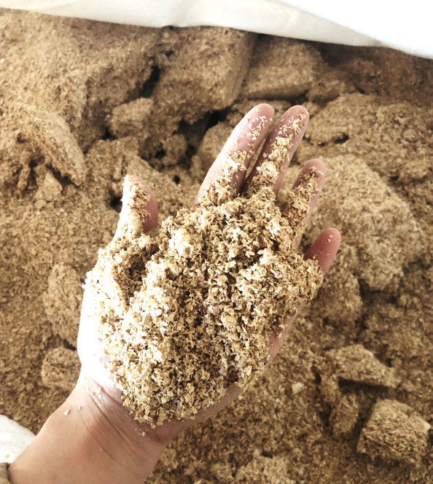
LCA Example : MDF Made from Sawdust
1. Raw Material Extraction
Sawdust from wood processing, synthetic resins
  Environmental Impact
  CO2 emissions from energy used in raw material collection
  and resin production.
Source: https://worldexport.com
Notes:
Raw Materials: Sawdust + resin; CO₂ from collection and resin production.

Slide 18
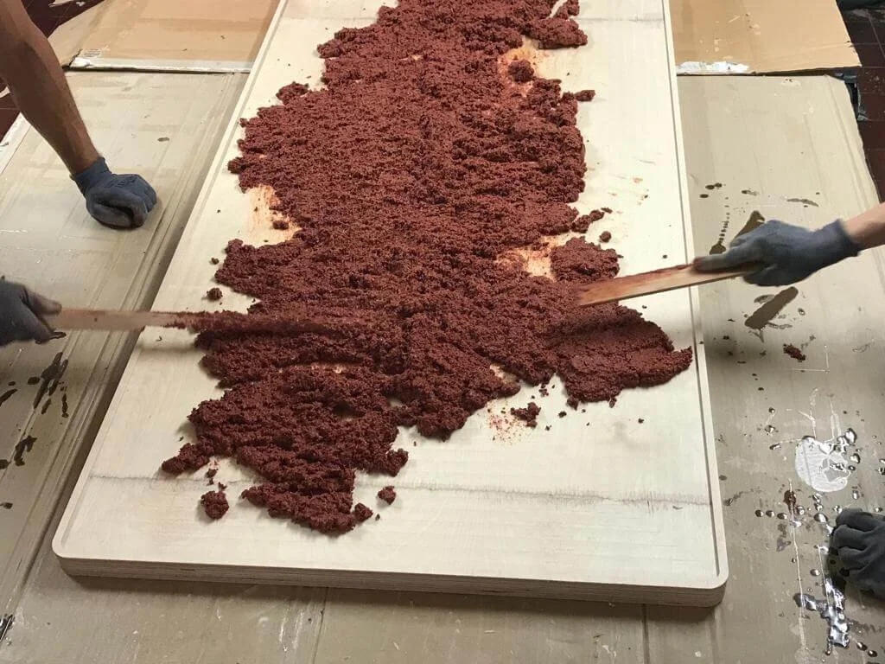
LCA Example : MDF Made from Sawdust
2. Manufacturing/Assembly
Mixing sawdust with resin
Pressing and drying to form MDF sheets.
  Environmental Impact
  Energy consumption leads to CO2 emissions.
  Chemical emissions from resins.
Source: https://www.lozidesigns.com/
Notes:
Manufacturing: Energy use + chemical emissions.

Slide 19

LCA Example : MDF Made from Sawdust
3. Transportation & Distribution
Transporting raw materials to the factory
Distributing the finished MDF product to various markets
  Environmental Impact
  CO2 emissions from transportation
  Fuel consumption for moving materials
Source: https://www.flaticon.com/
Notes:
Transport: CO₂ from trucks and ships.

Slide 20
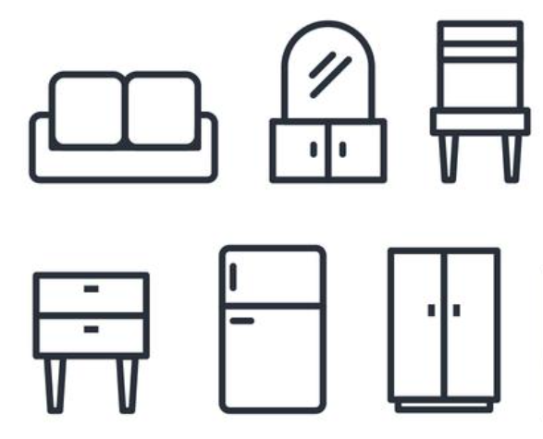
LCA Example : MDF Made from Sawdust
4. Use
MDF used in furniture, construction, and other applications
  Environmental Impact
  Low energy use during its life.
  Potential release of VOC emissions from resins
Source: https://www.vecteezy.com/
Notes:
Use: Minimal energy, possible VOC emissions.

Slide 21

LCA Example : MDF Made from Sawdust
5. Disposal/Recycling
Disposal: If landfilled, releases chemicals over time
Recycling: Currently challenging, but efforts to recycle MDF
are growing
  Environmental Impact
  Waste generation if not recycled
  Energy recovery possible through incineration
Source: https://www.shutterstock.com/
Notes:
Disposal/Recycling: Landfill = waste; recycling is tricky but improving; incineration can recover energy.

Slide 22
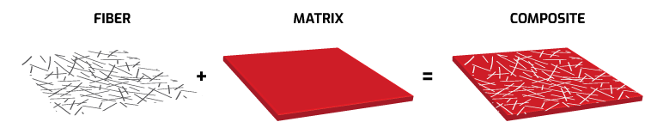
Composite Materials
Materials made from two or more components that combine to create unique properties.
Components:
  Matrix:
  Holds the material together (e.g., EcoFlex™ silicone).
  Reinforcement:
  Strengthens the material (e.g., sawdust, fibers).
Source: https://romeorim.com

Slide 23
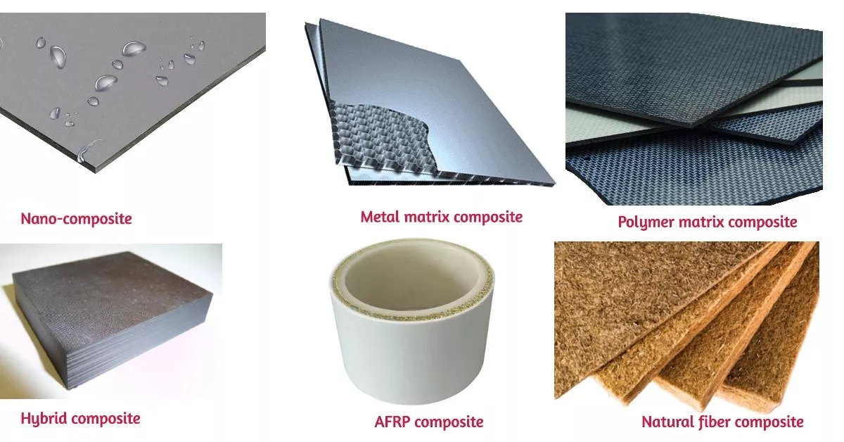
Advantages of Composite Materials
Lightweight: High strength-to-weight ratio.
Durable: Resistant to corrosion and wear.
Customizable: Tailored for specific needs.
Sustainable: Biocomposite use renewable resources.
Energy Efficient: Reduced fuel consumption in transport.
Source: https://www.rapiddirect.com/

Slide 24
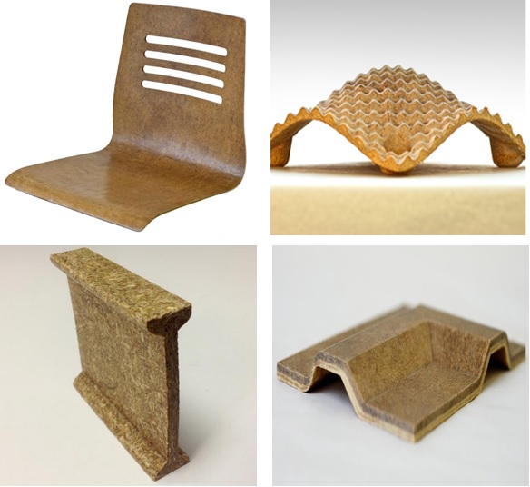
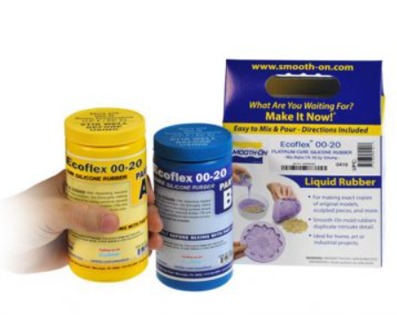
Introduction to Hands-on Activity
Objective: Create a biocomposite product using sawdust
📽️ Sawdust bowl
Materials:
  EcoFlex™ silicone
  Sawdust
  Molds
  Safety equipment (gloves, goggles, paper towels)
Source: https://www.researchgate.net
Source: https://www.kaupo.de
Notes:
We’ll make a biocomposite product from sawdust and silicone.
We’ll follow a step-by-step guide and reflect on sustainability while it cures.

Slide 25
Safety Briefing
Safety First:
  Always wear gloves 🧤
  Wear safety goggles 👓
  Work in a well-ventilated area 🌬️
Handling EcoFlex™ Silicone:
  Avoid direct skin contact
  Ensure proper clean-up of any spills immediately
Source: https://www.kaupo.de
Notes:
Gloves and goggles are mandatory.
Avoid skin contact with EcoFlex silicone.
Work in a well-ventilated area.
Clean spills immediately.

Slide 26
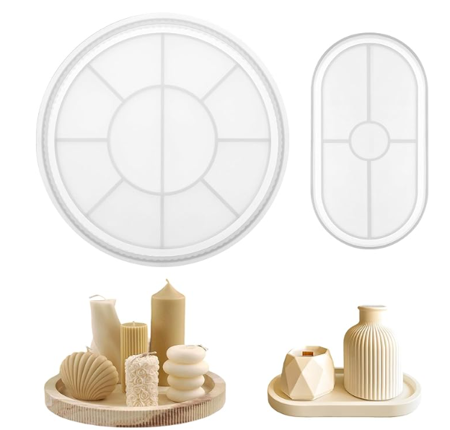
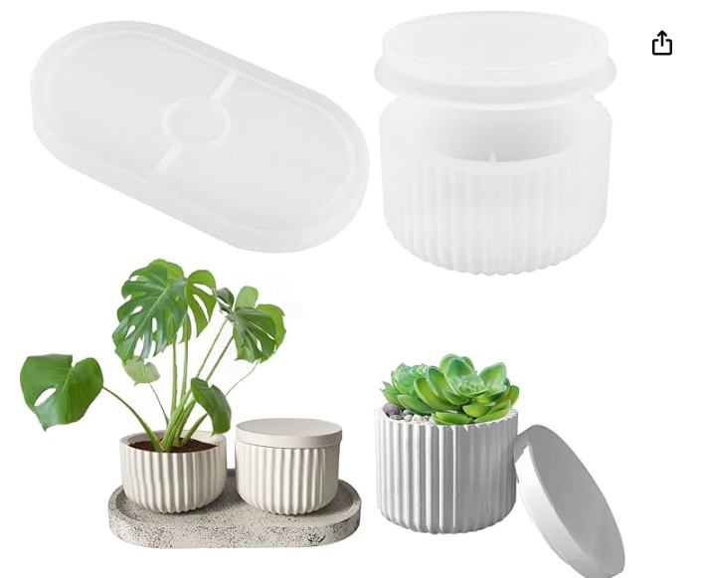
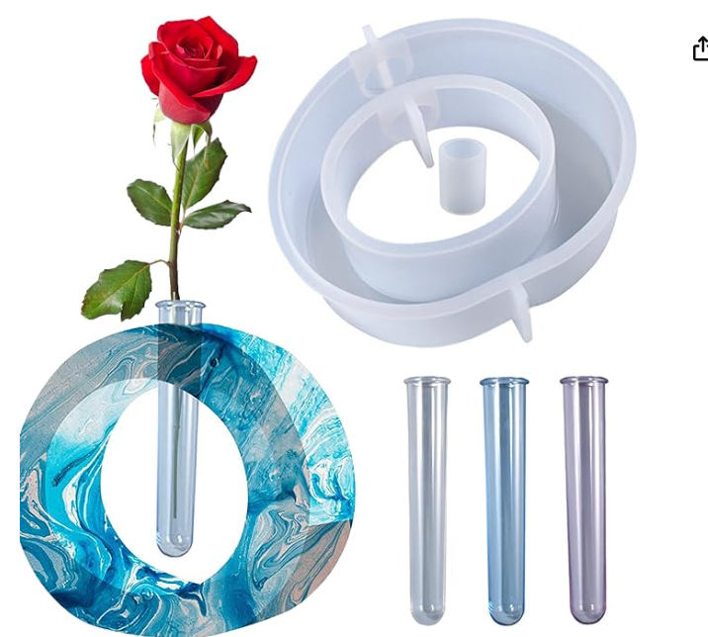
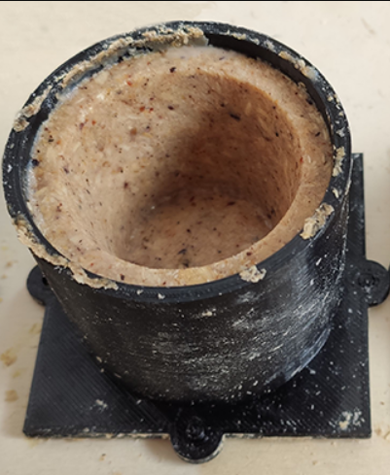
List of Molds
Molds for Making Tray
Desktop Decoration Mold
Flowerpot Casting Mold
Source: https://www.amazon.de/
Source: https://www.amazon.de/
Source: https://www.amazon.de/
Source: https://slnpr.gitlab.io/
Notes:
Choose from tray molds, desktop decorations, or flowerpots.
Think about function—how will your design be useful?
Also think about form—how will it look appealing?

Slide 27
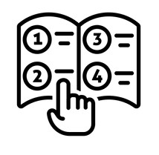
Step-by-Step Instructions
Step 1: Mix equal parts EcoFlex™ A + B (quickly)
Step 2: Stir in sawdust until a thick paste forms
Step 3: Pour or press into molds
Step 4: Let cure for ~20 minutes (fan optional)
Step 5: Begin LCA reflection during curing time
Source: https://www.shutterstock.com/
Notes:
Step 1: Mix EcoFlex A + B quickly.
Step 2: Add sawdust until it’s thick.
Step 3: Fill molds.
Step 4: Let cure ~20 min (fan optional).
Step 5: While curing, start your LCA reflection.

Slide 28
Sample LCA Table: Sawdust Desk Organizer
LCA Stage | Materials Used | Energy Consumption | Environmental Impact | Possible Improvements
1. Raw Material Extraction | Sawdust (from wood processing) | Low energy for collecting and transporting sawdust | Impact: - Uses waste from wood processing. - Low energy required for collection. - CO2 emissions from transportation. | - Source locally to reduce transportation emissions. - Ensure sawdust comes from sustainable sources.
2. Manufacturing | Sawdust + EcoFlex™ silicone or wood glue | Moderate energy for mixing, pressing, and curing | Impact: - High energy for curing or drying process. - Emissions from synthetic resins or glue. - Waste generated from excess material. | - Use bio-based resins. - Explore renewable energy sources in production.
3. Use Phase | Desk organizer for holding supplies | No significant energy use | Impact: - Low environmental impact during use. - Functional for a long time without consuming energy. | - Encourage students to reuse and repurpose it as needed (e.g., use for other purposes).
4. End-of-Life | Desk organizer after use | Energy used in disposal or recycling | Impact: - May not be easily recyclable due to resin or glue content. - Potential for landfill if not recycled. | - Repurpose the organizer into a different item (e.g., a small plant pot). - Investigate better recycling options for resin-based products.
5. Disposal/Recycling | Product at the end of its useful life | Energy used for recycling or incineration | Impact: - Non-recyclable due to resin content. - CO2 emissions from incineration. - Potential to repurpose or reuse for other functions. | - Design for recyclability. - Use materials that are easier to recycle or repurpose.
Notes:
Here’s an example for a desk organizer.
Fill in your own version—list the materials, LCA stages, and one way to improve sustainability.

Slide 29

Preparing for Presentations
Sketch or drawing of your product
Brief description of materials used
LCA stages analysis
How your product supports the Circular Economy
One idea to improve sustainability further
Source: https://www.shutterstock.com/
Notes:
You’ll present:
A sketch or photo of your product.
The materials you used.
LCA stage impacts.
How your product supports the circular economy.
One improvement idea.

Slide 30
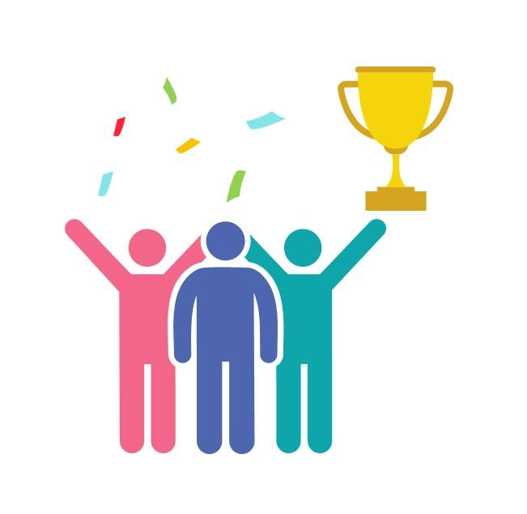
Awards
🎨 Most Creative Design
📊 Best LCA Reflection
🤝 Best Team Collaboration
💡 Most Innovative Circular Economy Idea
Source: https://www.slideteam.net/
Notes:
Four awards up for grabs

Slide 31

Any Questions? Let’s Discuss!
❓ Ask about anything unclear in the LCA or CE concepts
💭 Share your ideas for improving the activity or your product
💡 Challenge: If you could replace EcoFlex with another material,
what would you choose and why?
Source: https://pngtree.com/
Notes:
Ask anything unclear about CE or LCA.
Share your improvement ideas.
Bonus challenge: If not EcoFlex, what sustainable material would you use instead?

Slide 32
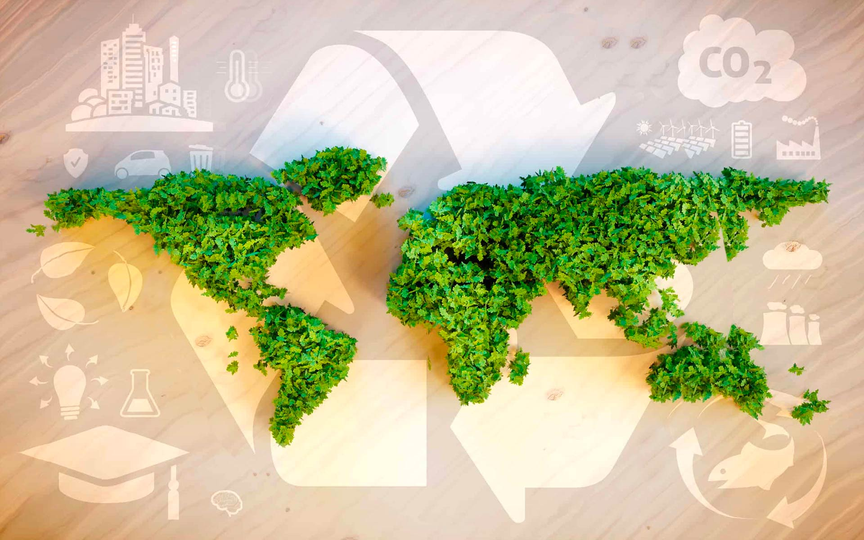
Thank You & Goodbye!
You are now an Eco Designer!
Keep thinking about trees, materials, and the planet
Source: www.fedongroup.com
Notes:
Keep thinking about the journey from tree to product to recycling.
Remember: waste is just a resource in the wrong place.

