Slide 1


EDU-CIRC
Rete transfrontaliera per la formazione sull’economia circolare e la decarbonizzazione nella produzione
Grenzübergreifendes Netzwerk zur Aus- und Weiterbildung in Kreislaufwirtschaft und Dekarbonisierung in der Produktion
Europa noch näher
Un’Europa più vicina

Slide 2
FROM TREE TO TABLE
🌴🌳🌲
THEME: WOOD

Slide 3

Welcome! – From Tree to Table
Welcome to the fun workshop where trees become tables.
You will identify stages in the wood product life cycle
You will build, think, and become eco-designers
Reflect on sustainable choices and creative reuse
Source: AI Generated (openart.ai)
Notes:
Welcome everyone!
“Hi everyone! I’m happy you’re here for our workshop called From Tree to Table.”
“Today, we’ll learn how trees turn into things like tables — and why that’s important.”
What’s this all about?
“Have you ever thought about where your wooden desk or chair came from?
We’ll explore that journey — from a growing tree to the furniture you use every day.”
What will we do today?
First, we’ll learn the steps in how a tree becomes something useful like a table.
Then, you’ll get to build something fun, use your imagination, and design something of your own.
Finally, we’ll think about smart choices we can make to help the planet, like reusing and not wasting materials.
Refer to the image on the slide
“Look at the picture — the tree has become a table, but it still reminds us where it came from. We want to respect nature while creating useful things.”
Wrap-up and motivation
“Let’s get creative, learn something new, and have fun while helping the Earth. Ready to begin?”

Slide 4

Today’s Plan
Discover where wood comes from
Learn about the wood journey (Life Cycle Assessment)
Build a mini table (group challenge)
Share your cool design with friends
Wrap up
Notes:
“Here’s what we’ll do today!”
Briefly explain each point:
Discover where wood comes from.
Learn how wood goes through different stages — this is called a life cycle.
Work in teams to build a mini table using craft sticks.
Share your creations and ideas.
At the end, we’ll think about how to be smart and kind to nature.
“Let’s jump in!”

Slide 5
Warm-Up Quiz! What Comes from Trees?
Which of these come from trees?
Item | From Trees? (✔ / ✘)
Wooden spoon
Paper plate
Wooden pencil
Carton of milk
Rubber band
Tissue box
Wooden chair
Cotton t-shirt
Notes:
“Let’s warm up with a quick quiz.”
Show some objects (e.g., spoon, paper, milk carton) — ask: “Does this come from a tree?”
Encourage guesses and participation.
“You’ll be surprised by what does — and doesn’t — come from trees.”

Slide 6
Warm-Up Quiz! What Comes from Trees?
Which of these come from trees?
Item | From Trees? (✔ / ✘)
Wooden spoon | ✔
Paper plate | ✔
Wooden pencil | ✔
Carton of milk | ✔
Rubber band | ✘
Tissue box | ✔
Wooden chair | ✔
Cotton t-shirt | ✘
Notes:
Use this slide to repeat the quiz visually or let students choose items.
Reinforce thinking: “Not everything comes from trees — some items are tricky!”

Slide 7
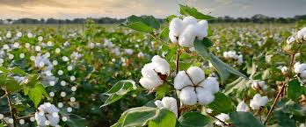
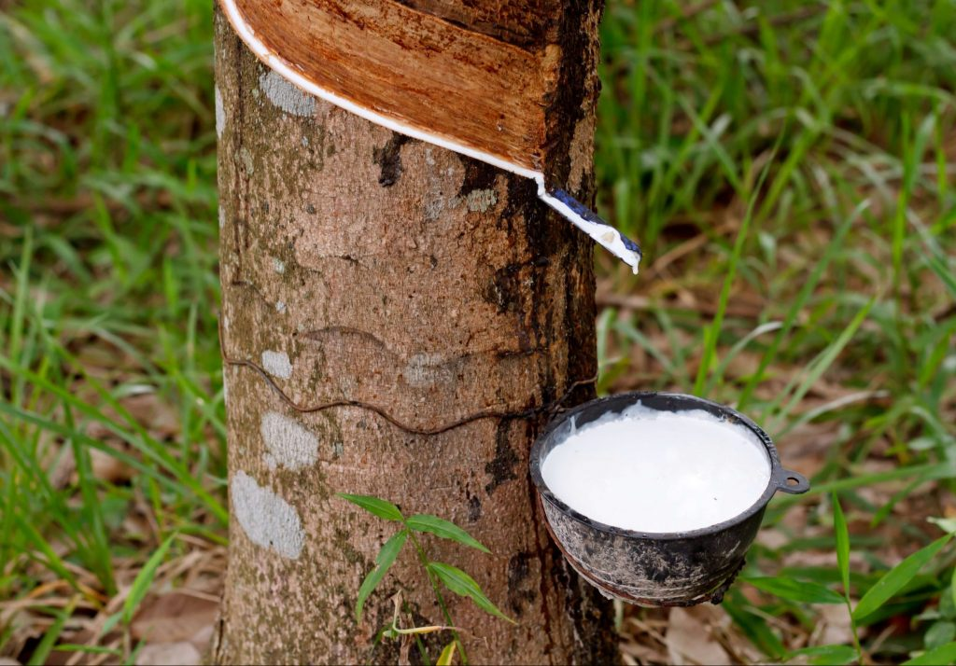
Warm-Up Quiz! What Comes from Trees?
Which of these come from trees?
❌ Cotton t-shirt? Cotton grows on a plant, not a tree.
📽️ Cotton Processing
❌ Rubber band? It’s from rubber tree sap, but not the wood.
📽️ Rubber Processing
Source: https://us.timacagro.com/
Source: https://nexttravelsrilanka.com
Notes:
Clarify misconceptions:
“A cotton t-shirt comes from a plant — not a tree.”
“A rubber band comes from the sap of a rubber tree, but not from the wood itself.”
Mention videos if used:
“We’ll show a short video on cotton or rubber if there’s time.”

Slide 8
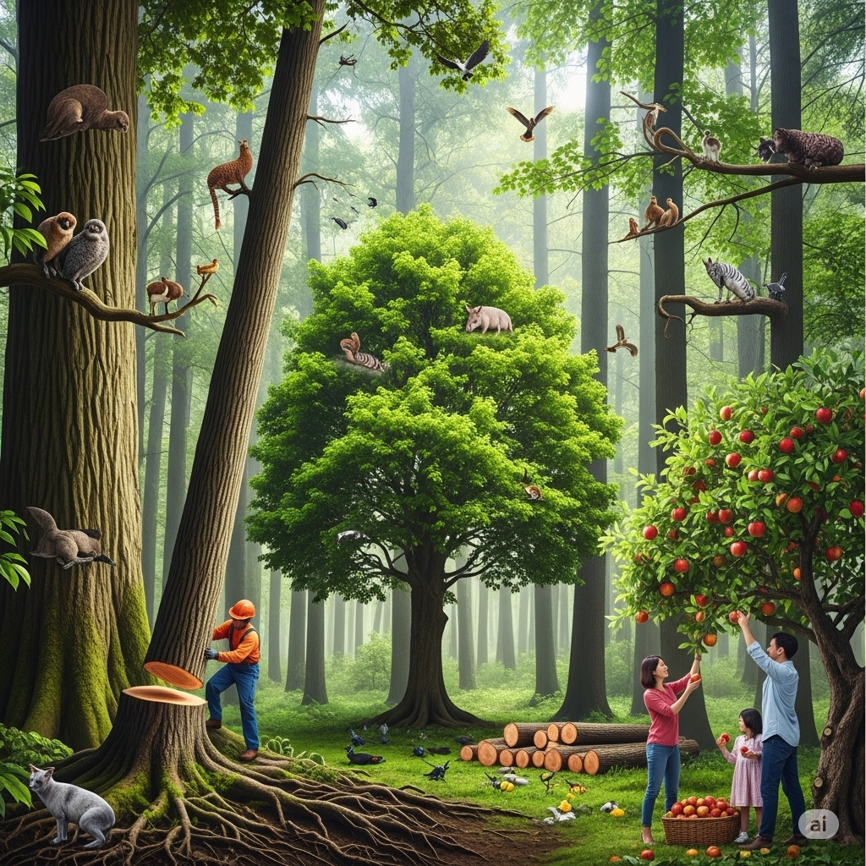
Trees are Superheroes!
Trees give us oxygen 🌬️
Homes for animals 🐿️
Give us useful materials 📦
Source: AI Generated
Notes:
“Trees aren’t just pretty — they do super things for us and the planet.”
Introduce the three roles:
Give us oxygen.
Give animals homes.
Give us useful materials.
“Let’s take a closer look at each.”

Slide 9
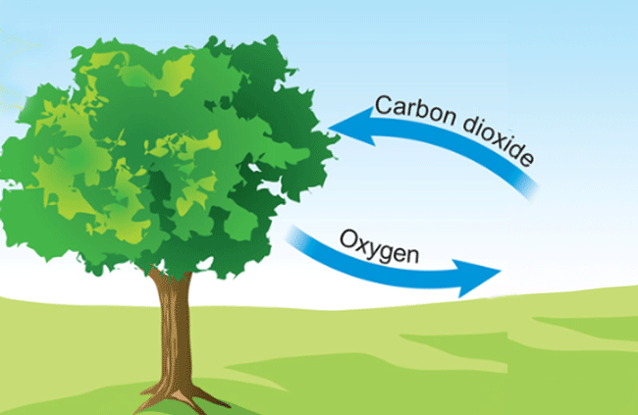
Trees are Superheroes!
Trees Give us Oxygen
  Take in carbon dioxide (CO₂) from the air and release clean oxygen that we breathe
Source: www.mladi.org
Notes:
“Trees breathe in dirty air and breathe out clean oxygen.”
“Without trees, we wouldn’t have enough air to breathe.”

Slide 10
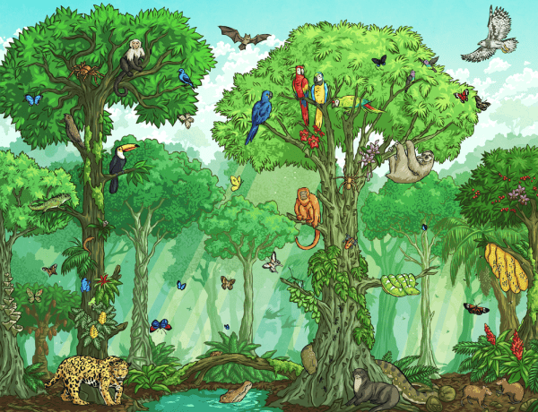
Trees are Superheroes!
Homes for Animals
Provide shelter for birds, squirrels, insects, and more
Forests are full of life because of trees
Losing trees = animals lose their homes
Source: www.twinkl.at
Notes:
“Trees are homes for birds, squirrels, insects — even ants!”
“Cutting too many trees can make animals lose their homes.”
Ask: “Can you name an animal that lives in a tree?”

Slide 11
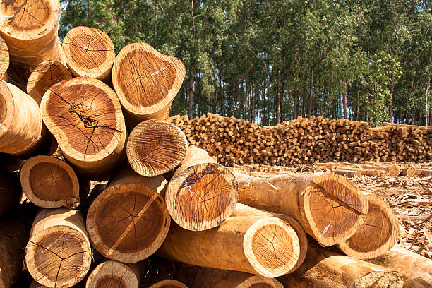
Trees are Superheroes!
Give us Useful Materials
Wood is used to make tables, paper, pencils, and books
Some trees grow back fast — others take a long time
Using wood wisely helps nature stay healthy
Source: www.istockphoto.com
Notes:
“Wood from trees helps us make tables, paper, pencils — even books.”
“But we have to be careful. Some trees grow fast, others take a long time.”
“Using wood wisely helps keep forests healthy.”

Slide 12
Story Time – The Life Cycle of Wood
🌳 Tree Growing – Growing in the forest
🪚 Harvesting & Transport – Tree is cut down and transport
🏭 Processing in Sawmill – Wood is cut into planks
🪑 Product Making – Becomes a table or chair
🚚 Use & Delivery – Delivered to homes or schools
♻️ End of Life – Reused, recycled, burned for energy
📽️Wood Life Cycle Video: Wood Life Cycle
Notes:
“Let’s follow a tree’s journey — from the forest to your table.”
Go through each stage:
Grows in a forest.
Cut down and moved.
Cut into pieces at a sawmill.
Made into furniture.
Delivered and used.
Reused, recycled, or burned for energy.
Mention the word: “This whole journey is called a Life Cycle.”
“Now let’s watch a short video that shows the wood life cycle in action.”
Encourage focus: “Watch for all the steps we just talked about.”

Slide 13
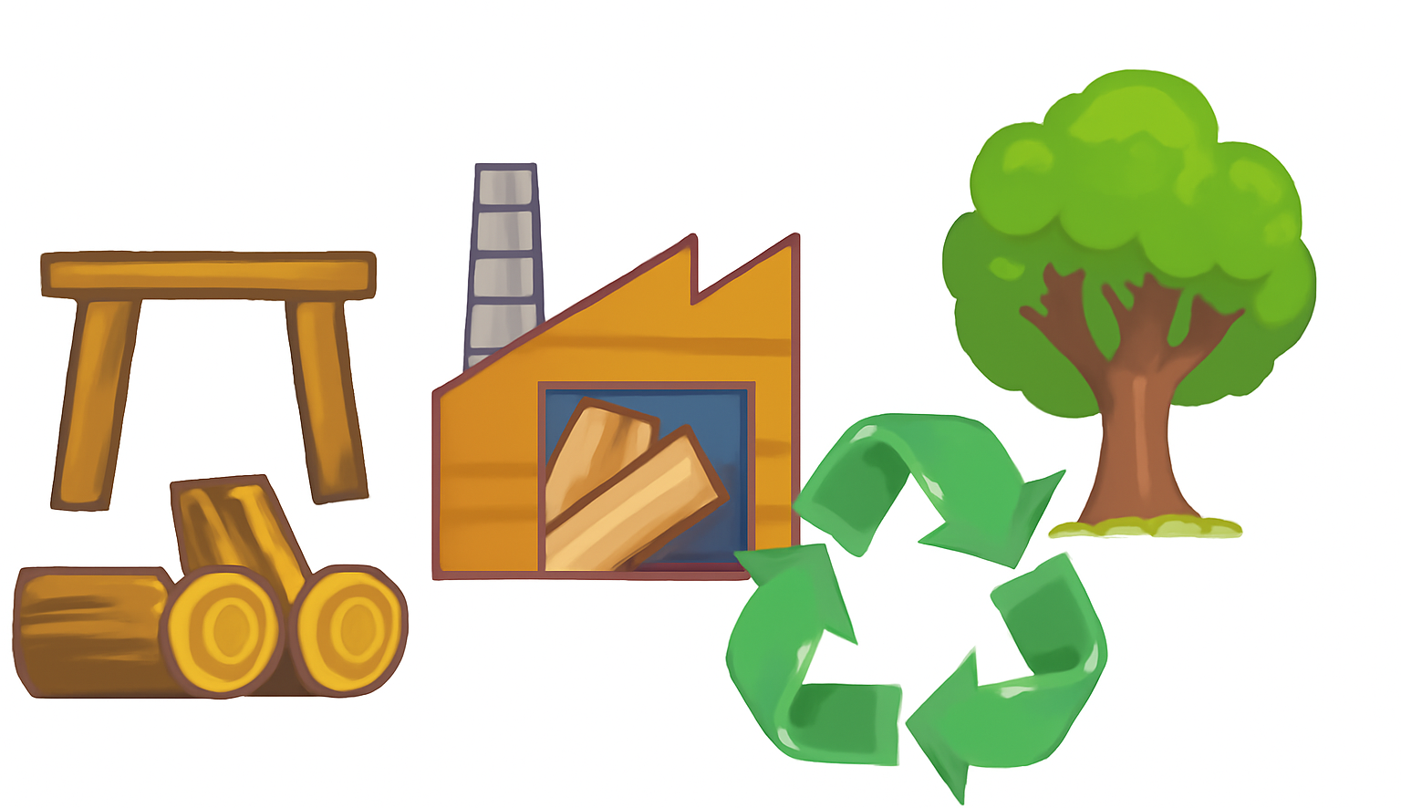
Puzzle Time: Put the Stages in Order!
Put these in order – Wood Life Cycle:
  Chop & Move
  Make Stuff
  Cut It Up
  Send It Out
  Tree Stage
  Recycling
2
4
3
5
1
Source: AI Generated
6
Notes:
“Can you put the wood’s life cycle stages in the right order?”
Explain each stage briefly as kids drag or guess.
Let them collaborate if it’s interactive.

Slide 14
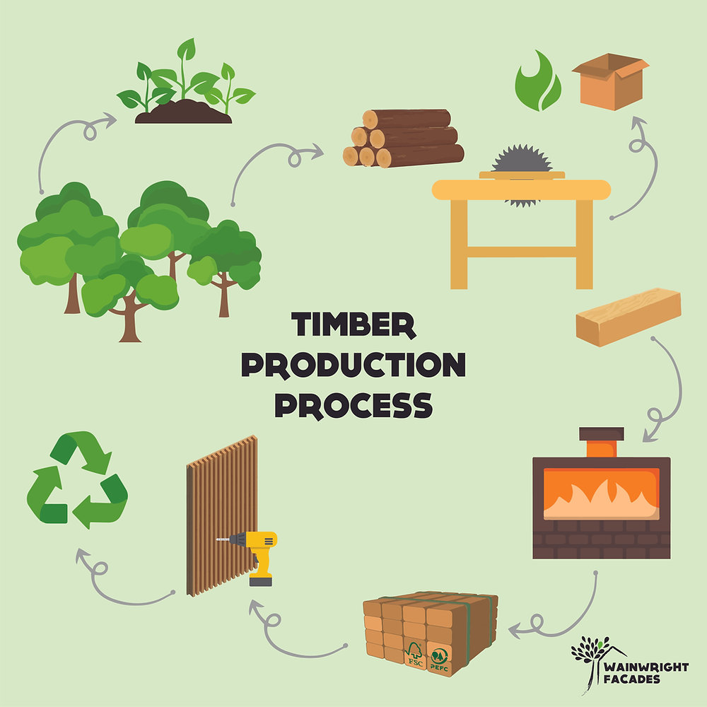
Puzzle Time: Put the Stages in Order!
✅ Correct Order Should Be:
1.🌳 Tree Stage
2.🪚 Chop & Move
3. 🏭 Cut It Up
4. 🪑 Make Stuff
5. 🚛 Send It Out
6. ♻️ Recycling
Source: www.wainwrightfacades.com
Notes:
Reveal the correct order and explain it clearly:
Tree Stage
Chop & Move
Cut It Up
Make Stuff
Send It Out
Recycling
“Now you know the real journey of a wooden product!”

Slide 15
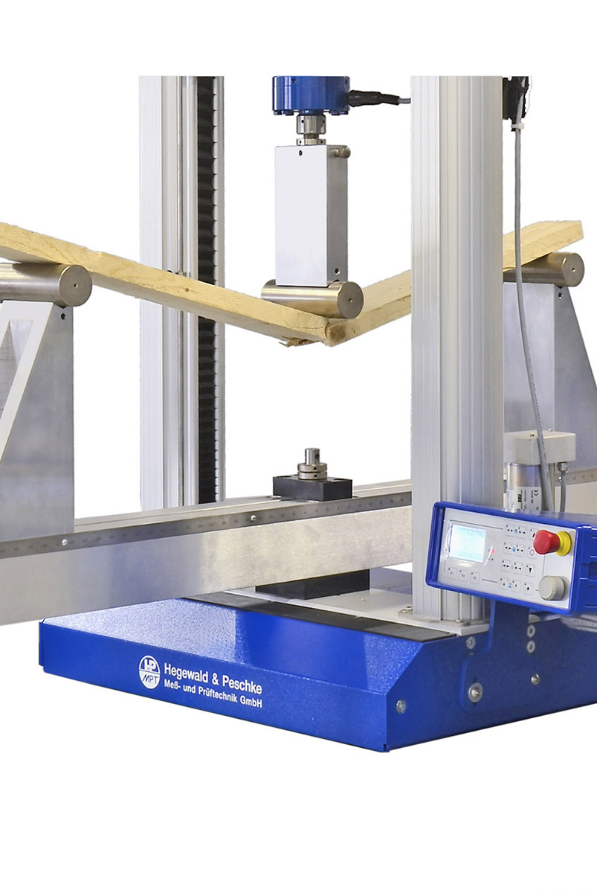
Bend It Like Timber: Comparing Wood Strengths
Test different wood types using a 3-point bend test
Observe how each wood bends or breaks under pressure
Compare strength and flexibility across samples
Learn about material properties
Source: www.hegewald-peschke.com
Notes:
Bending Test

Slide 16
Bend It Like Timber: Comparing Wood Strengths
Stick Type | Material Name | Thickness | Notes
♻️ Reclaimed | MDF Fire Retardant Oak Mix Veneer | 20 mm | Engineered wood with reclaimed content
🌿 Bamboo | Bamboo Caramel 3L Side Pressed | 20 mm | Side-pressed bamboo with good flex characteristics
🌿 Bamboo | Bamboo Tiger 3L Density | 20 mm | Unique structure for stronger comparative test
🪵 Plywood | MDF Moisture-Resistant Oak Mix Veneer | 20 mm | Represents modern veneered plywood
🌲 Solid Wood | Solid Three Layers Panel Oak Rustic | 20 mm | Natural solid wood with rustic properties
Notes:
Bending Test

Slide 17
Bend It Like Timber: Comparing Wood Strengths
VIDEOS
Notes:
Bending Test Videos + Explanation

Slide 18
Bend It Like Timber: Comparing Wood Strengths
Material | Strength (Flexural) | Why?
Solid Oak Rustic (Solid Wood) | 🔼 High | Dense hardwood, natural grain, strong structure
Bamboo Tiger 3L | 🔼 High | Engineered bamboo with vertical layering – very strong
Bamboo Caramel 3L Side Pressed | 🔼 Medium-High | Compressed bamboo, strong but more elastic
MDF Fire Retardant Oak Mix Veneer | 🔽 Low-Medium | MDF core is weaker; veneer adds only surface strength
MDF Moisture-Resistant Oak Veneer | 🔽 Low-Medium | Similar to above; moisture-resistance adds density but not much flexural strength
Notes:
Bending Test Results

Slide 19
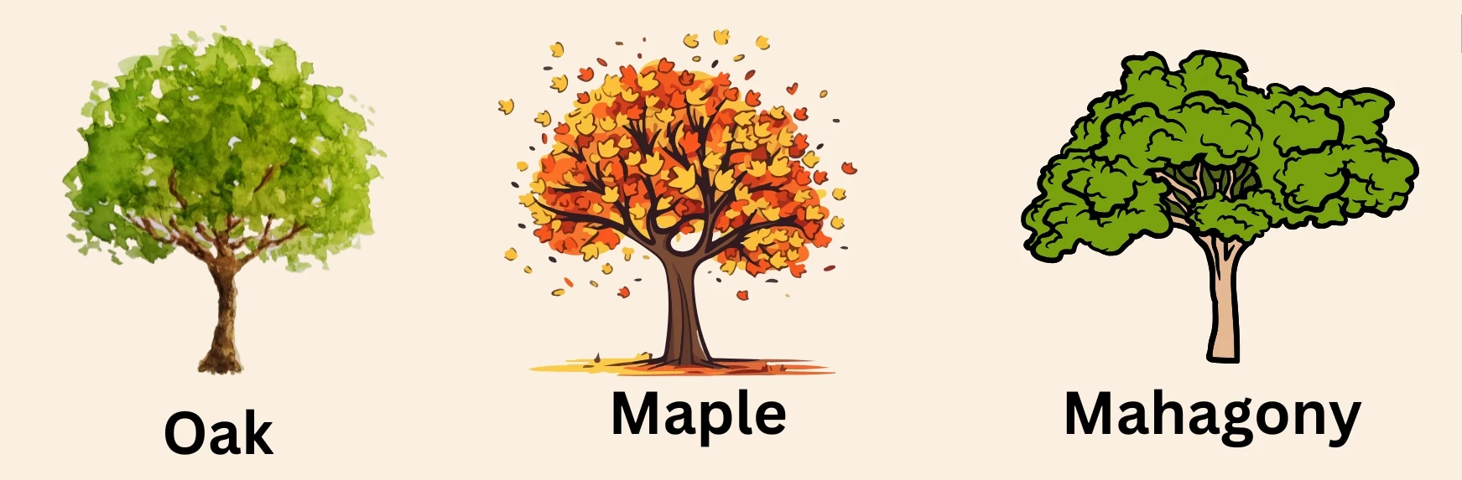
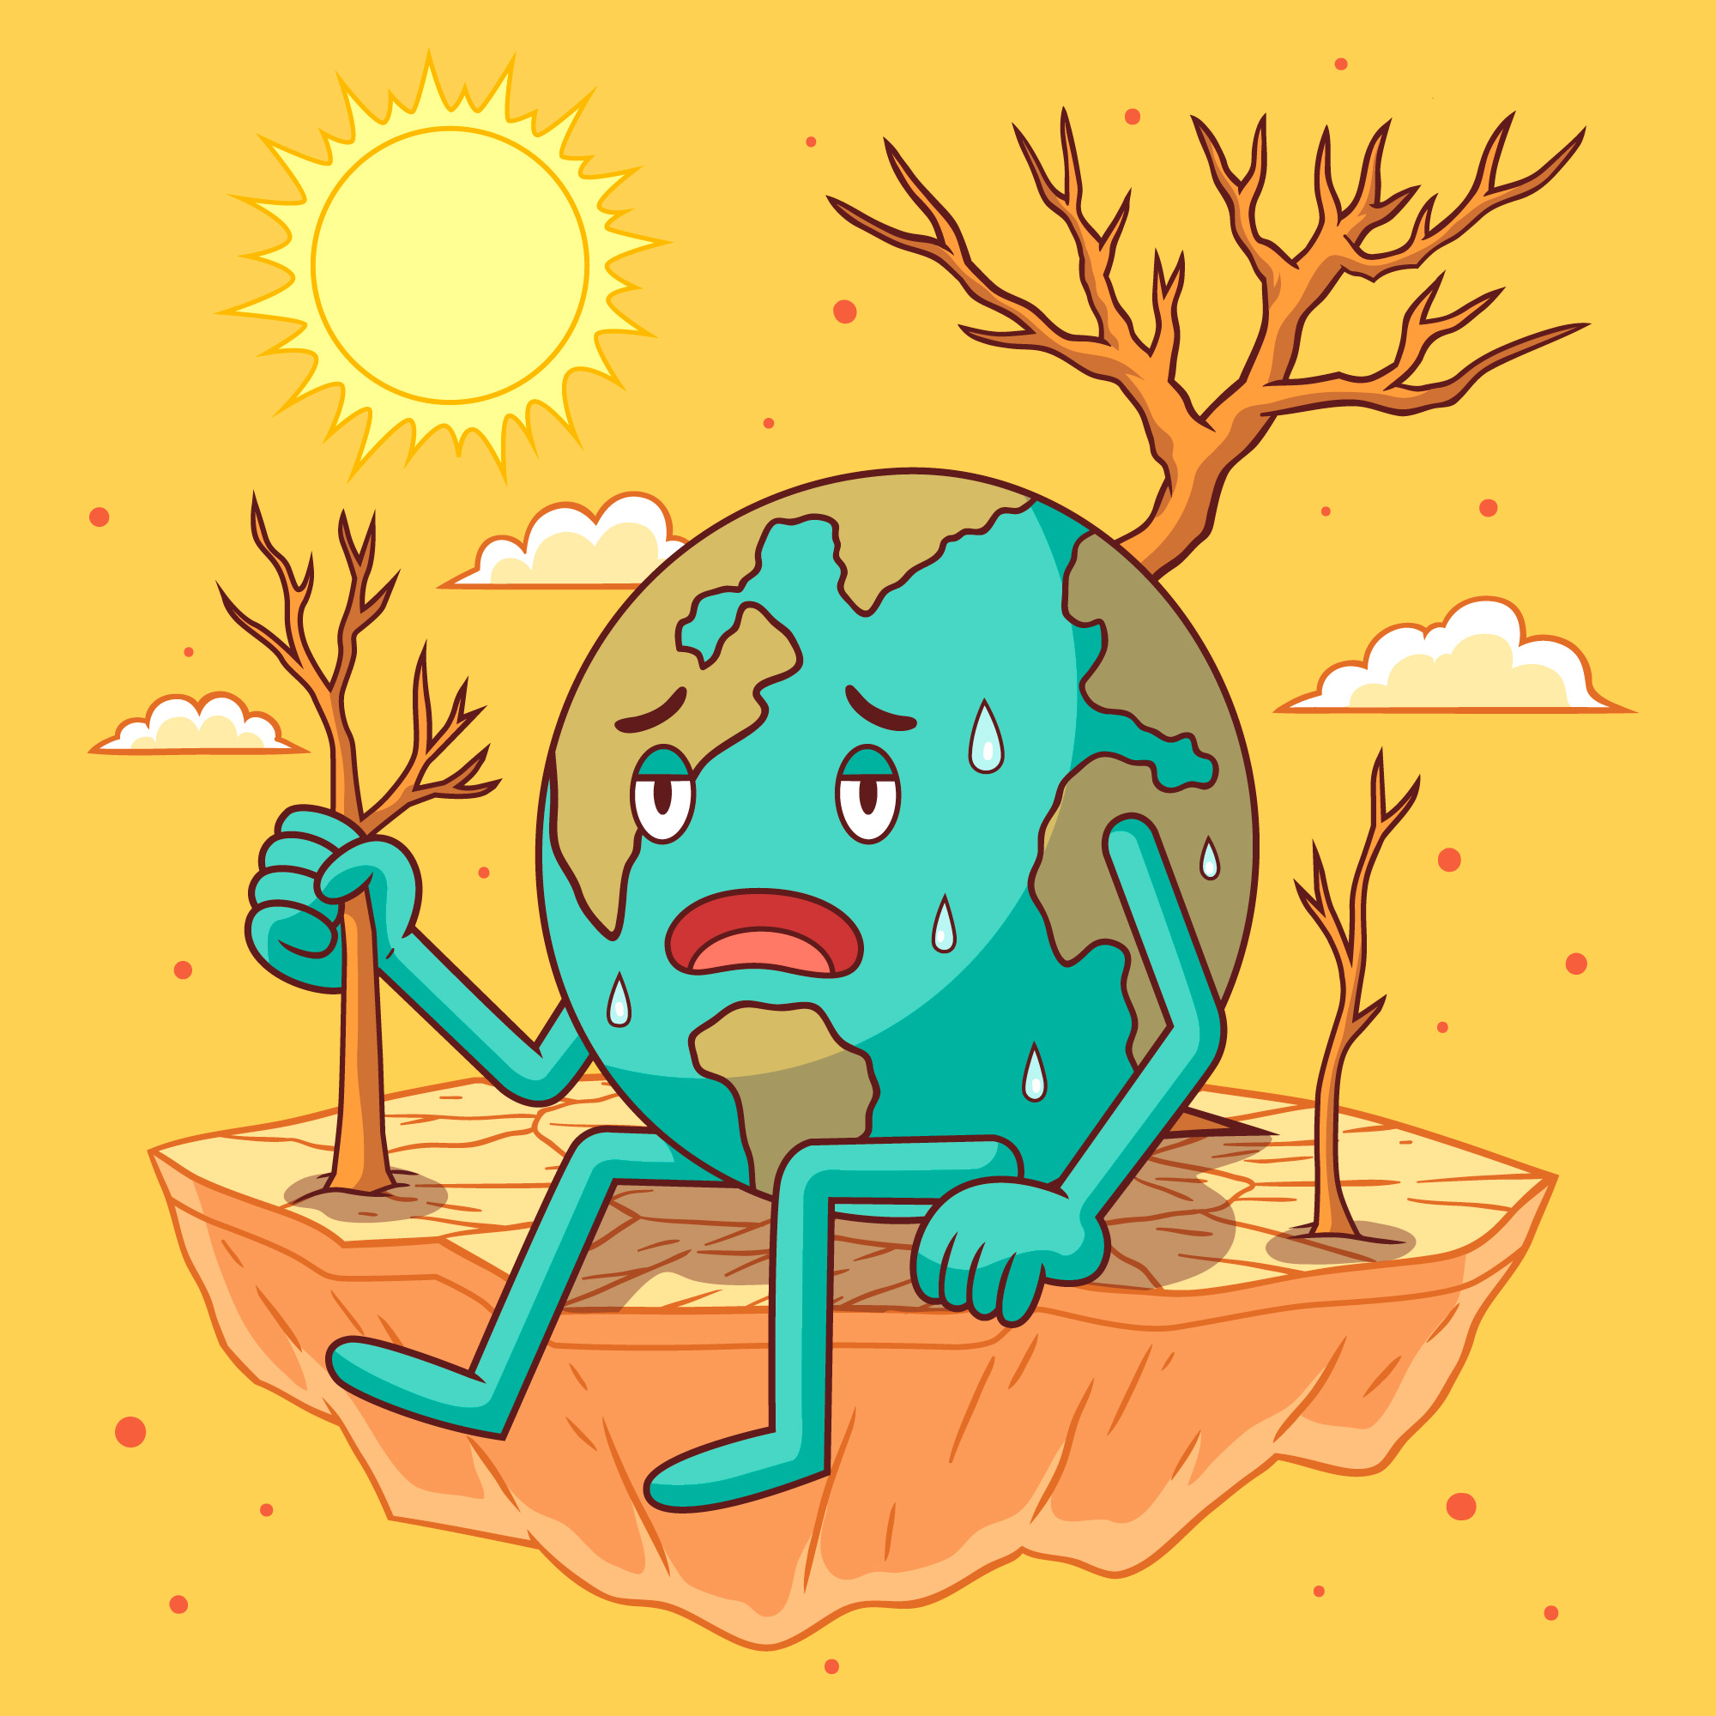
Every Choice Matters: The LCA Story
Not all wood is the same
Some types cause more pollution
Some help save the planet
That’s where LCA (Life Cycle Assessment) comes in.
It helps us see how products help or harm the planet
Source: www.buzzenviro.com
Source: https://www.freepik.com
Notes:
“Not all wood is equal. Some kinds of wood hurt nature more than others.”
Introduce the idea of LCA (Life Cycle Assessment):
“It helps us understand how products affect the planet.”
“Let’s learn how to choose wisely.”

Slide 20
What is an Eco Point?
Fewer Eco points = Greener choice!
Some wood is better for the planet
We can compare them using Eco Points
🪵 Wood Type | 🧮 Eco Points | 🌿 Why?
♻️ Reused Wood | 2 point | No new trees cut, already made
🌲 Fast-growing Local Wood | 3 points | Regrows quickly, travels a short distance
🪵 Imported Hardwood | 8 points | Cut from slow-growing trees, shipped far
Notes:
“Eco Points help us compare materials. Fewer points mean better for Earth.”
“Today, you’ll use Eco Points to make smart choices when you build.”

Slide 21
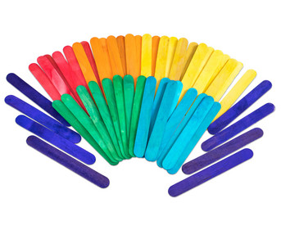
Meet Your Building Materials
Craft Sticks
Each wood type has different properties
Use at least 20 sticks
Stay under 100 Eco Points
Minimum Strength 50 ⭐ (stars)
Source: www.betzold.at
Notes:
“Here are your building blocks: craft sticks of different types.”
Rules:
Use at least 20 sticks.
Stay under 100 Eco Points.
Your structure must be strong — at least 50 stars in strength.

Slide 22
Meet Your Building Materials
Craft Stick Properties
Stick Type | Color | Eco Points | Strength
♻️ Reclaimed | Blue | 2 pts | ⭐⭐
🌿 Bamboo | Green | 3 pts | ⭐⭐
🪵 Plywood | Yellow | 5 pts | ⭐⭐⭐
🌲 Solid Wood | Red | 8 pts | ⭐⭐⭐⭐
Notes:
Go over the chart: wood types, colours, points, and strength.
Help students think like designers: “Pick your materials carefully!”

Slide 23
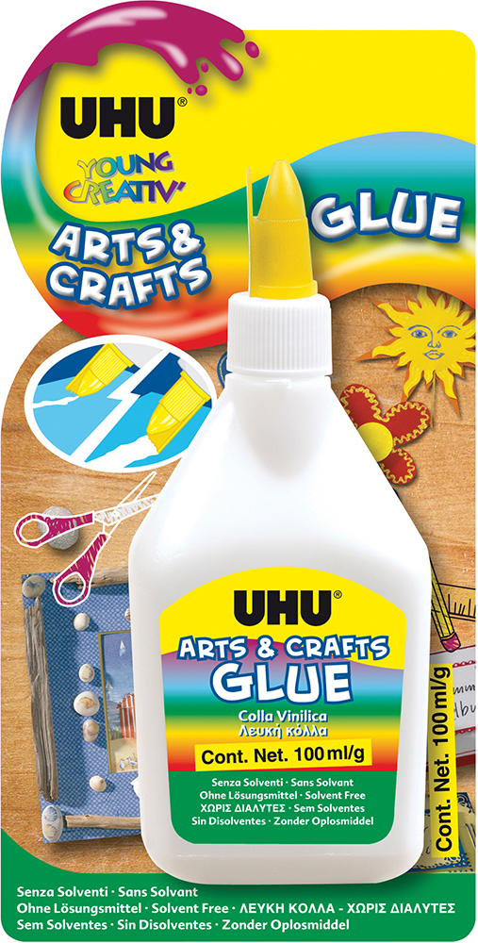
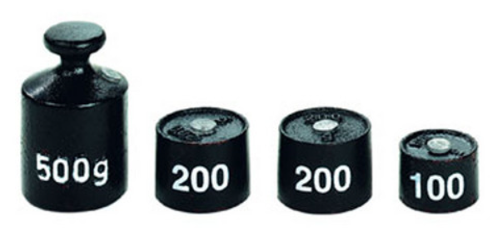
Meet Your Building Materials
Glue
UHU Craft Glue Young Creative - Arts and Crafts 100 ml
Weights
Test strength by placing different weights on top of your structure, will it hold?
Source: www.libro.at
Source: www.betzold.at
Notes:
“You’ll get glue to build and water to test your table’s strength.”
“Can your table hold a cup of water (S M L Sizes)?”

Slide 24
Time to Team Up!
Teams of 4–5:
Plan a design
Give it a name
Build it
Calculate strength
Create a poster
Source: www.betzold.at
Source: www.libro.at
Source: www.betzold.at
Notes:
Explain teamwork:
Groups of 4–5
Plan your design
Choose a team name
Build and test
Create a poster to explain your table
Encourage creativity and teamwork.

Slide 25
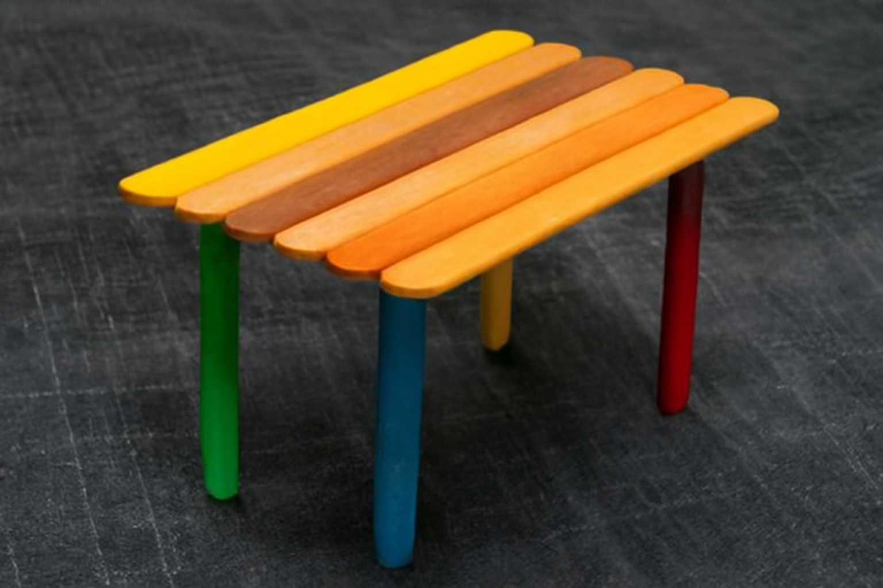
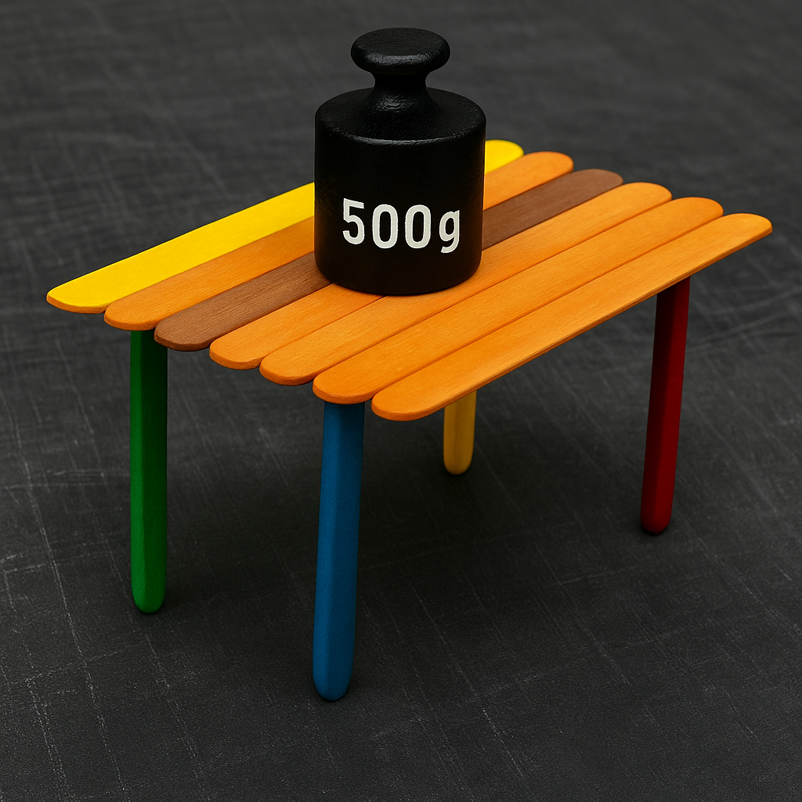
Ready, Set, Build!
Build your mini table!
Use different types of sticks
Track your Eco Points & Strength
Create poster
You have 45 minutes
Source: AI Generated
Source: AI Generated
Notes:
“Now it’s time to build!”
Remind them to:
Track Eco Points and strength
Work together
Be safe with glue
Give time updates if needed.

Slide 26
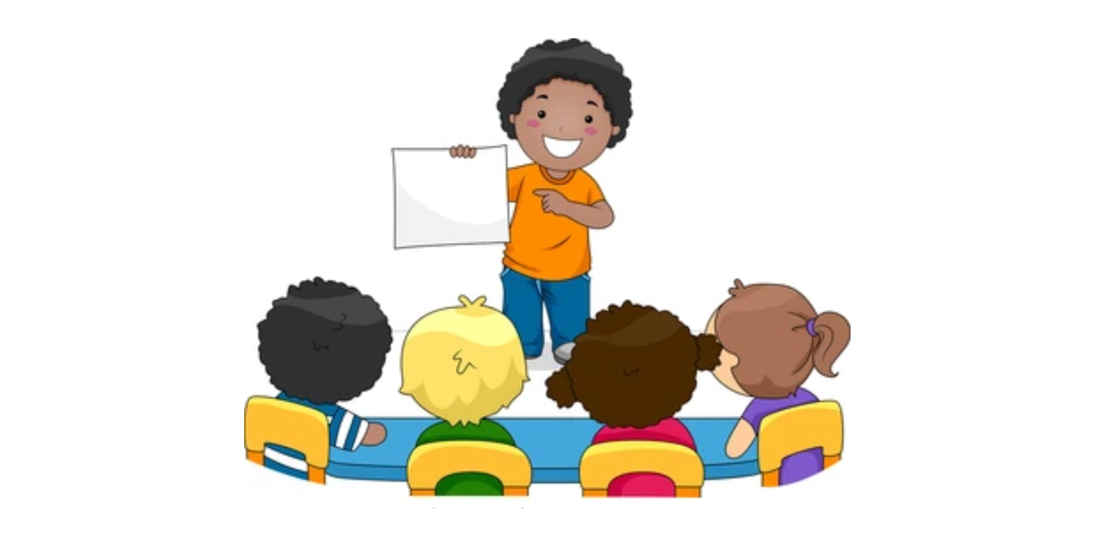
Let’s Present Our Tables!
Each team presents:
Team Name
Table Design & Materials
Types of Sticks Used
Total Eco Points
Water Cup Test Result
One Eco-Friendly Choice Made
Source: www.srdalvifoundation.com
Notes:
Each team shares:
Team name
Table design
Materials used
Eco Points
Did it pass the water cup test?
One eco-friendly choice they made
Clap and cheer for each team.

Slide 27
Award Time!
🎉 Everyone gets a sticker!
Bonus Awards:
🌿 Greenest Design
💪 Strongest Table
🎨 Most Creative
🤝 Best Teamwork
Notes:
“You all did an amazing job!”
Everyone gets a sticker.
Give fun awards for:
Greenest Design
Strongest Table
Most Creative
Best Teamwork
Celebrate effort, not just success.

Slide 28
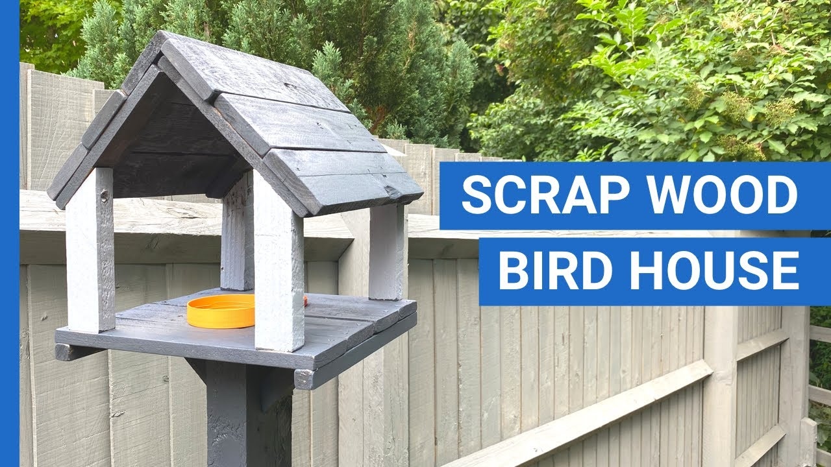
Recycling & Reuse
Wood can get a second life!
Ideas
  Upcycled wooden furniture (e.g., pallet sofas, crate shelves)
  Recycled wood art (e.g., signs, wall art, sculptures)
  DIY projects from scraps (e.g., birdhouses, organizers)
Always think: Can I reuse it?
📽️ Sustainable Wood Video: Sustainable Wood
📽️ Build Sofa Using Pallets: DIY Sofa Video
Source: www.diypalletideas.com/
Notes:
“Wood can get a second life.”
Show examples:
Pallet sofas
Recycled wood art
DIY birdhouses
Ask: “What could you make from old wood instead of throwing it away?”

Slide 29
What’s Your Wood-Wise Eco Superpower?
Slide Prompts
  “I can save trees by…”
  “Next time, I’ll reuse wood by turning it into ___.”
Your Ideas?
Notes:
Invite sharing:
“I can save trees by…”
“Next time I’ll reuse wood by making…”
Let kids shout out their ideas or write/draw them.

Slide 30

Thank You & Goodbye!
You are now an Eco Designer!
Keep thinking about trees, materials, and the planet
Source: www.fedongroup.com
Notes:
“You’re now official Eco Designers!”
“Remember what you learned today — every little choice helps our planet.”
Say thank you, take a group photo if possible, and hand out any takeaway sheets or stickers.

