Slide 1


EDU-CIRC
Rete transfrontaliera per la formazione sull’economia circolare e la decarbonizzazione nella produzione
Grenzübergreifendes Netzwerk zur Aus- und Weiterbildung in Kreislaufwirtschaft und Dekarbonisierung in der Produktion
Europa noch näher
Un’Europa più vicina

Slide 2
Fix It with Sawdust!
🪵🪚♻️
THEME: WOOD
Notes:
Welcome participants and introduce the workshop theme “Fix It with Sawdust.” Briefly explain the focus: using wood waste creatively, learning circular economy principles, and practicing hands-on repair.

Slide 3

Workshop Objectives
Circular Economy: Learn the principles.
Life Cycle Assessment: Evaluate environmental impact.
Activity: Hands-on repair activity with sawdust + glue.
Share: Teamwork & eco-ideas.
Notes:
Explain what participants will learn: circular economy basics, life cycle assessment, a practical sawdust repair activity, teamwork, and idea-sharing.

Slide 4
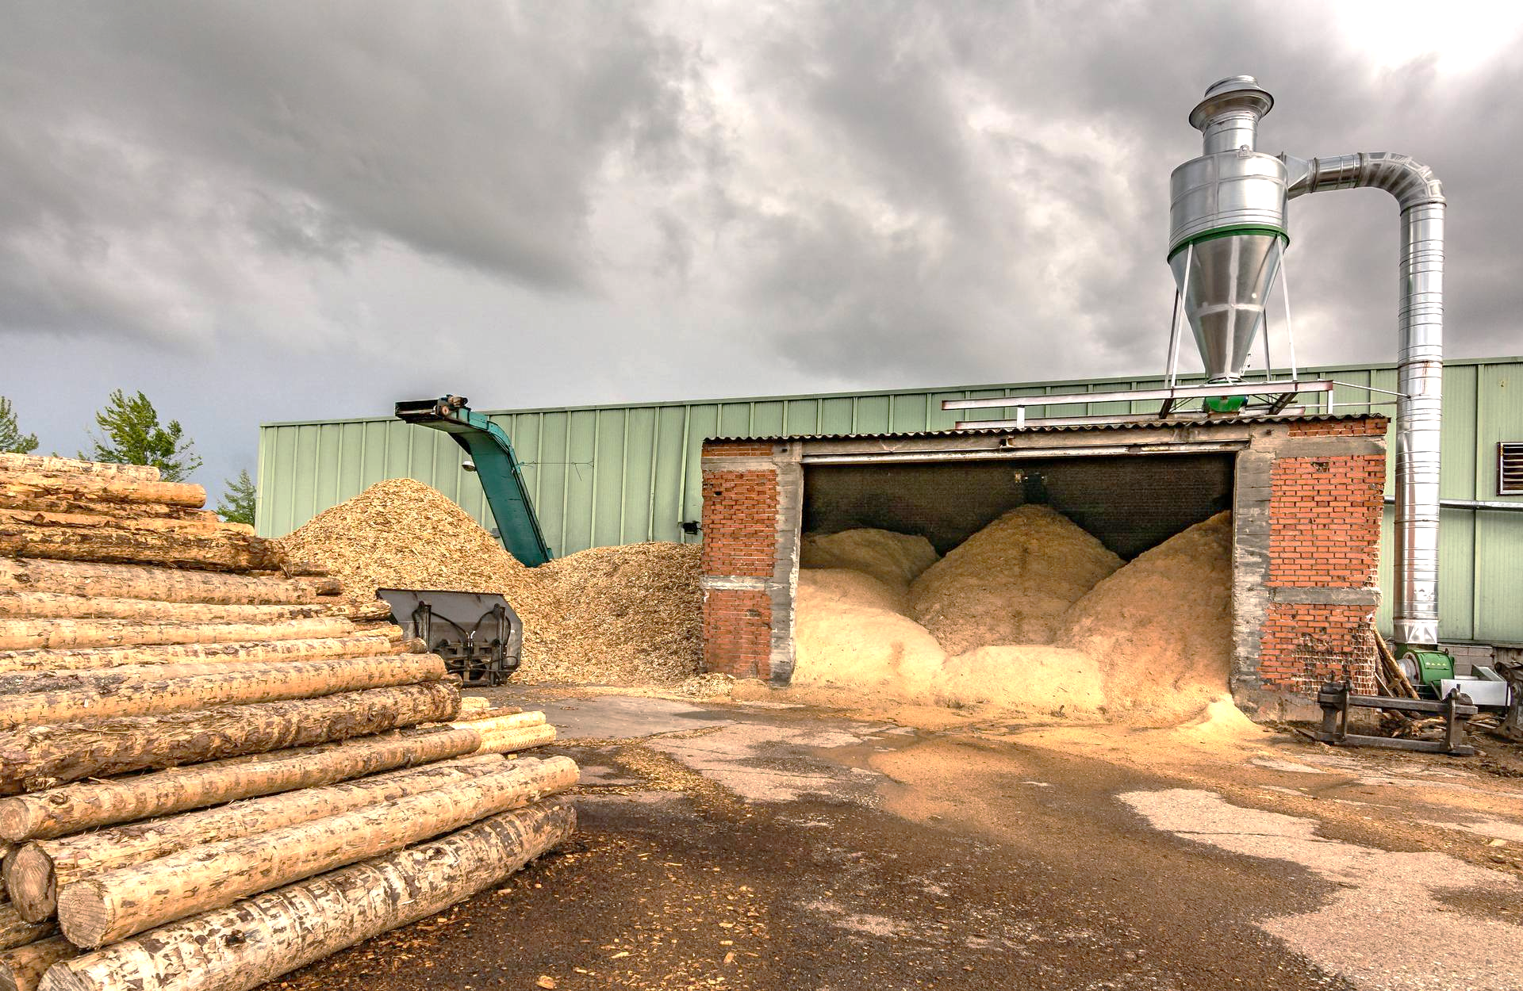
What is sawdust?
Sawdust is the tiny bits of wood that fall off when we cut, sand, or saw wood.
Source: www.phwintertonandson.co.uk
Notes:
Define sawdust simply. Mention how it’s produced in everyday woodworking. Connect to the workshop activity where sawdust becomes useful again.

Slide 5
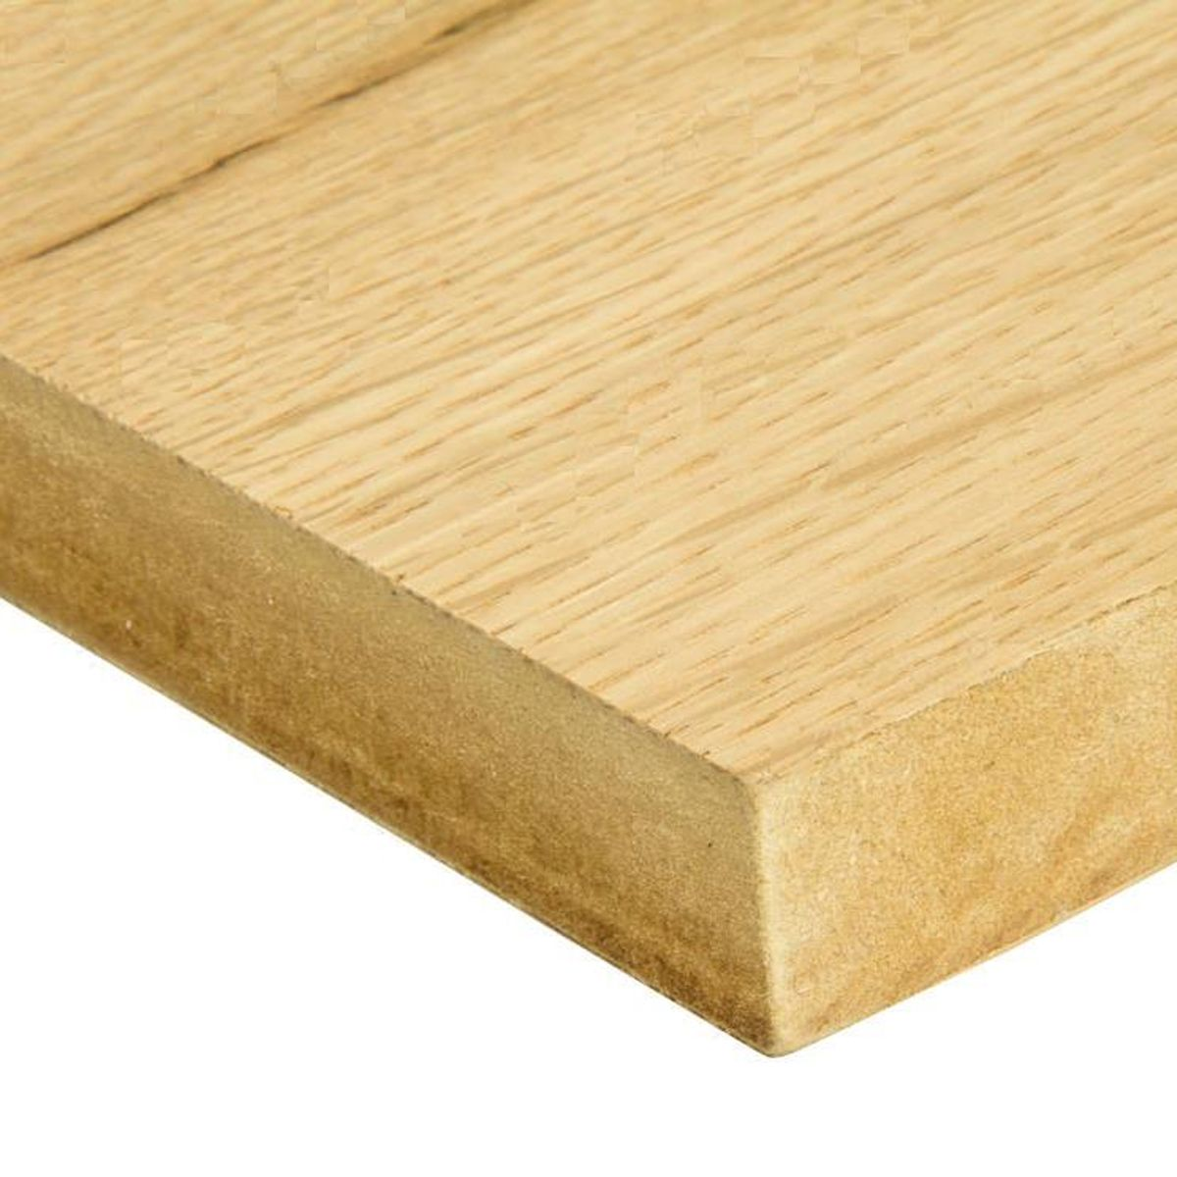
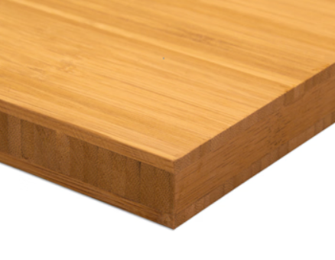
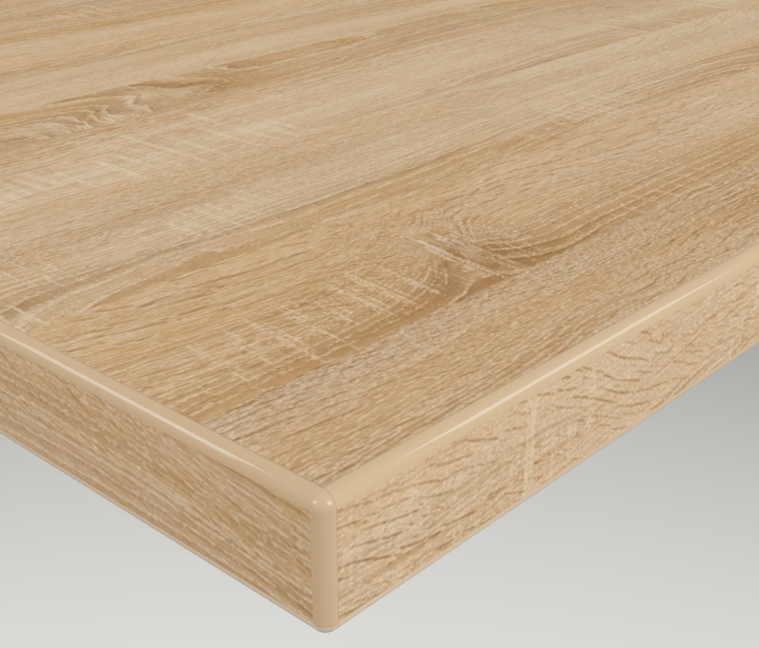
Guess the Material!
Which ones contain sawdust or wood fibers?
Source: https://www.laver.co.uk/
Source: https://holzplatte.de/
Source: https://holzplatte.de/
MDF Fire Retardant Oak Mix Veneer
Bamboo Tiger
Solid Three Layers Panel Oak
Notes:
Explain the slide is an interactive guessing activity. Ask the audience: which materials contain sawdust or wood fibers? Encourage participation.

Slide 6
Feel the Wood
Pass around real wood & sawdust samples
Source: https://www.laver.co.uk/
Source: https://holzplatte.de/
Source: https://holzplatte.de/
MDF Fire Retardant Oak Mix Veneer
Bamboo Tiger
Solid Three Layers Panel Oak
Notes:
Tell participants to handle the wood and sawdust samples. Emphasize the difference between natural wood and engineered panels.

Slide 7
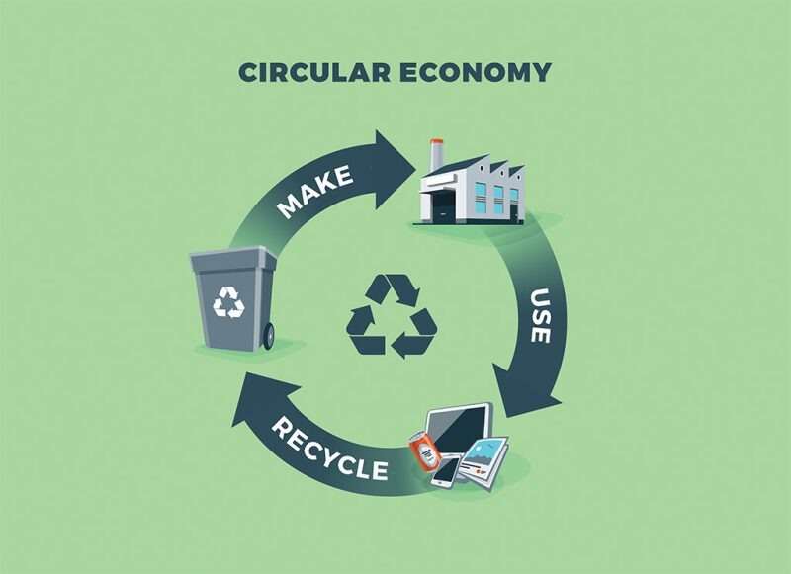
What is Circular Economy (CE)?
Definition:
A system where products, materials, and resources are kept in use for as long as possible.
📽️ Circular Economy
Source: https://jpt.spe.org/
Notes:
Define CE as a system where resources stay in use as long as possible. Contrast briefly with the traditional “take-make-dispose” model.

Slide 8
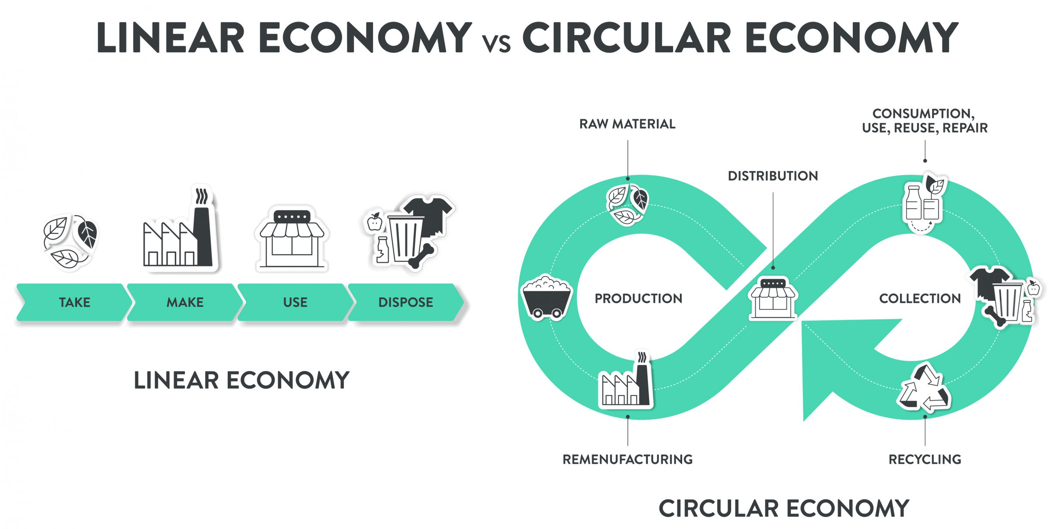
Linear vs Circular Economy:
How does the video illustrate the difference between a linear and a circular economy?
Source: https://www.technikum-wien.at/
Notes:
Explain the video that illustrates the difference. Ask participants what they notice about waste and reuse in each system.

Slide 9
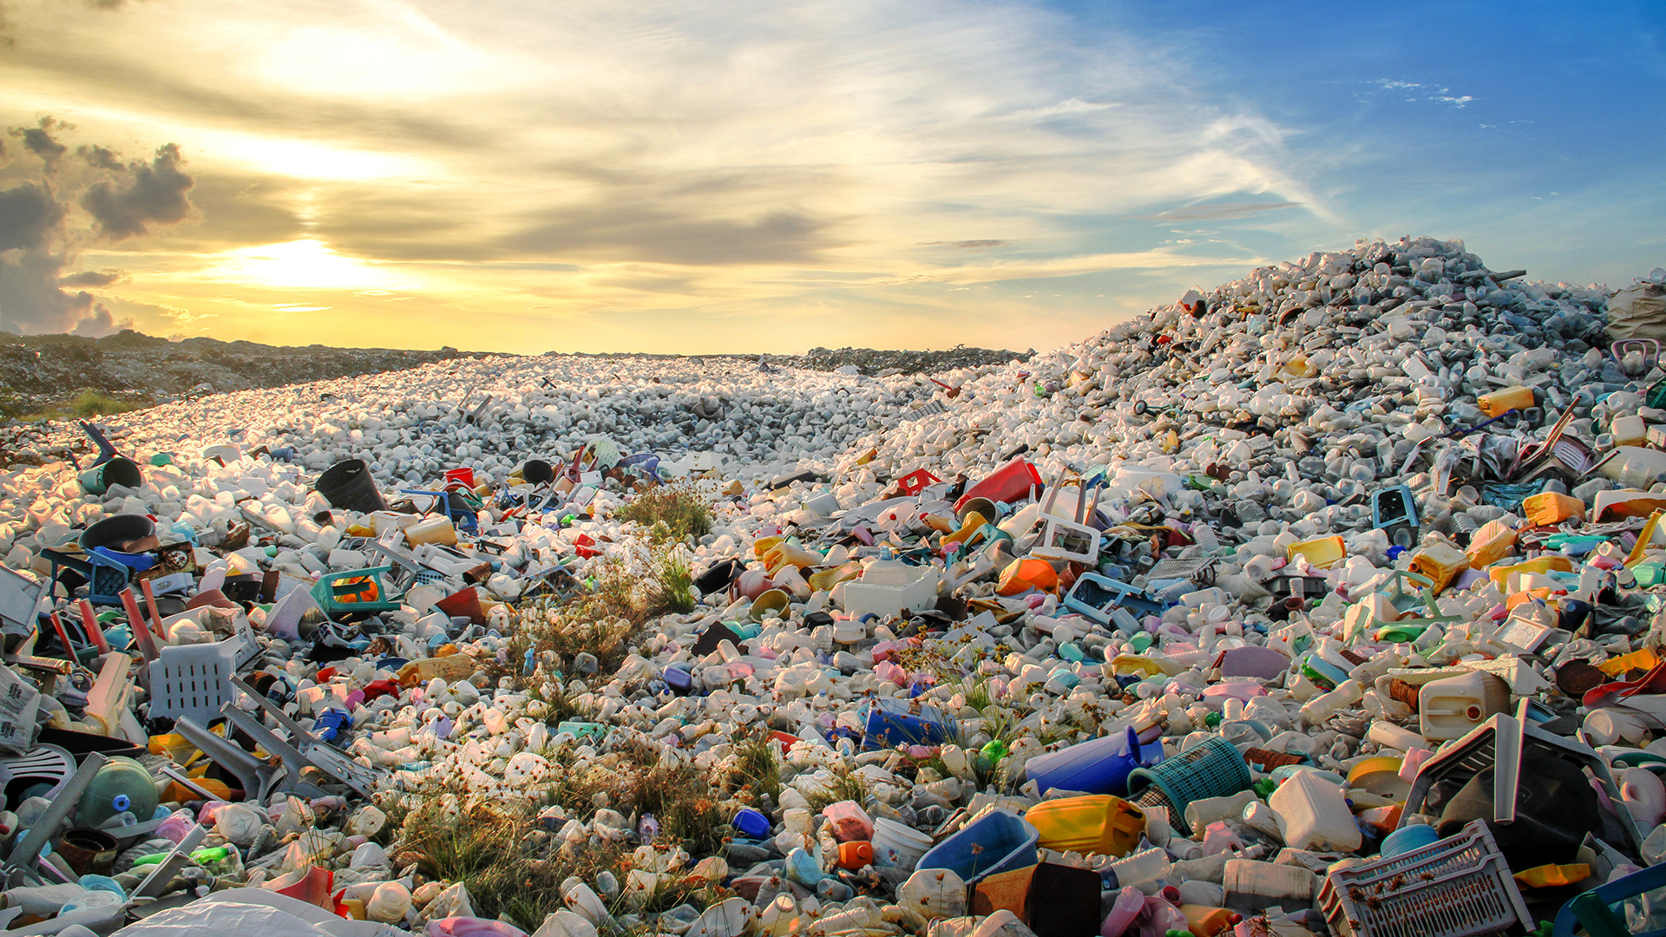
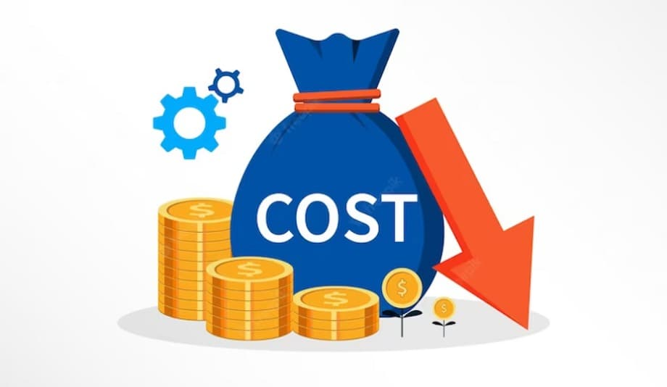

Why Circular Economy Matters
Environmental : Less waste 🌍
Economic : Save money 💰
Social : Cleaner, healthier life ❤️
Source: https://www.innovationnewsnetwork.com/
Source: https://cashflowinventory.com/blog/
Source: https://radiant.edu.np/
Notes:
Discuss three dimensions: environmental (less waste), economic (saves money), and social (cleaner and healthier lives). Use relatable examples.

Slide 10
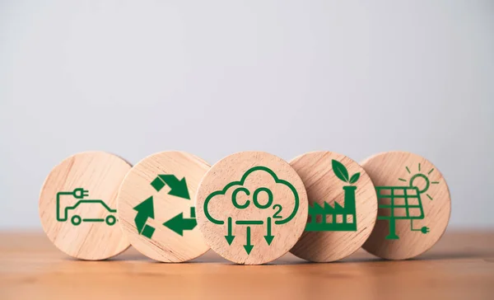
Meet the 4Rs
Reduce : Use less
Repair : Fix instead of throw
Reuse : Use again
Recycle : Make into new things
Source: https://depositphotos.com/
Notes:
Introduce Reduce, Repair, Reuse, and Recycle as the foundation of CE. Give quick everyday examples.

Slide 11
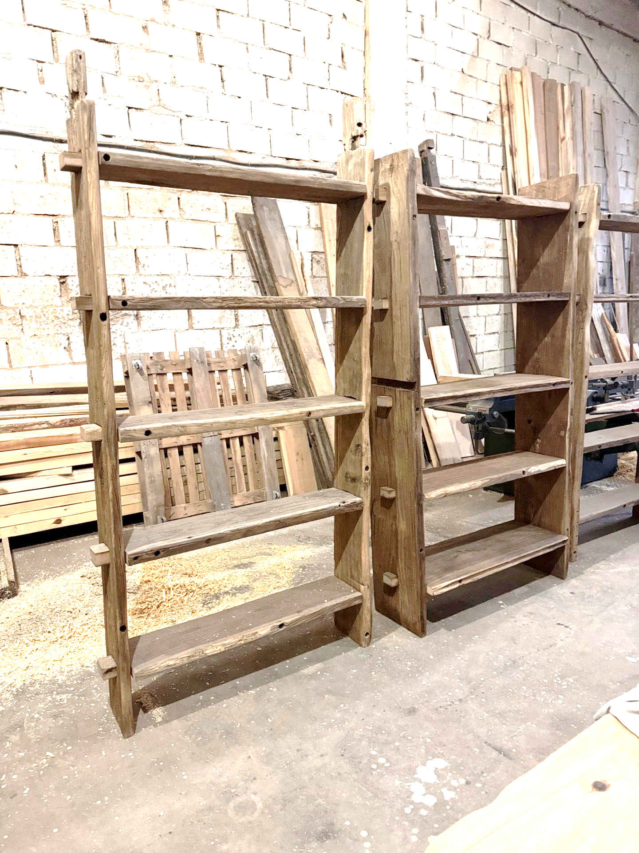
Meet the 4Rs - Old Wooden Shelf Example
Reduce : Buy fewer new shelves
Repair : Fix cracks and repair
Reuse : Use in another room
Recycle : Cut into pieces for boards
www.cwistore.com
Notes:
Walk through the shelf case: how each “R” applies to a single object. Reinforce how multiple choices exist for sustainability.

Slide 12
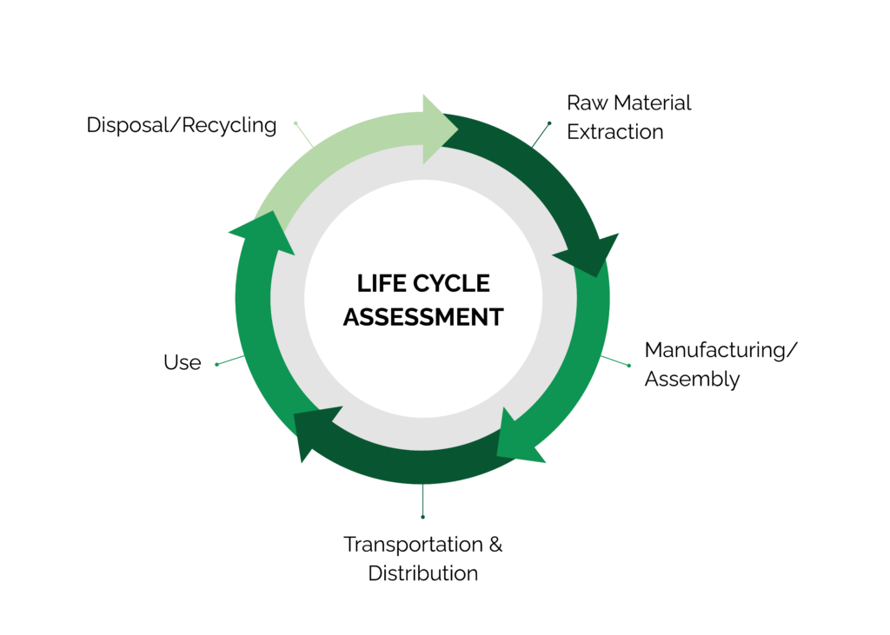
Life Cycle Assessment (LCA) – Introduction
What is LCA? : A method to assess the environmental impacts of a product throughout its life cycle
Source: www.stich.culturalheritage.org
Notes:
Introduce LCA as a tool to measure a product’s impact from start to end. Stress it’s about seeing the “whole picture.”

Slide 13

Importance of LCA
Helps us see:
🌱 Where pollution comes from
🔧 How to improve products
♻️ Why repair and reuse matter
Source: https://www.list.lu/fileadmin/files
Notes:
Explain that LCA identifies pollution sources, guides improvements, and shows why repair and reuse reduce impacts.

Slide 14
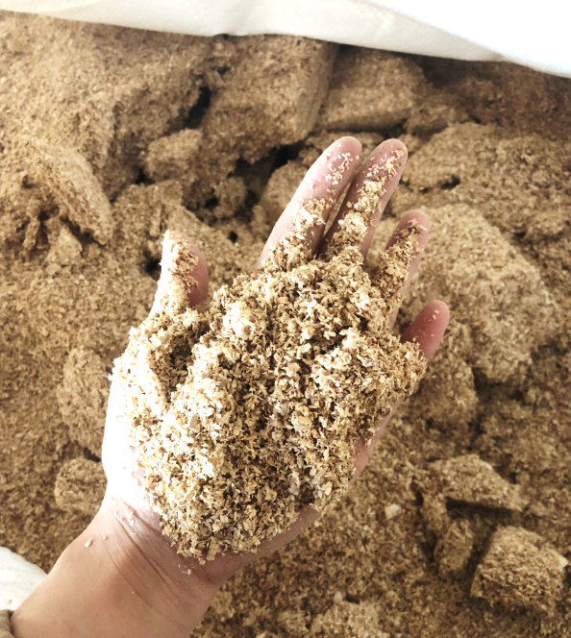
LCA Example : MDF Made from Sawdust
1. Raw Material Extraction
Sawdust from wood processing, synthetic resins
  Environmental Impact
  CO2 emissions from energy used in raw material collection
  and resin production.
Source: https://worldexport.com
Notes:
Discuss sawdust and resin inputs.
Mention CO₂ emissions and environmental effects from extraction and production.

Slide 15
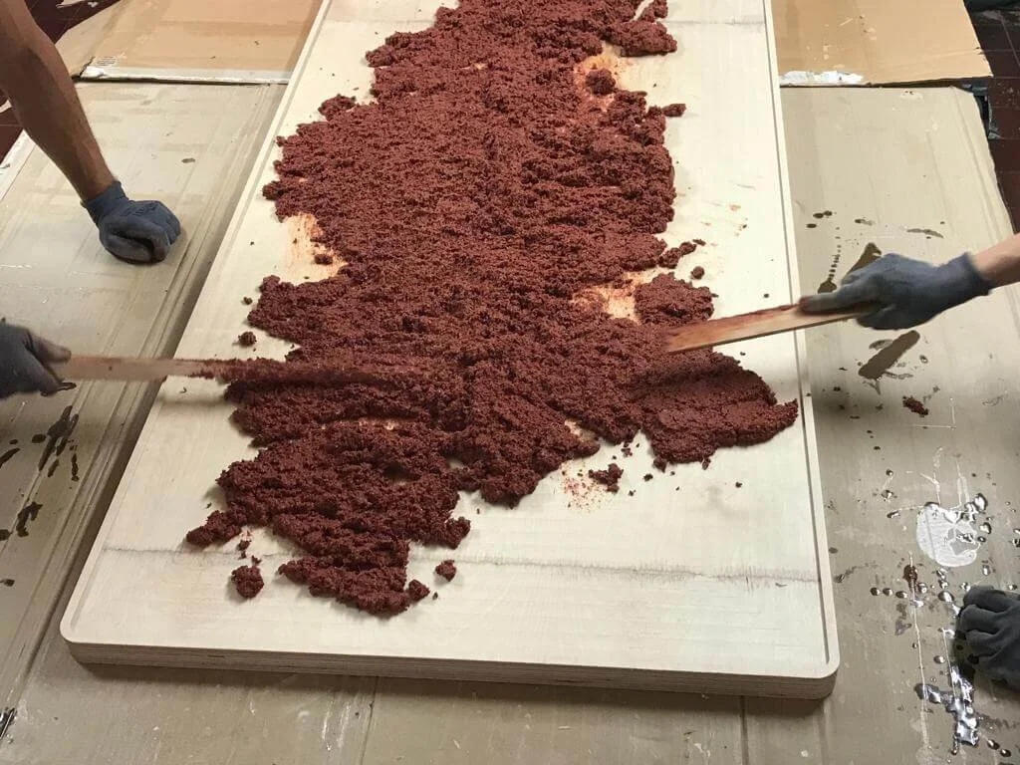
LCA Example : MDF Made from Sawdust
2. Manufacturing/Assembly
Mixing sawdust with resin
Pressing and drying to form MDF sheets.
  Environmental Impact
  Energy consumption leads to CO2 emissions.
  Chemical emissions from resins.
Source: https://www.lozidesigns.com/
Notes:
Explain how sawdust is mixed with resin and pressed. Highlight the energy use and emissions during this stage.

Slide 16

LCA Example : MDF Made from Sawdust
3. Transportation & Distribution
Transporting raw materials to the factory
Distributing the finished MDF product to various markets
  Environmental Impact
  CO2 emissions from transportation
  Fuel consumption for moving materials
Source: https://www.flaticon.com/
Notes:
Talk about environmental costs of moving raw materials and finished products—fuel use and emissions.

Slide 17
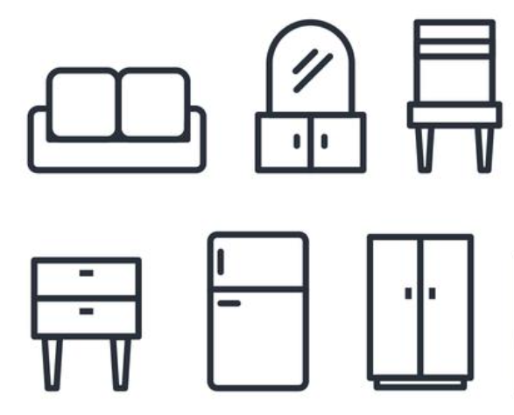
LCA Example : MDF Made from Sawdust
4. Use
MDF used in furniture, construction, and other applications
  Environmental Impact
  Low energy use during its life.
  Potential release of VOC emissions from resins
Source: https://www.vecteezy.com/
Notes:
Explain how MDF is used in furniture. Note that it uses little energy but may release chemical emissions.

Slide 18

LCA Example : MDF Made from Sawdust
5. Disposal/Recycling
Disposal: If landfilled, releases chemicals over time
Recycling: Currently challenging, but efforts to recycle MDF
are growing
  Environmental Impact
  Waste generation if not recycled
  Energy recovery possible through incineration
Source: https://www.shutterstock.com/
Notes:
Explain landfill and recycling challenges. Mention waste and possible energy recovery.

Slide 19
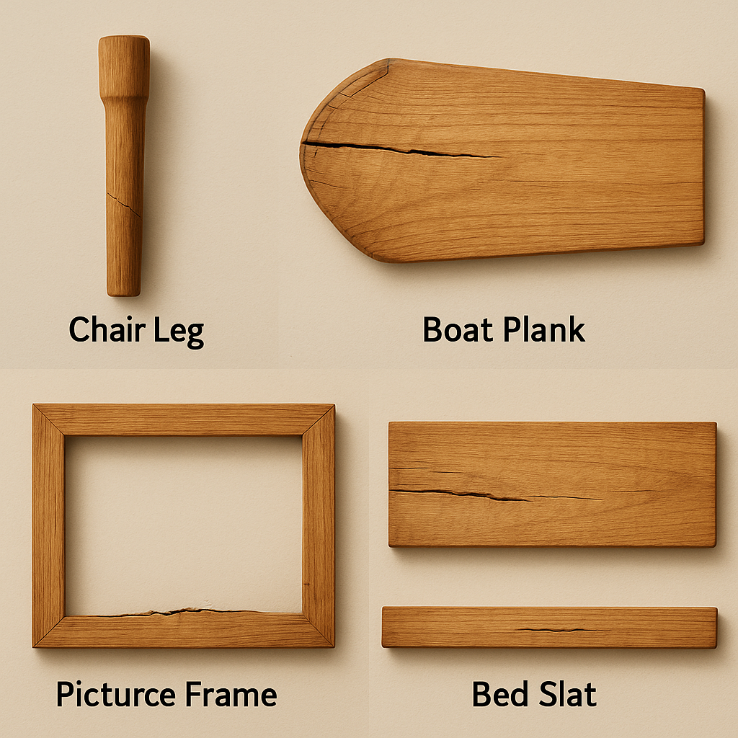
Today’s Challenge
Each team receives a wood piece (off-cut from an old product).
🪑 Chair leg
🚤 Boat plank
🖼️ Picture frame
🛏️ Bed slat
Source: AI Generated
Notes:
Present the activity: each team receives a unique wood piece to repair. Show examples (chair leg, plank, frame, bed slat).

Slide 20
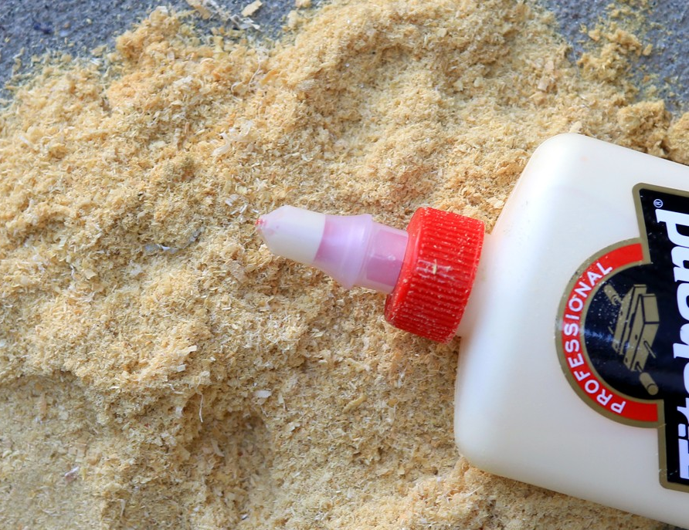
Today’s Challenge
Objective: Make wood filler (sawdust + bio glue) → repair crack.
📽️ Homemade Wood Filler with Sawdust
Materials:
  Damaged wood parts (with tag)
  Bio glue
  Sawdust
  Scaper
  Safety equipment (gloves, paper towels)
www.homehacks.com
Notes:
Explain the goal: make wood filler from sawdust and glue to repair cracks. Show the short video and materials provided.

Slide 21

Safety Briefing
Safety First:
  Always wear gloves 🧤
  Wipe spills 🧽
  Wash hands 🚰
www.vecteezy.com
Notes:
Emphasize safety: always wear gloves, wipe spills quickly, and wash hands. Ensure everyone follows before starting.

Slide 22

Step-by-Step Instructions
Step 1 : Prepare bio glue
Step 2 : Mix bio glue with saw dust to make paste
Step 3 : Repair wood part
Step 4 : Smooth, let dry
Step 5 : Prepare for presentations
Source: https://www.shutterstock.com/
Notes:
Guide through the repair process: mix, paste, apply, smooth, dry, and prepare results for sharing.

Slide 23

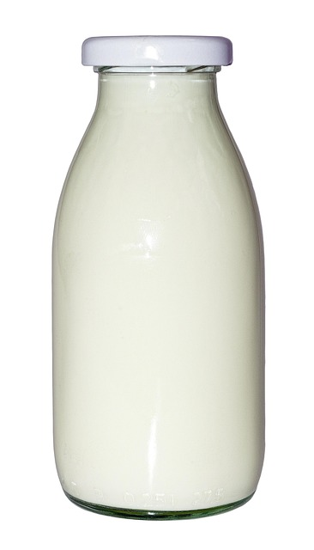

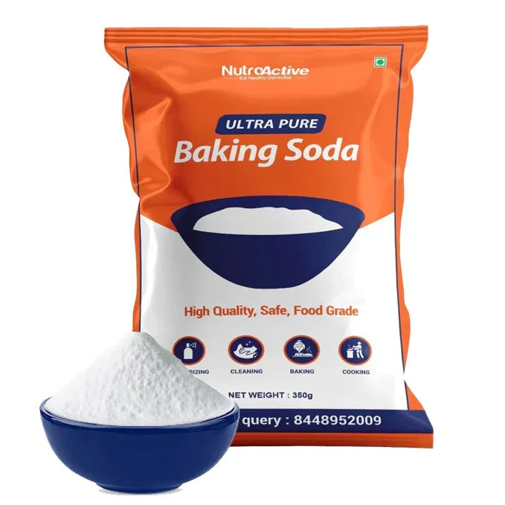
Step-by-Step Instructions: Prepare bio glue
Homemade BIO-glue: Step 1.0 (Ingredients)
15ml of white vinegar
100ml of milk
Water
Backing soda

Slide 24

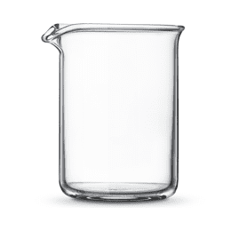
Step-by-Step Instructions: Prepare bio glue
Homemade BIO-glue: Step 1.1
15ml of white vinegar
100ml of milk

Slide 25
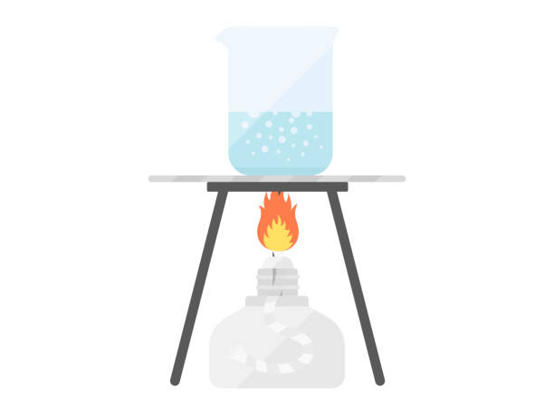
Step-by-Step Instructions: Prepare bio glue
Homemade BIO-glue: Step 1.2
Place the mixture on heat and stir gently, until mixture begins to boil and curds are seen floating.

Slide 26
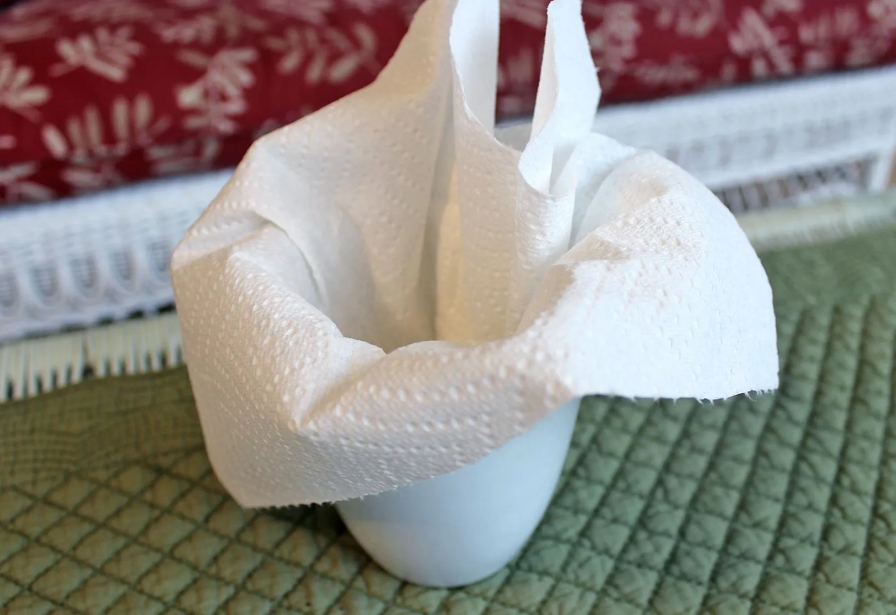
Step-by-Step Instructions: Prepare bio glue
Homemade BIO-glue: Step 1.3
Filter the mixture, using a folded piece of paper towel. Then discard the liquid filtrate

Slide 27
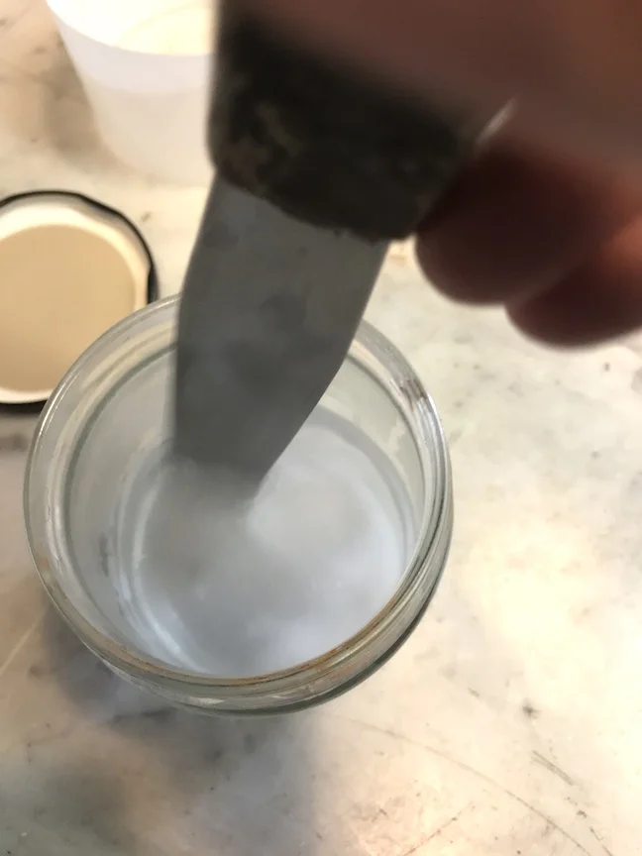
Step-by-Step Instructions: Prepare bio glue
Homemade BIO-glue: Step 1.4
Scrape the curds from the paper towel into a small cup
Slowly add 1 tsp baking soda and stir
Carefully add drops of water, stirring periodically, until the consistency of white glue is obtained

Slide 28
Task 1: Circular Economy (CE) Idea
Which R fits your wood piece ?
  🔧 Repair
  🔄 Reuse
  ♻️ Recycle
  ➖ Reduce
👉 Pick 1 or more Rs and explain how it works for your product
Notes:
Ask teams: which of the 4Rs applies best to your wood piece? Encourage explanation of why they chose repair, reuse, recycle, or reduce.

Slide 29
Task 2: The Life of Your Wood Piece
Which R fits your wood piece ?
  🪵 Start
  🏭 Make
  🚚 Move
  🏠 Use
  🗑️/♻️ End
👉 Draw these 5 steps on your poster. Show what changes if you Repair it.
Notes:
Teams should map the product life cycle with five stages. Ask them to show how repair changes the “end of life” step.

Slide 30

Preparing for Presentations
Fixed wood part
Circular Economy (CE) Ideas (Task 1)
LCA ideas (Task 2)
One idea to improve sustainability further
Source: https://www.shutterstock.com/
Notes:
Guide participants to summarize their repair, CE ideas, LCA insights, and one new sustainability improvement.

Slide 31

Awards
🌍 Best Circular Idea
🔄 Best LCA Reflection
🤝 Best Team Collaboration
💡 Most Innovative Sustainability Idea
Source: https://www.slideteam.net/
Notes:
Announce fun awards: best CE idea, best LCA reflection, best teamwork, most innovative sustainability idea.

Slide 32

Any Questions? Let’s Discuss!
❓ What was the easiest / hardest part today?
💭 Share your ideas for improving the activity or your product
💡 Challenge: If you couldn’t use glue,
what else could you use to fix the hole ?
Source: https://pngtree.com/
Notes:
Open discussion. Ask about what was easy or hard, suggestions for improvement, and creative alternatives to glue.

Slide 33

Thank You & Goodbye!
You are now an Eco Designer!
Keep thinking about trees, materials, and the planet
Source: www.fedongroup.com
Notes:
Congratulate participants. Encourage them to think about trees, materials, and sustainable living in daily choices.
Thank everyone for joining. Invite final reflections and close the workshop warmly.

