Slide 1


EDU-CIRC
Rete transfrontaliera per la formazione sull’economia circolare e la decarbonizzazione nella produzione
Grenzübergreifendes Netzwerk zur Aus- und Weiterbildung in Kreislaufwirtschaft und Dekarbonisierung in der Produktion
Europa noch näher
Un’Europa più vicina

Slide 2
Re-Build the Future
Eco-Homes in a Circular World
THEME: CONSTRUCTION

Slide 3

Workshop Objectives
Understand CE principle of keeping materials in use.
See design for disassembly.
Recognize environmental benefits through LCA thinking.
Brainstorm real-world reusable building solutions.
Notes:
To clearly state the four main goals of the workshop
This slide acts as a roadmap, breaking down the overarching theme into specific, actionable learning outcomes. It guides participants from conceptual understanding (CE principle) to practical application (design for disassembly), critical thinking (LCA thinking), and creative problem-solving (brainstorm real-world solutions).

Slide 4
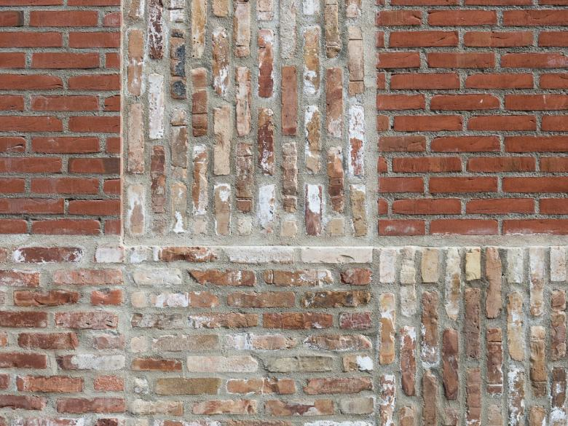
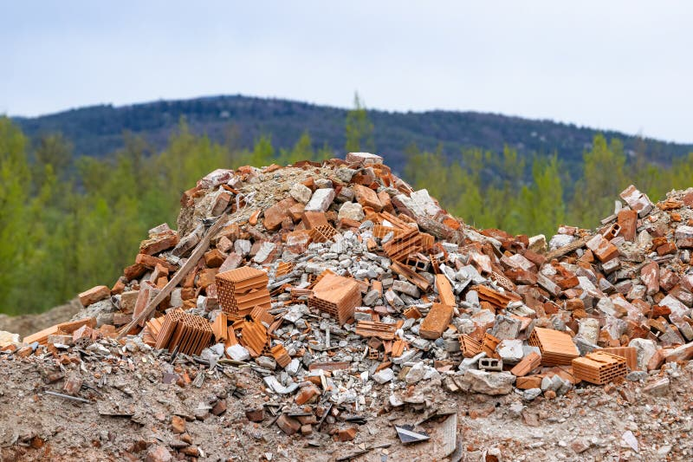
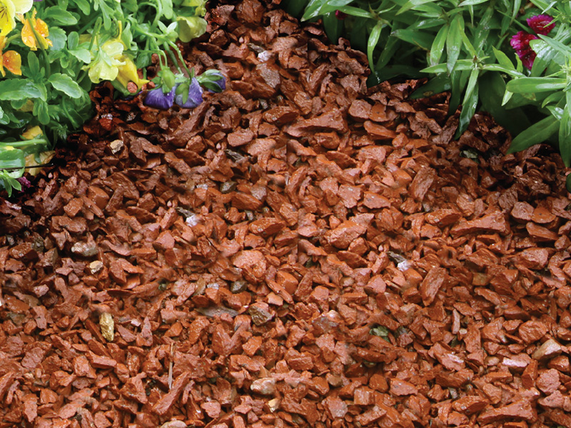
QUIZ
What happens to houses after 100 years?
📽️Brick Demolish
  ♻️ Reuse materials
  🚮 Landfill
  🔨 Demolition/rebuild
Reuse
Landfill
Crushed
https://www.world-architects.com/
https://www.dreamstime.com/
https://www.pacificclay.com/
Notes:
To engage the audience and activate their prior knowledge about construction waste.
The quiz format is an effective way to start a discussion. By presenting three possible fates for demolished bricks—Reuse, Landfill, and Crushed for fill/gravel—it prompts participants to think about the consequences of different end-of-life scenarios. This slide establishes the problem that the circular economy aims to solve.

Slide 5
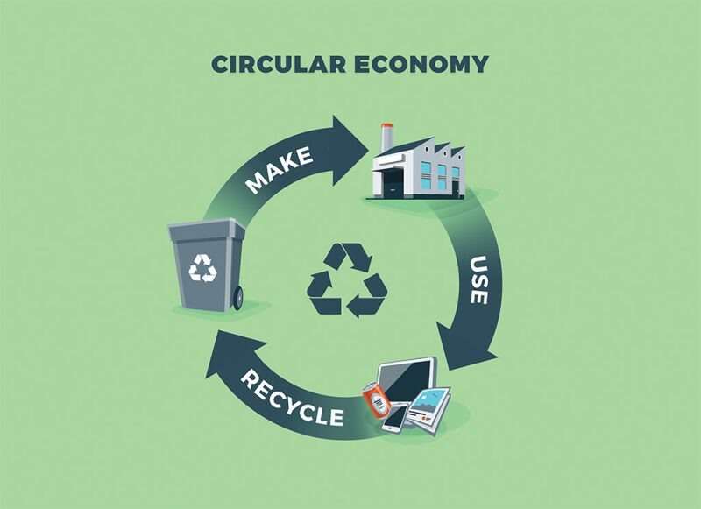
What is Circular Economy (CE)?
Definition:
A system where products, materials, and resources are kept in use for as long as possible.
📽️ Circular Economy
Source: https://jpt.spe.org/
Notes:
To define the core concept of the entire workshop.
This slide provides the fundamental definition of a circular economy: a system that keeps products and resources in use as long as possible. The simple, circular visual reinforces the idea of a closed loop, contrasting with the linear model.

Slide 6
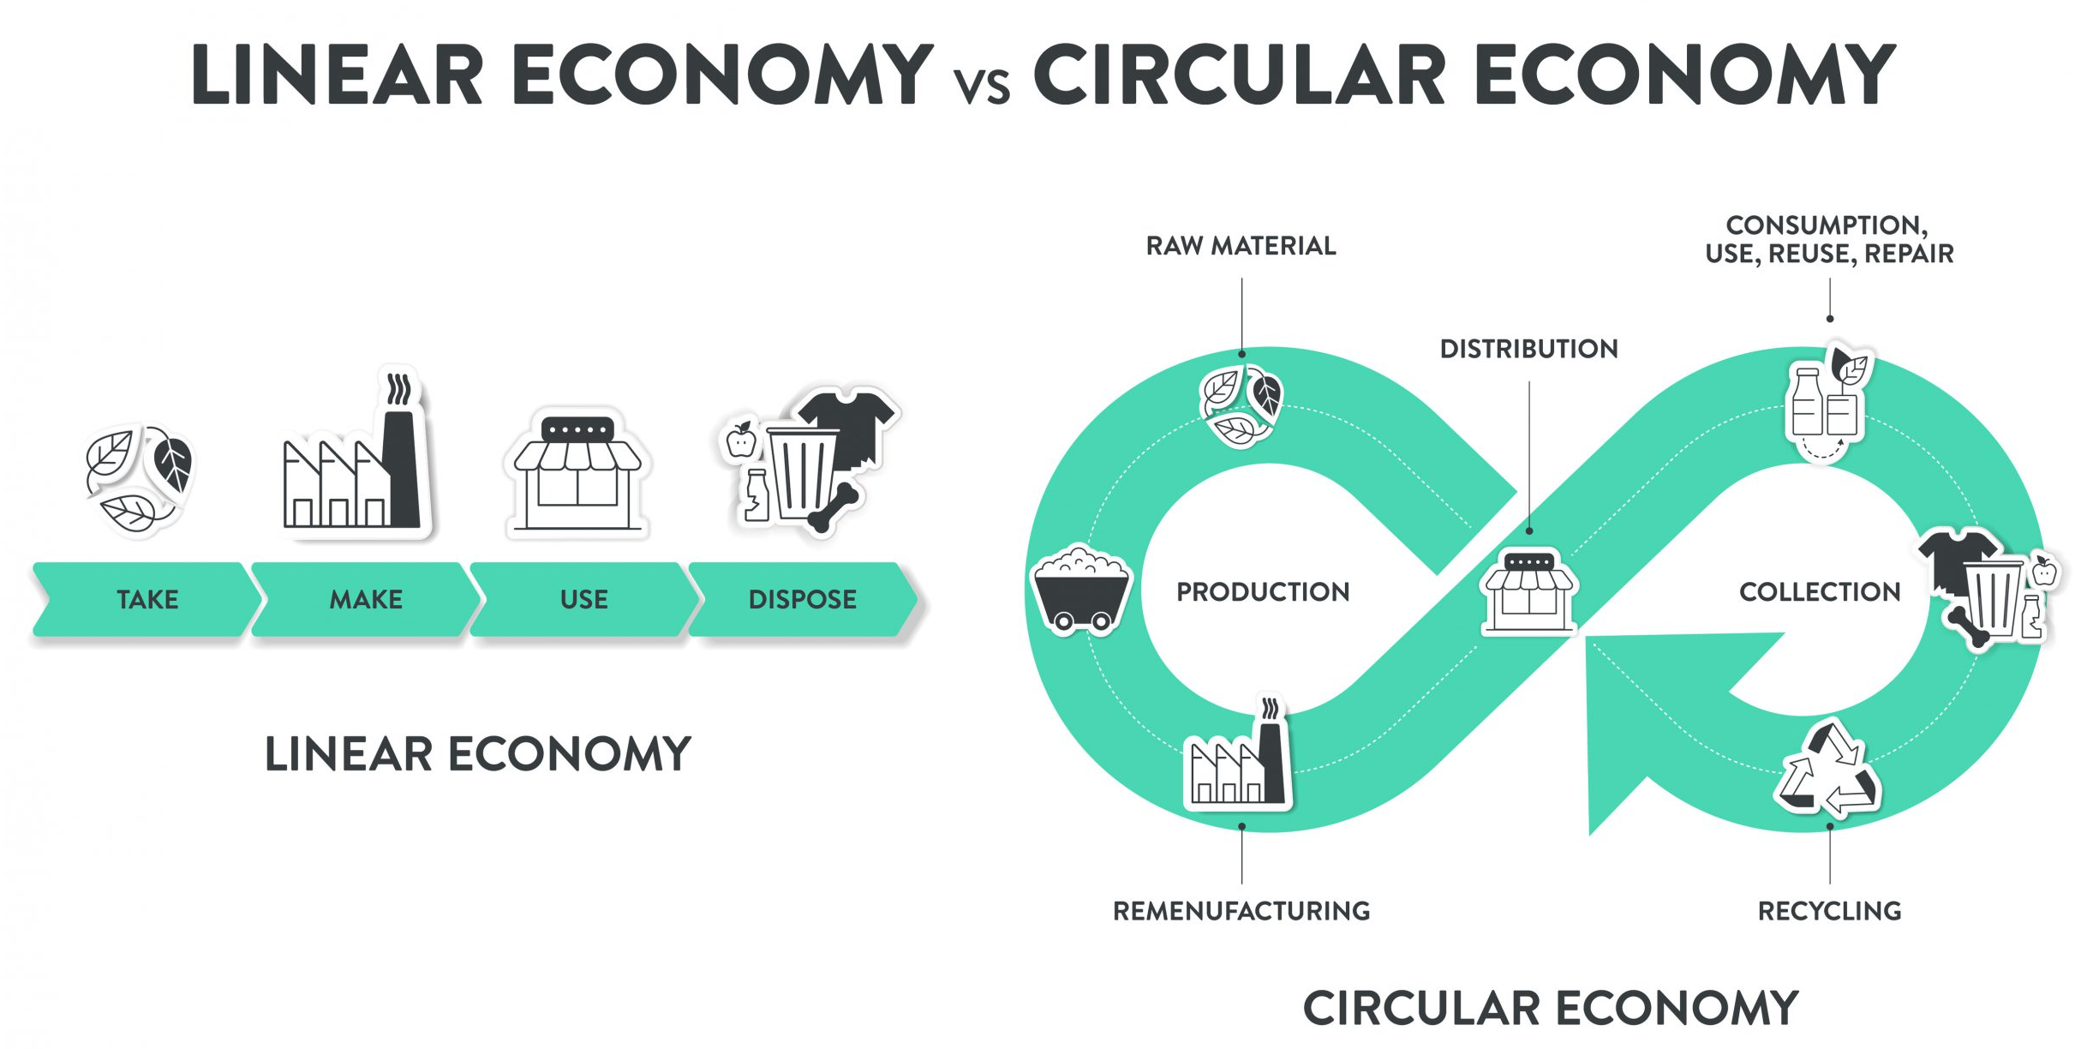
Linear vs Circular Economy:
How does the video illustrate the difference between a linear and a circular economy?
Source: https://www.technikum-wien.at/
Notes:
To visually and conceptually differentiate between the two economic models.
This slide highlights the difference between the wasteful "Take, Make, Use, Dispose" linear model and the sustainable, continuous loop of a circular economy. The side-by-side comparison makes the contrast clear and helps participants understand the need to transition to a circular system.

Slide 7
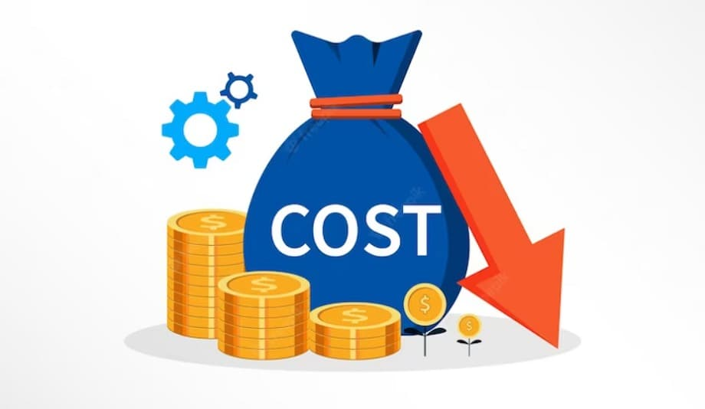

Why Circular Economy Matters
Environmental Impact: Waste, pollution, depletion of resources
Economic Benefits: Reduced costs, innovation, job creation
Social Impact: Sustainable living, waste reduction
Source: www.pacificclay.com
Source: https://cashflowinventory.com/blog/
Source: https://radiant.edu.np/
Notes:
To justify the importance of adopting a circular model by outlining its benefits.
This slide broadens the scope of the discussion by detailing the positive impacts of a circular economy on the environment, the economy, and society. It provides a compelling reason for participants to engage with the workshop's content by showing how these principles can create a better world.

Slide 8
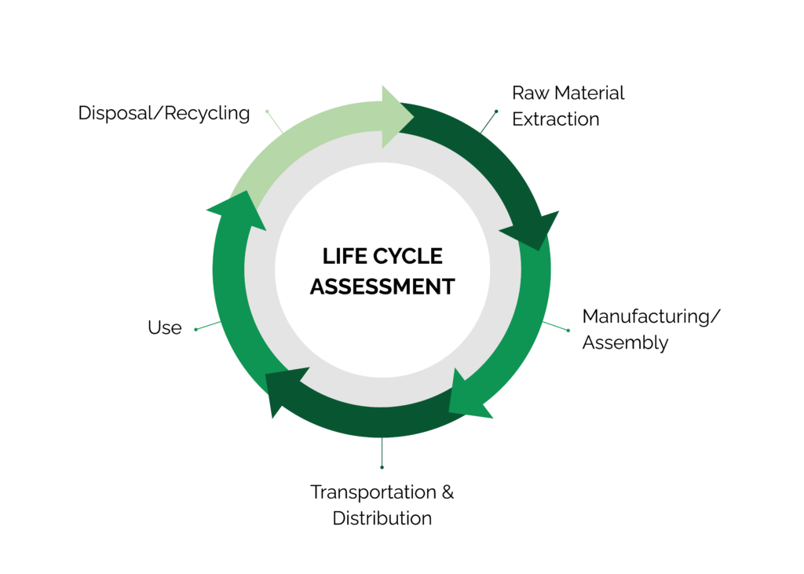
Life Cycle Assessment (LCA) – Introduction
What is LCA? : A method to assess the environmental impacts of a product throughout its life cycle
Source: www.stich.culturalheritage.org
Notes:
To introduce the concept of Life Cycle Assessment as a key analytical tool.
LCA provides a systematic method for measuring a product's environmental impact across its entire lifespan. This slide defines it, preparing the audience to use it as a framework to evaluate their own building project.

Slide 9
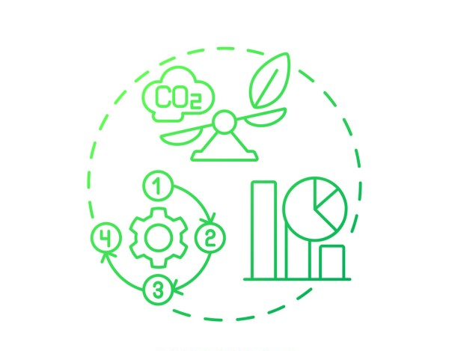
Importance of LCA
Purpose: Helps identify areas to reduce environmental footprint
Application: Guides design choices for more sustainable products
Source: https://www.list.lu/fileadmin/files
Notes:
To explain the practical application and significance of LCA.
This slide clarifies that LCA is not just a theoretical concept; it's a tool used to guide decision-making toward more sustainable products. It helps identify "hot spots" in a product's life cycle where the most environmental impact occurs.

Slide 10
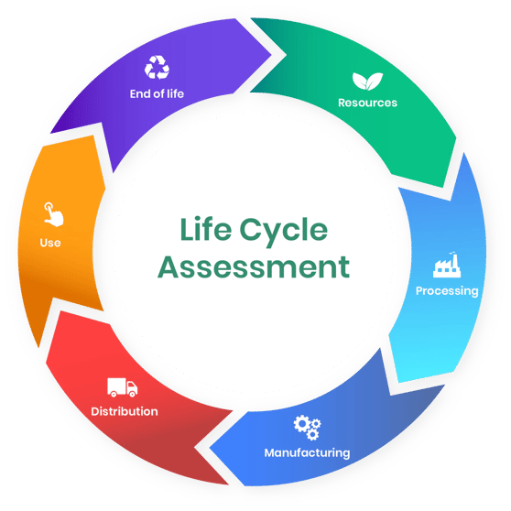
Life Cycle Assessment
1️⃣ Raw Material Extraction
2️⃣ Material Processing
3️⃣ Manufacturing/Construction
4️⃣ Use Phase
5️⃣ End-of-Life
https://oneclicklca.com/
Notes:
To apply the LCA framework directly to a familiar material.
This slide breaks down the life cycle of a brick into five distinct phases, from raw material extraction to its end-of-life. This makes the abstract concept of LCA concrete and relatable, showing participants how to apply it to a real-world product.

Slide 11
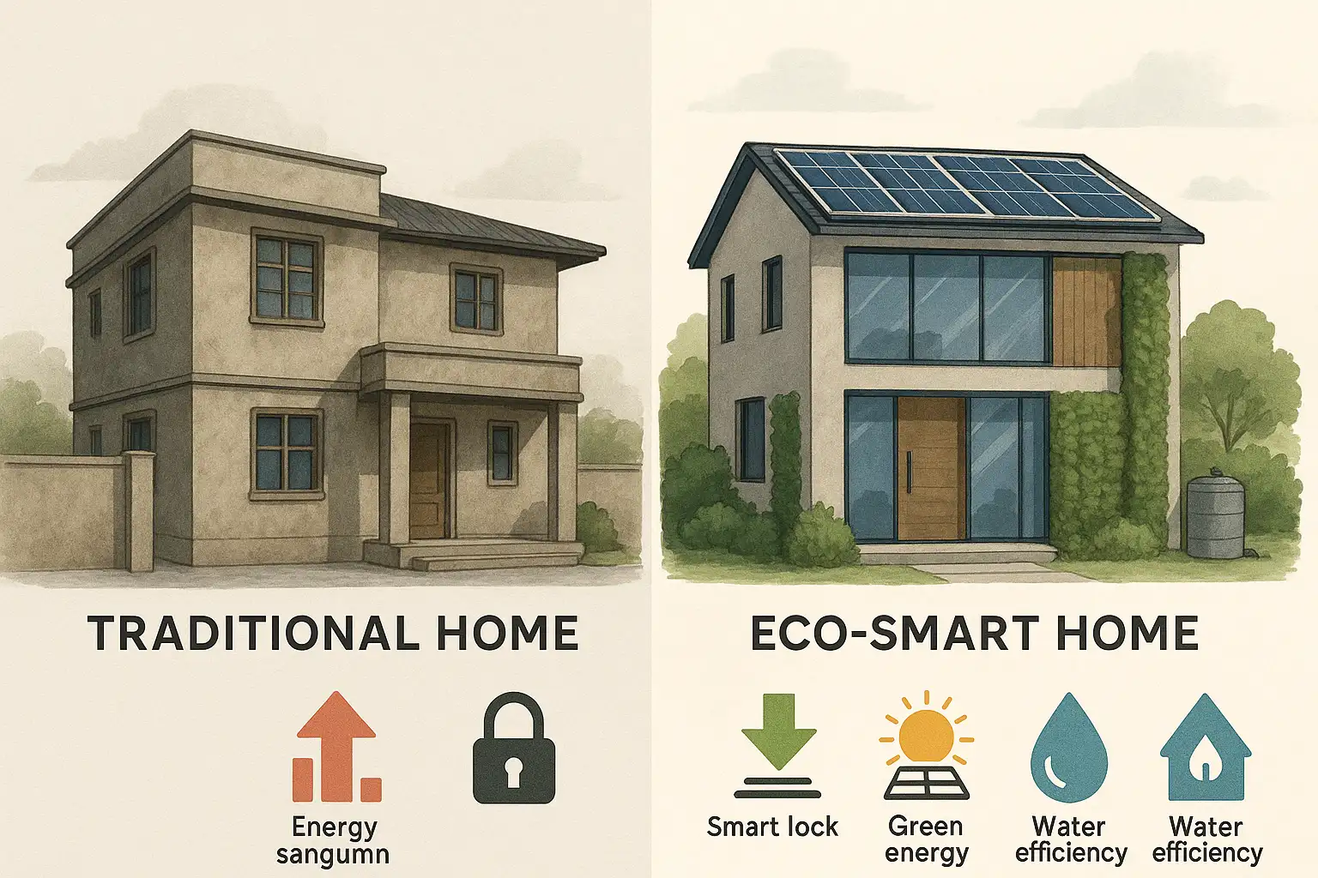
🏠 LCA Example: Traditional vs. Eco-House
1️⃣ Raw Material Extraction
Traditional House:
  Cement made from limestone (heavy mining, high CO₂).
  Steel from iron ore mining.
  Asphalt roofing from petroleum.
Eco-House:
  Sustainable wood from responsibly managed forests.
  Recycled plastic for parts.
  Soil & plants for green roof.
Source: www.housinginindia.com
Notes:
👉 Ask students: Which materials are renewable? Which are finite?

Slide 12
🏠 LCA Example: Traditional vs. Eco-House
2️⃣ Material Processing
Traditional House:
  Cement kilns = very energy-intensive, high CO₂.
  Steel smelting = large carbon footprint.
  Long transport distances for heavy materials.
Eco-House:
  Insulation made from recycled paper or natural fibers.
  Solar panel materials refined.
  Locally sourced soil/vegetation.
Source: www.housinginindia.com
Notes:
👉 Prompt: How does local vs. global sourcing affect sustainability?

Slide 13
🏠 LCA Example: Traditional vs. Eco-House
3️⃣ Manufacturing/Construction
Traditional House:
  Energy-intensive construction machinery.
  Cement and steel require heavy equipment.
  Lots of on-site waste during building.
Eco-House:
  Modular, lightweight assembly.
  Designed for disassembly → less waste.
  Smaller carbon footprint in assembly.
Source: www.housinginindia.com
Notes:
👉 Ask: Why is “design for disassembly” important?

Slide 14
🏠 LCA Example: Traditional vs. Eco-House
4️⃣ Use Phase
Traditional House:
  Electricity from fossil fuels (coal, oil, gas).
  High energy demand for cooling/heating (poor insulation).
  Roof absorbs heat → hotter indoors (urban heat island effect).
Eco-House:
  Solar panels generate clean electricity for lights and pump.
  Green roof provides natural insulation + cooling.
  Rainwater absorption reduces flood risk.
Source: www.housinginindia.com
Notes:
👉 Prompt: How much energy could be saved over 50 years?

Slide 15
🏠 LCA Example: Traditional vs. Eco-House
5️⃣ End-of-Life
Traditional House:
  Demolition → most materials go to landfill.
  Difficult to separate cement, steel, and plastics.
Eco-House:
  Components (solar, insulation, wood panels) can be reused.
  Soil/plants → compost or replant.
  Plastics/metals recycled.
  Modular design makes recovery easier.
Source: www.housinginindia.com
Notes:
👉 Ask: Which house leaves behind waste? Which leaves behind resources?

Slide 16
🏠LCA Summary: Traditional vs. Eco-House
LCA Stage | Traditional House | Eco-House
1. Raw Materials | Cement, steel, asphalt | Wood, recycled plastics, soil/plants
2. Processing | Energy-heavy kilns, smelting | Recycled/natural insulation, solar panel refining
3. Construction | Energy-intensive, lots of waste | Modular, design for disassembly
4. Use Phase | Fossil electricity, poor insulation | Solar power, green roof insulation, water reuse
5. End-of-Life | Landfill, hard to recycle | Parts reused, recycled, composted
Notes:
To apply the LCA framework directly to a familiar material.
This slide breaks down the life cycle of a brick into five distinct phases, from raw material extraction to its end-of-life. This makes the abstract concept of LCA concrete and relatable, showing participants how to apply it to a real-world product.

Slide 17
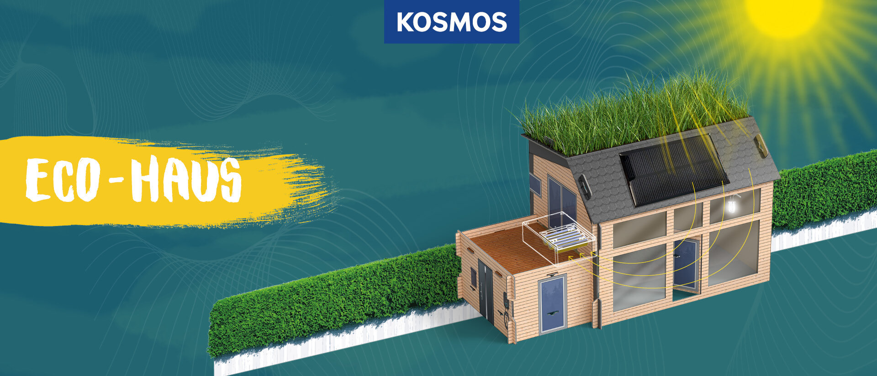
Introduction to Hands-on Activity
Objective: Build the Eco House
Materials:
  Eco house kit: Components: solar panel, LED, pump, felt roof, soil, plants.
www.kosmos.de
Notes:
To introduce the first practical task of the workshop.
This slide moves the session from theory to practice. It provides the objective and material list for the initial building activity, giving participants a clear starting point for their hands-on learning.

Slide 18
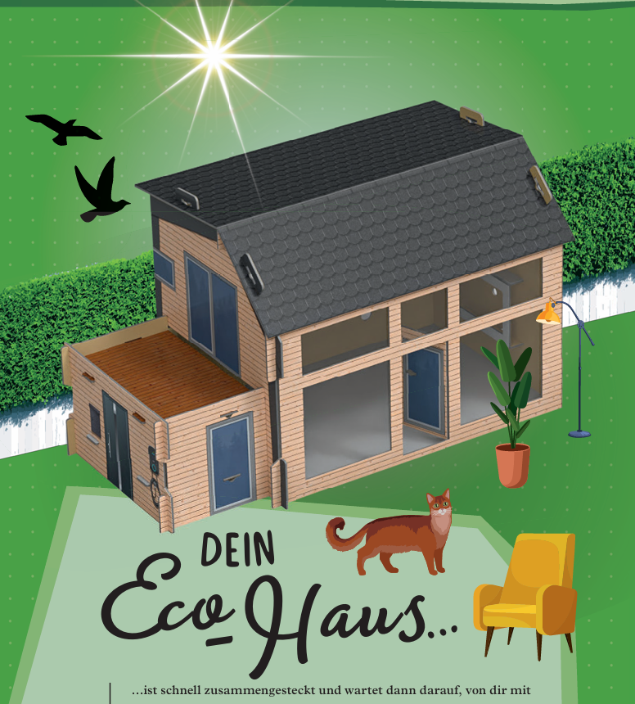
Hands-on Activity: Instructions
Build the Base House
Team topics:
  🌱 Team Rooftop Garden & Water Cycle
  🔆 Team Solar & Lighting
  ❄️ Team Cooling & Insulation
Pick one specialist team topic
www.kosmos.de
Notes:
To give specific, step-by-step instructions for building the wall.
This slide provides the technical details for the first activity, including the exact dimensions of the wall. The tip "Apply mortar carefully (less is better!)" is a subtle but critical instruction, as it directly impacts the next phase of the activity, disassembly.

Slide 19

Preparing for Presentations
Present the Eco House
Experiment Results
Circular Economy findings
LCA Insights
Source: https://www.shutterstock.com/
Notes:
To provide a clear structure for participants to share their results and insights.
This slide guides participants on what they need to present. It ensures they report not only on the physical outcome (the house and recovery percentage) but also on the conceptual understanding they gained (CE principle and LCA insight).

Slide 20
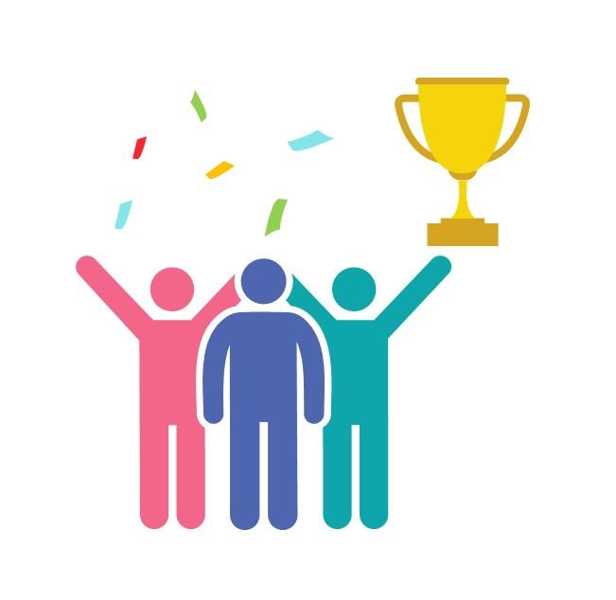
Awards
🏢 Best Build
📊 Best LCA Reflection
🤝 Best Team Collaboration
💡 Most Innovative Circular Economy Idea
Source: https://www.slideteam.net/
Notes:
To add an element of recognition and motivate participants.
The awards for Best LCA Reflection, Best Team Collaboration, and Most Innovative Circular Economy Idea celebrate different skills and contributions, encouraging a positive and collaborative atmosphere.

Slide 21
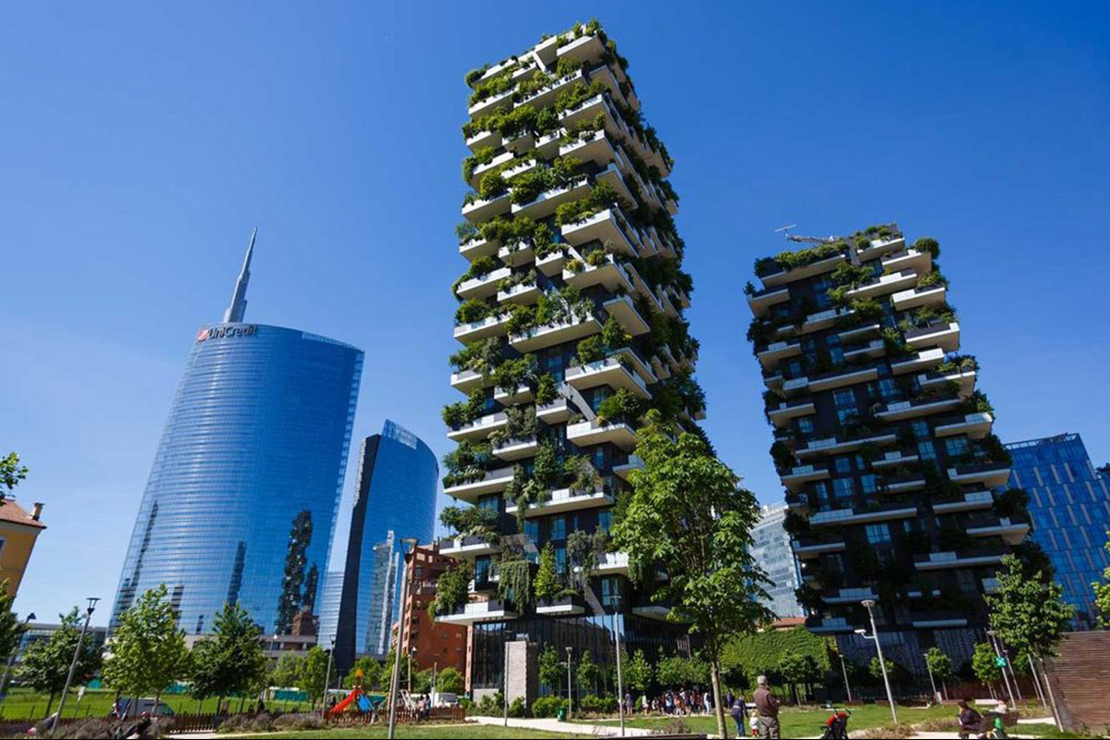
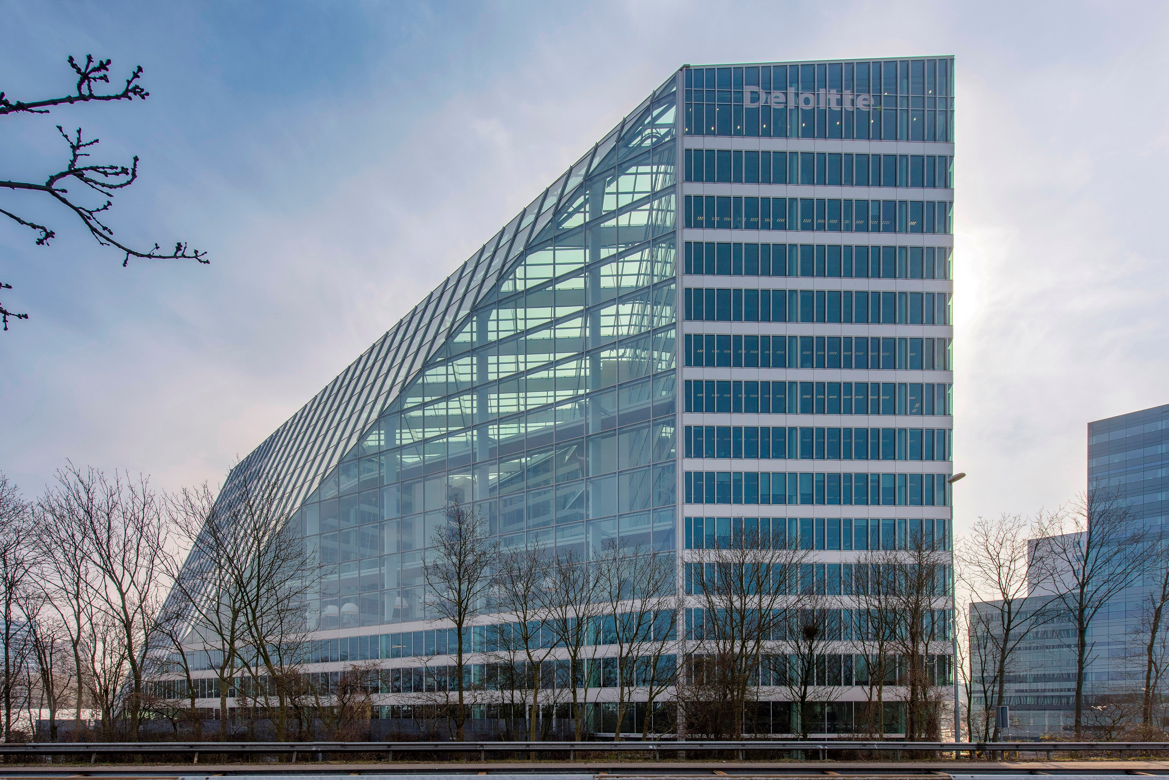
Real-World Inspiration
Bosco Verticale: Milan
The Edge: Amsterdam
https://youtu.be/eh1MxO-u7bU
https://youtu.be/JSzko-K7dzo
www.pedestal-eternoivica.com
www.archilovers.com
Notes:
To facilitate a final, open discussion and reflection.
This slide encourages participants to ask questions, share their ideas, and think critically about the concepts they learned. The "Challenge" question pushes them to think beyond the workshop's materials and apply their new knowledge to a broader context.

Slide 22

Any Questions? Let’s Discuss!
❓ Ask about anything unclear in the LCA or CE concepts
💭 Share your ideas for improving the activity or your product
Source: https://pngtree.com/
Notes:
To facilitate a final, open discussion and reflection.
This slide encourages participants to ask questions, share their ideas, and think critically about the concepts they learned. The "Challenge" question pushes them to think beyond the workshop's materials and apply their new knowledge to a broader context.

Slide 23
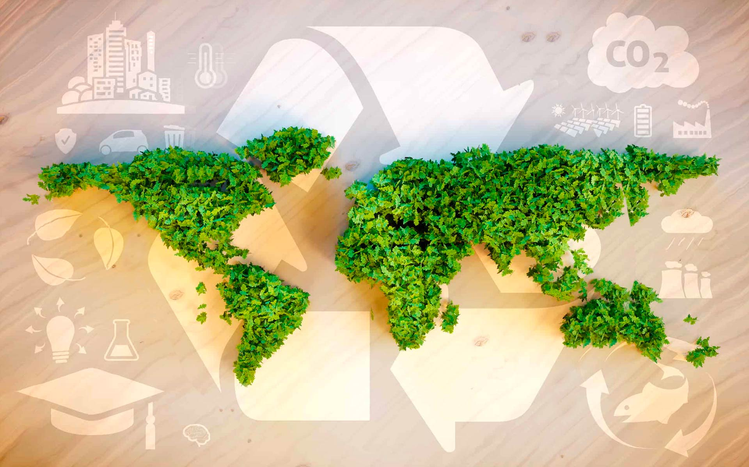
Thank You & Goodbye!
You are now an Eco Designer!
Keep thinking about materials and the planet
Source: www.fedongroup.com
Notes:
To end the workshop on an empowering and inspiring note.
The final message, "You are now an Eco Designer!," serves as a powerful validation of the participants' efforts and new skills. It leaves them with a call to action, encouraging them to continue thinking about sustainability in their daily lives.

