Slide 1


EDU-CIRC
Rete transfrontaliera per la formazione sull’economia circolare e la decarbonizzazione nella produzione
Grenzübergreifendes Netzwerk zur Aus- und Weiterbildung in Kreislaufwirtschaft und Dekarbonisierung in der Produktion
Europa noch näher
Un’Europa più vicina

Slide 2
Bricks with a Past
🧱 🏗️ 🔄
THEME: CONSTRUCTION
Notes:
Our theme today is ‘Bricks with a Past’. These bricks aren’t just construction materials – they carry stories from the earth, factories, and into homes, and maybe even into our future innovations through reuse.

Slide 3
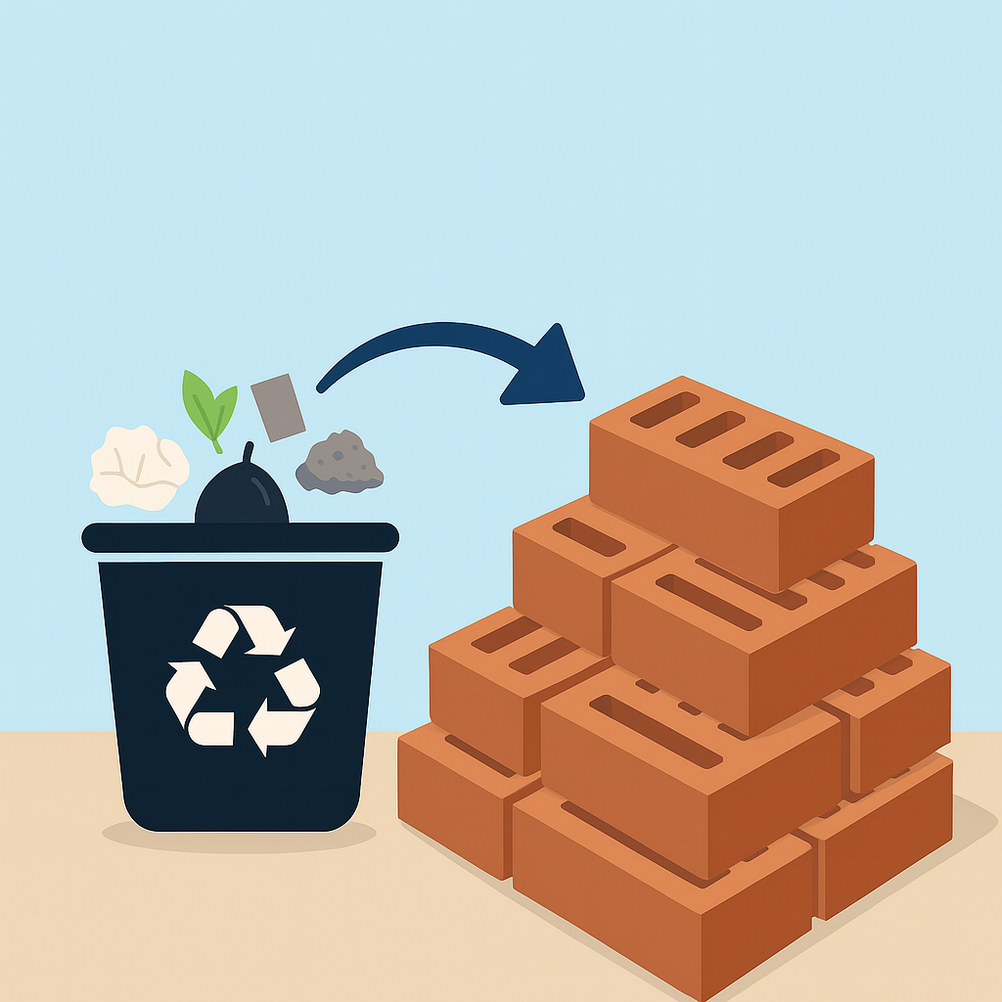
Welcome! – Bricks with a Past
Today, you're going to trace the life of a brick
  From the soil, through factories, into buildings, and maybe… even into trash or reuse!
Source: AI Generated
Notes:
Today, we’ll follow a brick's journey – from raw material to end-of-life. You'll get to think critically about its environmental impacts and imagine how we can make better choices as future designers, builders, or consumers.

Slide 4

Learning Objectives
Understand Life Cycle Assessment (LCA) and its stages
Compare environmental impacts of different brick types
Build and evaluate a model wall using LCA principles
Work in teams with assigned roles
Reflect on sustainability, functionality, and aesthetics
Notes:
Here’s what we aim to learn: understand Life Cycle Assessment, compare different brick types, and apply this knowledge in a team activity where you’ll build a model wall. We’ll also reflect on the balance between sustainability, strength, and aesthetics.

Slide 5
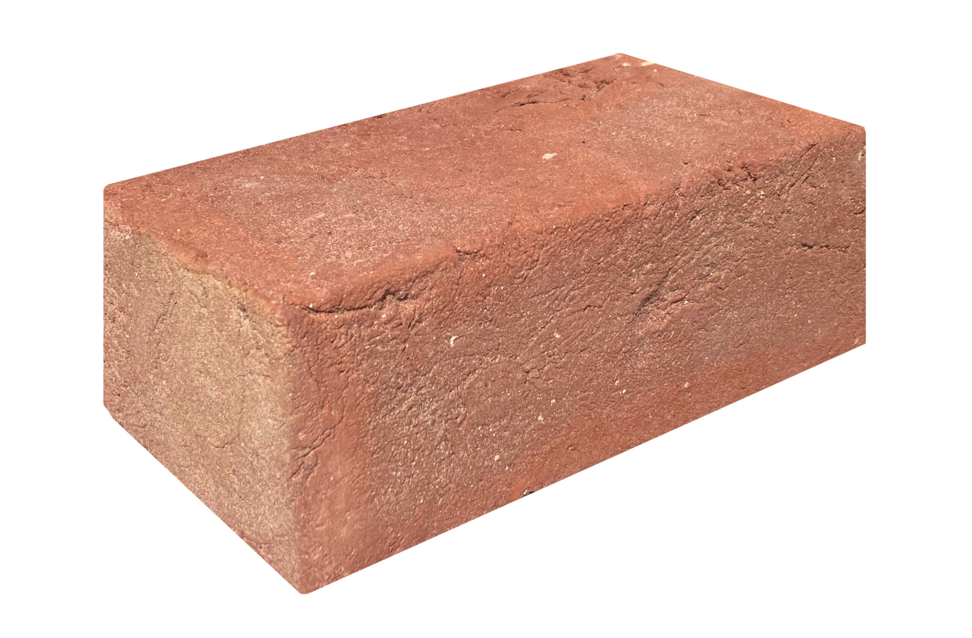
Quiz 1 - What’s in a Brick?
What material is most used to make traditional red bricks?
  Clay
  Sand
  Wood
  Plastic
✅ Answer: Clay
Clay is dug from the ground and then fired in kilns at high temperatures to harden.
Source: www.obi.at
Notes:
Let’s warm up with a quiz. What’s the most common material in red bricks? It’s clay – dug from the earth and hardened in kilns. This gives us our first clue about where environmental impact begins.

Slide 6
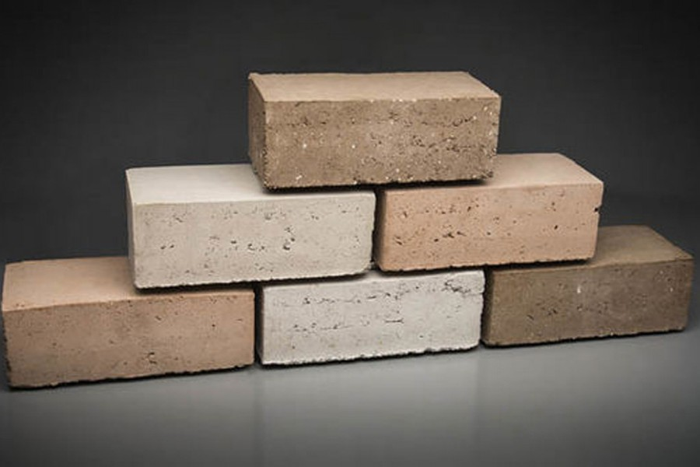
Quiz 2 - What’s in a Brick?
Which brick type is usually the most environmentally friendly to produce?
  Clay Brick
  Concrete Brick
  Recycled Plastic Brick
✅ Answer: Recycled Plastic Brick
These reuse waste plastic and need less energy to produce, but they’re usually weaker.
Source: www.thefinancialexpress.com
Notes:
Next question: Which type of brick is usually the most eco-friendly? Recycled plastic bricks! They reuse waste and need less energy, though they might lack the strength of traditional options.

Slide 7
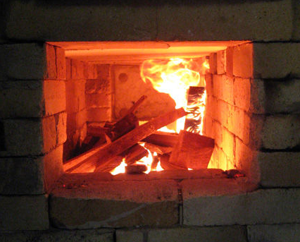
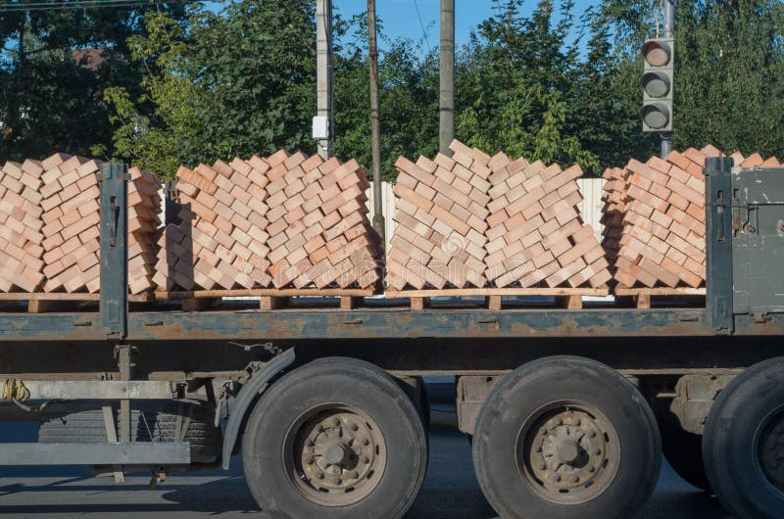
Quiz 3 - What’s in a Brick?
Which step in the brick production process contributes the most to carbon dioxide (CO₂) emissions?
  Painting the bricks
  Transporting the bricks
  Firing in a kiln (heating)
  Packaging bricks in plastic
✅ Answer: Firing in a kiln
Kilns use fossil fuels and produce lots of CO₂.
Source: www.katherinefortnumceramics.com
Source: www.dreamstime.com
Notes:
Which part of brickmaking emits the most CO₂? It’s firing in a kiln. This high-temperature step burns a lot of fossil fuel – a key area where innovation can reduce emissions.

Slide 8
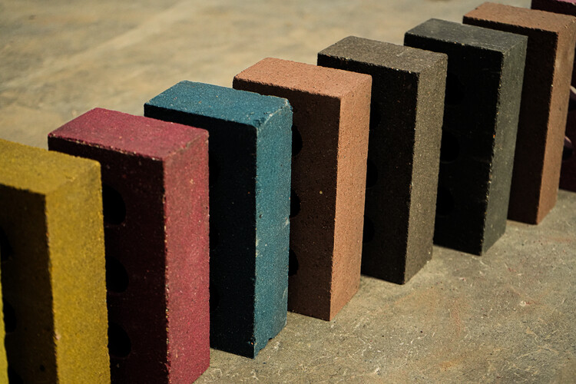
Quiz 4 - What’s in a Brick?
Which of these bricks is likely to use the most water in production?
  Clay Brick
  Concrete Brick
  Recycled Plastic Brick
✅ Answer: Clay Brick
The process of shaping and firing clay requires significant amount of water.
Source: www.archdaily.com
Notes:
Which brick type uses the most water? Clay bricks. Water is needed in shaping and firing – another area to watch in sustainable manufacturing.

Slide 9
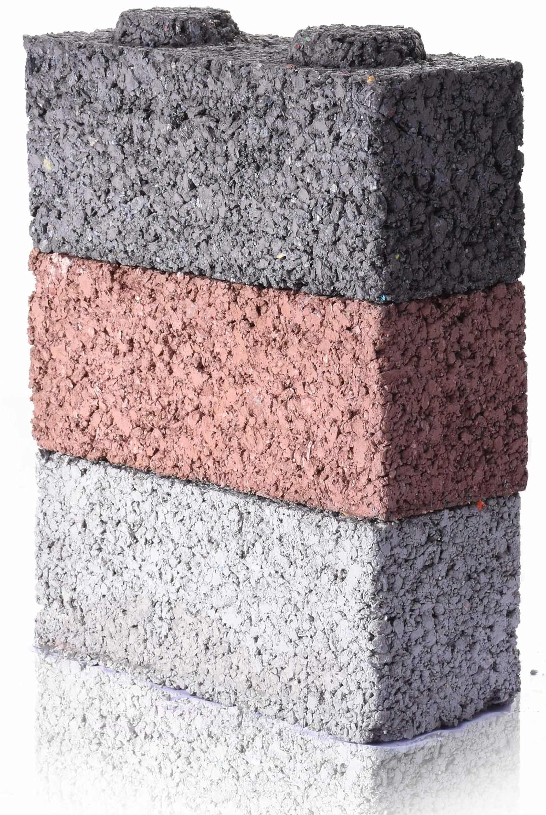
Quiz 5 - What’s in a Brick?
Which of these can be used to make eco bricks?
  Plastic Bricks
  Banana Leaves
  Eggshells
  All of the above
✅ Answer: All of the above
Innovative bricks can be made using bio-based or recycled materials
Source: www/agriculture.com.ph
Notes:
Can eco bricks be made from plastic, banana leaves, eggshells? Actually – all of the above! Eco bricks embrace reuse and biomaterials, showing that innovation in sustainability starts with imagination.

Slide 10
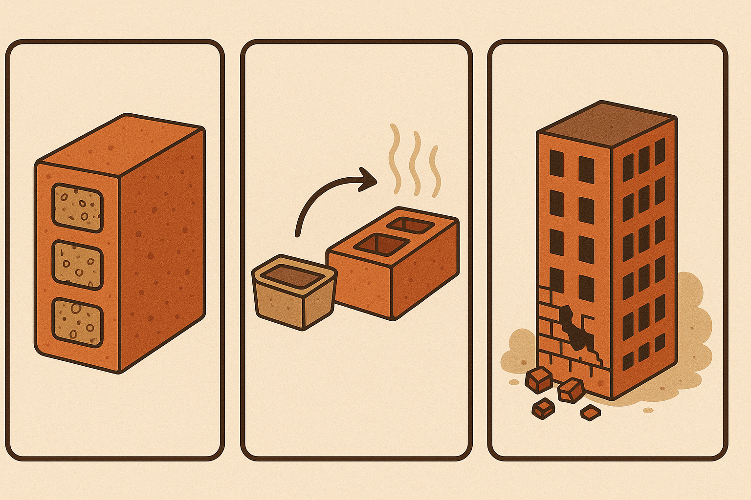
Life Cycle Assessment - Introduction
🔎 Have you ever asked...
  “What’s really inside a brick?”
  “How was this brick made?”
  “What happens to a brick when a building is knocked down?”
Source: AI Generated
Notes:
Have you ever thought about what’s really inside a brick? How it’s made or where it ends up after demolition? These are the kinds of questions we explore through Life Cycle Assessment, or LCA.

Slide 11
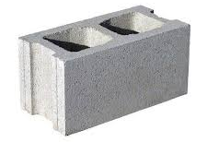
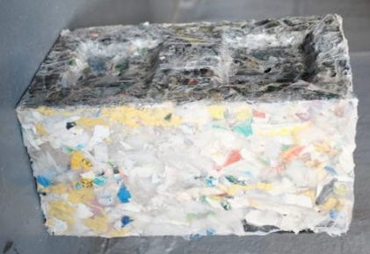
Life Cycle Assessment - Introduction
🎬Story of a Clay Brick
  How It's Made: Clay Bricks
🎬Story of a Concrete Bricks
  How It's Made: Concrete Bricks
🎬Story of an Eco Bricks
  How It's Made: Eco Bricks 1
  How It's Made: Eco Bricks 2
Source: www.obi.at
Source: www. brickcart.in
Source: www.designindaba.com
Notes:
Let’s now explore how different types of bricks are made. These three short video stories show us how clay, concrete, and eco bricks go through their life cycle. Pay attention to raw materials, energy used, and the process of shaping and curing.

Slide 12
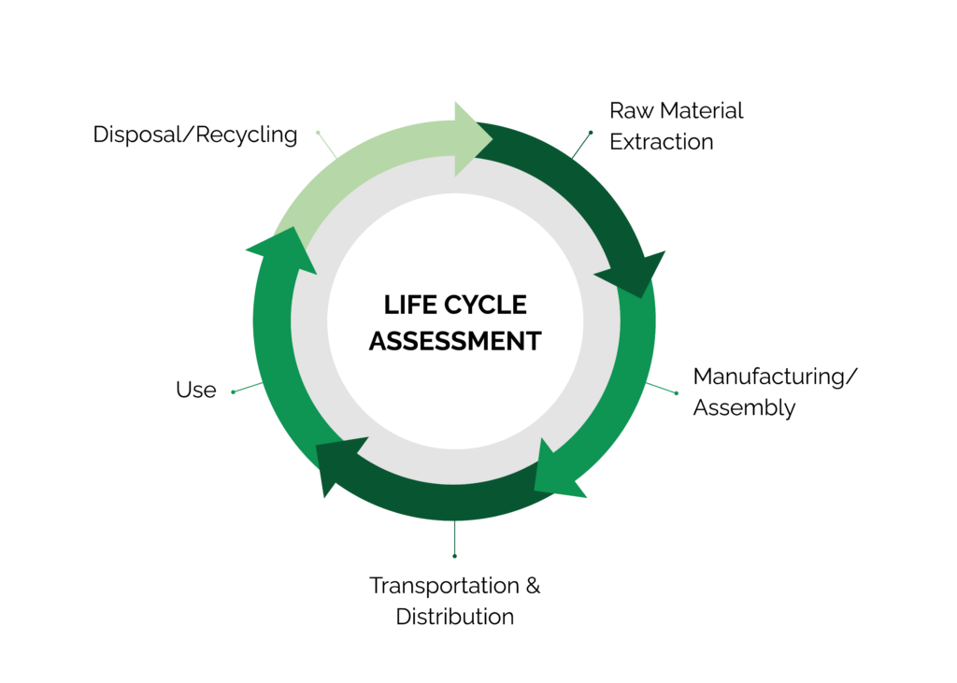
Life Cycle Assessment - Introduction
🌍 That’s what LCA helps us figure out!
  Life Cycle Assessment (LCA) : Tracking a brick’s full journey and measuring its impact on the planet.
Source: www.stich.culturalheritage.org
Notes:
This is where Life Cycle Assessment, or LCA, comes in. LCA helps us measure the total environmental impact of a product like a brick—from the extraction of materials to its final disposal. It’s a way to understand the full story of a product's footprint.

Slide 13
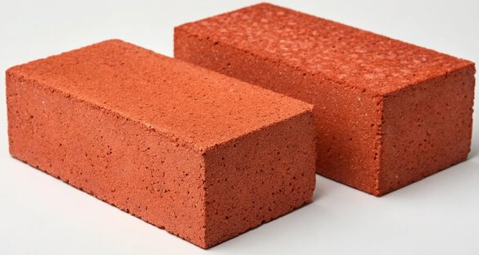
Life Cycle Assessment – Clay Bricks
Raw Materials – Clay dug from the ground or plastic collected from recycling
Processing – Mixing with water, shaping the brick
Manufacturing – Fired in hot kilns or molded in factories
Use Phase – Used in walls, pavements, buildings
End-of-Life – Crushed as rubble, reused, or thrown into landfills
Source: www.stock.adobe.com
Notes:
For clay bricks, we start with digging up clay, then mix it with water, mold it, and fire it in kilns. This process uses a lot of energy and water. After use, it can be crushed, reused, or thrown away. Think about where the most impact happens here.

Slide 14
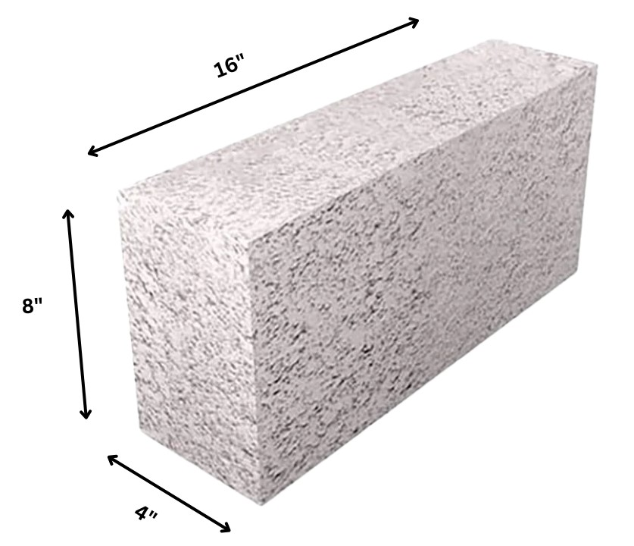
Life Cycle Assessment – Concrete Bricks
Raw Materials - Cement, sand, gravel, and water are sourced locally
Processing - Ingredients are proportioned and mixed to form concrete
Manufacturing - Poured into molds and cured naturally or with steam
Use Phase - Applied in construction like walls, pavements, and foundations
End-of-Life - Demolished and reused as aggregate or sent to landfills
Source: https://www.realthinbrick.com
Notes:
Concrete bricks are made from sand, gravel, cement, and water. These materials are mixed and poured into molds, then cured. Unlike clay, they don’t require high heat but still use resources like cement which has a high carbon footprint.

Slide 15
Life Cycle Assessment – Eco Bricks
Raw Materials - Plastic waste and sometimes sand or earth, collected from households or landfills
Processing - Waste is cleaned, dried, and compacted into molds
Manufacturing - Bricks made by molding plastic into solid forms
Use Phase - Used in walls, furniture, paths, and insulation in sustainable builds
End-of-Life - Reused in non-structural roles; reduces landfill plastic but hard to recycle
Source: www.designindaba.com
Notes:
Eco bricks use plastic waste – a great way to keep plastic out of landfills. They're cleaned, dried, and compacted into bricks. Though not strong enough for big buildings, they’re great for paths or furniture. Their end-of-life recycling can be tricky.

Slide 16
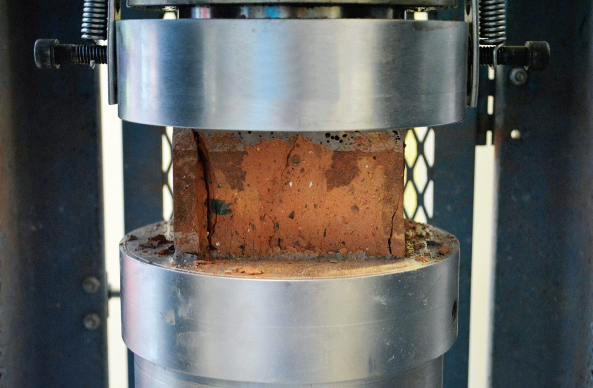
Life Cycle Assessment - Introduction
How Strong is a Brick?
Real-World Compression Test
Brick Type | Average Strength (MPa)
Clay Brick (fired) | 10–20 MPa
Concrete Brick | 5–15 MPa
Recycled Plastic Brick | 3–7 MPa
Source: https://happho.com/determine-compresive-strength-brick/
Notes:
Now let’s look at how strong different bricks are. A real-world compression test tells us how much force a brick can withstand. Strength is important when choosing bricks, especially when balancing it with sustainability.

Slide 17
Life Cycle Assessment - Introduction
Brick Type | CO₂e (kg) | Energy (MJ) | Water (L) | Strength (MPa) Measured | LCA Points Calculated
Fired Clay Brick | 5.502 ^{[1]} | 4.250 ^{[1]} | 2.02 ^{[2]} |  | 8.0
Concrete Brick | 2.3 - 3.8 ^{[3]} | 21.75 ^{[4] [5]} | 0.364 ^{[6]} |  | 6.0
Eco Brick(Recycled Plastic) | 0.0065 ^{[7]} | 0.54-3.14 ^{[8]} | negligible ^{[9]} |  | 3.0
Notes:
These are the sources behind what we’ve learned today. From academic studies on LCA to technical papers on water use and strength, these show how bricks differ in environmental impact. All findings are rooted in credible scientific literature.

Slide 18
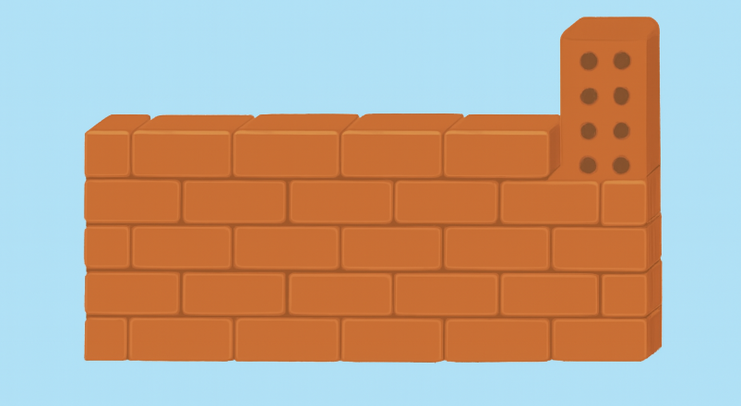
Activity Time! Build Your Wall
Your challenge: Build a Strong and Sustainable wall.
Use model bricks (clay, concrete, eco-recycled plastic).
Balance environmental impact (eco points) and strength.
Follow the design rules
Source: AI Generated
Notes:
Now it’s your turn to design! Use the LCA knowledge to build a model wall. Choose from clay, concrete, or eco bricks. Your goal is to balance strength and sustainability. Use the eco points wisely.

Slide 19

Activity Time! Build Your Wall
Use at least 40 bricks in total.
Stay under 150 Eco Points (your LCA budget).
Your wall must score at least Strength 80.
Max width: 30 cm (15 bricks wide).
Brick Type & Color | Strength (MPa) Measured | LCA Points
Fired Clay Brick : Red |  | 8.0
Concrete Brick : Black |  | 6.0
Eco Brick(Recycled Plastic): Green |  | 3.0
Notes:
You must use at least 40 bricks, keep your eco points under 150, and reach a strength score of 80. You can’t exceed 15 bricks in width. Be strategic – each brick type has a different point cost and strength.

Slide 20


Activity Time! Build Your Wall
Surprise Event Cards
Plastic Shortage - Max 10 recycled bricks allowed.
Recycled Subsidy - Recycled bricks cost only 2 points!
Clay Ban - Clay bricks are unavailable temporarily.
Bonus
Use all 3 brick types = 5 bonus points!
Notes:
To make it more exciting, surprise events will challenge your plan! For example, a plastic shortage may limit eco bricks, or you might get a subsidy that makes them cheaper. Adapting to these changes is part of sustainable design thinking!

Slide 21

Activity Time! Build Your Wall
Prepare Your Poster
Show your chosen bricks and explain why you used them.
List your total Eco Points and Strength Score.
Include a photo or sketch of your wall design.
Explain your trade-offs: strength vs. sustainability.
Pitch your poster and design to the class!
Source: www.srdalvifoundation.com
Notes:
As the last part of your activity, prepare a poster that presents your wall. Explain your material choices and why you used them. Show your final eco points and strength score. Include a photo or drawing of your wall design. Most importantly, reflect on the trade-offs you made between strength and environmental impact. Then, present your design to the class as if you're pitching a real-world sustainable solution.

Slide 22
References
[1] M. Dabaieh, J. Heinonen, D. El-Mahdy, and D. M. Hassan, “A comparative study of life cycle carbon emissions and embodied energy between sun-dried bricks and fired clay bricks,
”Journal of Cleaner Production, vol. 275, p. 122998, Dec. 2020, doi: 10.1016/j.jclepro.2020.122998.
[2] G. Skouteris, “Water Footprint and Water Pinch Analysis Techniques for Sustainable Water Management in the Brick-Manufacturing Industry”.
[3] M. H. Alzard, H. El-Hassan, and O. Najm, “Life Cycle Assessment of the Production of Concrete Masonry Units in the United Arab Emirates,” in Environment and Sustainable Development,
K. Ujikawa, M. Ishiwatari, and E. V. Hullebusch, Eds., in Environmental Science and Engineering. , Singapore: Springer Nature Singapore, 2024, pp. 137–149. doi: 10.1007/978-981-97-3320-0_11.
[4] [1]“Building Materials, Energy and the Environment: Towards Ecologically Sustainable Development,” BuildingGreen, Apr. 1997. https://www.buildinggreen.com/newsbrief/
building-materials-energy-and-environment-towards-ecologically-sustainable-development
[5] M. Mrmos, “How Much Does a Brick Weigh? Common Types Compared,” Realthinbrick , Nov. 17, 2024. https://www.realthinbrick.com/post/how-much-does-a-brick-weigh
‌[6] A. P. Meurer, R. A. Amorim, L. C. Quintanilha, and D. C. Parente, “Reuso de efluentes na fabricação de blocos de concreto para alvenaria de vedação,” Revista de la Asociación Latinoamericana de Control de Calidad, Patología y Recuperación de la Construcción, vol. 9, no. 2, pp. 215–227, Apr. 2019, doi: 10.21041/ra.v9i2.278.
[7] N. Ashraf, O. D. El-Monayeri, and H. A. Hassan, “Lego-like Bricks Manufacturing Using Recycled Polyethylene (PE) and Polyethylene Terephthalate (PET) Waste in Egypt,” Sustainability, vol. 16, no. 19, p. 8567, Oct. 2024, doi: 10.3390/su16198567.
[8] M. M. Barros, M. F. L. De Oliveira, R. C. Da Conceição Ribeiro, D. C. Bastos, and M. G. De Oliveira, “Ecological bricks from dimension stone waste and polyester resin,” Construction and Building Materials, vol. 232, p. 117252, Jan. 2020, doi: 10.1016/j.conbuildmat.2019.117252.
[9] Although exact figures for water use in eco-brick manufacturing are not published, the omission in LCAs and the minimal processing
required support the classification of water usage as negligible.
Notes:
Congratulations! You've now applied real-world tools to design sustainably. Whether you're an engineer, architect, or citizen, understanding life cycles helps us reduce waste and protect our planet. Go forth and design with purpose. Thank you for your creativity and engagement!

Slide 23
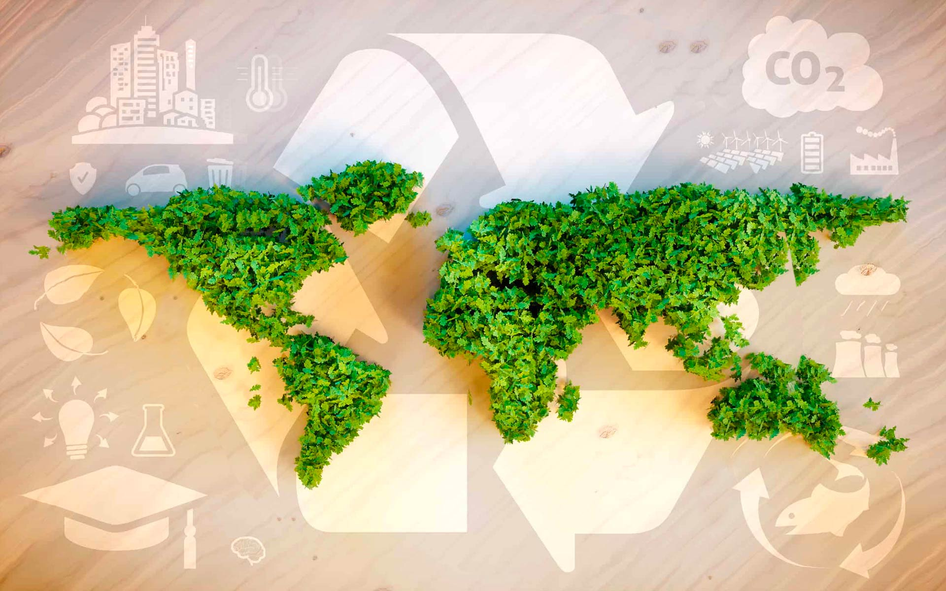
Thank You & Goodbye!
You are now an Eco Designer!
Go forth and design with the planet in mind!
Source: www.fedongroup.com
Notes:
Congratulations! You've now applied real-world tools to design sustainably. Whether you're an engineer, architect, or citizen, understanding life cycles helps us reduce waste and protect our planet. Go forth and design with purpose. Thank you for your creativity and engagement!

