Slide 1


EDU-CIRC
Rete transfrontaliera per la formazione sull’economia circolare e la decarbonizzazione nella produzione
Grenzübergreifendes Netzwerk zur Aus- und Weiterbildung in Kreislaufwirtschaft und Dekarbonisierung in der Produktion
Europa noch näher
Un’Europa più vicina

Slide 2
Modular Steel in the Circular Economy
THEME: CONSTRUCTION

Slide 3

Workshop Objectives
See the difference between steel reuse vs. recycling.
Learn how Design for Disassembly enables reuse.
Recognize environmental benefits through LCA thinking.
Apply CE concepts to real-world construction.
Notes:
To clearly state the four main goals of the workshop
This slide acts as a roadmap, breaking down the overarching theme into specific, actionable learning outcomes. It guides participants from conceptual understanding (CE principle) to practical application (design for disassembly), critical thinking (LCA thinking), and creative problem-solving (brainstorm real-world solutions).

Slide 4
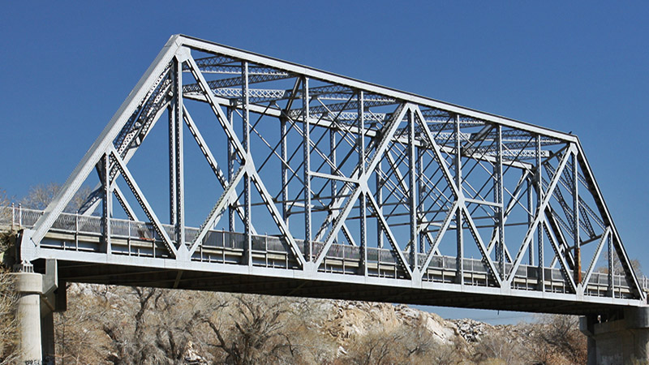
QUIZ
If a steel bridge is replaced, what happens to the steel?
  Melt into new steel
  Throw away
  Recycle
  Reuse
📽️Steel Truss Bridge Demolition
Source: www.route66ca.org
Notes:
💬 Discuss → Link answers to CE challenge.

Slide 5
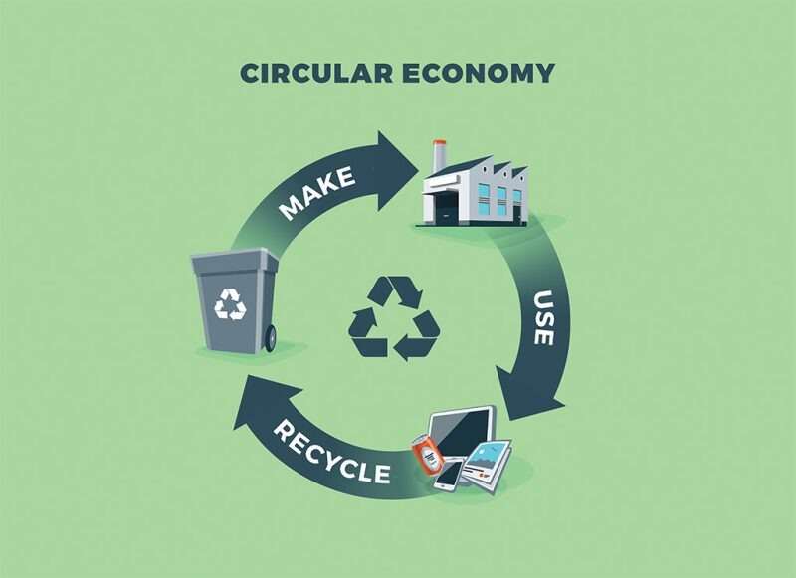
What is Circular Economy (CE)?
Definition:
A system where products, materials, and resources are kept in use for as long as possible.
📽️ Circular Economy
Source: https://jpt.spe.org/
Notes:
To define the core concept of the entire workshop.
This slide provides the fundamental definition of a circular economy: a system that keeps products and resources in use as long as possible. The simple, circular visual reinforces the idea of a closed loop, contrasting with the linear model.

Slide 6
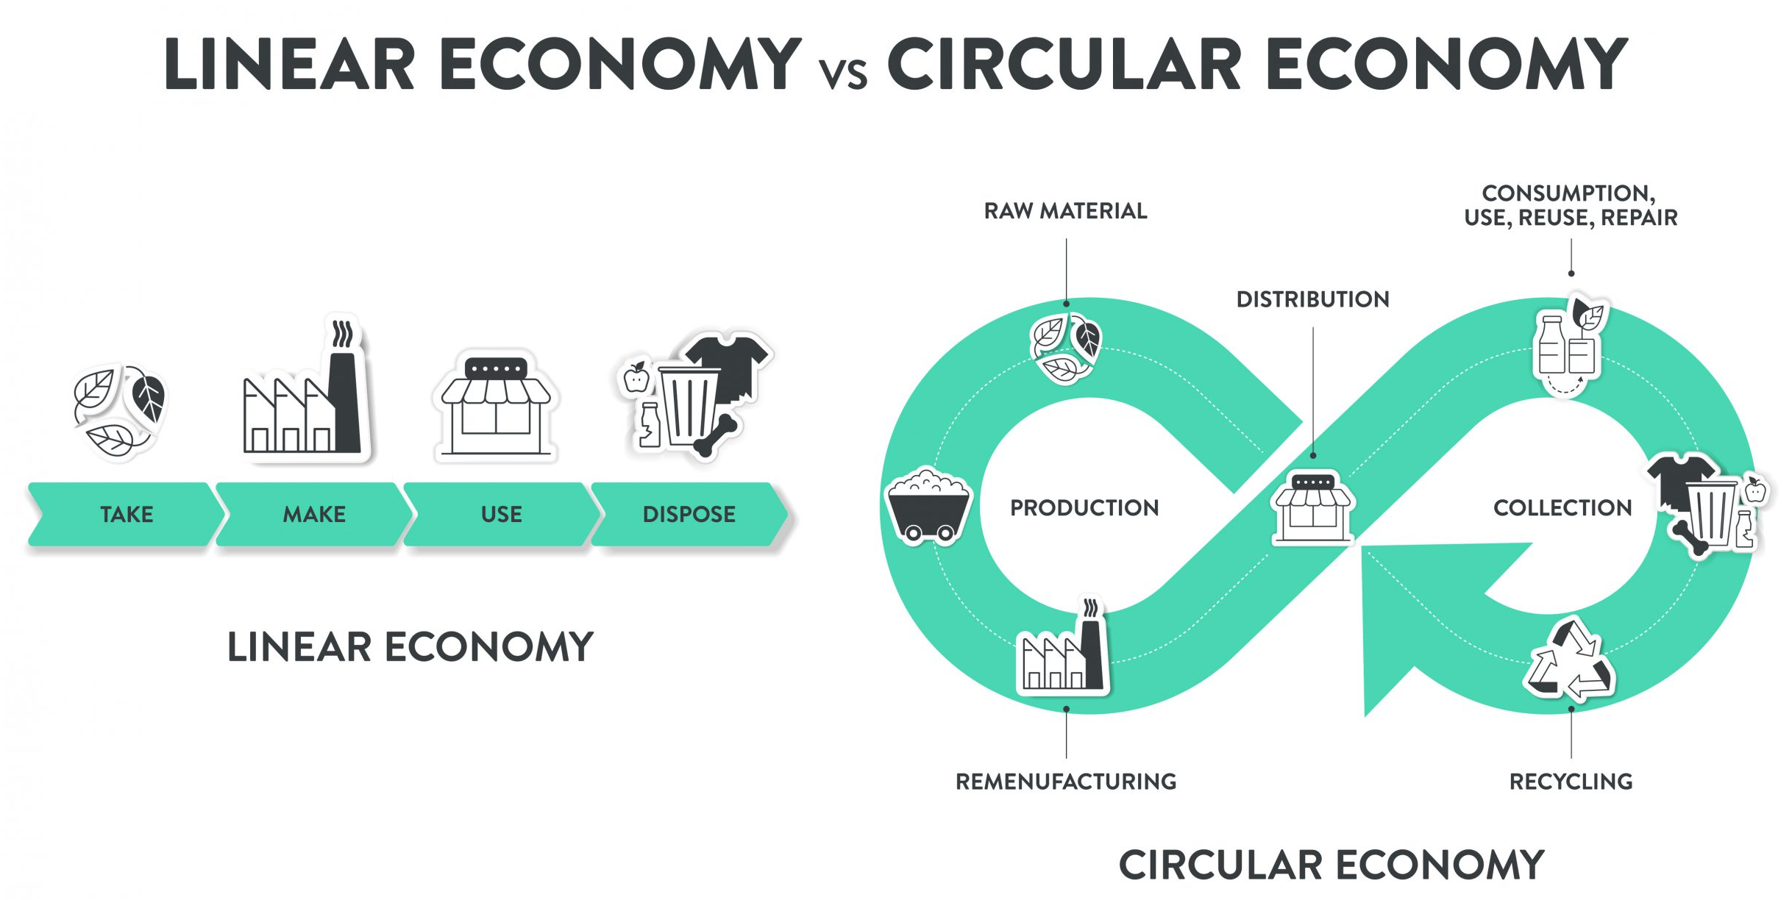
Linear vs Circular Economy:
How does the video illustrate the difference between a linear and a circular economy?
Source: https://www.technikum-wien.at/
Notes:
To visually and conceptually differentiate between the two economic models.
This slide highlights the difference between the wasteful "Take, Make, Use, Dispose" linear model and the sustainable, continuous loop of a circular economy. The side-by-side comparison makes the contrast clear and helps participants understand the need to transition to a circular system.

Slide 7
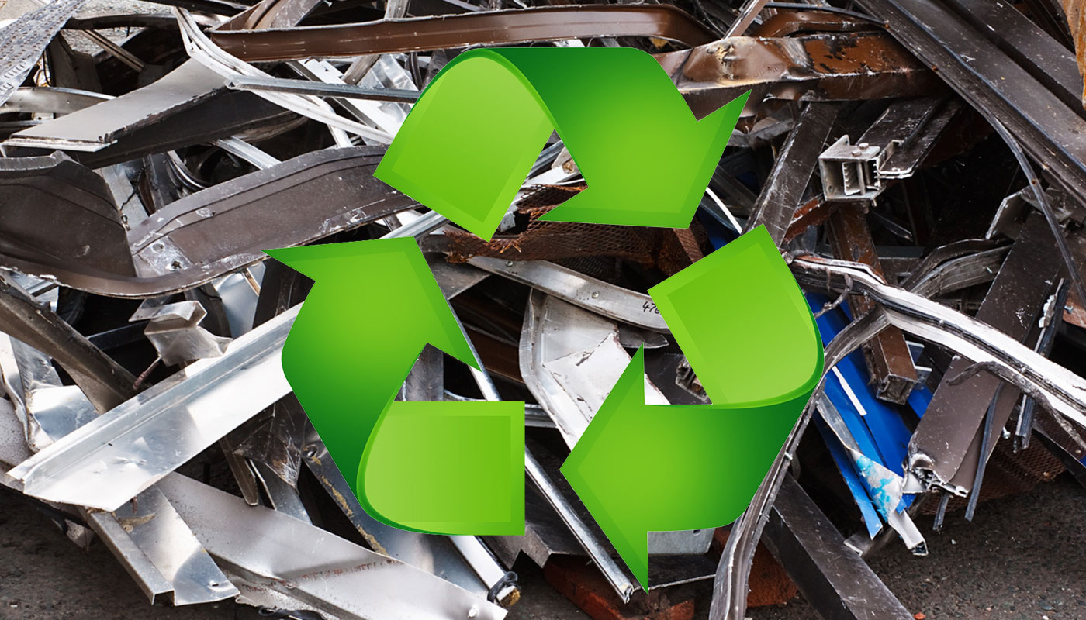
Steel in the Circular Economy
📽️Process of Metal Recycling
Steel is infinitely recyclable, but recycling = melting → high energy + CO₂.
Many structures are welded, making reuse difficult.
Source: www.recyclingdepotadelaide.com.au
Notes:
To justify the importance of adopting a circular model by outlining its benefits.
This slide broadens the scope of the discussion by detailing the positive impacts of a circular economy on the environment, the economy, and society. It provides a compelling reason for participants to engage with the workshop's content by showing how these principles can create a better world.

Slide 8
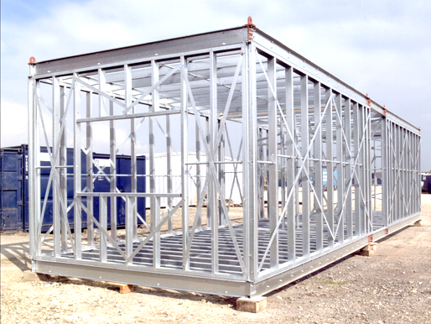
Steel in the Circular Economy
Design for Disassembly (DFD):
Use bolts, clamps, modular connectors → enables reuse.
📽️ Modular House in 6 Minutes
www.steelconstruction.info
Notes:
To justify the importance of adopting a circular model by outlining its benefits.
This slide broadens the scope of the discussion by detailing the positive impacts of a circular economy on the environment, the economy, and society. It provides a compelling reason for participants to engage with the workshop's content by showing how these principles can create a better world.

Slide 9
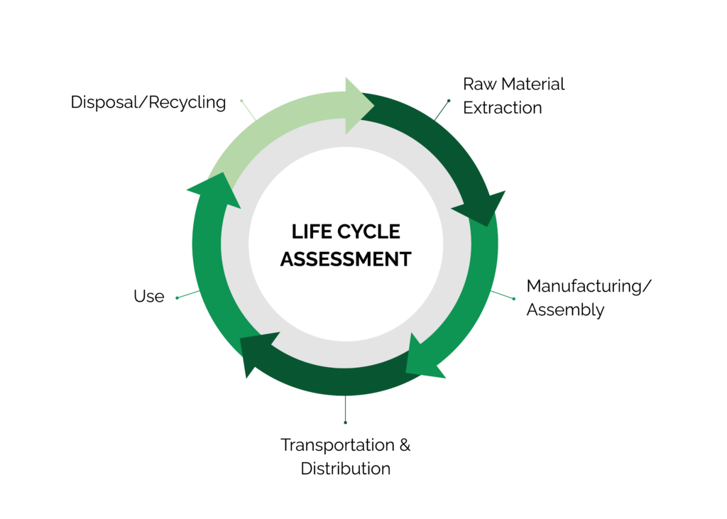
Life Cycle Assessment (LCA) – Introduction
What is LCA? : A method to assess the environmental impacts of a product throughout its life cycle
Source: www.stich.culturalheritage.org
Notes:
To introduce the concept of Life Cycle Assessment as a key analytical tool.
LCA provides a systematic method for measuring a product's environmental impact across its entire lifespan. This slide defines it, preparing the audience to use it as a framework to evaluate their own building project.

Slide 10
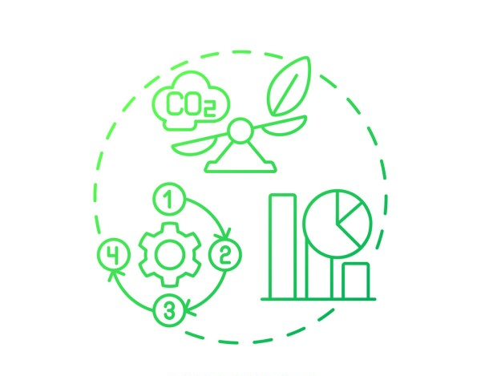
Importance of LCA
Purpose: Helps identify areas to reduce environmental footprint
Application: Guides design choices for more sustainable products
Source: https://www.list.lu/fileadmin/files
Notes:
To explain the practical application and significance of LCA.
This slide clarifies that LCA is not just a theoretical concept; it's a tool used to guide decision-making toward more sustainable products. It helps identify "hot spots" in a product's life cycle where the most environmental impact occurs.

Slide 11
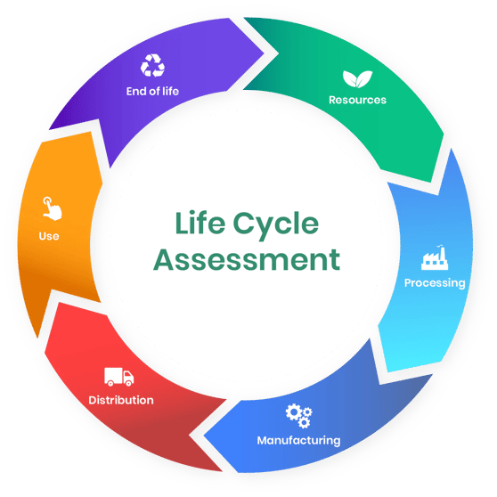
Life Cycle Assessment
1️⃣ Raw Material Extraction
2️⃣ Material Processing
3️⃣ Manufacturing/Construction
4️⃣ Use Phase
5️⃣ End-of-Life
https://oneclicklca.com/
Notes:
To apply the LCA framework directly to a familiar material.
This slide breaks down the life cycle of a brick into five distinct phases, from raw material extraction to its end-of-life. This makes the abstract concept of LCA concrete and relatable, showing participants how to apply it to a real-world product.

Slide 12
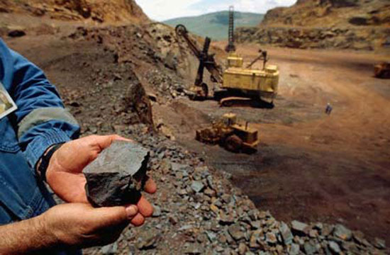
🏗️ Life Cycle of Steel (LCA)
1️⃣ Raw Material Extraction
What happens : Mining of iron ore, coal, limestone.
Impacts : Land disruption, biodiversity loss, CO₂.
CE Opportunity : Reuse steel, use scraps.
Source: https://u.osu.edu/
Notes:
💭 Student Question: “What is better for the planet—digging for new ore or reusing steel beams from old bridges?”

Slide 13
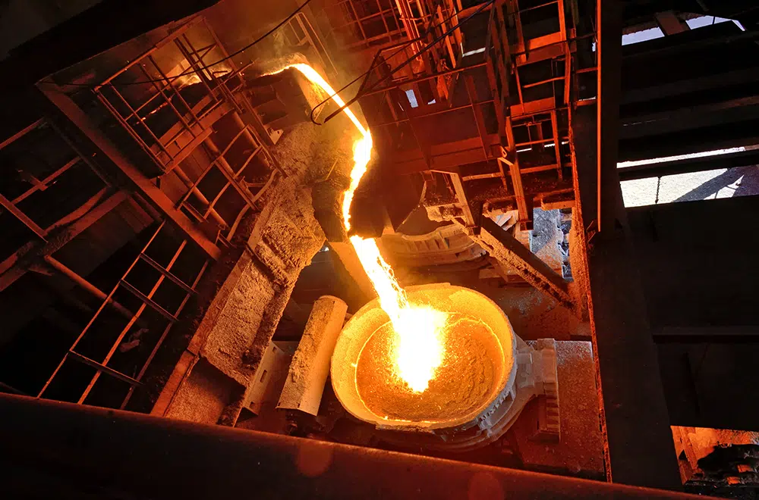
🏗️ Life Cycle of Steel (LCA)
2️⃣ Material Processing
What happens : Smelting, refining steel.
Impacts : High energy, high CO₂.
CE Opportunity : Skip stage by direct reuse.
Source: www.thecoaltrader.com
Notes:
💭 Student Question: “If we reuse beams directly, which entire stage of LCA can we avoid?”

Slide 14
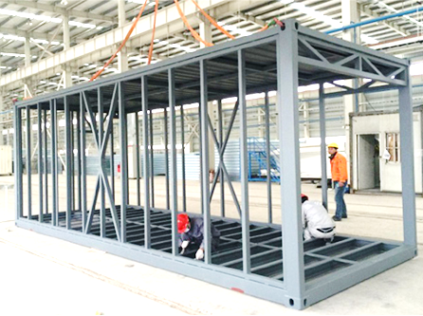
🏗️ Life Cycle of Steel (LCA)
3️⃣ Manufacturing/Construction
What happens : Cutting, welding, drilling, shaping steel.
Impacts : Welding = permanent joints
CE Opportunity : Bolts & modular connectors.
Source: www.gshousinggroup.com
Notes:
💭 Student Question: “Which would be faster to take apart later: welded or bolted joints?”

Slide 15
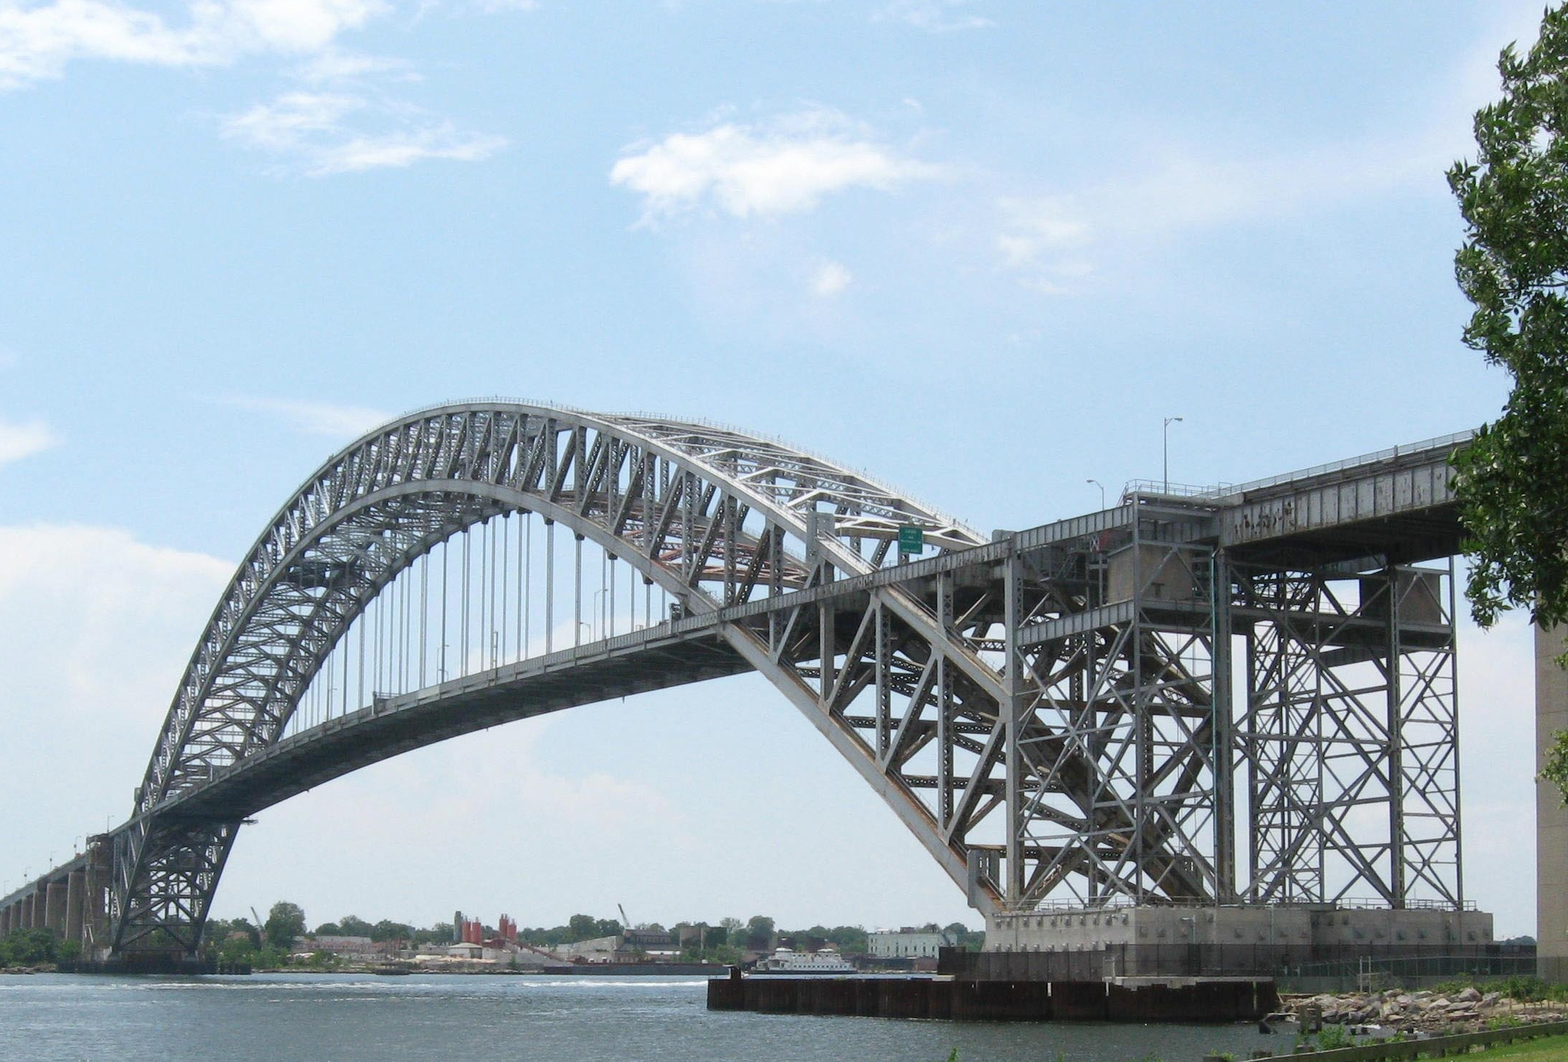
🏗️ Life Cycle of Steel (LCA)
4️⃣ Use Phase
What happens: Steel in bridges, cranes, buildings.
Impacts: Durable but repairs costly.
CE Opportunity: Modular systems for easy maintenance.
Source: https://en.wikipedia.org/
Notes:
💭 Student Question: “If one beam gets damaged, do we replace the whole bridge—or just that piece?”

Slide 16
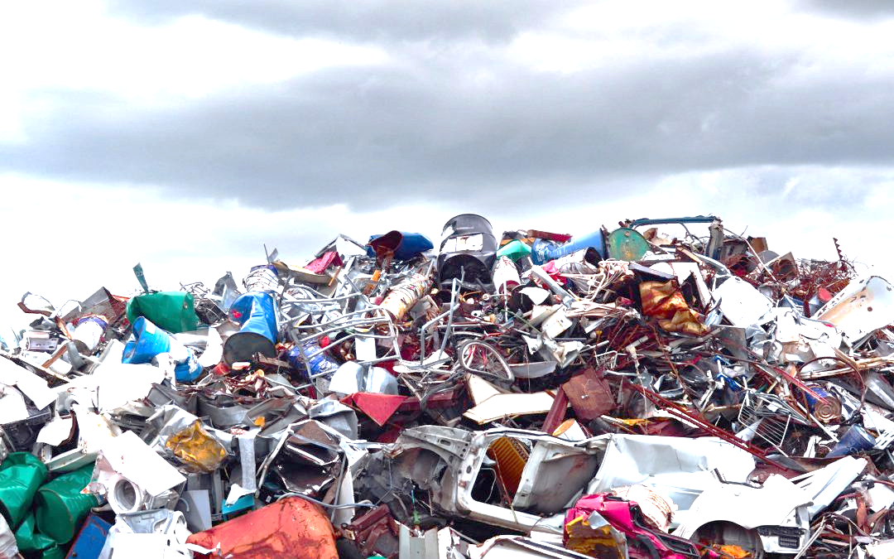
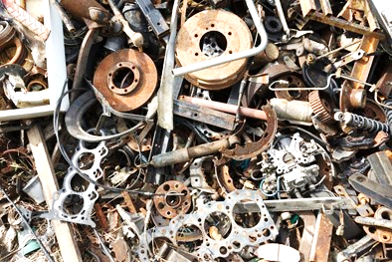
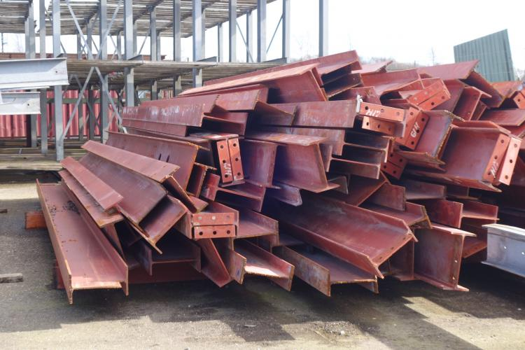
🏗️ Life Cycle of Steel (LCA)
5️⃣ End-of-Life
Traditional Path: Demolition, landfill.
Circular Path: Direct reuse, then recycle only if needed.
Source: https://trasmms.com/
Source: https://opalis.eu/
Source: https://opalis.eu/
Notes:
End-of-Life
Traditional Path: The traditional approach involves demolition and landfill disposal, which contributes to environmental degradation.
Circular Path: In the circular economy, materials are reused directly, and recycling is done only if necessary, promoting sustainability.
Why Metals End Up in Landfills:
Lack of Recycling Systems: Inadequate infrastructure may lead to metals being disposed of instead of recycled.
Contamination: Mixed materials make recycling difficult, especially when metals are contaminated with plastics or chemicals.
Cost of Recycling: Recycling metals can be expensive and energy-intensive, so disposal in landfills may be seen as more cost-effective.
End-of-Life Products: Many consumer goods containing metals are not properly recycled at their end-of-life.
Inadequate Sorting: Ineffective waste sorting processes can lead to metals being mixed with general trash.

Slide 17
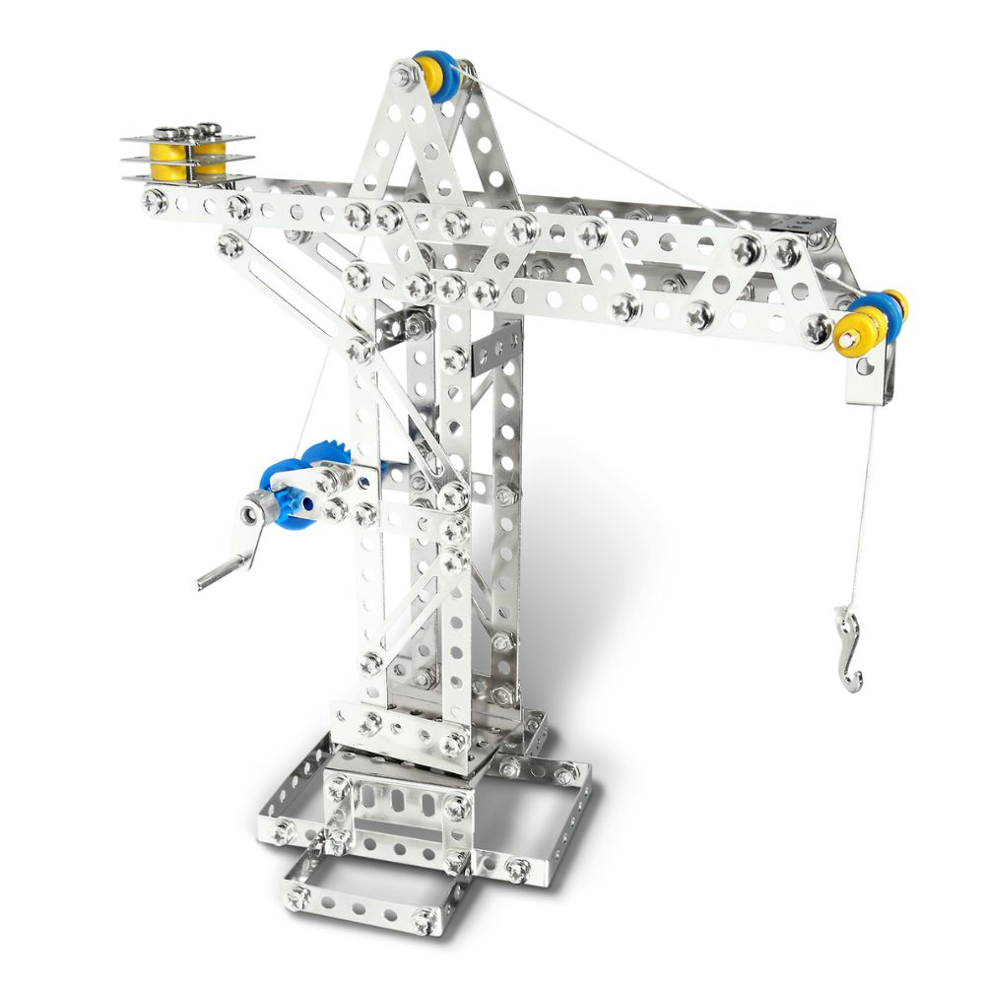
Build Phase 1: Crane
Objective: Build the Rotatable Crane
🛠️ Instructions for Teams:
Build rotatable crane with winch & hook.
Use only bolts and nuts (no bending).
Keep modular subassemblies (base, mast, arm).
Source: www.eitech.de
Notes:
To introduce the first practical task of the workshop.
This slide moves the session from theory to practice. It provides the objective and material list for the initial building activity, giving participants a clear starting point for their hands-on learning.

Slide 18
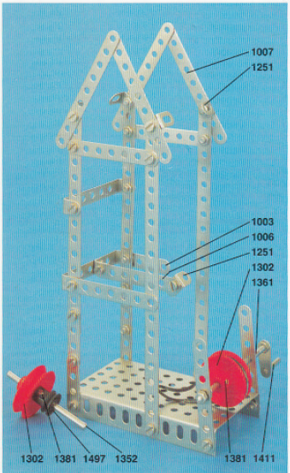
CE Twist: Client Change Request
Objective: Disassembly & Component Recovery
🛠️ Instructions for Teams:
Project has changed: crane no longer needed.
New requirement: a lifting bridge.
No new steel available → reuse as many crane parts as possible.
Source: www.eitech.de
Notes:
To introduce the first practical task of the workshop.
This slide moves the session from theory to practice. It provides the objective and material list for the initial building activity, giving participants a clear starting point for their hands-on learning.

Slide 19
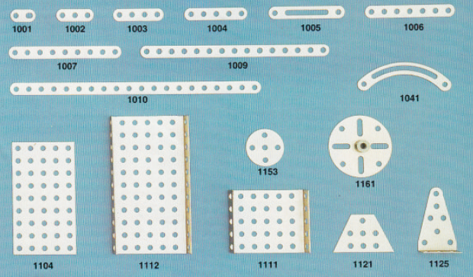
CE Twist: Client Change Request
Objective: Disassembly & Component Recovery
Steps:
Carefully disassemble crane.
Count total components.
Formula: Reuse % = (Recovered ÷ Total) × 100
Source: www.eitech.de
Notes:
To introduce the first practical task of the workshop.
This slide moves the session from theory to practice. It provides the objective and material list for the initial building activity, giving participants a clear starting point for their hands-on learning.

Slide 20
CE Twist: Client Change Request
💬 Discussion:
Which parts were easiest to recover?
What slowed you down?
How does this compare to welded steel?
Source: www.eitech.de
Notes:
To introduce the first practical task of the workshop.
This slide moves the session from theory to practice. It provides the objective and material list for the initial building activity, giving participants a clear starting point for their hands-on learning.

Slide 21
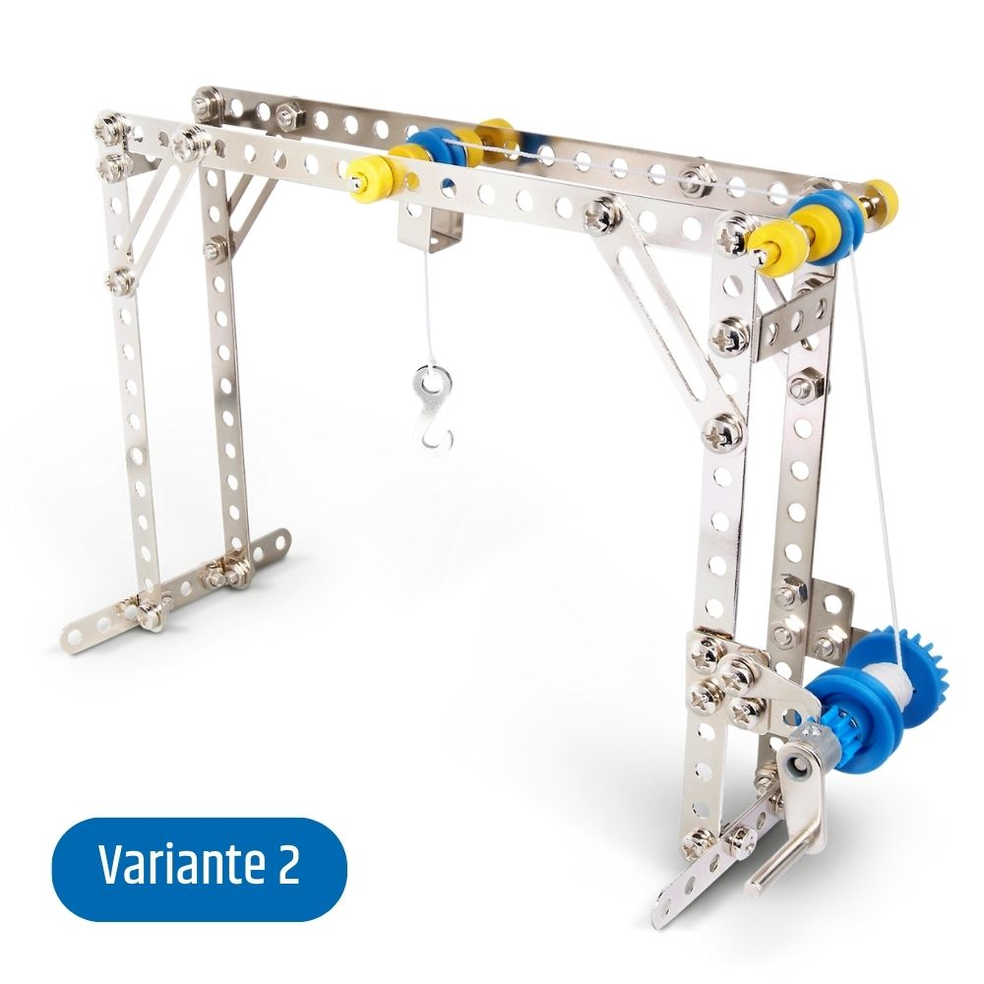
Build Phase 2: Lifting Bridge
🛠️ Instructions:
Rebuild the bridge using recovered crane components.
Aim for 100% reuse.
Any new parts used must be listed separately.
Source: www.eitech.de
Notes:
To introduce the first practical task of the workshop.
This slide moves the session from theory to practice. It provides the objective and material list for the initial building activity, giving participants a clear starting point for their hands-on learning.

Slide 22

Preparing for Presentations
Present the crane
Reuse % achieved
LCA stages skipped by reuse
Suggest Improvements for design (more circular?)
Source: https://www.shutterstock.com/
Notes:
To provide a clear structure for participants to share their results and insights.
This slide guides participants on what they need to present. It ensures they report not only on the physical outcome (the house and recovery percentage) but also on the conceptual understanding they gained (CE principle and LCA insight).

Slide 23
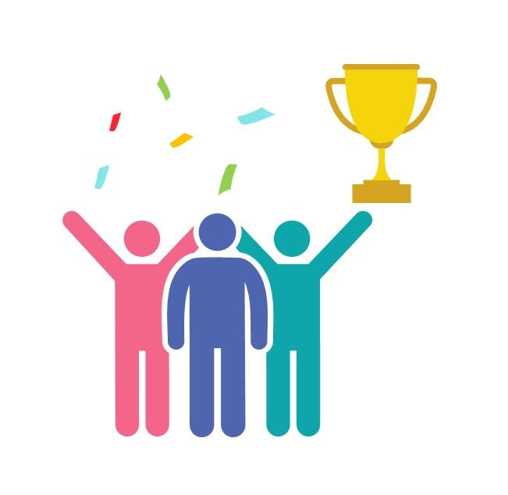
Awards
🏢 Best Build
📊 Best LCA Reflection
🤝 Best Team Collaboration
💡 Most Innovative Circular Economy Idea
Source: https://www.slideteam.net/
Notes:
To add an element of recognition and motivate participants.
The awards for Best LCA Reflection, Best Team Collaboration, and Most Innovative Circular Economy Idea celebrate different skills and contributions, encouraging a positive and collaborative atmosphere.

Slide 24
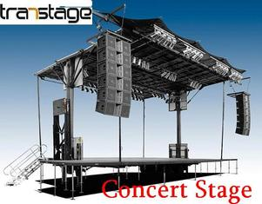
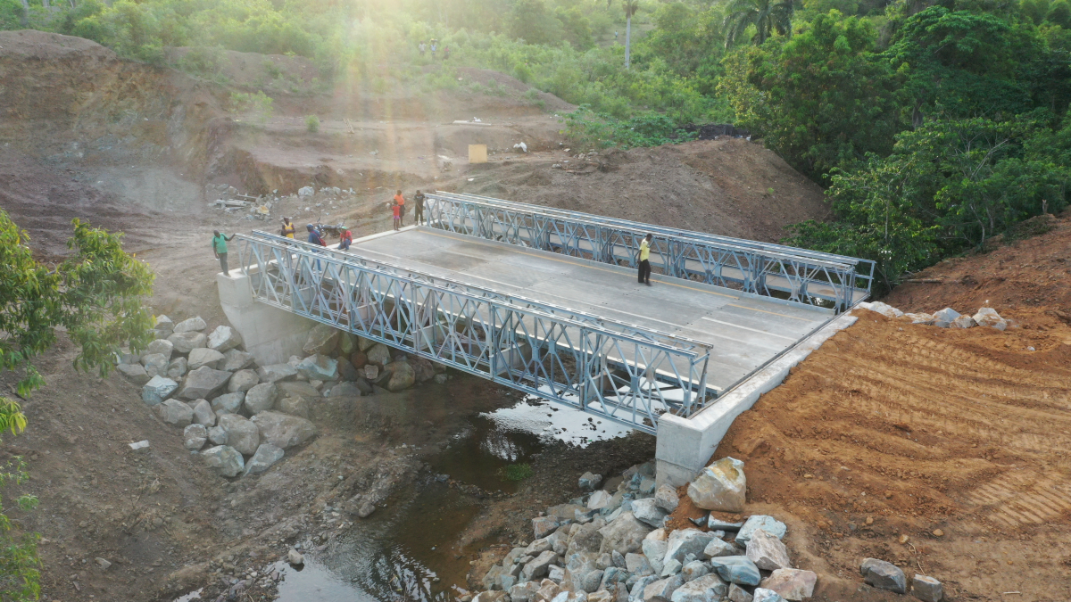
Real-World Applications
Examples of modular/reusable steel:
Temporary bridges 📽️ Panel Bridge System
Scaffolding reused for decades
Concert/event structures 📽️Structure
Pre-engineered modular steel buildings
Source: www.transtage.weebly.com
Source: www.shortspansteelbridges.org
Notes:
To add an element of recognition and motivate participants.
The awards for Best LCA Reflection, Best Team Collaboration, and Most Innovative Circular Economy Idea celebrate different skills and contributions, encouraging a positive and collaborative atmosphere.

Slide 25

Any Questions? Let’s Discuss!
❓ Ask about anything unclear in the LCA or CE concepts
💭 Share your ideas for improving the activity or your product
Source: https://pngtree.com/
Notes:
To facilitate a final, open discussion and reflection.
This slide encourages participants to ask questions, share their ideas, and think critically about the concepts they learned. The "Challenge" question pushes them to think beyond the workshop's materials and apply their new knowledge to a broader context.

Slide 26

Thank You & Goodbye!
You are now an Eco Designer!
Keep thinking about materials and the planet
Source: www.fedongroup.com
Notes:
To end the workshop on an empowering and inspiring note.
The final message, "You are now an Eco Designer!," serves as a powerful validation of the participants' efforts and new skills. It leaves them with a call to action, encouraging them to continue thinking about sustainability in their daily lives.

