Slide 1


EDU-CIRC
Rete transfrontaliera per la formazione sull’economia circolare e la decarbonizzazione nella produzione
Grenzübergreifendes Netzwerk zur Aus- und Weiterbildung in Kreislaufwirtschaft und Dekarbonisierung in der Produktion
Europa noch näher
Un’Europa più vicina

Slide 2
Designing a Better Plastic Future
THEME: CONSTRUCTION
Notes:
Welcome participants and introduce the workshop theme.
Emphasize the focus: Circular Economy (CE), Life Cycle Assessment (LCA), and upcycling plastic waste.
Mention the interactive, hands-on nature of the session.

Slide 3

Workshop Objectives
Circular Economy: Learn the principles.
Life Cycle Assessment: Evaluate environmental impact.
Activity: Turn waste into useful/fun products.
Present: Share your idea with the class
Notes:
Explain the key learning goals: understanding CE principles, applying LCA, turning waste into useful products, and presenting results.
Highlight that the workshop blends theory with practice.

Slide 4
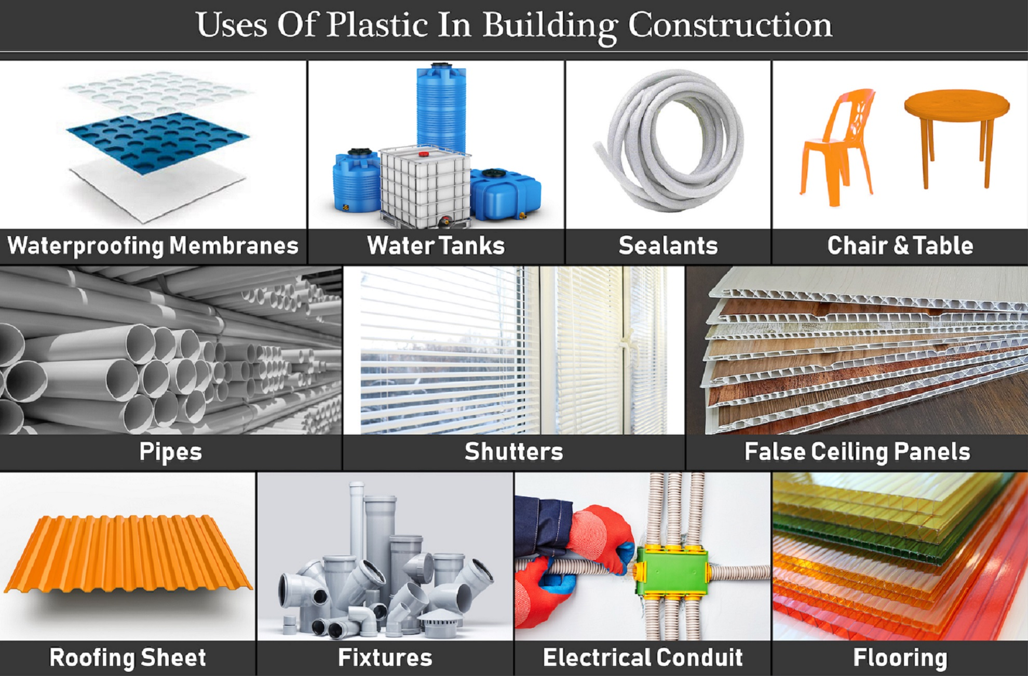
Why Plastic?
Why are we talking about plastic in building materials today?
It’s everywhere : used in pipes, insulation, flooring, and windows..
Useful : lightweight, durable, corrosion-resistant, waterproof,
Challenges : non-biodegradable, difficult to recycle
Source: https://gharpedia.com/
Notes:
Begin by highlighting how plastics have become integral to modern construction, not just for aesthetics but for functionality and cost-efficiency.
Mention examples visible in the image: pipes, water tanks, roofing sheets, insulation, and fixtures — all essential in everyday building projects.
Emphasize why plastics are favored:
Lightweight → easier transport and installation.
Durable and corrosion-resistant → especially valuable in humid or coastal regions.
Waterproof and low maintenance → ideal for roofing and plumbing systems.
Transition to challenges: explain that while plastics extend building life, they create end-of-life problems — most are non-biodegradable and hard to recycle due to mixed additives and coatings.

Slide 5
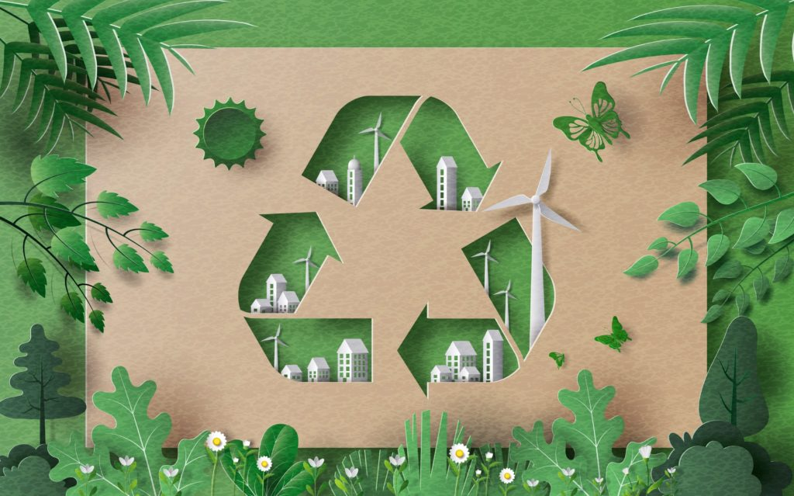
Quick Quiz - Myth or Fact??
📽️ Only 9% of the world's plastic is recycled
All plastics are easy to recycle :
Clean items recycle better :
Plastic breaks down quickly in nature :
❌/✅ ?
❌/✅ ?
❌/✅ ?
❌
✅
❌
Source: www.ukconstructionmedia.co.uk
Notes:
Engage participants with interactive myths vs facts.
Clarify answers: only 9% of plastic is recycled; clean items recycle better; plastic does NOT break down quickly in nature.
Encourage participants to guess before revealing answers.

Slide 6
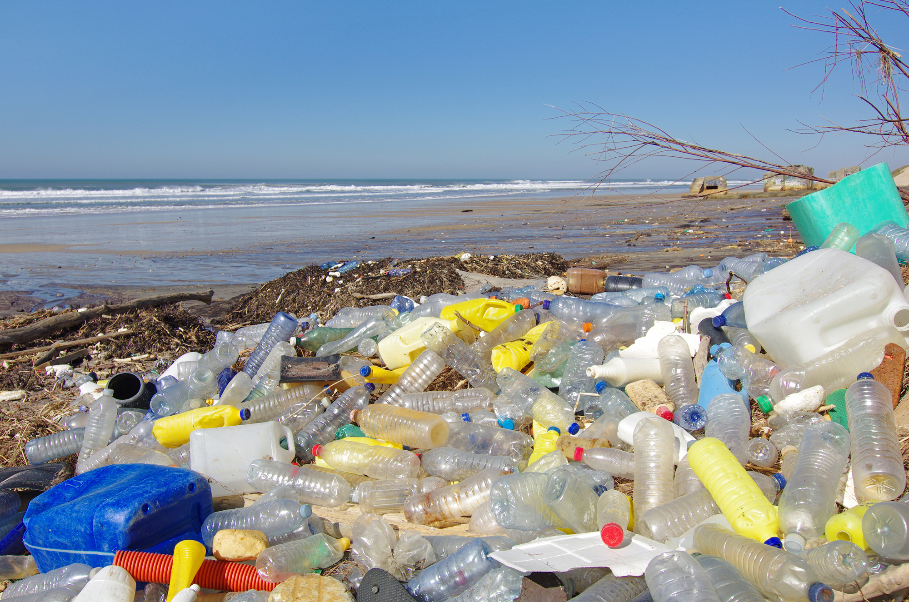
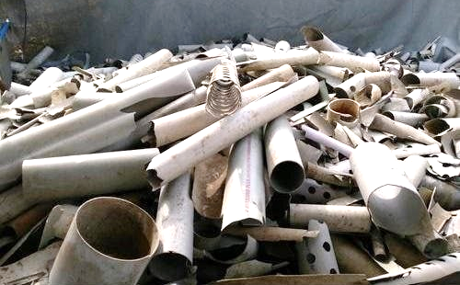
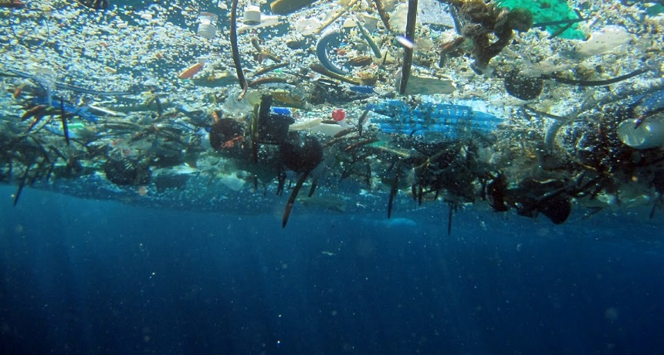
Why Plastic Can Be a Problem
Many items are used once, then thrown away.
Does not break down quickly; can fragment into tiny pieces.
Can harm wildlife and litter land and water.
Source: www.japantimes.co.jp
Source: https://www.justdial.com/
Source: www.snexplores.org
Notes:
Highlight problems: single-use nature, persistence in the environment, microplastics harming wildlife, litter issues.
Ask participants if they’ve seen local examples (beach litter, clogged drains).

Slide 7
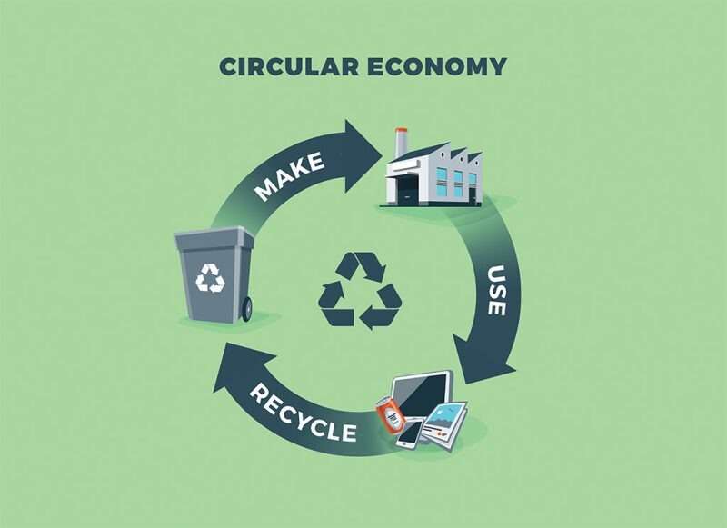
What is Circular Economy (CE)?
Definition:
A system where products, materials, and resources are kept in use for as long as possible.
📽️ Circular Economy
Source: https://jpt.spe.org/
Notes:
CE is about keeping products, materials, and resources in use for as long as possible.
Instead of throwing things away, we reuse, repair, refurbish, and recycle.
We’ll watch a short video: pay attention to how the “linear” system wastes resources compared to the “circular” system.
After the video, I’ll ask you: how did they show the difference visually?

Slide 8
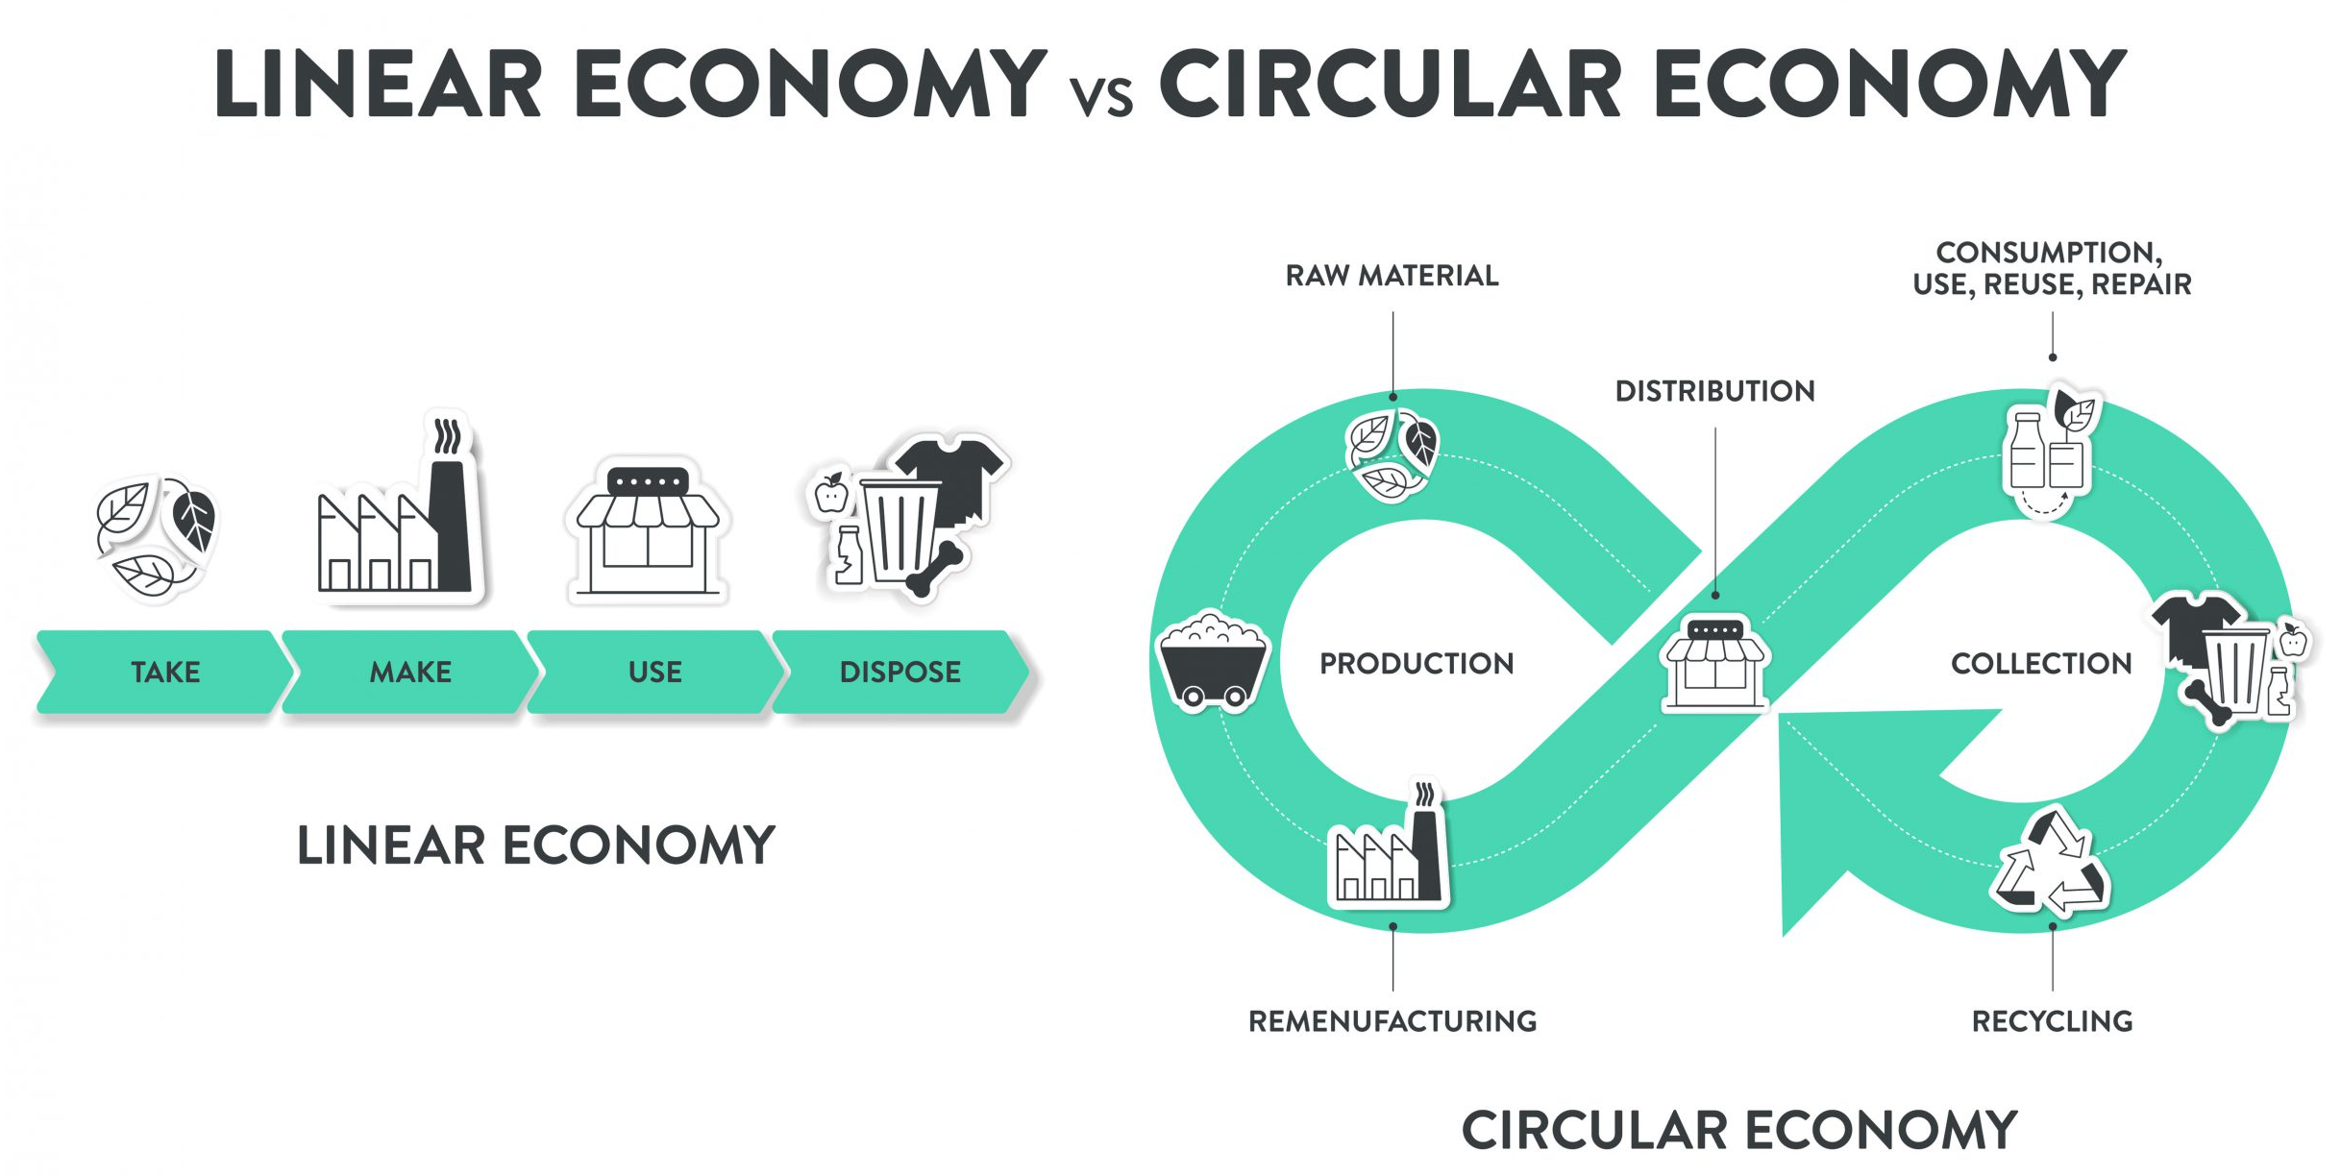
Linear vs Circular Economy:
How does the video illustrate the difference between a linear and a circular economy?
Source: https://www.technikum-wien.at/
Notes:
In a linear economy, it’s “take, make, dispose.”
In a circular economy, it’s “make, use, reuse, recycle”—closing the loop so nothing is wasted.

Slide 9
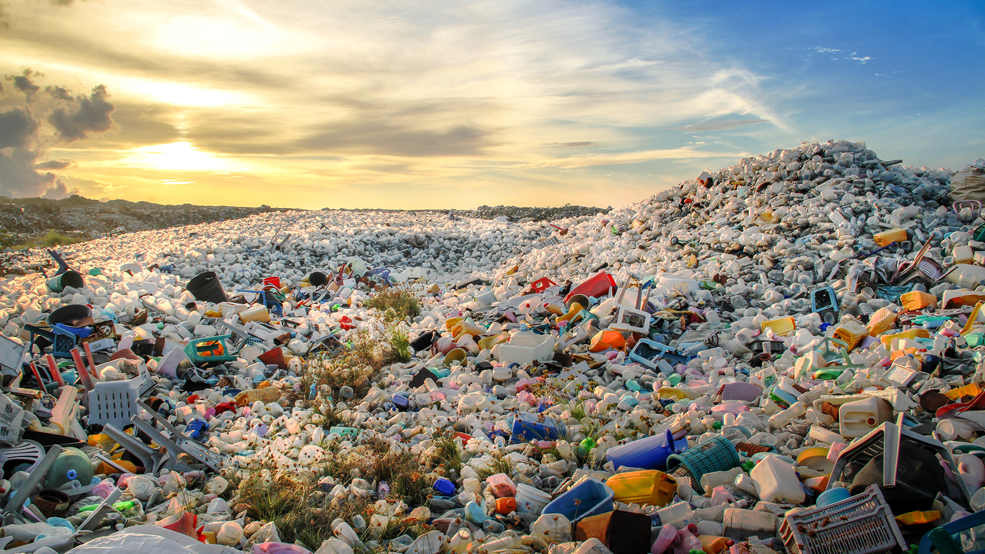
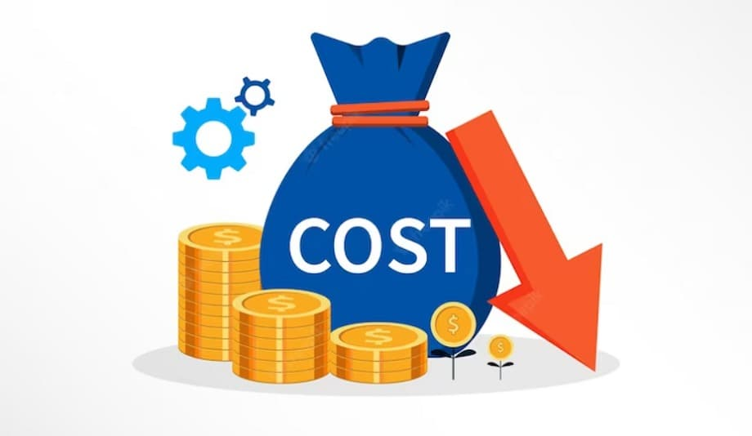
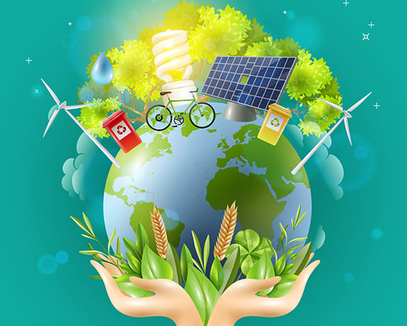
Why Circular Economy Matters
Environmental Impact: Waste, pollution, depletion of resources
Economic Benefits: Reduced costs, innovation, job creation
Social Impact: Sustainable living, waste reduction
Source: https://www.innovationnewsnetwork.com/
Source: https://cashflowinventory.com/blog/
Source: https://radiant.edu.np/
Notes:
Cover three pillars:
Environmental: reduce waste/pollution.
Economic: cut costs, drive innovation, create jobs.
Social: enable sustainable lifestyles.
Stress relevance to their future.

Slide 10

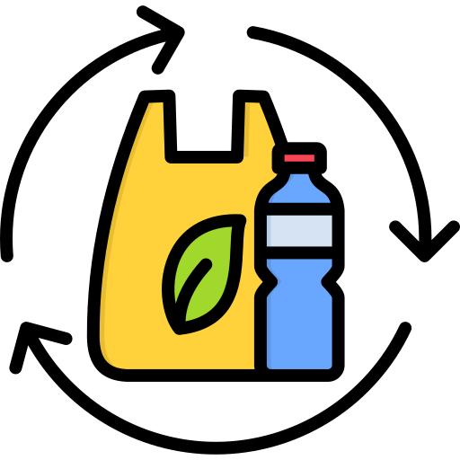
Example of Circular Economy Application
Reduce : use fewer parts
Example: one bottle, minimal tape
Reuse : give it a new job
Example: bottle → planter; tub → pen pot
Repair : fix, don’t bin
Example: re-tie a loose string
Source: www.trutravels.com
Source: www.freepik.com
Notes:
Show practical applications: Reduce, Reuse, Repair, Redesign, Recycle.
Give examples from daily life (bottle as planter, repairing ties, recycling caps).
Ask groups to brainstorm more examples.

Slide 11
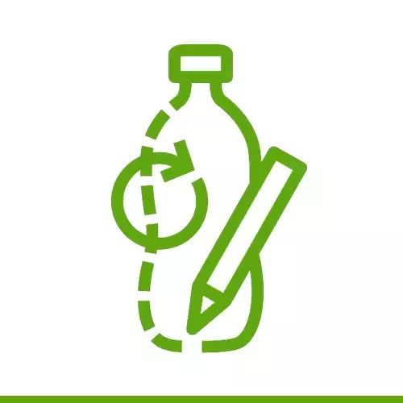
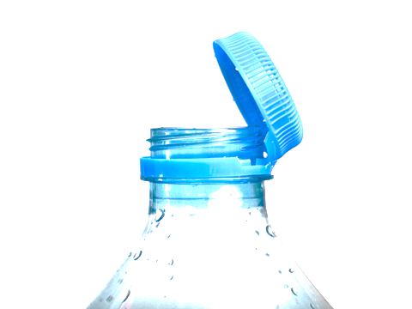
Example of Circular Economy Application
Redesign : make parts easy to take apart.
Example: ties/clips, not heavy glue
Recycle : clean and sort.
EU tip: keep drink bottle caps attached for recycling
Source: www.nestle.com
Source: packagingeurope.com
Notes:
Define LCA: assessing environmental impact across a product’s life cycle.
Explain its importance in design decision-making.
Connect to the plastic bottle case study.

Slide 12
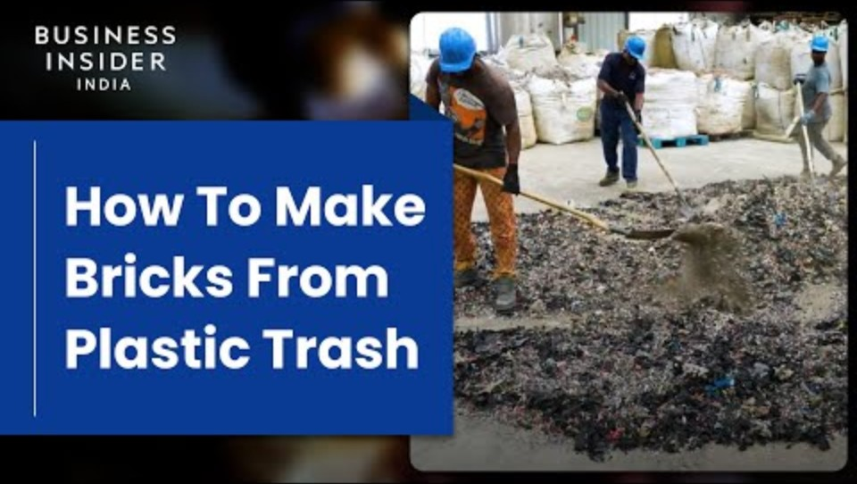
Video Case Study: Plastic Bricks for Construction
Repurposing Plastic Waste into Construction Bricks
Notes:
Introduce the video by saying something like: “Now let’s see an inspiring real-world example of how plastic trash becomes a building block.”
Before playing ask students to watch for process steps (collection, cleaning, mixing, compression)
After the video: lead the discussion using the prompts above
Connect it back to your themes of circular economy, design for reuse, and sustainable construction

Slide 13
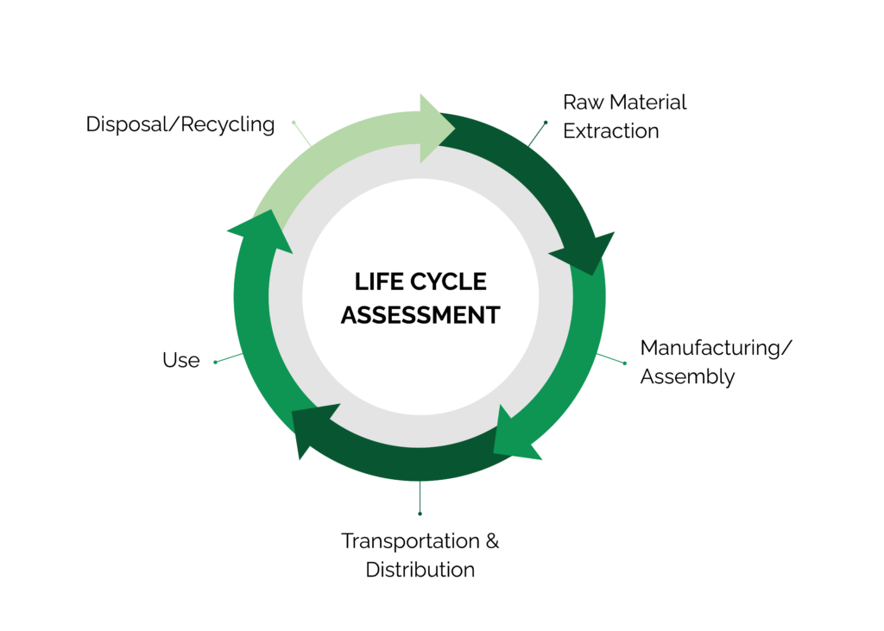
Life Cycle Assessment (LCA) – Introduction
What is LCA? : A method to assess the environmental impacts of a product throughout its life cycle
Source: www.stich.culturalheritage.org
Notes:
LCA helps us measure the environmental impact of a product from creation to disposal.
Covers five stages: raw material extraction, manufacturing, transport, use, and disposal/recycling.
The aim is to identify where impacts occur and find ways to make products more sustainable.
Highlight the circular diagram — it shows that materials can be reused instead of wasted.

Slide 14
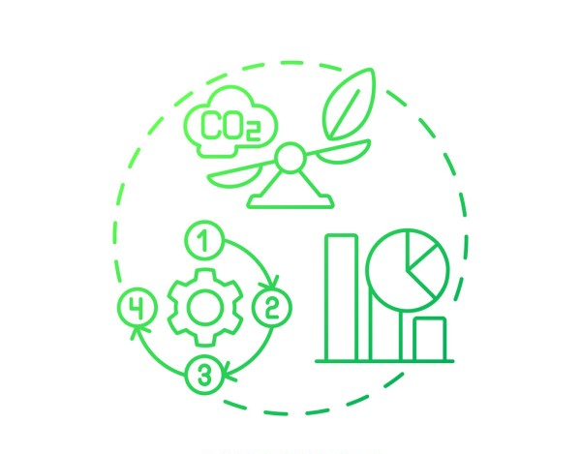
Importance of LCA
Purpose: Helps identify areas to reduce environmental footprint
Application: Guides design choices for more sustainable products
Source: https://www.list.lu/fileadmin/files
Notes:
LCA helps identify hotspots (e.g., high energy use, CO₂).
Supports better design choices and sustainability strategies.
Mention: “It’s like tracing the footprint of a product.”

Slide 15
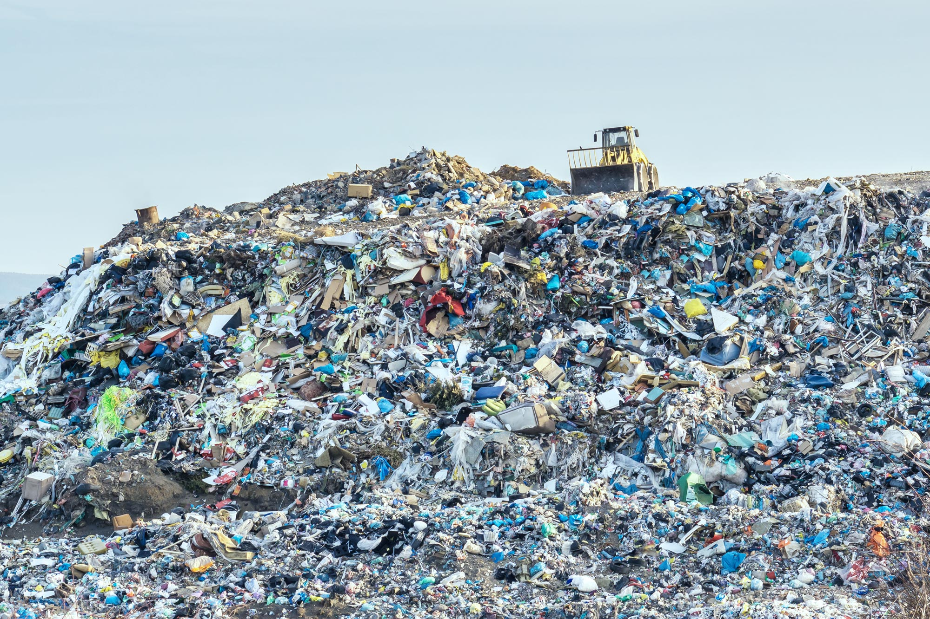
LCA Example: Plastic Bricks for Construction
1. Raw Material Extraction
  Plastic waste collected from households
  or landfills.
  Environmental Impact
  Reduces need for virgin raw materials.
Source: https://theoceancleanup.com/
Notes:
Explain that this stage begins with collecting post-consumer plastic waste from households, roadsides, or landfills.
Emphasize that the key benefit here is diverting plastic from waste streams before it reaches oceans or dumps.
You can mention the image: “This landfill shows how much raw material potential we’re wasting daily.”
Environmental focus: point out how this process reduces dependence on virgin petroleum-based plastics, directly saving natural resources.
Transition idea: “Once the waste is sorted and cleaned, it becomes the foundation for new building materials.”

Slide 16
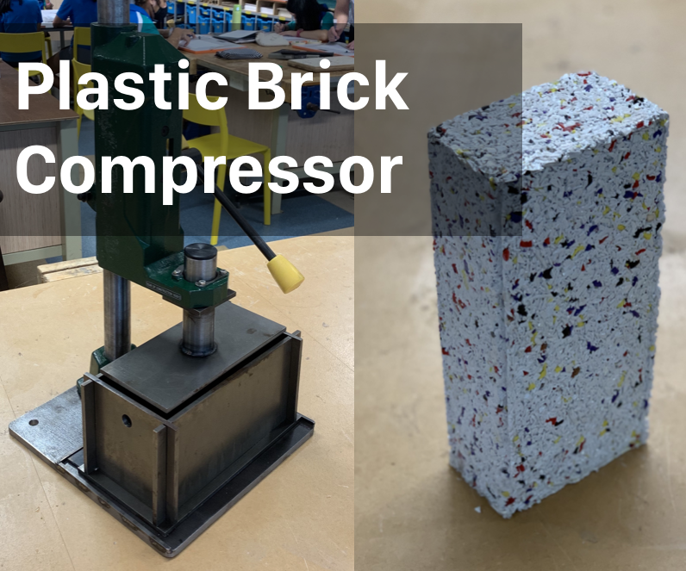
LCA Example: Plastic Bricks for Construction
2. Manufacturing
Shredded plastic mixed with sand or clay.
Heated and compressed into brick molds.
  Environmental Impact
  No cement needed → lower CO₂ footprint.
Source: www.instructables.com
Notes:
Describe how shredded plastic is mixed with sand or clay and compressed under heat to form bricks.
Highlight that no cement is required, making it a low-carbon alternative.
Mention that small-scale setups can even operate with local equipment or manually powered presses.
Environmental focus: lower CO₂ emissions and less dust pollution compared to traditional brick kilns.

Slide 17

LCA Example: Plastic Bricks for Construction
3. Transportation & Distribution
Bricks transported to construction sites.
  Environmental Impact
  Usually, lower transport weight than clay bricks.
Source: https://www.flaticon.com/
Notes:
Explain that once manufactured, bricks are transported to local construction sites or sold to builders.
Stress that plastic bricks are lighter than clay or concrete, leading to lower fuel use and easier handling.
Environmental focus: highlight that transport emissions are reduced but still present — encouraging localized production as a sustainability strategy.
You can connect this to circular economy thinking: “Keeping production close to use reduces both costs and carbon footprint.”

Slide 18
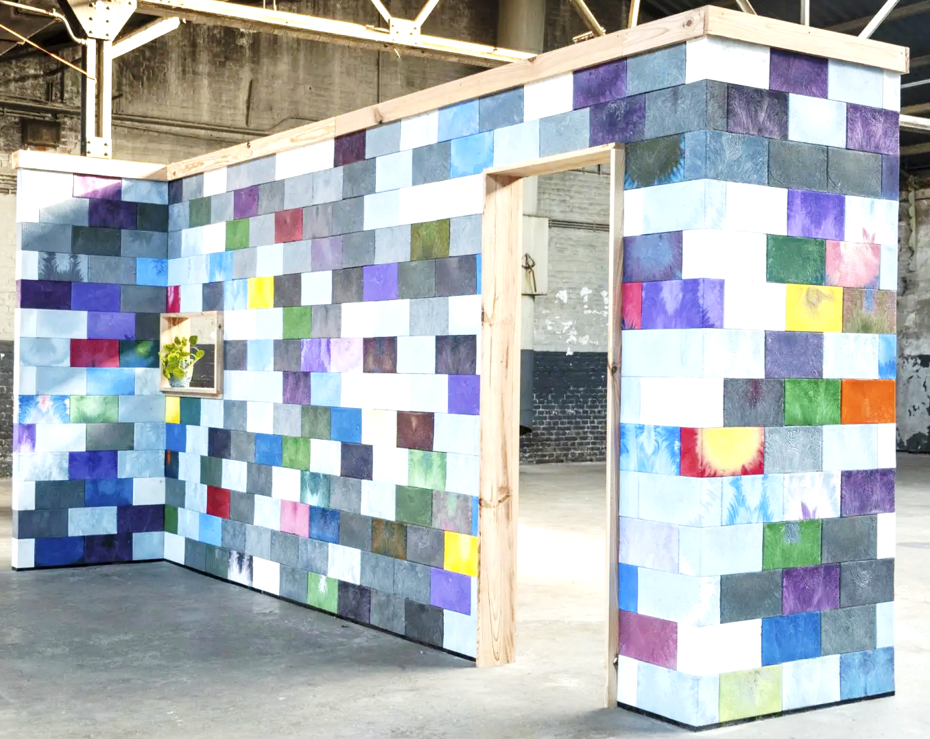
LCA Example: Plastic Bricks for Construction
4. Use
Used in walls, pavements, or small structures.
  Environmental Impact
  Long lifespan
  Provides insulation and low maintenance.
Source: https://designwanted.com/
Notes:
Point out that these bricks are strong, waterproof, and termite-resistant, making them ideal for walls, pavements, or shelters.
Explain that they also provide good insulation and require minimal maintenance.
Environmental focus: since they last long, they delay waste generation and reduce replacement cycles.

Slide 19
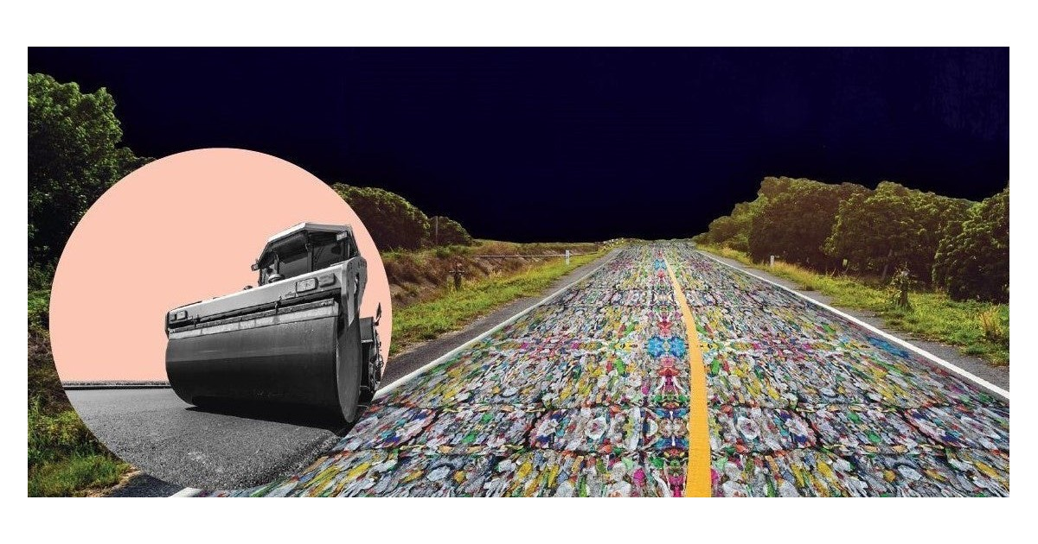
LCA Example: Plastic Bricks for Construction
5. Disposal/Recycling
Can be reused in new construction or crushed for road base.
  Environmental Impact
  Reuse extends life cycle, delaying waste.
Source: https://blogs.worldbank.org/
Notes:
Conclude by explaining that at the end of their life, plastic bricks can be reused in new constructions or crushed into road base material.
Highlight that although they’re durable, recycling after mixing with sand can be difficult.
Environmental focus: still, reusing bricks greatly extends their lifecycle and helps reduce landfill waste.
Wrap up by connecting back to the Circular Economy concept: “By turning plastic waste into a long-lasting building material, we keep resources circulating and waste minimized.”

Slide 20
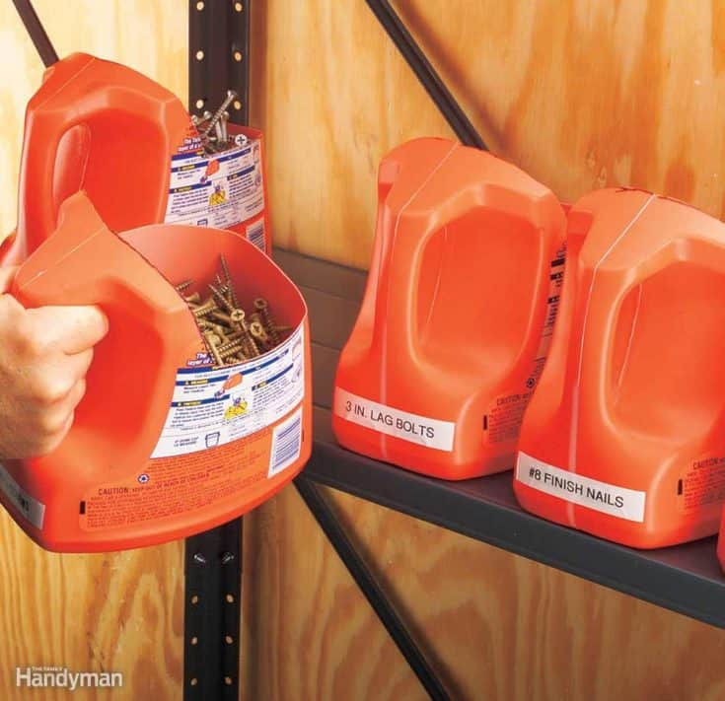
Activity – Upcycling Challenge
Objective: Re-Invent with Plastic
📽️Plastic Recycling Ideas
Steps
  Use discarded plastics (Cans, caps, spoons, tubs).
  Choose a product to make: Planter, Organizer, Scoop or your own idea.
  Start building your idea
Source: https://deliciousmadeeasy.com/
Notes:
Introduce main activity: build something new from discarded plastics.
Options: planter, organizer, feeder, spinner, scoop.
Emphasize teamwork, creativity, and application of CE + LCA.

Slide 21
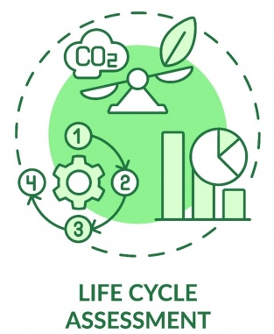
Activity Questions
Life Cycle Assessment (LCA)
  Which part of the product’s journey did you make better?
  (When it’s made, used, moved, or thrown away)
  Which 2 problems did you help reduce?
  (Energy, Pollution/CO₂, Water, Waste)
  What change in your design made this happen?
  (Example: used less tape → easier to recycle)
Source: https://rralur.si/
Notes:
Guide teams: Which part of the life cycle did you improve?
Which two problems did you help reduce (energy, pollution, water, waste)?
What design choice led to improvement?

Slide 22

Activity Questions
Circular Economy (CE)
  Which 2 Rs does your product show?
  (Reuse, Repair, Redesign, Recycle, Reduce)
Reflection
  If it breaks, how could you fix or reuse it ?
  What happens to your product at end-of-life ?
  (reused, recycled, composted, or disposed)
earth5r.org
Notes:
Which Rs (Reuse, Repair, Redesign, Recycle, Reduce) does your product show?
If it breaks, how could it be fixed or reused?
What happens to the product at end-of-life?

Slide 23

Preparing for Presentations
Show your product (name + what it does)
CE link → Which Rs did you use?
LCA map → Where did you cut impacts?
Leftover bits → What happened to scraps?
Next step → One idea to improve
Source: www.shutterstock.com
Notes:
Advise: structure presentations with CE link, LCA improvements, scraps management, and one improvement idea.
Encourage creativity in storytelling.

Slide 24
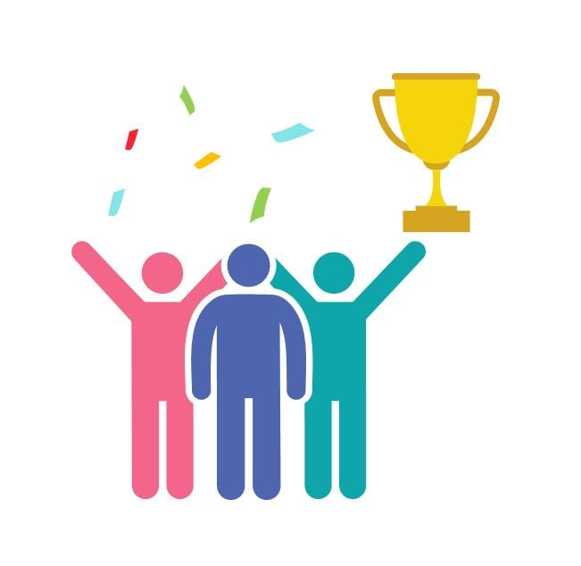
Awards
🏆 Best Circular Economy Idea
(most creative use of the Rs)
📊 Best LCA Reflection
(clear link to hotspots & stages)
🤝 Best Teamwork
(collaboration, sharing roles, presentation)
💡 Best Further Improvement Idea
(smartest suggestion for Version 2 / next step)
Source: https://www.slideteam.net/
Notes:
Explain award categories: Best CE Idea, Best LCA Reflection, Best Teamwork, Best Improvement Idea.
Motivate participants: “Everyone is an eco-designer today.”

Slide 25
Any Questions? Let’s Discuss!
❓ Ask about anything unclear in the LCA or CE concepts
💭 Share your ideas for improving the activity or your product
Notes:
Open floor for clarifications.
Encourage participants to share suggestions to improve activity or their design.

Slide 26
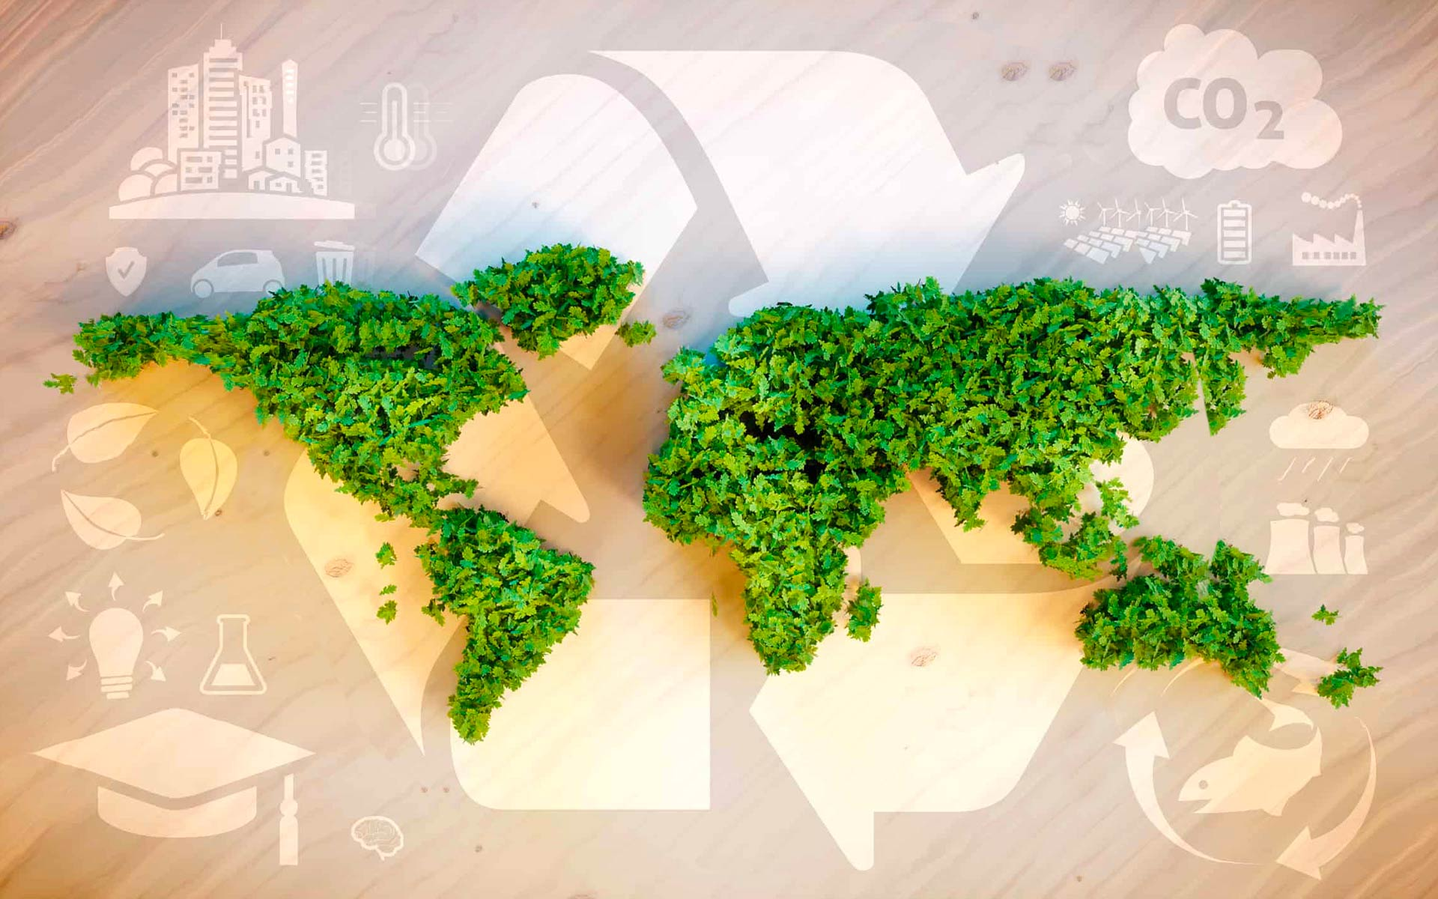
Thank You & Goodbye!
You are now an Eco Designer!
Keep thinking about trees, materials, and the planet
Source: www.fedongroup.com
Notes:
Conclude by reminding participants: “You are now eco-designers—keep thinking about how to design a better future for plastics and the planet.”
Thank everyone for participation.

