Slide 1


EDU-CIRC
Rete transfrontaliera per la formazione sull’economia circolare e la decarbonizzazione nella produzione
Grenzübergreifendes Netzwerk zur Aus- und Weiterbildung in Kreislaufwirtschaft und Dekarbonisierung in der Produktion
Europa noch näher
Un’Europa più vicina

Slide 2
Brick to Brick – The Circular Build
🧱🛠♻️
THEME: CONSTRUCTION

Slide 3

Workshop Objectives
Understand CE principle of keeping materials in use.
See design for disassembly.
Recognize environmental benefits through LCA thinking.
Brainstorm real-world reusable building solutions.
Notes:
To clearly state the four main goals of the workshop
This slide acts as a roadmap, breaking down the overarching theme into specific, actionable learning outcomes. It guides participants from conceptual understanding (CE principle) to practical application (design for disassembly), critical thinking (LCA thinking), and creative problem-solving (brainstorm real-world solutions).

Slide 4
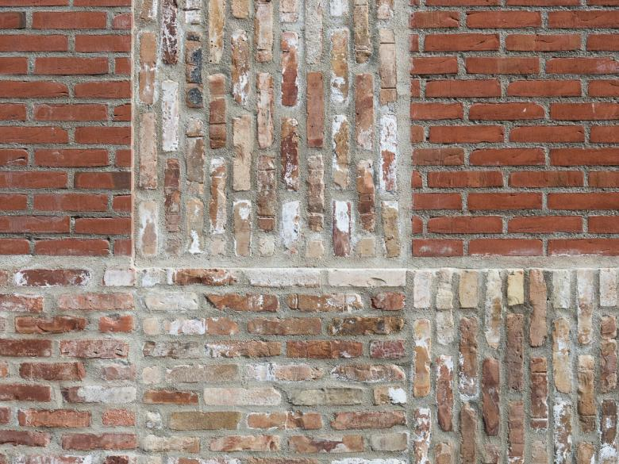
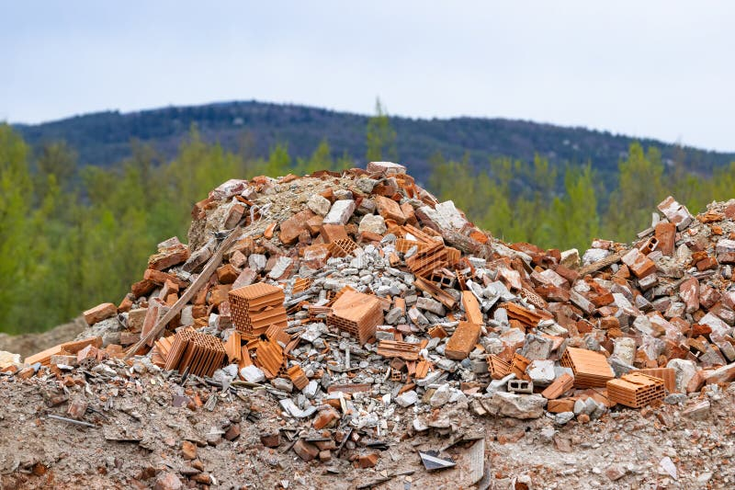
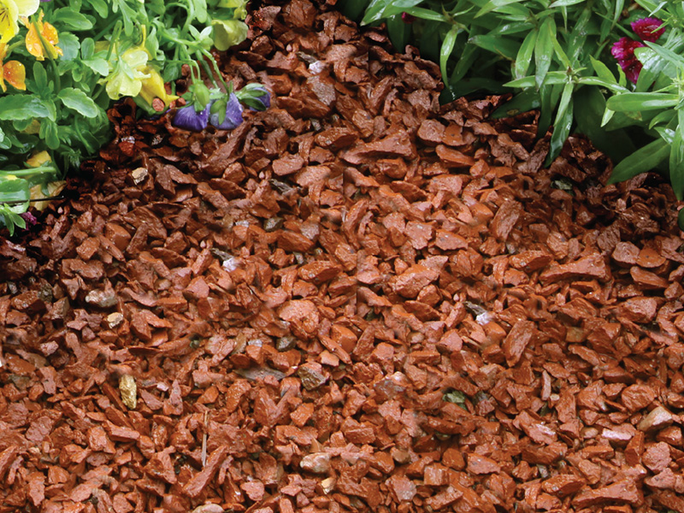
QUIZ
What happens to bricks when a building is demolished?
📽️Brick Demolish
  Reuse ✅
  Landfill 🚫
  Crushed for fill/gravel ♻️
Reuse
Landfill
Crushed
https://www.world-architects.com/
https://www.dreamstime.com/
https://www.pacificclay.com/
Notes:
To engage the audience and activate their prior knowledge about construction waste.
The quiz format is an effective way to start a discussion. By presenting three possible fates for demolished bricks—Reuse, Landfill, and Crushed for fill/gravel—it prompts participants to think about the consequences of different end-of-life scenarios. This slide establishes the problem that the circular economy aims to solve.

Slide 5
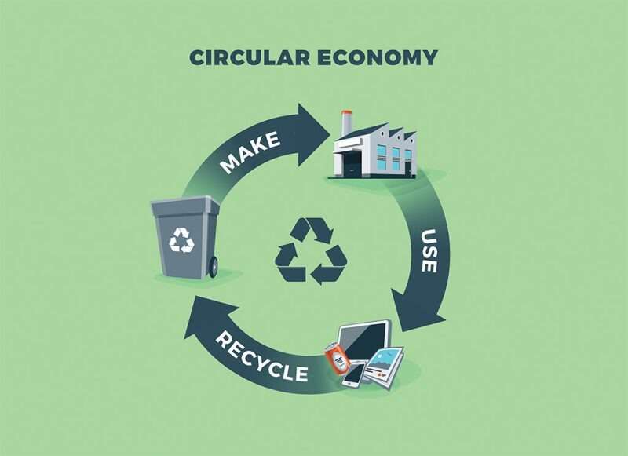
What is Circular Economy (CE)?
Definition:
A system where products, materials, and resources are kept in use for as long as possible.
📽️ Circular Economy
Source: https://jpt.spe.org/
Notes:
To define the core concept of the entire workshop.
This slide provides the fundamental definition of a circular economy: a system that keeps products and resources in use as long as possible. The simple, circular visual reinforces the idea of a closed loop, contrasting with the linear model.

Slide 6
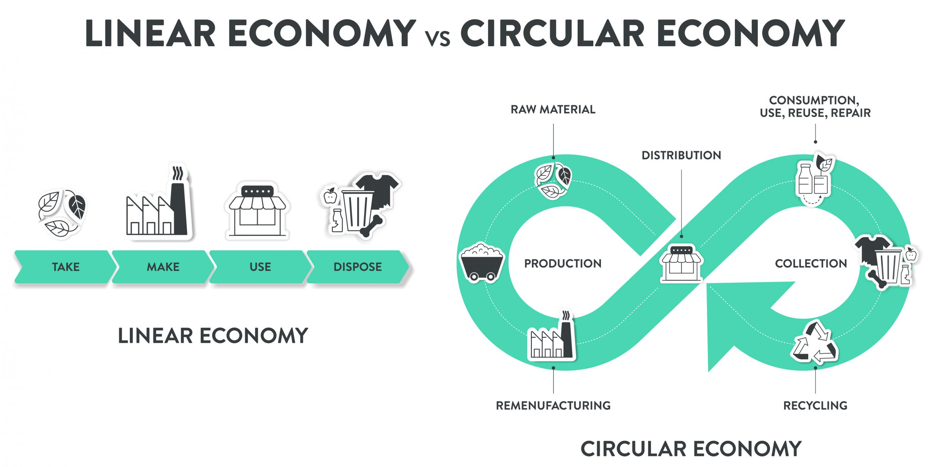
Linear vs Circular Economy:
How does the video illustrate the difference between a linear and a circular economy?
Source: https://www.technikum-wien.at/
Notes:
To visually and conceptually differentiate between the two economic models.
This slide highlights the difference between the wasteful "Take, Make, Use, Dispose" linear model and the sustainable, continuous loop of a circular economy. The side-by-side comparison makes the contrast clear and helps participants understand the need to transition to a circular system.

Slide 7
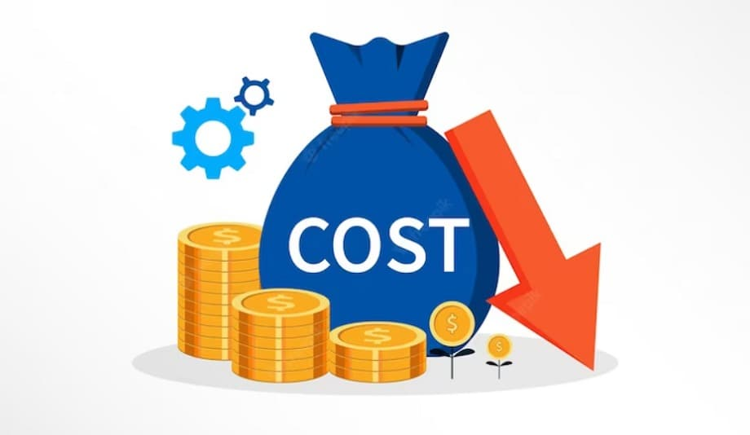

Why Circular Economy Matters
Environmental Impact: Waste, pollution, depletion of resources
Economic Benefits: Reduced costs, innovation, job creation
Social Impact: Sustainable living, waste reduction
Source: www.pacificclay.com
Source: https://cashflowinventory.com/blog/
Source: https://radiant.edu.np/
Notes:
To justify the importance of adopting a circular model by outlining its benefits.
This slide broadens the scope of the discussion by detailing the positive impacts of a circular economy on the environment, the economy, and society. It provides a compelling reason for participants to engage with the workshop's content by showing how these principles can create a better world.

Slide 8
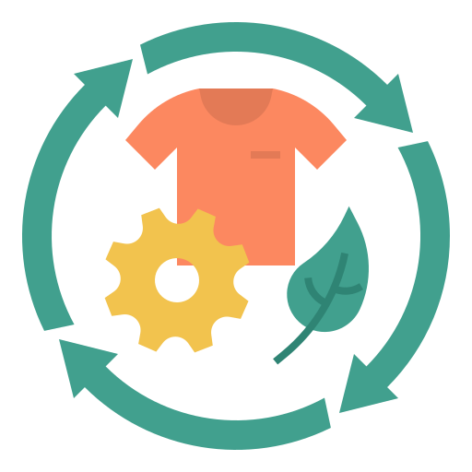
9Rs of Circular Economy
Overview : Set of principles designed to reduce environmental impact and maximize the reuse of resources throughout the lifecycle of products and materials
Focus : The key principles for sustainable production and consumption
Notes:
To introduce CE framework for circularity of bricks.

Slide 9



Circular Economy of Bricks
R0 - Refuse: Avoid bricks with high-impact production
(e.g., cement-based or non-reusable types).
R1 - Rethink: Design for disassembly using dry joints or lime mortar.
R2 – Reduce: Use fewer new bricks through efficient
design and less waste.
Notes:
To introduce a detailed framework for circularity, starting with the first three principles applied to bricks.
This slide translates the abstract concept of the circular economy into concrete actions for the construction industry.
Refuse: Challenges participants to reject unsustainable materials.
Rethink: Focuses on designing for the end of a product's life from the very beginning.
Reduce: Emphasizes efficiency and minimizing material use.

Slide 10



Circular Economy of Bricks
R3 – Reuse: Use whole bricks again in new builds or landscaping.
R4 – Repair: Fix brickwork with minimal replacement.
R5 – Refurbish: Clean or repoint bricks to extend their life.
Notes:
To continue applying the circular principles to the specific context of bricks.
This slide focuses on principles that extend the life of a product in its original form.
Reuse: The core principle of the workshop, using whole bricks again.
Repair: Encourages fixing existing structures instead of replacing them.
Refurbish: Highlights the value of restoring materials to extend their usability.

Slide 11

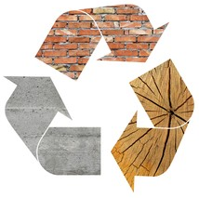


Circular Economy of Bricks
R6 – Remanufacture: Rebuild components using salvaged bricks.
R7 – Repurpose: Use broken bricks creatively in other applications.
R8 – Recycle: Crush bricks for use as aggregate or filler.
R9 – Recover: Recover material/energy only if reuse isn’t possible
Notes:
To complete the 9Rs framework, covering the last-resort principles.
This slide addresses the full spectrum of circularity, from higher-value uses to lower-value recovery.
Remanufacture: Rebuilding components.
Repurpose: Finding new, creative uses for old materials.
Recycle: Breaking down a material for use in a new product.
Recover: The final option for extracting value, usually energy.

Slide 12
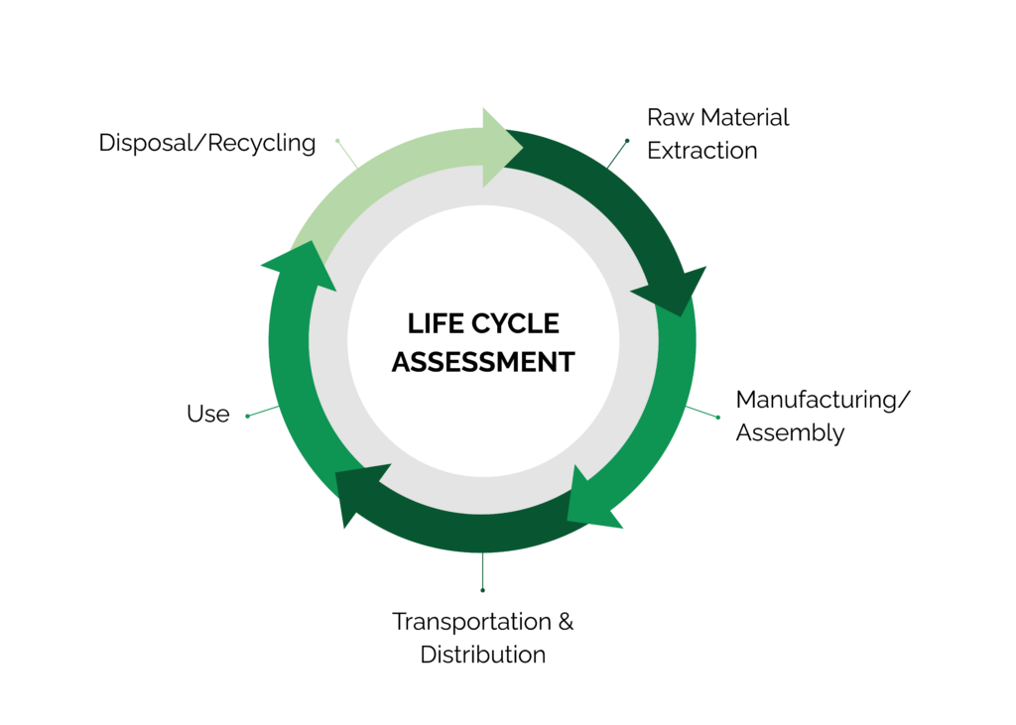
Life Cycle Assessment (LCA) – Introduction
What is LCA? : A method to assess the environmental impacts of a product throughout its life cycle
Source: www.stich.culturalheritage.org
Notes:
To introduce the concept of Life Cycle Assessment as a key analytical tool.
LCA provides a systematic method for measuring a product's environmental impact across its entire lifespan. This slide defines it, preparing the audience to use it as a framework to evaluate their own building project.

Slide 13
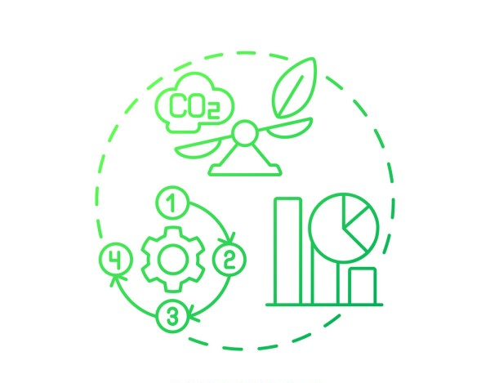
Importance of LCA
Purpose: Helps identify areas to reduce environmental footprint
Application: Guides design choices for more sustainable products
Source: https://www.list.lu/fileadmin/files
Notes:
To explain the practical application and significance of LCA.
This slide clarifies that LCA is not just a theoretical concept; it's a tool used to guide decision-making toward more sustainable products. It helps identify "hot spots" in a product's life cycle where the most environmental impact occurs.

Slide 14
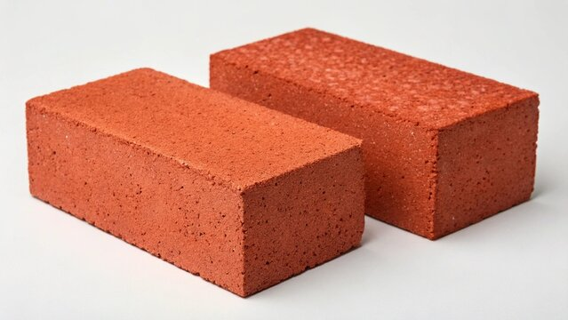
Life Cycle Assessment – Clay Bricks
📽️Brick Manufacturing Process
Raw Materials – Clay dug from the ground or plastic collected from recycling
Processing – Mixing with water, shaping the brick
Manufacturing – Fired in hot kilns or molded in factories
Use Phase – Used in walls, pavements, buildings
End-of-Life – Crushed as rubble, reused, or thrown into landfills
Source: www.stock.adobe.com
Notes:
To apply the LCA framework directly to a familiar material.
This slide breaks down the life cycle of a brick into five distinct phases, from raw material extraction to its end-of-life. This makes the abstract concept of LCA concrete and relatable, showing participants how to apply it to a real-world product.

Slide 15
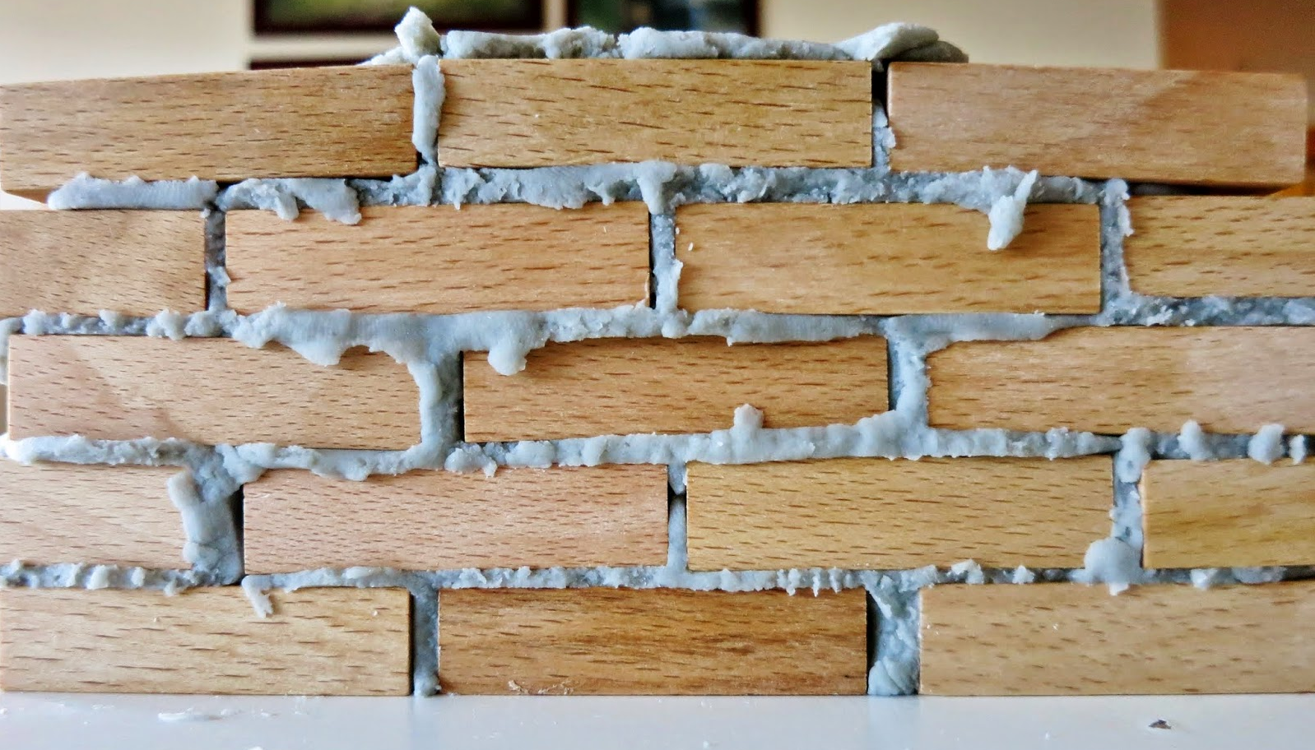
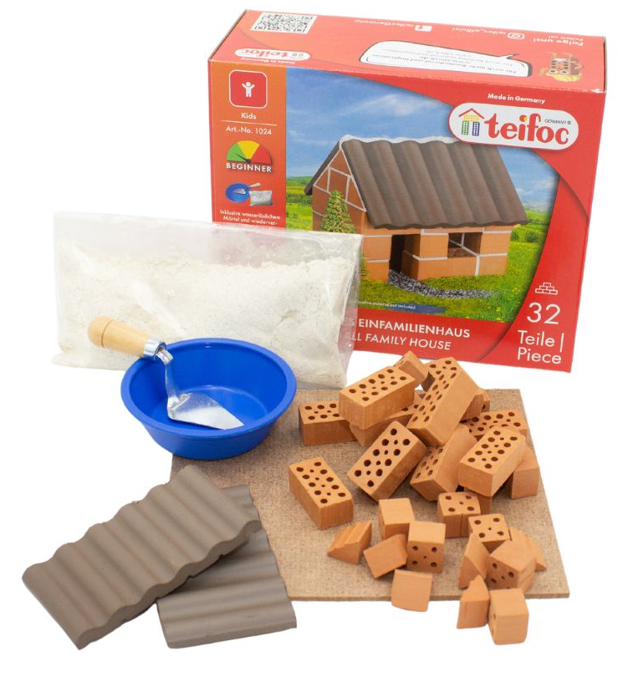
Introduction to Hands-on Activity
Objective: Build The Wall
Materials:
  Small family home kit
  Safety equipment (gloves, paper towels)
Source: https://www.learnwithplayathome.com/
Source: https://www.teifoc.de/en
Notes:
To introduce the first practical task of the workshop.
This slide moves the session from theory to practice. It provides the objective and material list for the initial building activity, giving participants a clear starting point for their hands-on learning.

Slide 16

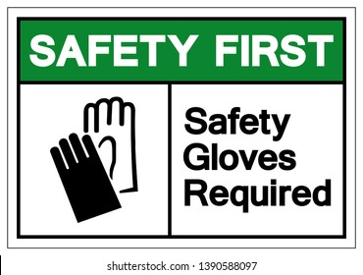
Safety Briefing
Safety First:
  Always wear gloves 🧤
  Work in a well-ventilated area 🌬️
Source: https://www.vecteezy.com/
Source: https://www.shutterstock.com/
Notes:
To ensure the safety of all participants during the hands-on activity.
This is a crucial, non-negotiable step. The clear instructions to "Always wear gloves" and "Work in a well-ventilated area" are paramount for a safe and successful workshop.

Slide 17


Hands-on Activity 1: Instructions
Wall: bricks- 6 long × 4 high × 1 thick
Apply mortar carefully (less is better!)
Keep the area clean
Source: https://icon-library.com/
Source: https://www.shutterstock.com/
Notes:
To give specific, step-by-step instructions for building the wall.
This slide provides the technical details for the first activity, including the exact dimensions of the wall. The tip "Apply mortar carefully (less is better!)" is a subtle but critical instruction, as it directly impacts the next phase of the activity, disassembly.

Slide 18

Quiz: Reuse or Refuse?
📽️ Reuse or Refuse
Why is it important to recover bricks instead of buying new ones?
What happens to the carbon footprint when bricks are reused?
How will you take bricks apart later?
What if we had used cement?
Source: https://poki.com/
Notes:
To prompt participants to reflect on the concepts they have learned and apply them to the current activity.
The questions on this slide are designed to bridge the gap between theory and practice. They challenge participants to think about the long-term consequences of their choices, specifically relating to the carbon footprint and the disassembly process.

Slide 19
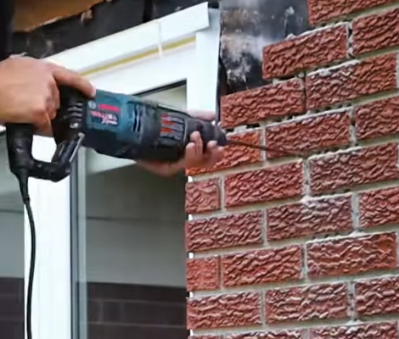
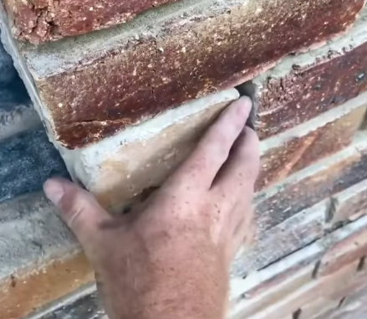
Reuse or Refuse?
📽️Cement Brick Reuse 1
📽️Cement Brick Reuse 2
Source: youtube.com
Source: youtube.com
Notes:
To visually demonstrate a key point about the difficulty of disassembly with traditional materials.
The videos on this slide provide a compelling visual answer to the quiz question about how to take the bricks apart. It highlights the problem that the workshop's chosen mortar aims to solve, reinforcing the value of design for disassembly.

Slide 20
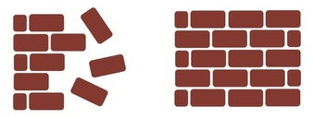
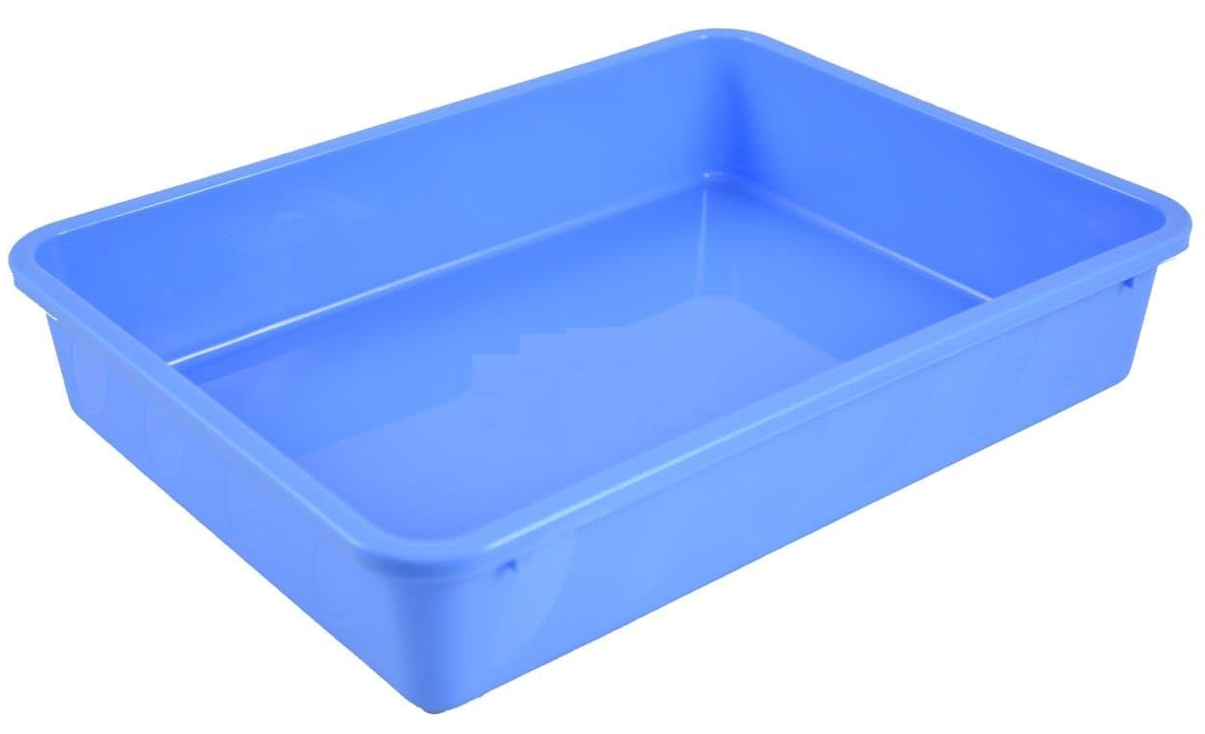
Hands-on Activity 2: Disassembly
The wall is not needed anymore
  Recover every brick without damage!
💭How to recover bricks?
Source: https://www.shutterstock.com/
Place walls in water trays for 15-20 min.
Source: https://www.amazon.in/
Notes:
To guide participants in the second practical task.
This activity directly tests the concept of reusability. The objective to "Recover every brick without damage!" reinforces the core principle of a circular economy. The instruction to use water trays demonstrates a practical solution to enable disassembly.

Slide 21

Circularity Measurement
📊 Brick Recovery % Formula:
  (Recovered ÷ Total Bricks) × 100
  🧮 Example: (48 ÷ 50) × 100 = 96%
Source: https://www.flaticon.com/
Notes:
To provide a quantitative way for participants to measure their success.
The Brick Recovery % Formula turns the abstract concept of circularity into a measurable metric. By calculating their own percentage, participants can see a tangible result of their efforts in the disassembly phase.

Slide 22
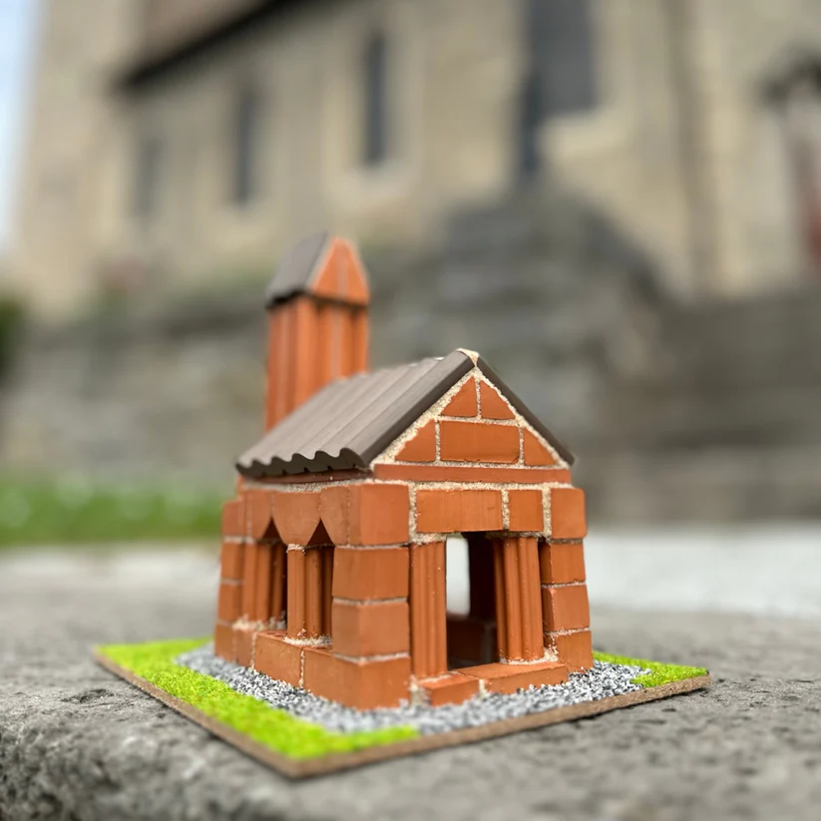
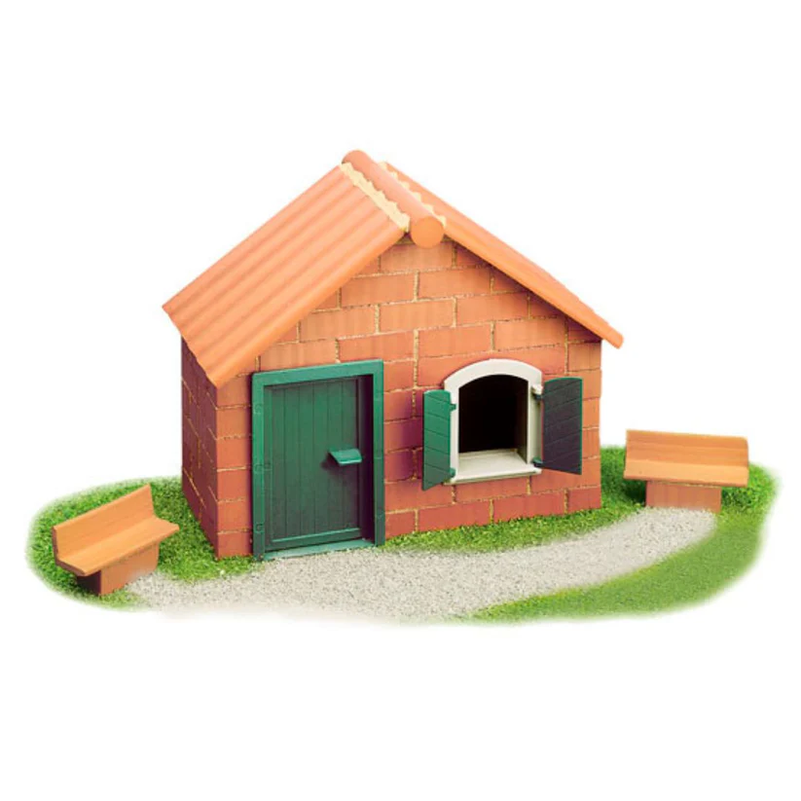
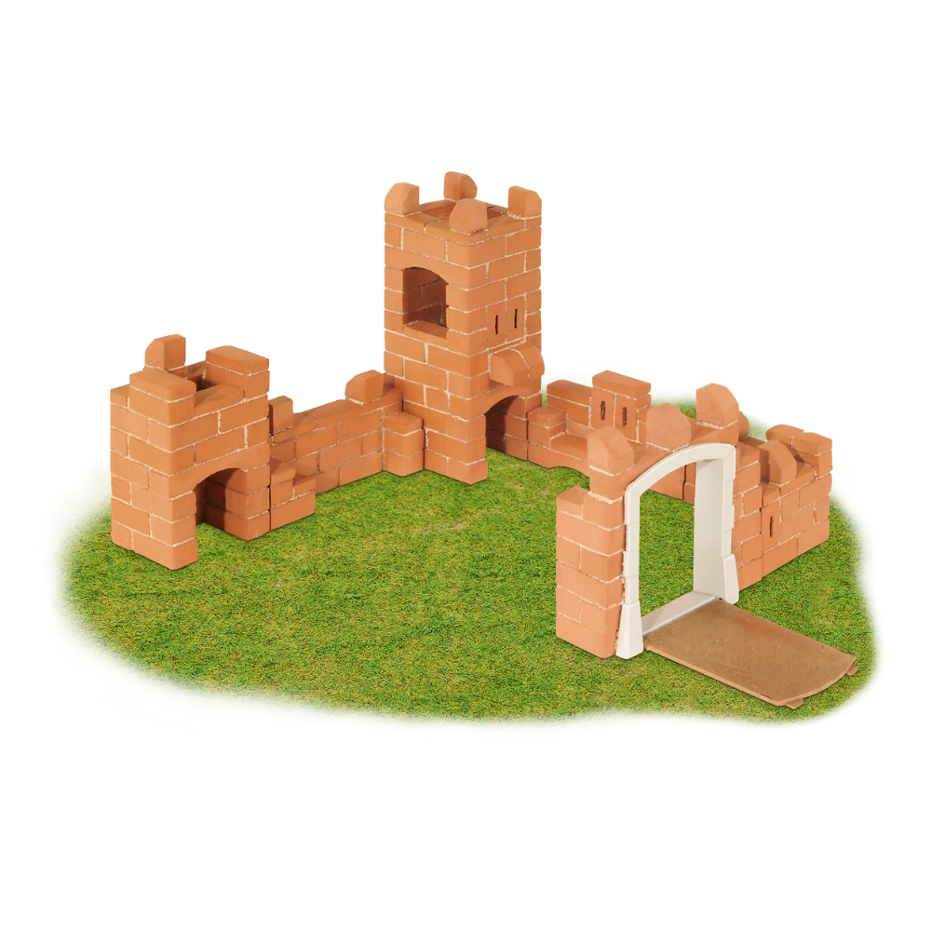
Hands-on Activity 3: Instructions
Objective: Build The House/ Church/Castle Using Recovered Bricks
Materials:
  Recovered bricks
  Unused bricks
  Safety equipment (gloves, paper towels)
Build using recovered + new bricks.
Source: https://www.teifoc.de/en
Source: https://www.teifoc.de/en
Notes:
To introduce the final, creative building task.
This activity puts all the learned principles into action. Participants are required to use the bricks they successfully recovered, along with any unused ones, to build a new structure. This demonstrates the full cycle of building, disassembly, and reuse.

Slide 23

Preparing for Presentations
Present the Building Made Using Recovered Bricks
Brick Recovery Percentage
Circular Economy Principle
LCA Insight of Brick Reuse
Source: https://www.shutterstock.com/
Notes:
To provide a clear structure for participants to share their results and insights.
This slide guides participants on what they need to present. It ensures they report not only on the physical outcome (the house and recovery percentage) but also on the conceptual understanding they gained (CE principle and LCA insight).

Slide 24
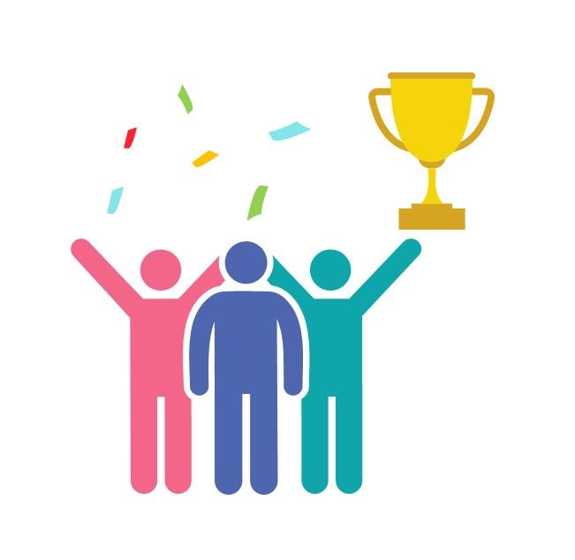
Awards
🏢 Best Build
📊 Best LCA Reflection
🤝 Best Team Collaboration
💡 Most Innovative Circular Economy Idea
Source: https://www.slideteam.net/
Notes:
To add an element of recognition and motivate participants.
The awards for Best LCA Reflection, Best Team Collaboration, and Most Innovative Circular Economy Idea celebrate different skills and contributions, encouraging a positive and collaborative atmosphere.

Slide 25

Any Questions? Let’s Discuss!
❓ Ask about anything unclear in the LCA or CE concepts
💭 Share your ideas for improving the activity or your product
Source: https://pngtree.com/
Notes:
To facilitate a final, open discussion and reflection.
This slide encourages participants to ask questions, share their ideas, and think critically about the concepts they learned. The "Challenge" question pushes them to think beyond the workshop's materials and apply their new knowledge to a broader context.

Slide 26
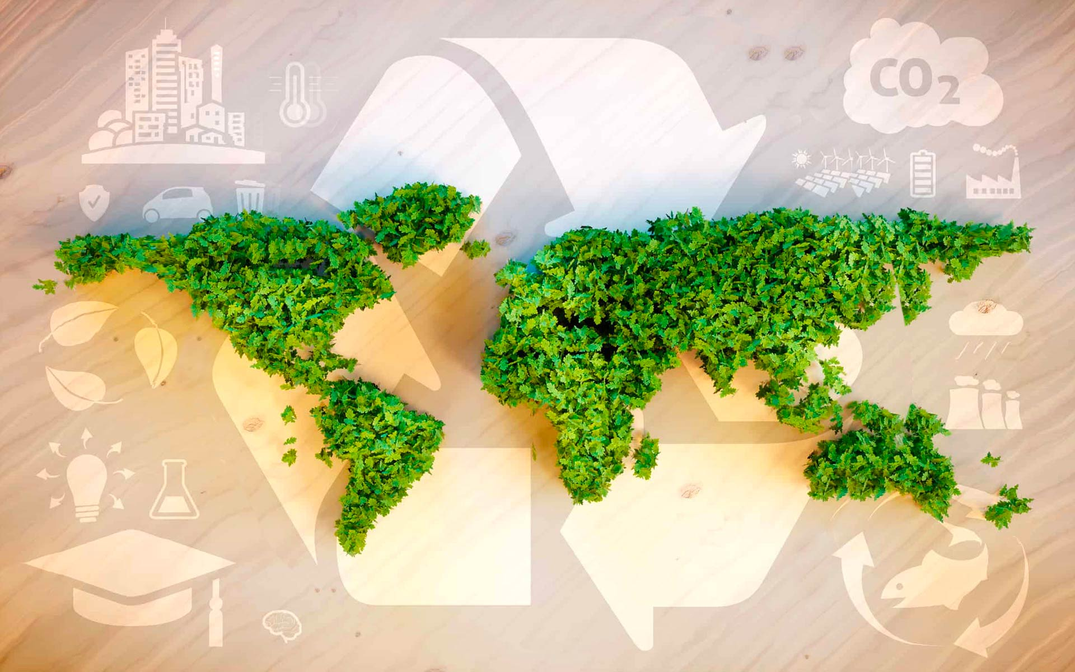
Thank You & Goodbye!
You are now an Eco Designer!
Keep thinking about materials and the planet
Source: www.fedongroup.com
Notes:
To end the workshop on an empowering and inspiring note.
The final message, "You are now an Eco Designer!," serves as a powerful validation of the participants' efforts and new skills. It leaves them with a call to action, encouraging them to continue thinking about sustainability in their daily lives.

