Slide 1


EDU-CIRC
Rete transfrontaliera per la formazione sull’economia circolare e la decarbonizzazione nella produzione
Grenzübergreifendes Netzwerk zur Aus- und Weiterbildung in Kreislaufwirtschaft und Dekarbonisierung in der Produktion
Europa noch näher
Un’Europa più vicina

Slide 2
Battery Born, Battery Buried
EVs and the Environment
THEME: AUTOMOTIVE

Slide 3

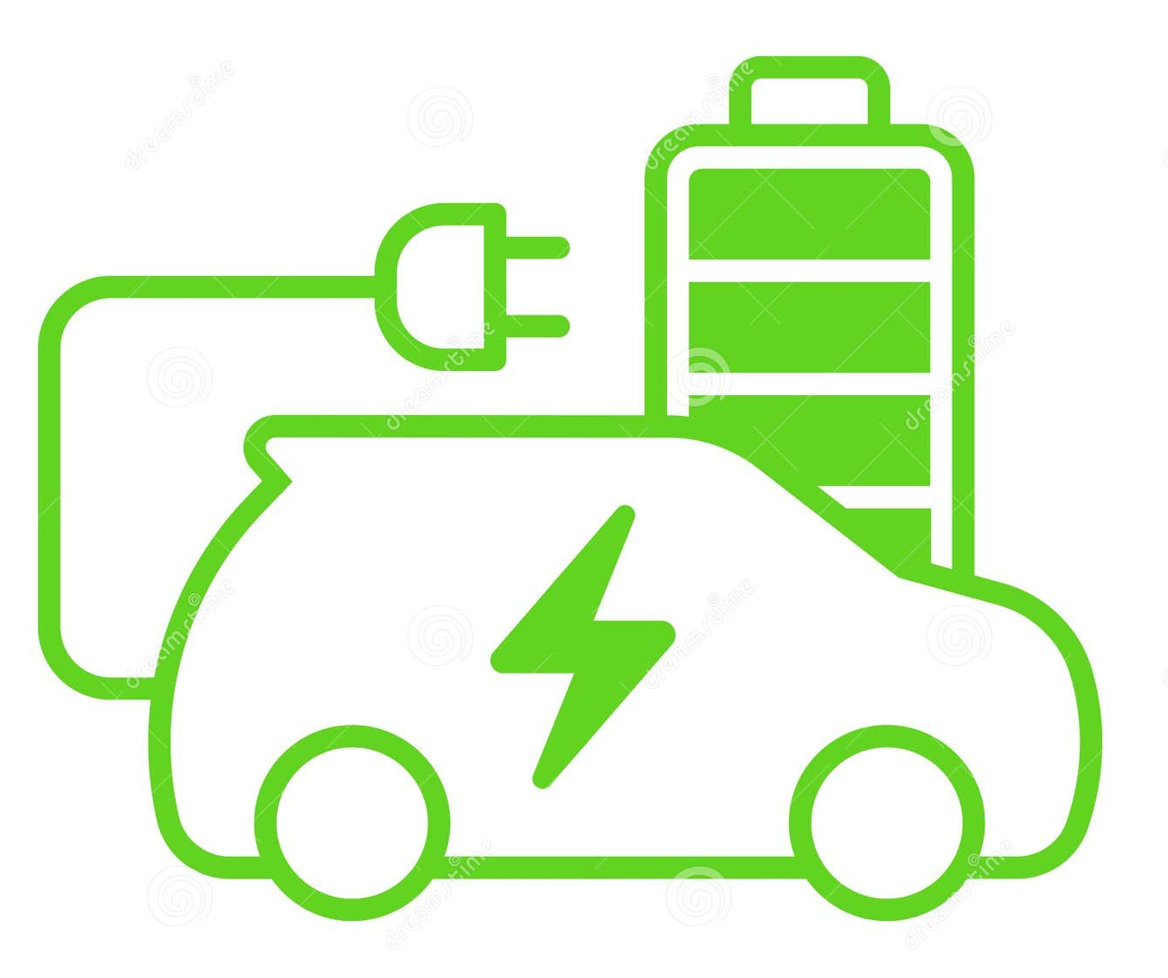
Welcome! – Battery Born, Battery Buried
In this hands-on workshop, you’ll explore how batteries are made, used, and their impact on the planet.
From lemon-powered circuits to electric vehicle batteries, you’ll discover how science meets sustainability.
Source: AI Generated
Notes:
Welcome students to our workshop! Today, we’ll explore the journey of batteries—from their birth to their environmental afterlife.
You'll learn by doing building your own battery using household items and comparing it to high-tech electric vehicle (EV) batteries.
We’ll also think about where materials come from and how our energy choices affect the planet.

Slide 4
Learning Objectives
🧪 Hands-On Skills
  Build and test simple natural batteries using everyday materials
  Measure and compare voltage using a voltmeter
🌱 Environmental Awareness
  Identify and reflect on the environmental impact of each material used
  Understand and apply the Life Cycle Assessment (LCA) process
🔋 Real-World Applications
  Compare simple battery experiments to real-world battery systems using LCA
Notes:
Build simple natural batteries using common materials
Learn how to measure voltage with a voltmeter
Reflect on the environmental impact of what you're using
Understand and apply Life Cycle Assessment (LCA)
Compare your experiment to real EV battery systems like Lithium-ion and Ni-Cad

Slide 5
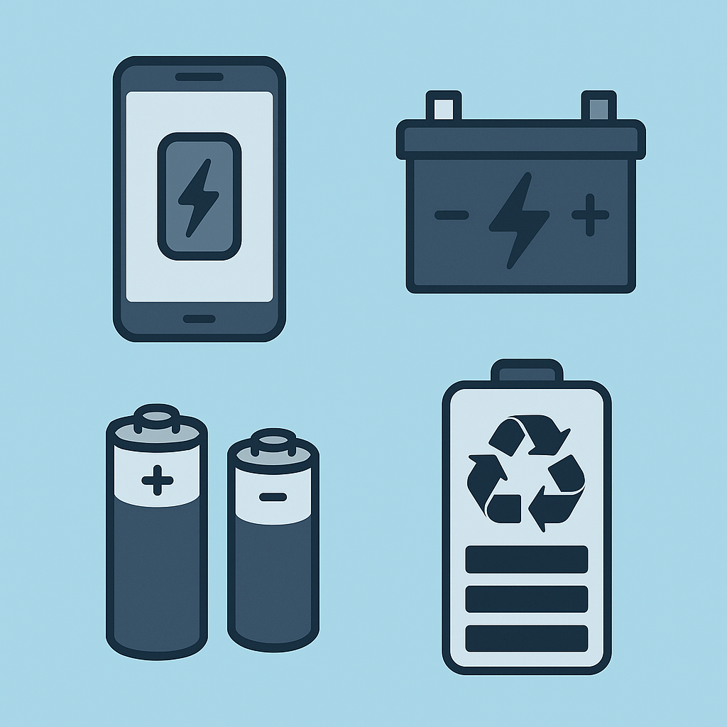



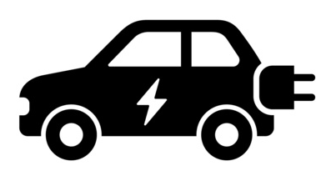
Quiz 1
Where do you find batteries in your daily life?
📱 Cell phones & tablets – powered by lithium-ion batteries
🎮 Toys & gaming devices – run on AA, AAA, or rechargeable packs
🕹️ TV remotes & clocks – often use small disposable batteries
🚗 Electric vehicles (EVs) – powered by large battery packs
Notes:
Let’s brainstorm. Where do we see or use batteries every day?
Think about your phone, remote controls, watches, toys, scooters, or EVs.
The goal here is to realize how common batteries are—and why it's important to understand their impact.

Slide 6
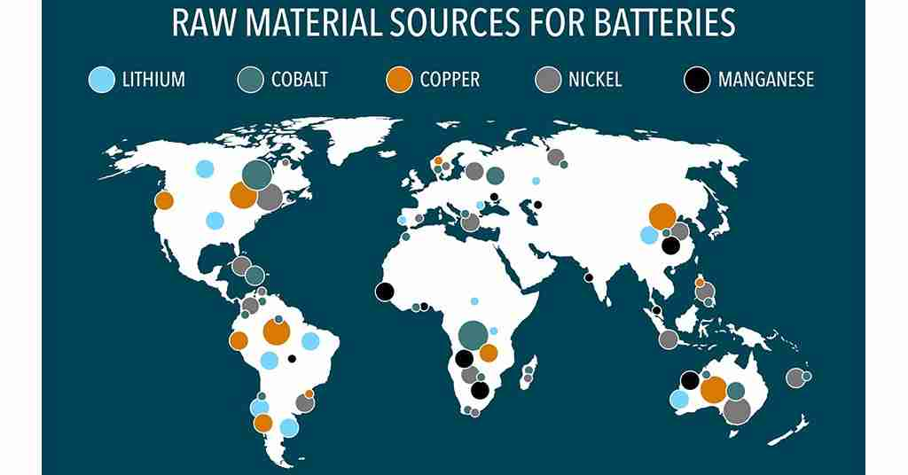
Quiz 2
Where Do Battery Materials Come From?
🪨 Mined from the Earth
Lithium, Cobalt, Nickel
🧪 Found in Nature (and Processed)
Graphite, Manganese, Zinc
🌎 Sourced from Key Countries
Chile (Lithium), Congo (Cobalt), Australia (Nickel)
Source: https://www.germanschoolcampus.com/raw-material-sources-for-batteries/
Notes:
Batteries aren’t just made in factories—they start with raw materials mined from the Earth.
Lithium is mined from salt flats, cobalt from the Democratic Republic of Congo, and nickel from Australia.
These processes have major environmental and social effects.

Slide 7
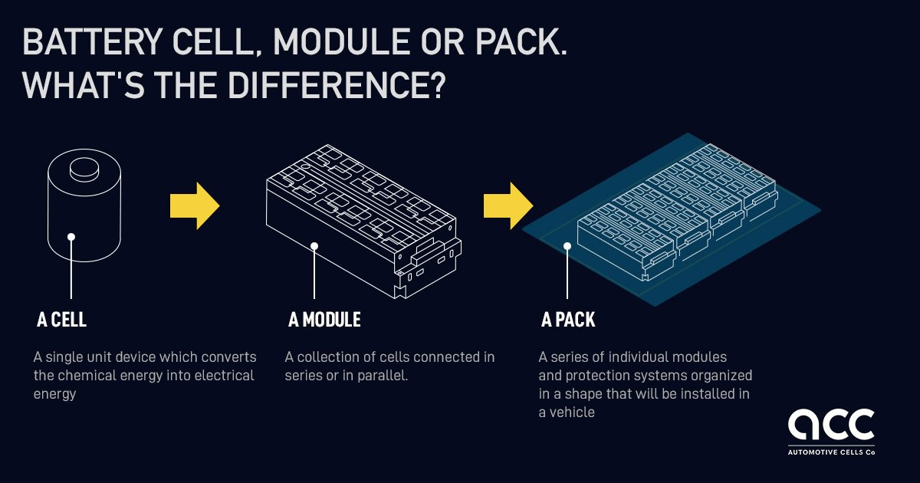
Quiz 3
How are batteries made and put together?
Built in special factories
Materials are cleaned, shaped, and tested
Made in steps: Cell → Module → Pack
Source: https://www.acc-emotion.com/stories/battery-cell-module-or-pack-whats-difference-infographics
📽️ How Lithium Cell to Module to Pack assembling
Notes:
Batteries go through multiple manufacturing steps.
Materials are refined and processed into cells, grouped into modules, and finally assembled into battery packs.
These are made in highly controlled factory environments, which also contribute to environmental impact.

Slide 8
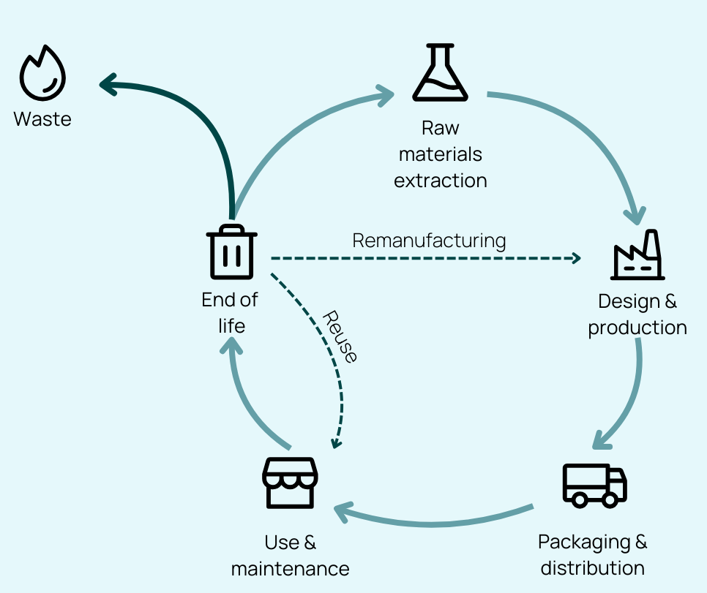
Introduction to LCA (Life Cycle Assessment)
What is Life Cycle Assessment?
Life Cycle Assessment (LCA) is a method used to evaluate the environmental impact of a product; from the moment it’s made to when it’s discarded or recycled.
https://youtube.com/shorts/-aQqWipI5AA?si=FtoxRYmYsc0jrNN2
It’s Called “Cradle to Grave” diagram
Source: https://www.zevero.earth
🌍 Raw Materials → 🏭 Manufacturing → 📦 Distribution → 🔌 Use → 🗑️ Disposal
Notes:
LCA is a method used to analyze the environmental impact of a product—from raw material extraction all the way to disposal.
It’s sometimes called “cradle-to-grave” analysis.
We’ll use this framework throughout our session.

Slide 9
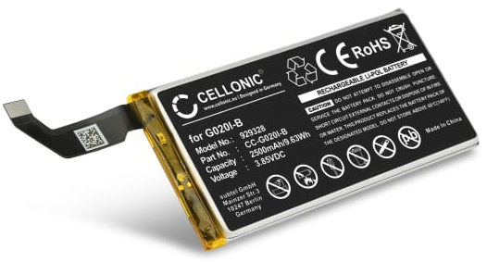
Introduction to LCA (Life Cycle Assessment)
Example: What's Behind a Phone Battery?
🌍 Materials → Mined metals: lithium, cobalt, rare earths
🏭 Production → Energy-intensive factory processes
🚚 Shipping → Global transportation footprint
⚡ Use → Daily charging = electricity
🗑️ End of Life → Often ends in landfill, low recycling rates
Source: https://www.subtel.be/
Notes:
Let’s walk through a common product—a phone battery.
It goes through five stages: raw materials, processing, transport, use, and end-of-life.
Each step has its own environmental footprint. Keep this in mind when we later compare with your own battery setup.

Slide 10
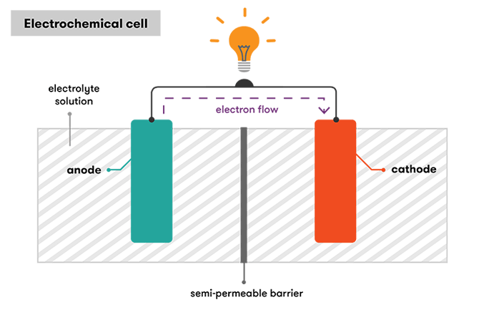
Simple Battery Chemistry
How do batteries work?
  Chemical energy → Electrical energy
  Two metals (like copper and zinc) +
  a liquid (electrolyte)
  The chemical reaction moves electrons → creates electricity
Source: https://www.science.org.au/curious/technology-future/batteries
Notes:
How do batteries work? A basic battery has two different metals—like copper and zinc—and an electrolyte (acidic liquid). A chemical reaction causes electrons to flow, producing electricity. This is the science behind the lemon or cola battery you'll build.

Slide 11
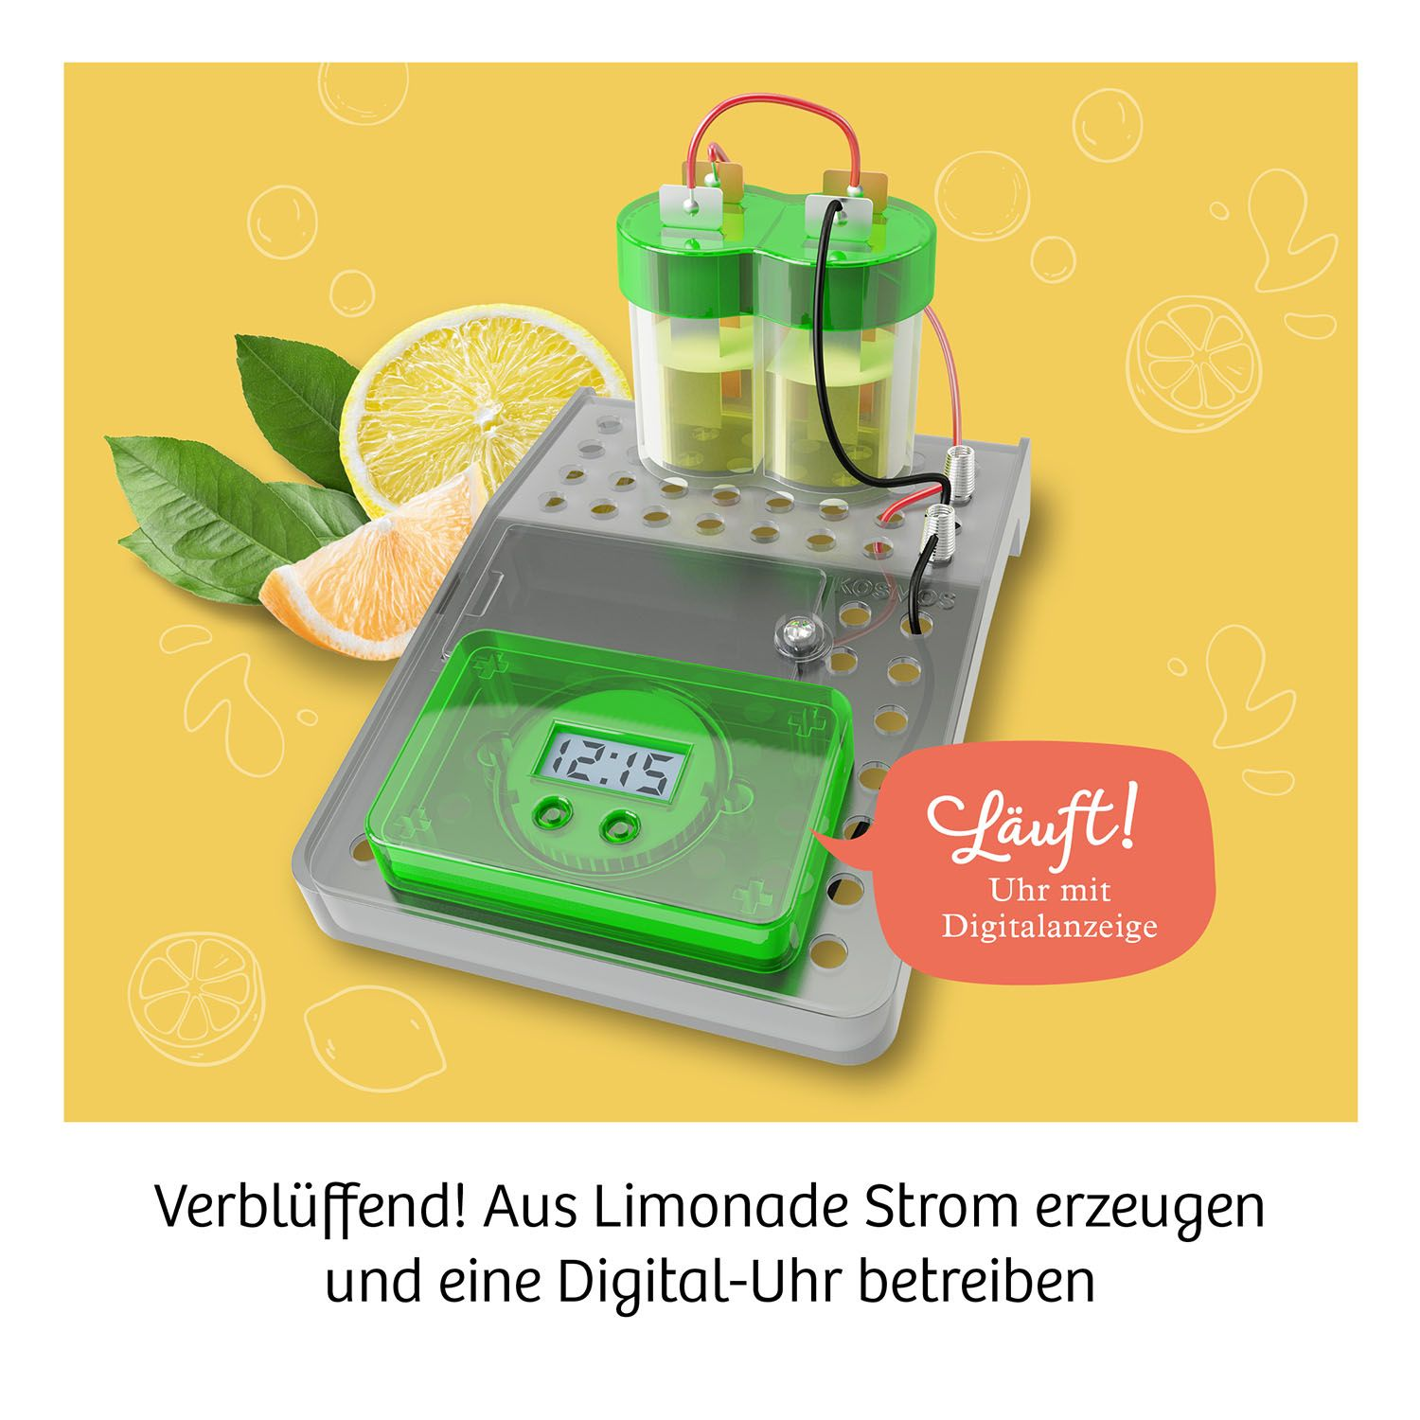
Simple Battery Chemistry
What you’re building today:
A simple circuit using food-based electrolytes!
Source: https://pickashop.at/
📽️ How to make a Vinegar Battery
Notes:
Each group will receive simple battery materials: copper and zinc electrodes, a voltmeter, and 2 liquids—like lemon juice, vinegar, or Coca-Cola.
Be careful with handling and set up the materials as instructed.

Slide 12
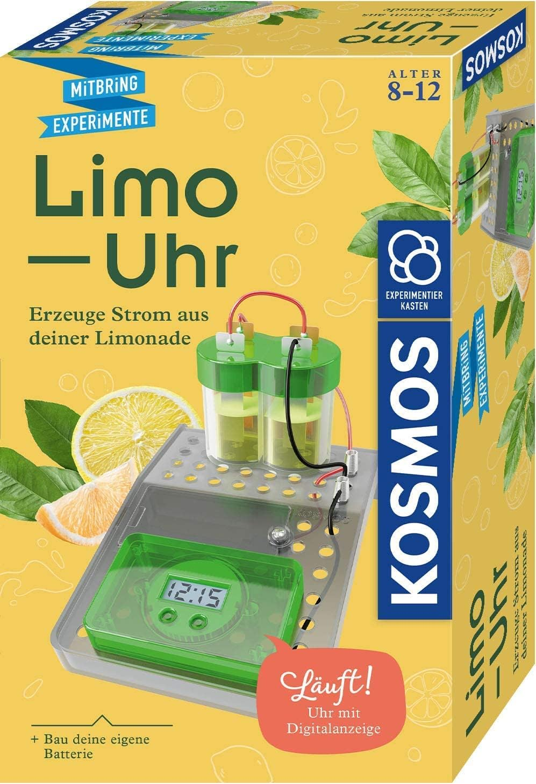



Group Activity- Lime Clock: Materials
Each Group Gets:
  Two Electrolytic Liquids (your group will test 2 of these):
  🍋 Lemon juice | 🥤 Coca-Cola | 🍶 Vinegar
  Lemon Clock Kit (Limo-Uhr)
  Voltmeter
  Connecting Cables
Source: https://www.amazon.de/
Source: https://www.betterequipped.co.uk
Source: www.gfifoods.com
Source: https://pickashop.at/
Notes:
Each group will receive simple battery materials: copper and zinc electrodes, a voltmeter, and 2 liquids—like lemon juice, vinegar, or Coca-Cola. Be careful with handling and set up the materials as instructed.

Slide 13
Group Activity: Setup Instructions
🔧 How to Set It Up:
  Read Lemon Clock Kit Instructions: Link
  Pour each liquid into the cups
  Insert the copper and zinc into the liquid (make sure they don’t touch!)
  Attach wires to each metal
  Connect to the voltmeter and record your result
  Repeat for the second liquid
Source: https://pickashop.at/
Notes:
Carefully insert the two metals into the liquids, ensuring they don’t touch. Connect the wires and use the voltmeter to measure voltage. Record your findings for each liquid and observe the difference in energy output.

Slide 14
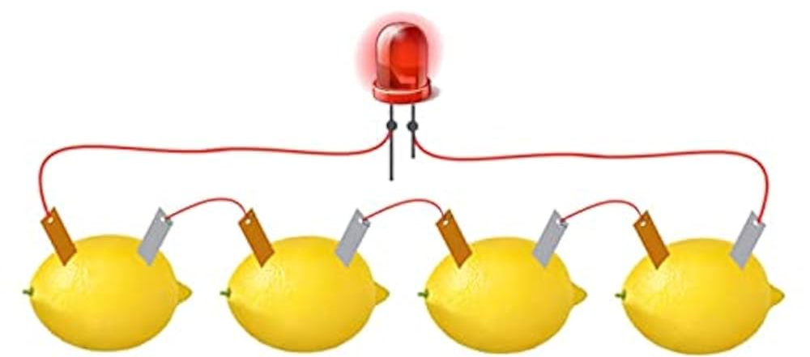
Group Activity: Observations
Liquid Tested | Voltage (V) | Color / Smell Observed | Any Bubbles? (Yes/No) | Notes / Comments
1.
2.
What made one electrolyte better than another?
Source: https://www.amazon.in/
Notes:
What differences did you see between liquids?
Which produced the highest voltage?
Was it what you expected?
Let’s discuss as a class what might explain the results based on acidity or conductivity.

Slide 15
Group Activity: Life Cycle Analysis
Material | 1. Raw Material Extraction | 2. Manufacturing / Production | 3. Transport / Shipping | 4. Use in Experiment | 5. End of Life | Environmental Impact Summary
Lemon Juice
Vinegar | Fermentation of sugars | Bottled in factories | Factory to supermarket | Electrolyte | Drainable | 🌱 Low (mild acid, biodegradable)
Coca-Cola | Water, sugar, CO₂, additives | Large-scale factory production | Distributed globally | Electrolyte | Drain / plastic waste | ⚠️ Medium (processing + packaging)
Zinc Electrode
Copper Electrode
Wires & Clips
Clock Module | Electronics + plastic casing | Assembled in factory | Shipped in battery kit | Measures voltage | E-waste | 🛑 High (needs proper disposal)
Plastic Cups
Notes:
Now apply the LCA method to the materials you used.
Where does lemon juice come from? What about copper or Coca-Cola?
Think about energy, water, transport, and waste. Even small items have environmental impacts.

Slide 16

Group Activity: Sharing & Results Discussion
Battery Setup Diagram
Results Table
Life Cycle Analysis Summary
Compare group findings (Lemon vs vinegar vs cola)
Notes:
Each group should present:
Battery Setup Diagram: Show how you arranged your electrodes and wires.
Results Table: Share your measured voltages for lemon, vinegar, or cola.
Life Cycle Analysis Summary: Briefly discuss where your materials come from and their environmental impact.
Compare Group Findings: Which liquid performed best? Lemon, vinegar, or cola — and why? Was it because of acidity or conductivity?”

Slide 17
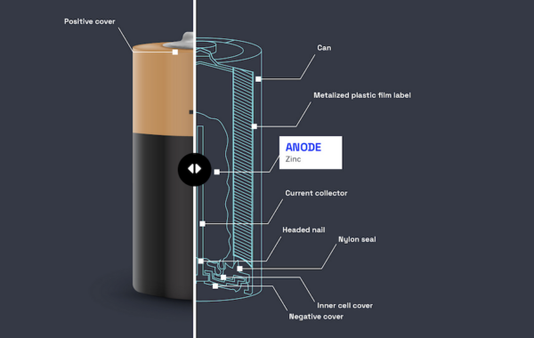
From Classroom Chemistry to Real Batteries
What Do Our Simple Batteries Have in Common with EV Batteries?
Experimental Battery (Lime Clock) | Real EV Battery
Copper & Zinc (electrodes) | Lithium, Cobalt, Graphite
Lemon/Cola (electrolyte) | Lithium Salt Electrolyte
Wires & clock (circuit) | Battery Management System
See: https://xplorlabs.org/resource/li-battery-interior/
Source: https://www.amazon.in/
Source: https://xplorlabs.org
Notes:
This slide helps us connect what we just did in the classroom — building a simple lime battery — to real electric vehicle (EV) batteries. Let’s walk through the comparison:
In our experiment, we used copper and zinc as electrodes. In real EV batteries, the electrodes are more advanced materials like lithium, cobalt, and graphite. These materials help store and transfer energy more efficiently.
The lemon juice or cola we used acted as the electrolyte, helping ions move between electrodes. Similarly, EV batteries use a lithium salt-based electrolyte to allow ion movement during charging and discharging.
The wires and clock in our experiment completed the circuit and powered a device. In an EV, the battery is connected to a more complex Battery Management System (BMS) that monitors performance, safety, and energy flow.
🔁 The takeaway is: The same basic principles apply — you need electrodes, an electrolyte, and a circuit — but the materials and scale are more advanced in real batteries.

Slide 18
Life Cycle Assessment: EV Battery
LCA Stage | Description
1. Raw Material Extraction | Mining of lithium (e.g., from brine in Chile) Cobalt (mainly from DRC), nickel, and graphite
2. Material Processing & Manufacturing | Refining metals and assembling battery cells Requires high heat, cleanrooms, and solvents Generates CO₂ emissions from energy use.
3. Distribution & Transport | Batteries are heavy and often shipped internationally Adds carbon footprint due to fuel-based logistics (sea, air, road).
4. Use Phase | Battery powers an electric vehicle for 8–15 years Efficiency and emissions savings depend on how clean the electricity source is (e.g., coal vs solar).
5. End of Life / Disposal | Batteries can be: Reused in second-life storage (solar backup, etc.) Recycled to recover lithium Cobalt → Landfilled (least desirable)
Notes:
Let’s take a moment to trace the full life cycle of an EV battery — just like we did with our cola or lemon batteries.
1️⃣ Raw Material Extraction
This includes mining lithium (from brine in places like Chile), cobalt (often from the DRC), nickel, and graphite. This is the most environmentally and socially impactful stage due to water use, pollution, and labor issues.
2️⃣ Material Processing & Manufacturing
Refining those metals and making the battery cells happens in factories that need cleanrooms, solvents, and a lot of energy. This generates CO₂ emissions from electricity use.
3️⃣ Distribution & Transport
Batteries are heavy and often shipped across countries and continents — adding a large carbon footprint due to air, sea, and road transport.
4️⃣ Use Phase
This is when the battery is inside an EV, lasting about 8 to 15 years. Its efficiency depends on how clean the power source is — e.g., solar is better than coal.
5️⃣ End of Life / Disposal
Batteries may be reused in second-life systems (like solar energy storage), recycled to recover metals like lithium, or unfortunately landfilled, which is the least preferred.
📌 This slide reminds us: Every stage in a product’s life has a footprint. Understanding the LCA helps us make better, more sustainable design and consumption decisions.

Slide 19
What Can We Do About It?
💬 Discussion Prompts:
Can we reduce the impact of raw material extraction?
How can batteries be made more sustainable?
What role do recycling or reusing materials play?
Would you still choose an EV knowing this? Why or why not?
Notes:
Let’s turn problems into solutions. Can we reduce this impact? Ideas include better mining practices, ethical sourcing, battery recycling, and second-life uses. What would your green battery look like?
🔹 Can we reduce the impact of raw material extraction?
Yes, through better mining practices, stricter regulations, and technologies that minimize land and water disruption.
Sourcing materials from ethical suppliers (e.g., no child labor, environmentally monitored mining sites).
Alternative materials could be explored—e.g., sodium-based batteries.
🔹 How can batteries be made more sustainable?
By designing batteries that last longer and are easier to recycle.
Using renewable energy in battery manufacturing.
Modular battery designs (replace parts instead of whole battery).
Innovations like solid-state batteries could lower resource use.
🔹 What role do recycling or reusing materials play?
Huge role! Recovered lithium, cobalt, and nickel reduce the need for new mining.
Reusing parts or cells in second-life applications like solar energy storage systems.
Encourages circular economy and reduces e-waste pollution.
🔹 Would you still choose an EV knowing this? Why or why not?
Many students may still say yes, because EVs reduce air pollution and carbon emissions during use.
Others may raise concerns about battery waste or ethical sourcing.
Use this moment to guide discussion on trade-offs and long-term benefits of cleaner transportation, especially if paired with better production methods.
Encourage students to share ideas, challenge assumptions, and explore real-life examples of companies improving sustainability (e.g., Tesla recycling, Fairphone sourcing, etc.). Try to keep the discussion balanced—this is a moment for reflection, not just answers.

Slide 20
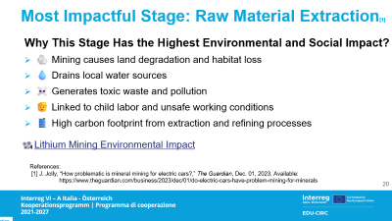
Most Impactful Stage: Raw Material Extraction[1]
Why This Stage Has the Highest Environmental and Social Impact?
🪨 Mining causes land degradation and habitat loss
💧 Drains local water sources
☠️ Generates toxic waste and pollution
🧒 Linked to child labor and unsafe working conditions
🛢️ High carbon footprint from extraction and refining processes
📽️Lithium Mining Environmental Impact
References:
[1] J. Jolly, “How problematic is mineral mining for electric cars?,” The Guardian, Dec. 01, 2023. Available: https://www.theguardian.com/business/2023/dec/01/do-electric-cars-have-problem-mining-for-minerals
‌
Notes:
Let’s take a closer look at the stage that has the highest environmental and social impact — the extraction of raw materials.
🔍 Why does this matter so much?
Mining operations can destroy ecosystems, especially in biodiverse regions like the Amazon or Congo.
It takes a lot of water to extract minerals like lithium — often draining local sources in already dry regions.
The process releases toxic waste into the soil and rivers.
In some countries, mining is done under dangerous conditions, sometimes involving child labor or unsafe workplaces.
And it doesn’t stop there — the carbon emissions from mining machinery and chemical refining are huge.
we can watch a short video to see what lithium or cobalt mining looks like.

Slide 21
How Can EVs Be More Sustainable
Battery recycling (recover lithium, cobalt, nickel)
Second-life batteries (reuse in solar/home systems)
Better mining practices (cleaner, safer, ethical sourcing)
Solid-state batteries (fewer toxic materials)
📽️ Mercedes-Benz Battery Recycling Factory
📽️ Lithium vs Hydrogen vs Solid State : EV Battery Technologies
Notes:
Introduce innovations: solid-state batteries, battery passports, cleaner mining, and improved recycling. Let students brainstorm ways to reduce environmental impact in future EVs or home energy storage.
🔹 Battery recycling
Batteries contain valuable metals like lithium, cobalt, and nickel.
Recycling reduces the need to mine more and helps close the loop in battery production.
Companies like Redwood Materials and Umicore are already doing this at scale.
🔹 Second-life batteries
Even after they are no longer efficient for vehicles, batteries can still store energy.
These can be reused in solar backup systems, off-grid homes, or grid storage.
Helps extend product life and reduce waste.
🔹 Better mining practices
Mining can have serious environmental and human costs.
Sustainable mining includes reducing pollution, safer labor conditions, and ensuring ethical sourcing (no child labor or conflict minerals).
Certifications and traceability are helping improve accountability.
🔹 Solid-state batteries
These are a next-generation technology.
Use fewer flammable liquids and potentially fewer toxic materials.
They promise higher efficiency and longer life spans—leading to less frequent replacement.

Slide 22
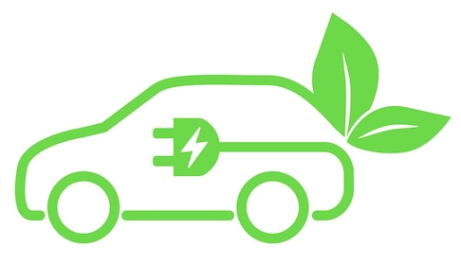
Thank You & Goodbye!
Go forth and design with the planet in mind!
Source: https://www.freepik.com
Notes:
Thank the students. Summarize: Batteries are essential, but they have a cost.
Through science, critical thinking, and innovation, we can design better and cleaner energy solutions for the future.
We’ve reached the end of today’s journey! From understanding where batteries come from, to building simple batteries, and exploring the life cycle of real EV batteries.
I hope you leave with new insight and inspiration. As you think about the future, remember: our planet needs thoughtful choices.
Whether you're designing, inventing, or simply making decisions as a consumer, ask yourself — how can this be done better, more sustainably?”

