Slide 1


EDU-CIRC
Rete transfrontaliera per la formazione sull’economia circolare e la decarbonizzazione nella produzione
Grenzübergreifendes Netzwerk zur Aus- und Weiterbildung in Kreislaufwirtschaft und Dekarbonisierung in der Produktion
Interreg VI – A Italia - Österreich
Europa noch näher
Un’Europa più vicina

Slide 2
Workshop
Vertical Farms

Slide 3




The Earth is getting hotter
One big reason: too much CO₂ (carbon dioxide) in the air
CO₂ comes from cars, factories… and farms too!

Slide 4


What is CO₂?
[2]
CO₂ is a gas, that traps heat, like a big blanket around the Earth
[1]
More CO₂ = a hotter planet
This is called global warming or climate change

Slide 5

What is Decarbonization?
Less fossil fuel
Absorb carbon
Using less carbon — or none at all
Cleaner, greener choices
Less pollution

Slide 6

Why Decarbonization Matters?
[3]
  🌍 The planet gets cooler
  🏘️ Cities become cleaner
    💡 We save energy
    🌿 Nature stays healthier

Slide 7
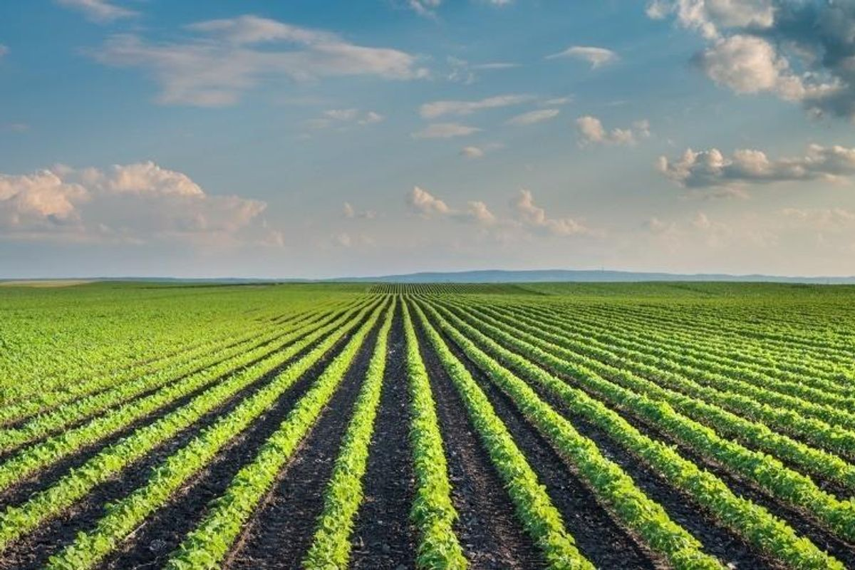
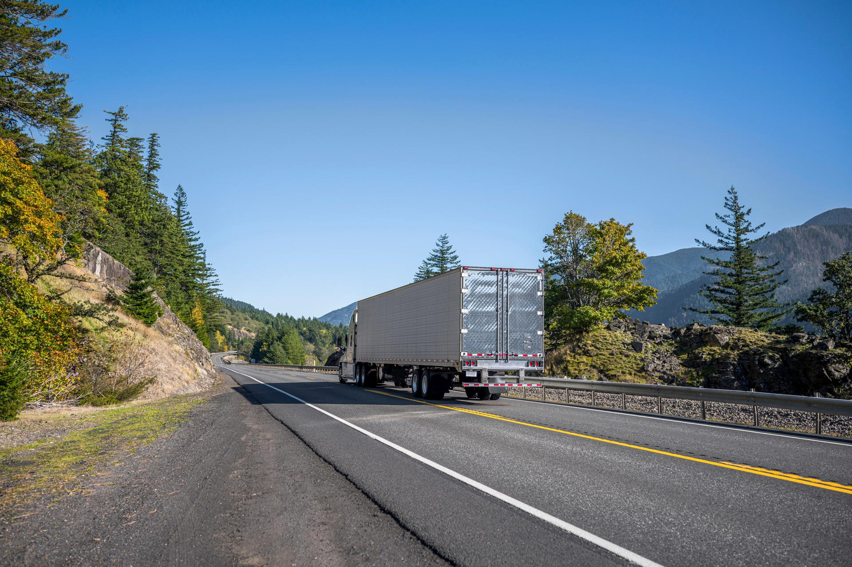
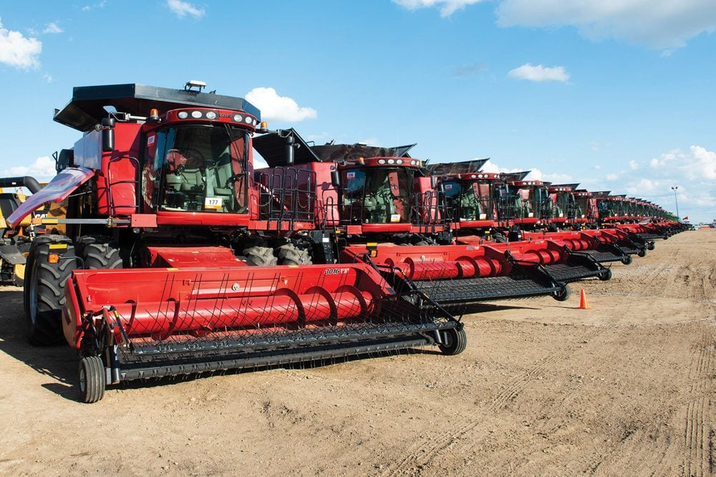
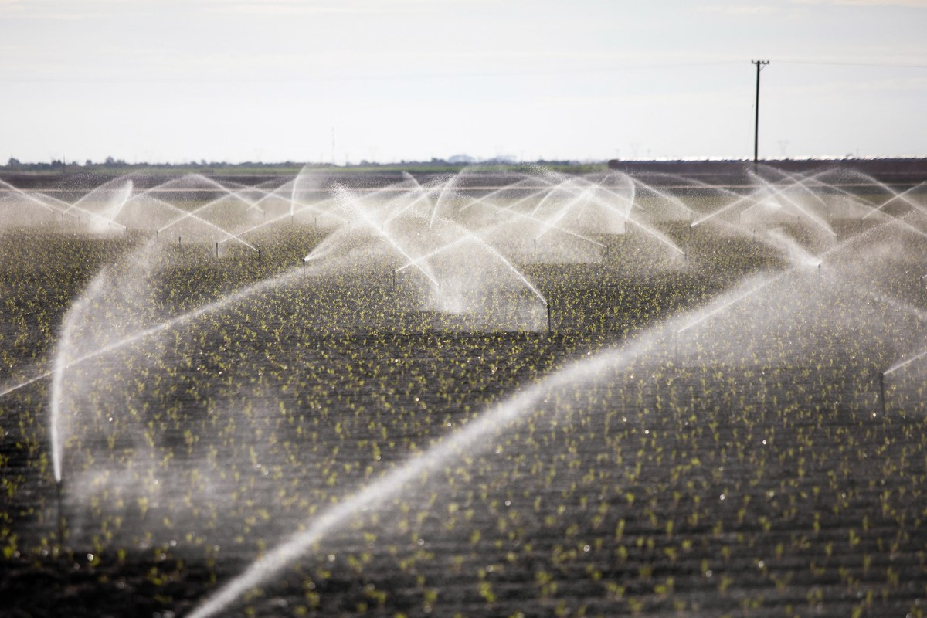
Why We Talk About Farms?
[4]
[5]
[6]
[7]
Huge land areas
Long trips for delivery
Diesel fuel for machines
Lots of water

Slide 8
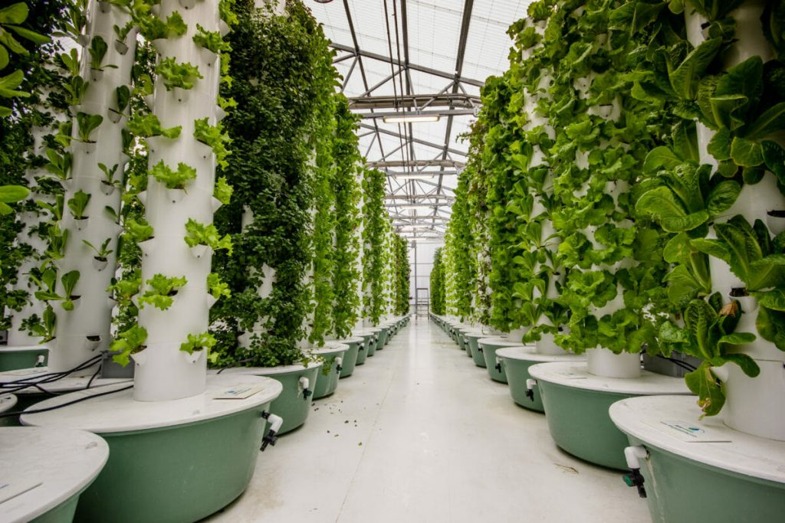
What is a Vertical Farm?
A vertical farm is a tall building where food grows in stacked layers — like shelves!
[8]

Slide 9
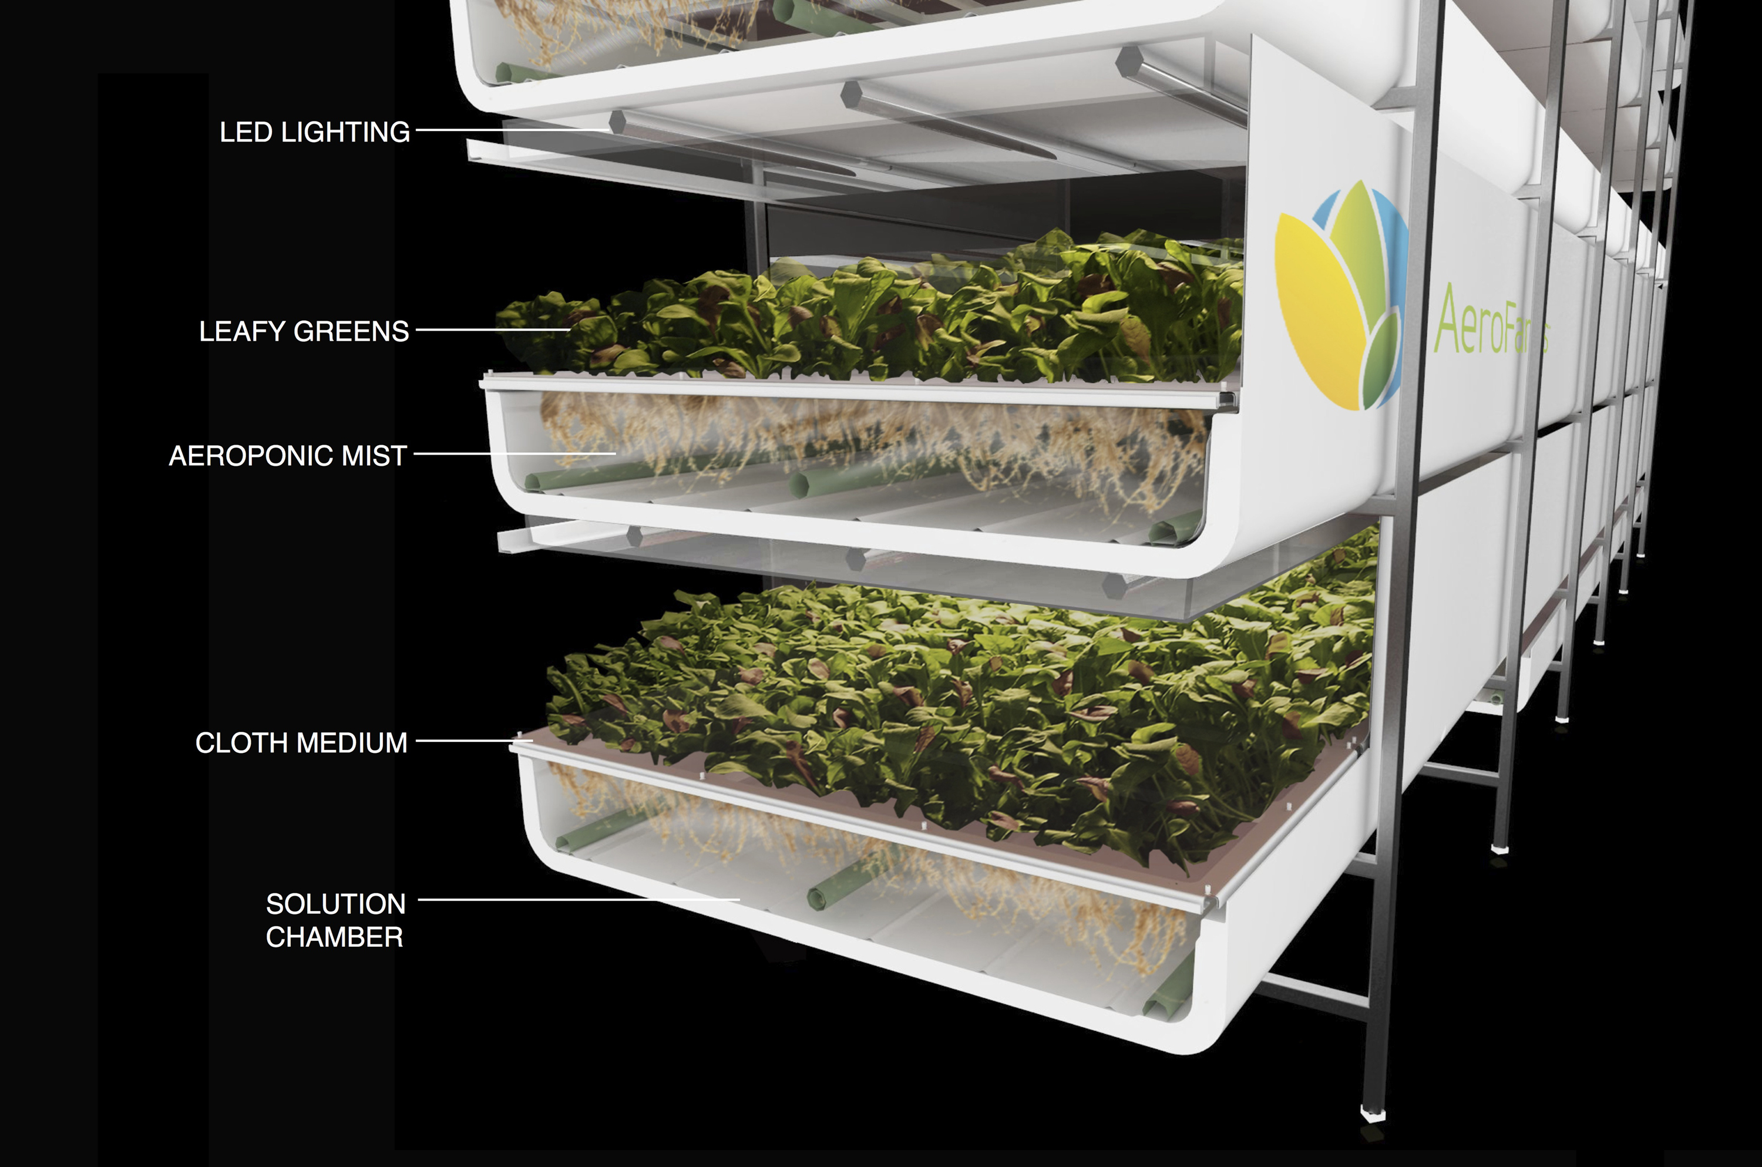
What is a Vertical Farm?
Plants grow indoors
Special lights help them grow
No soil is needed — just water and nutrients
Source: AeroFarms

Slide 10
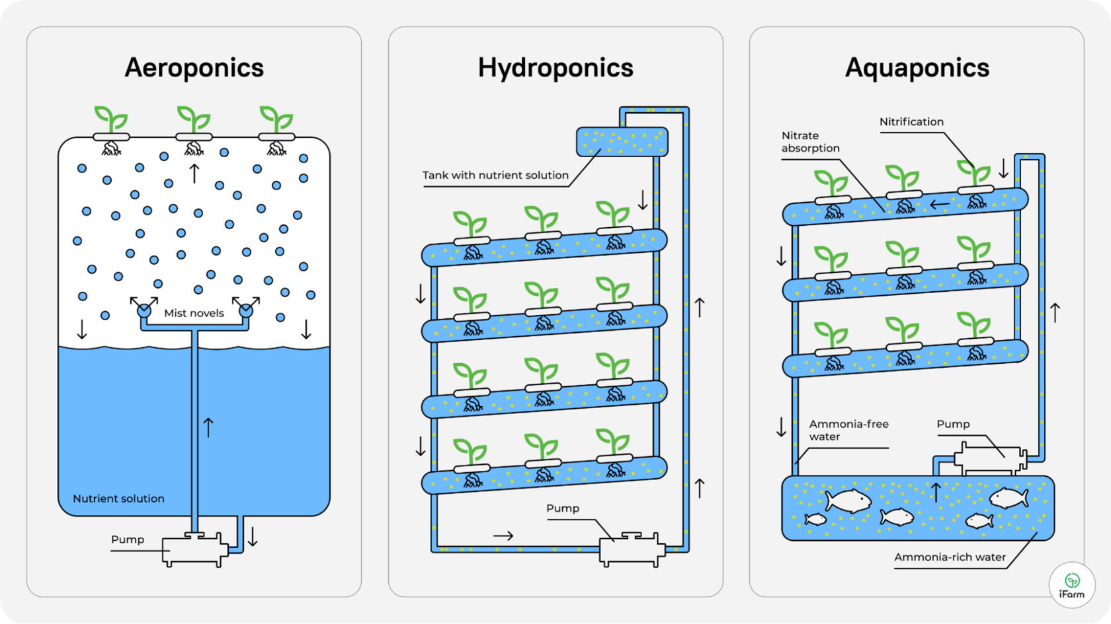
How does a Vertical Farm work?
Source: iFarm.

Slide 11
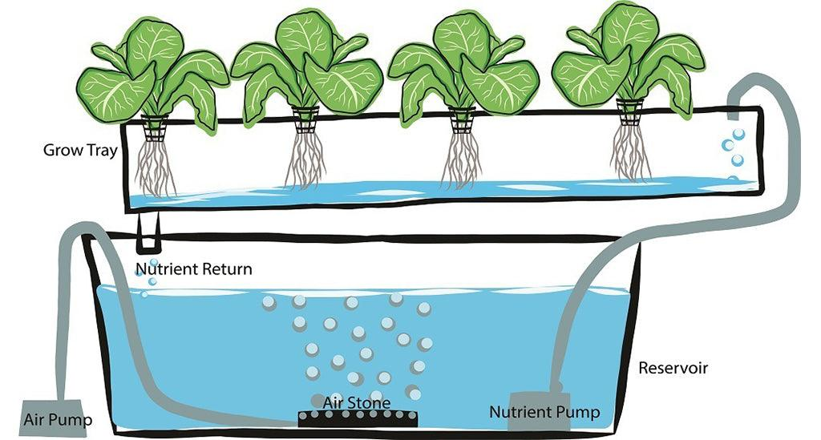
How Vertical Farms Work: Hydroponics
The roots are in water or in an inert substrate through which the solution circulates
[9]

Slide 12
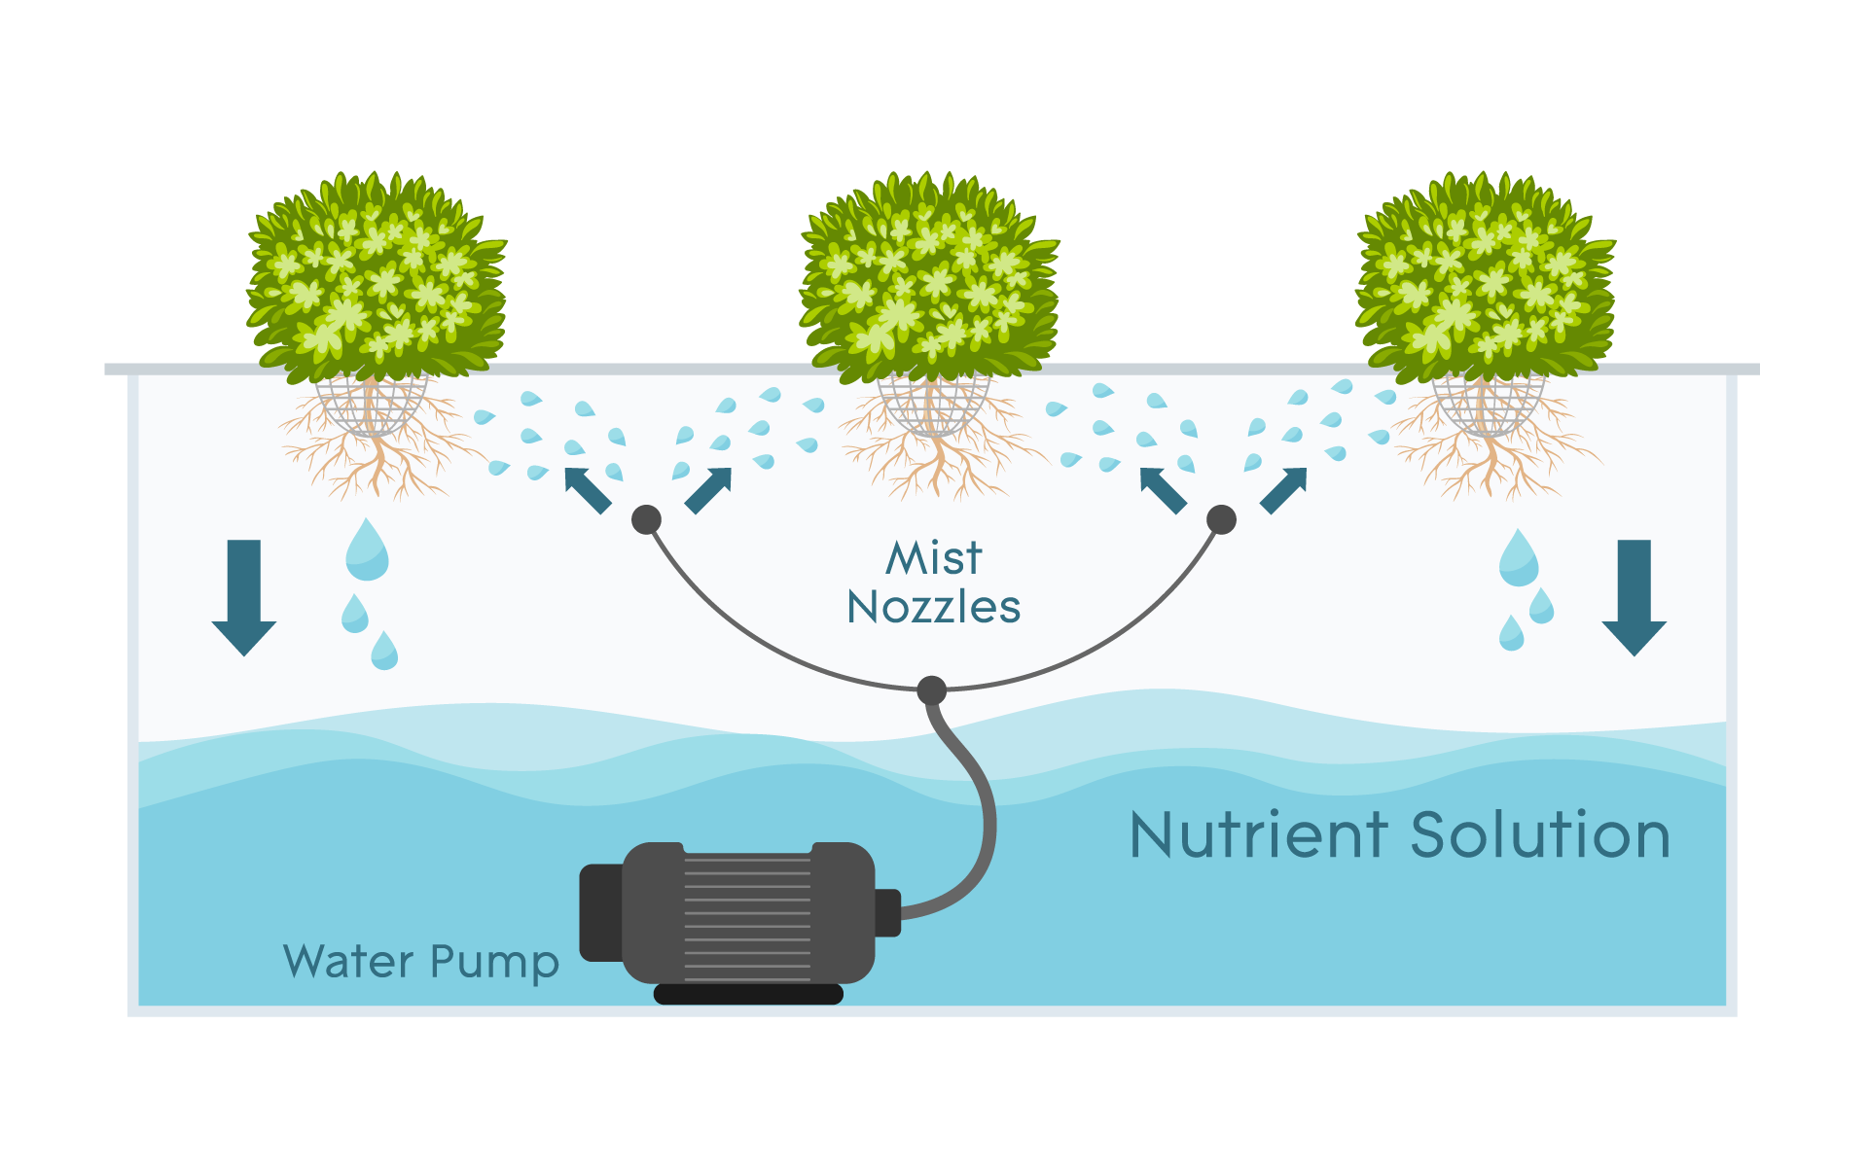
How Vertical Farms Work: Aeroponics
The roots hang in the air and are irrigated with a fine mist containing water and nutrients
Source: hydroexperts.com

Slide 13
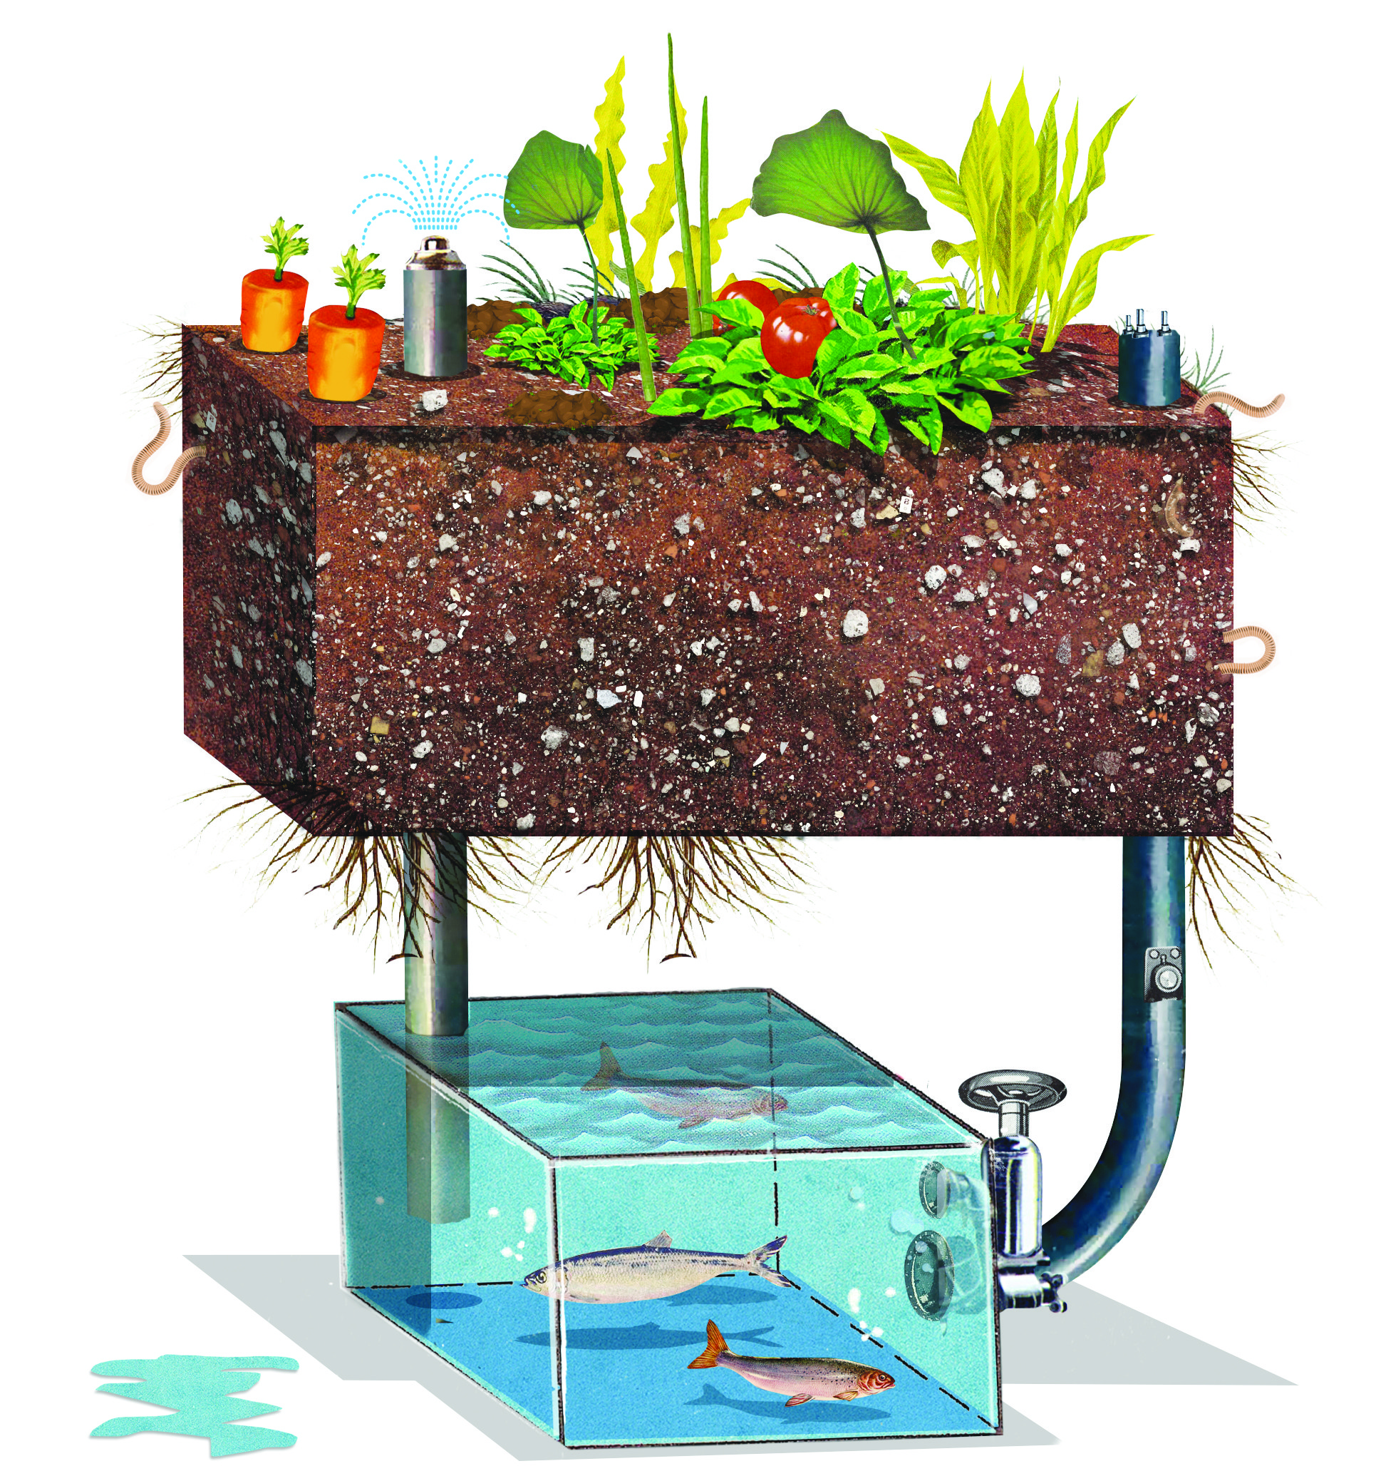
How Vertical Farms Work: Aquaponics
Combination of fish tank and hydroponic setup. Fish produce waste which bacteria convert into fertilizer for plants. Plants in turn clean water for fish
[10]

Slide 14
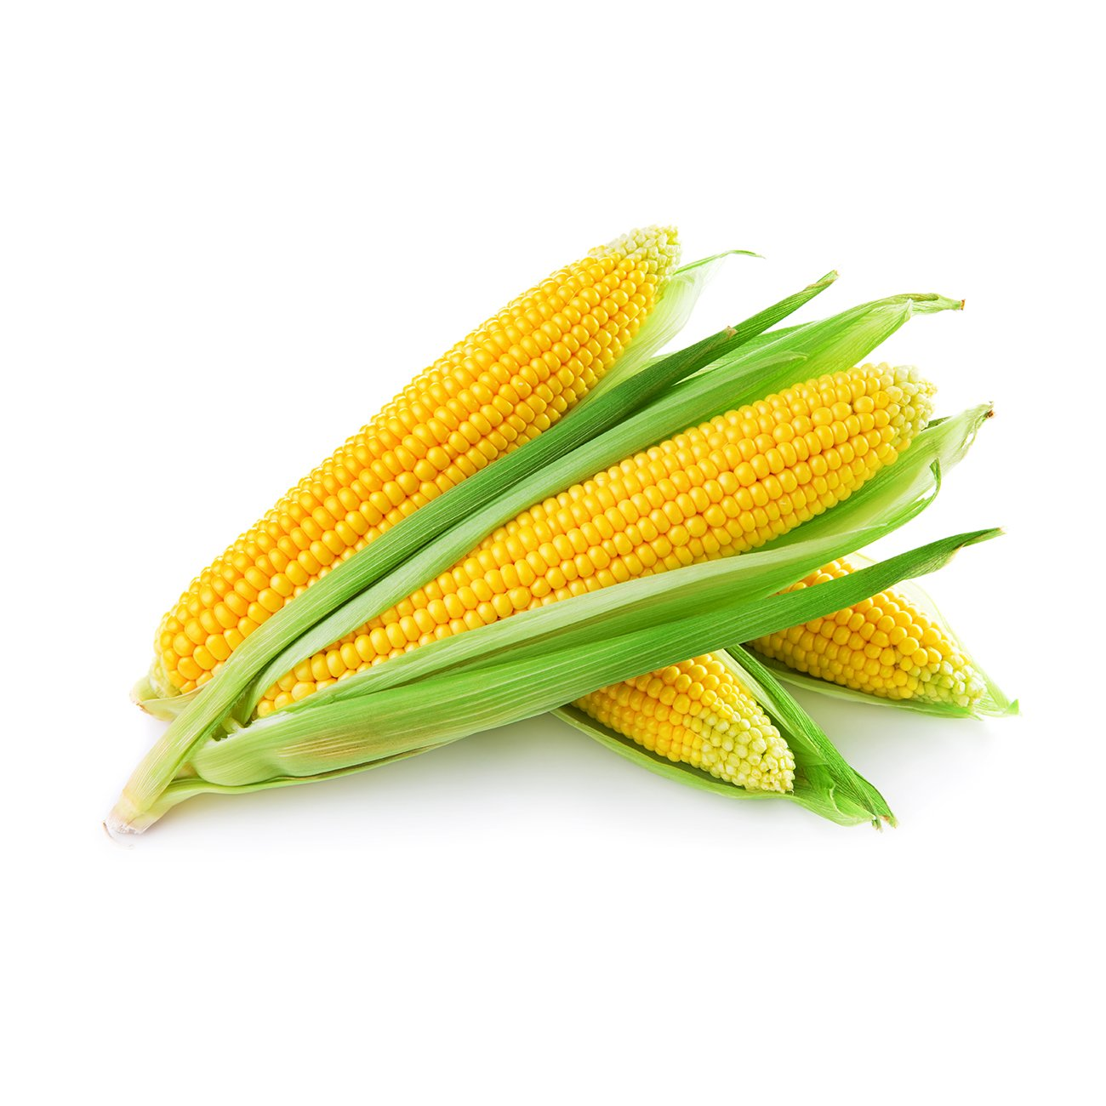
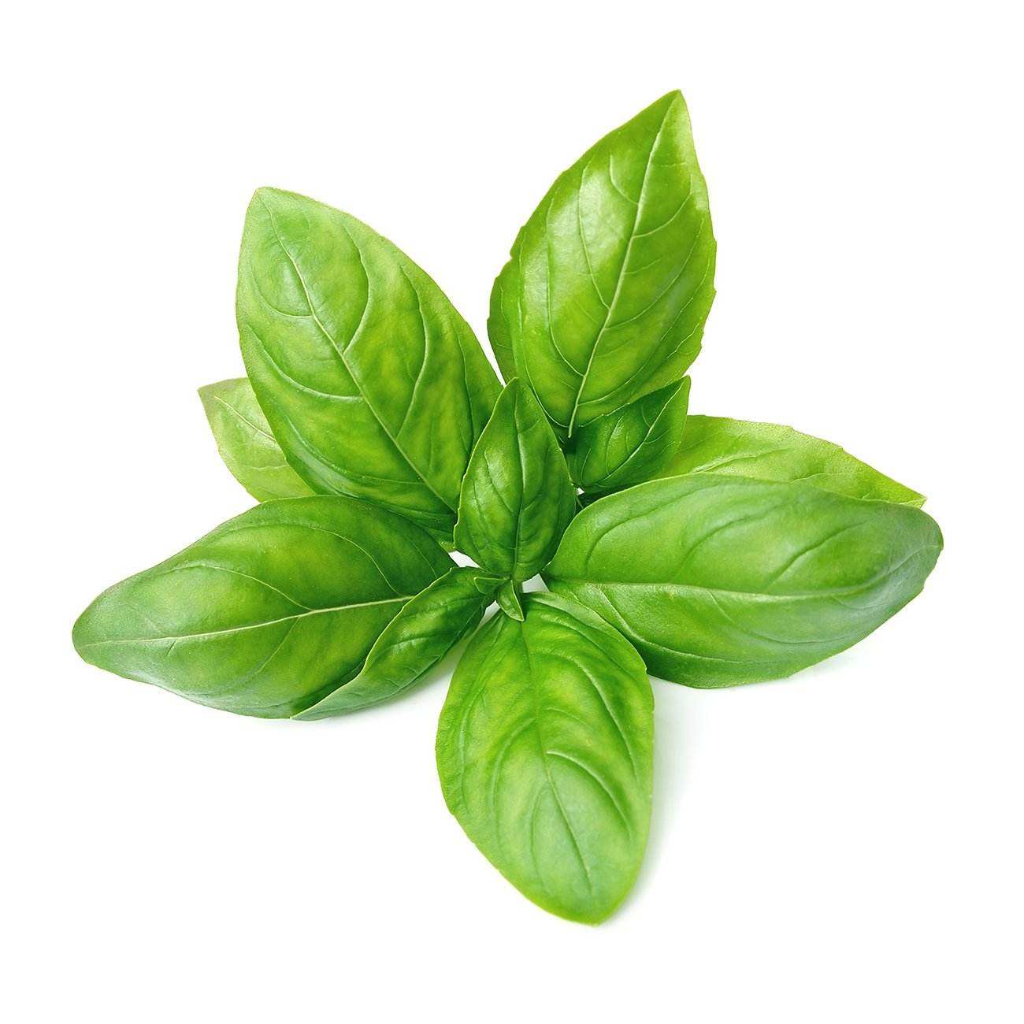
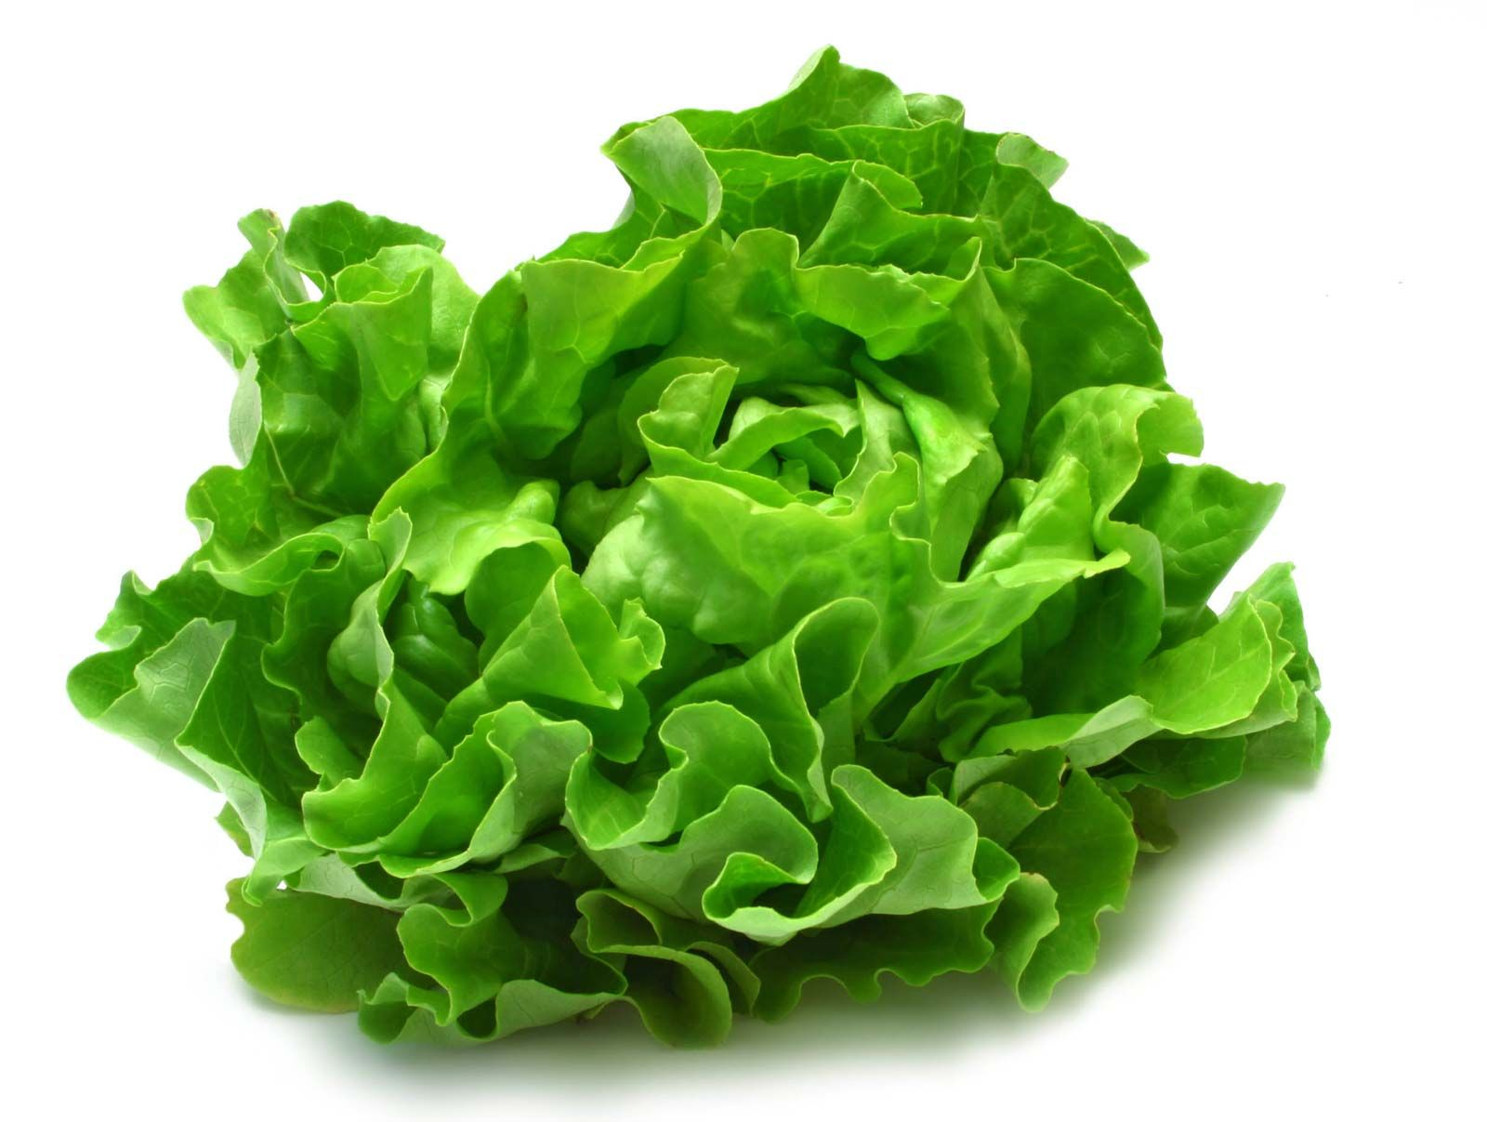


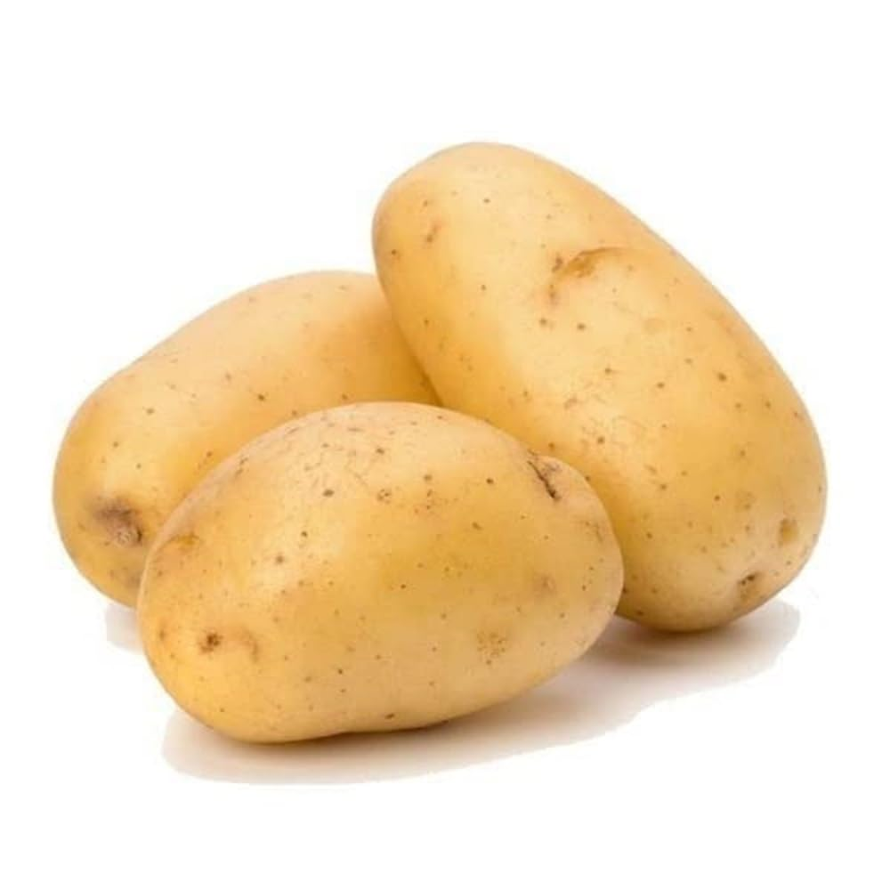
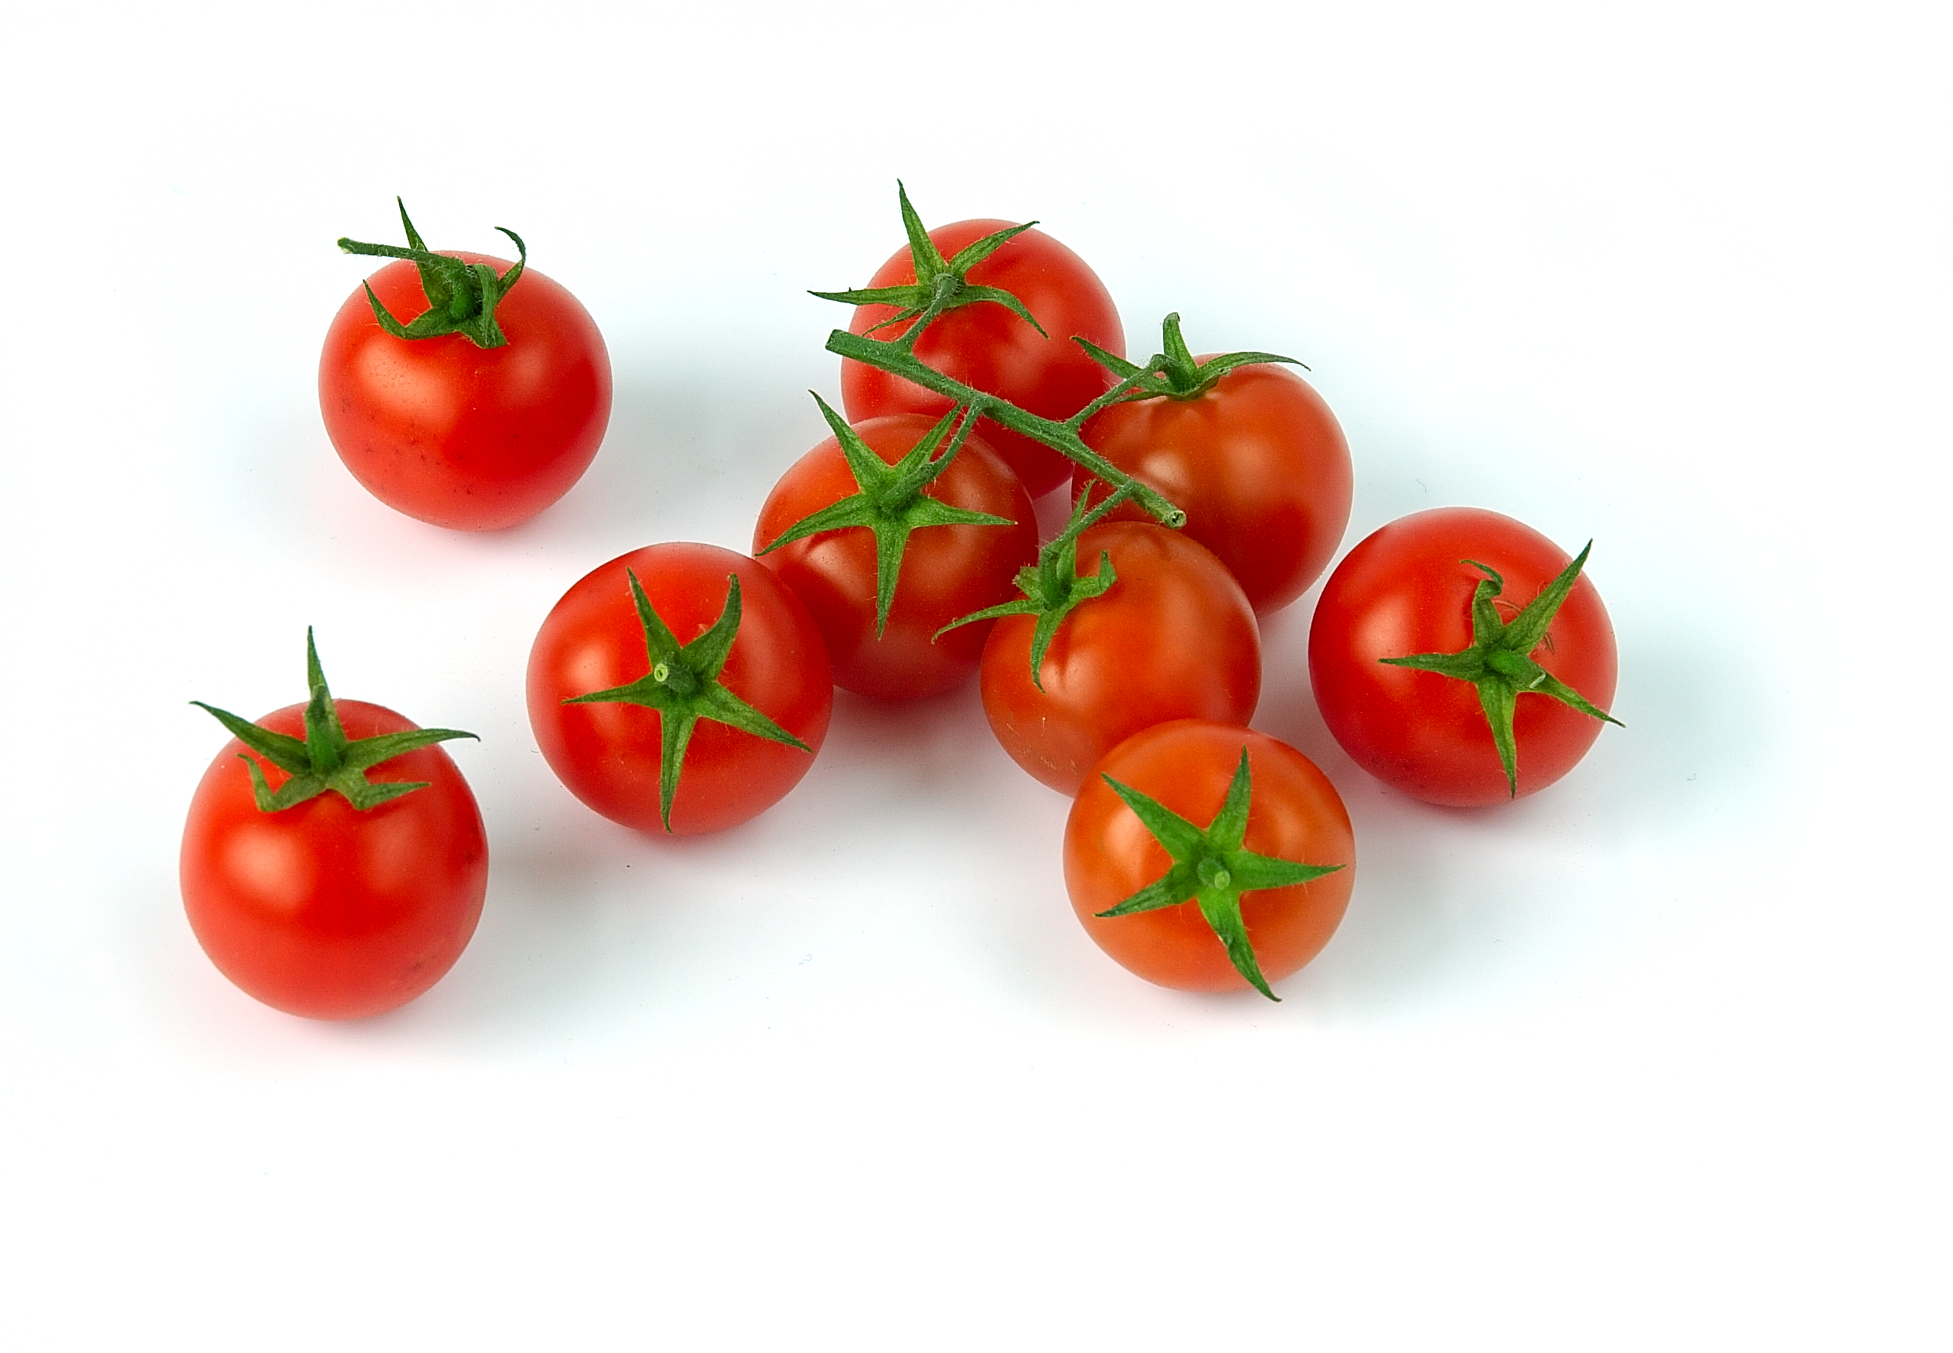
QUIZ: What can you grow in vertical farm?
Corn
Lettuce
Banana
Basil
Strawberry
Potato
Cherry tomatoes

Slide 15


QUIZ: What can you grow in vertical farm?
Corn
Lettuce
Banana
Basil
Strawberry
Potato
Cherry tomatoes

Slide 16
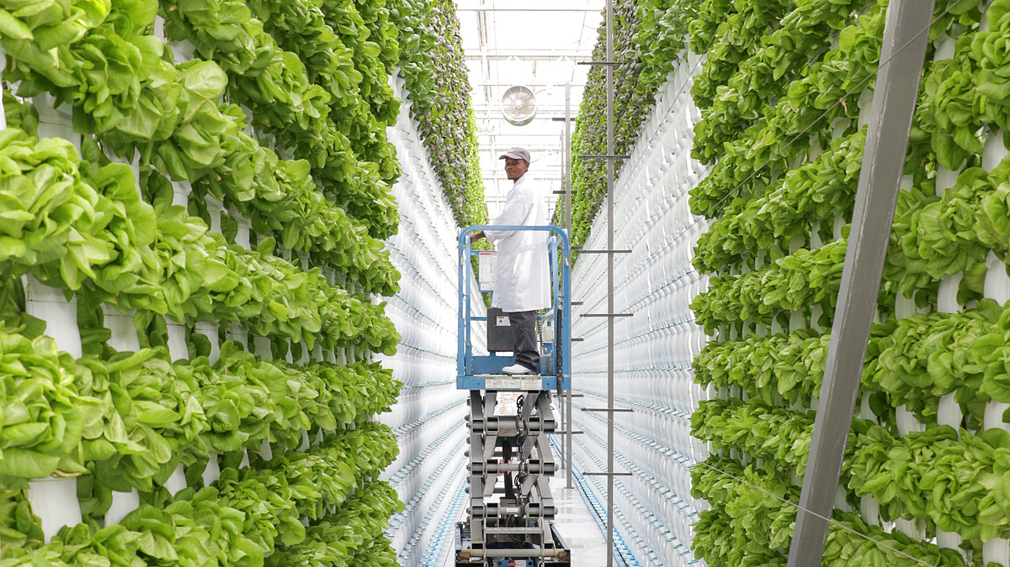
How Do Vertical Farms Help the Earth?
Use less land
Use less water
No big tractors = less fuel
Grown near cities = less delivery distance
Grow all year — even in winter!
Source: CAN-Agri

Slide 17

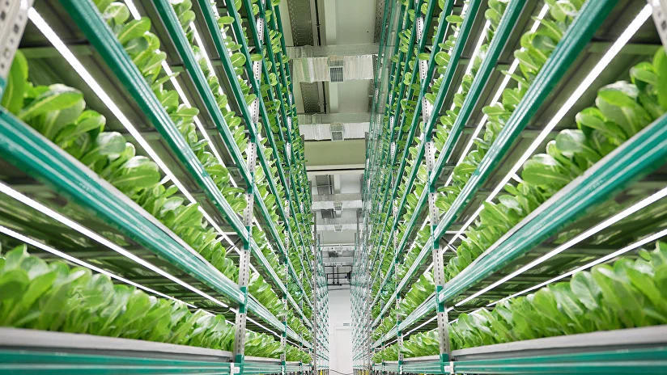
Challenges of Vertical Farms
High energy use for lights
Expensive to build
Can’t grow every type of crop (yet!)
Needs technology and experts
Source: iFarm.

Slide 18
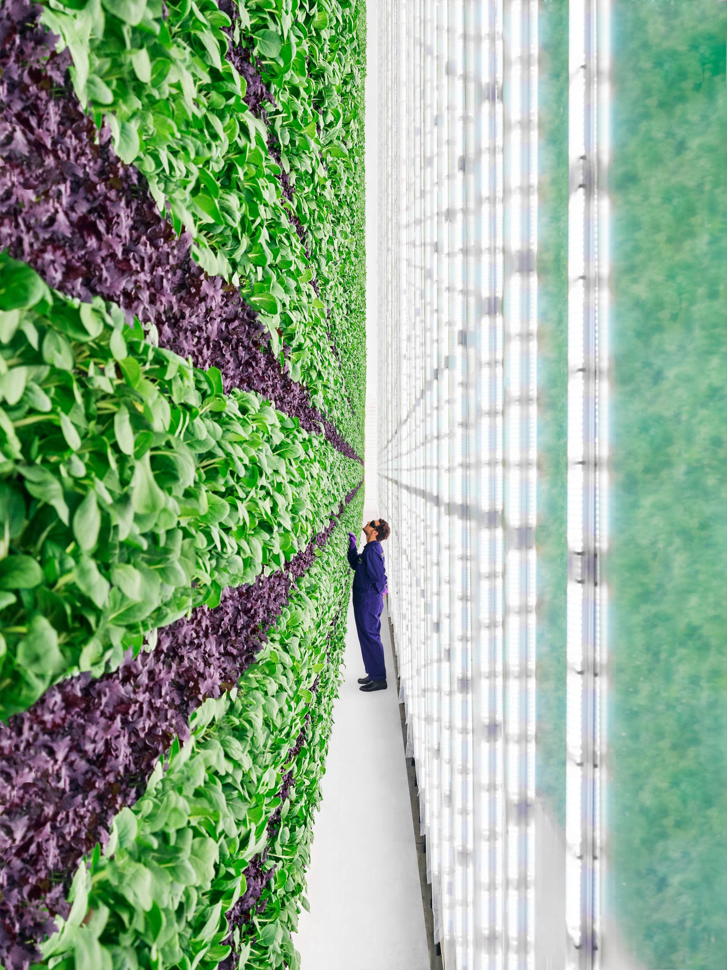
What About The Energy?
Vertical farms use a lot of electricity — for lights, fans, and pumps
But if they use solar or wind energy, they stay green!
[11]

Slide 19










Comparing Farms
 | Traditional Farms | Vertical Farms
Land
Water
Energy
Logistics
Weather dependency

Slide 20
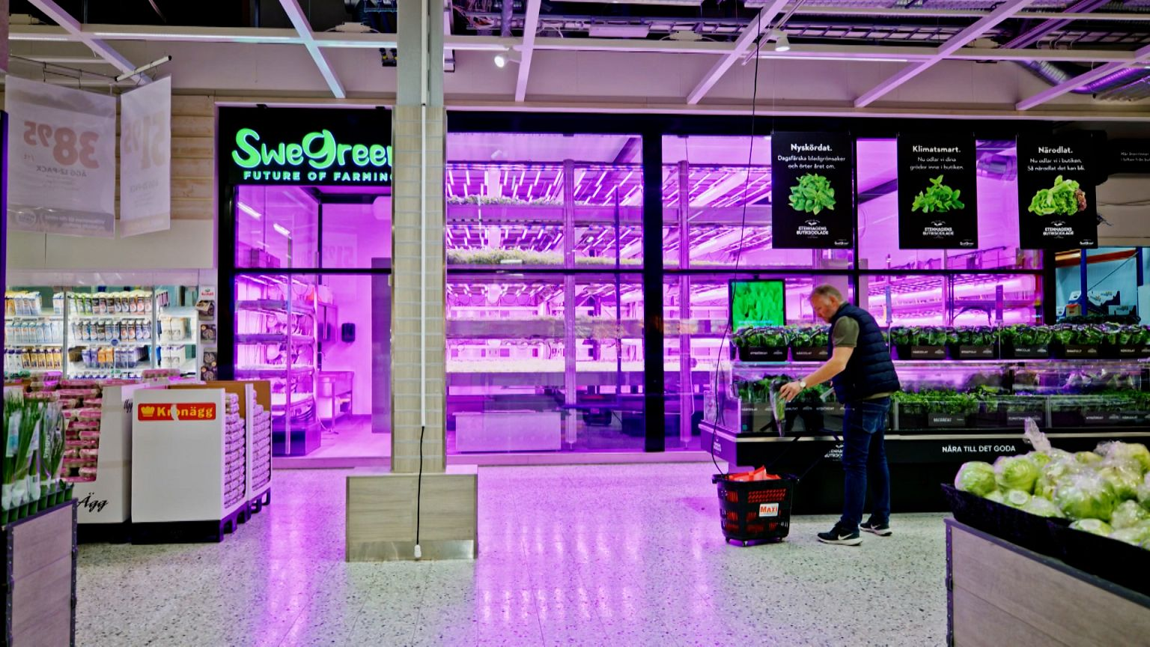
What Can the Future Look Like?
[12]
Supermarkets with fresh fruits & vegetables from upstairs

Slide 21
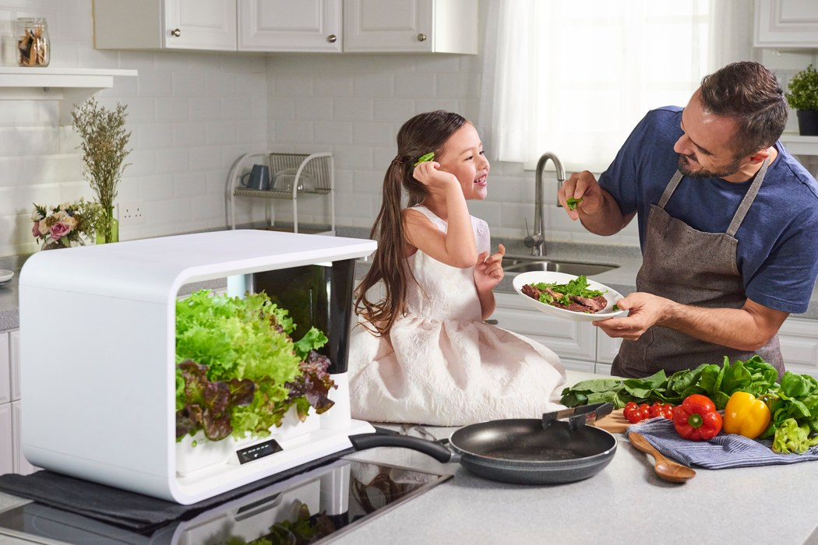
What Can the Future Look Like?
[13]
Fresh food grown right at home

Slide 22
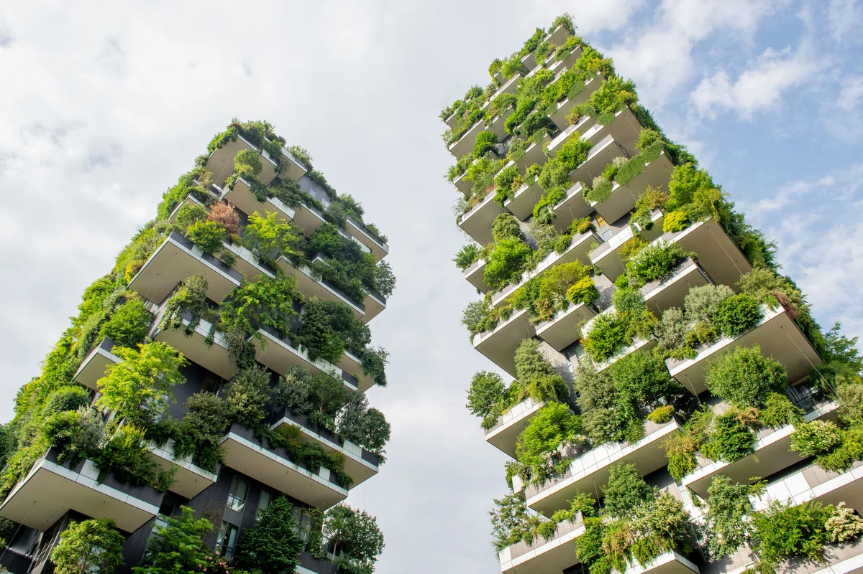
What Can the Future Look Like?
[14]
Skyscrapers full of lettuce

Slide 23
How To Design a Vertical Farm?

Slide 24






How To Design a Vertical Farm?
 | Water
 | Oxygen
 | Nutrition
 | Sensitivity
 | Roots depth
Special: This plant is tall

Slide 25
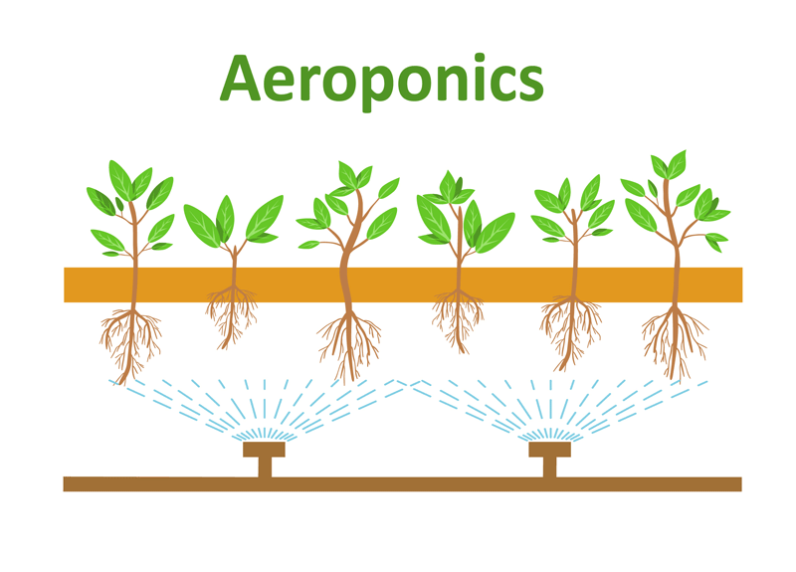

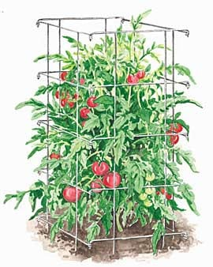
How To Design a Vertical Farm?
High need of oxygen, water and big roots
[15]
The plant is tall
[16]

Slide 26
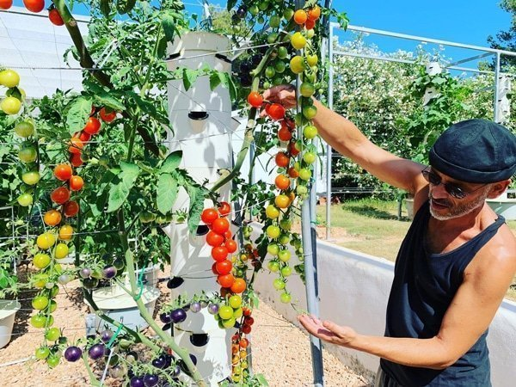
How To Design a Vertical Farm?
[17]

Slide 27
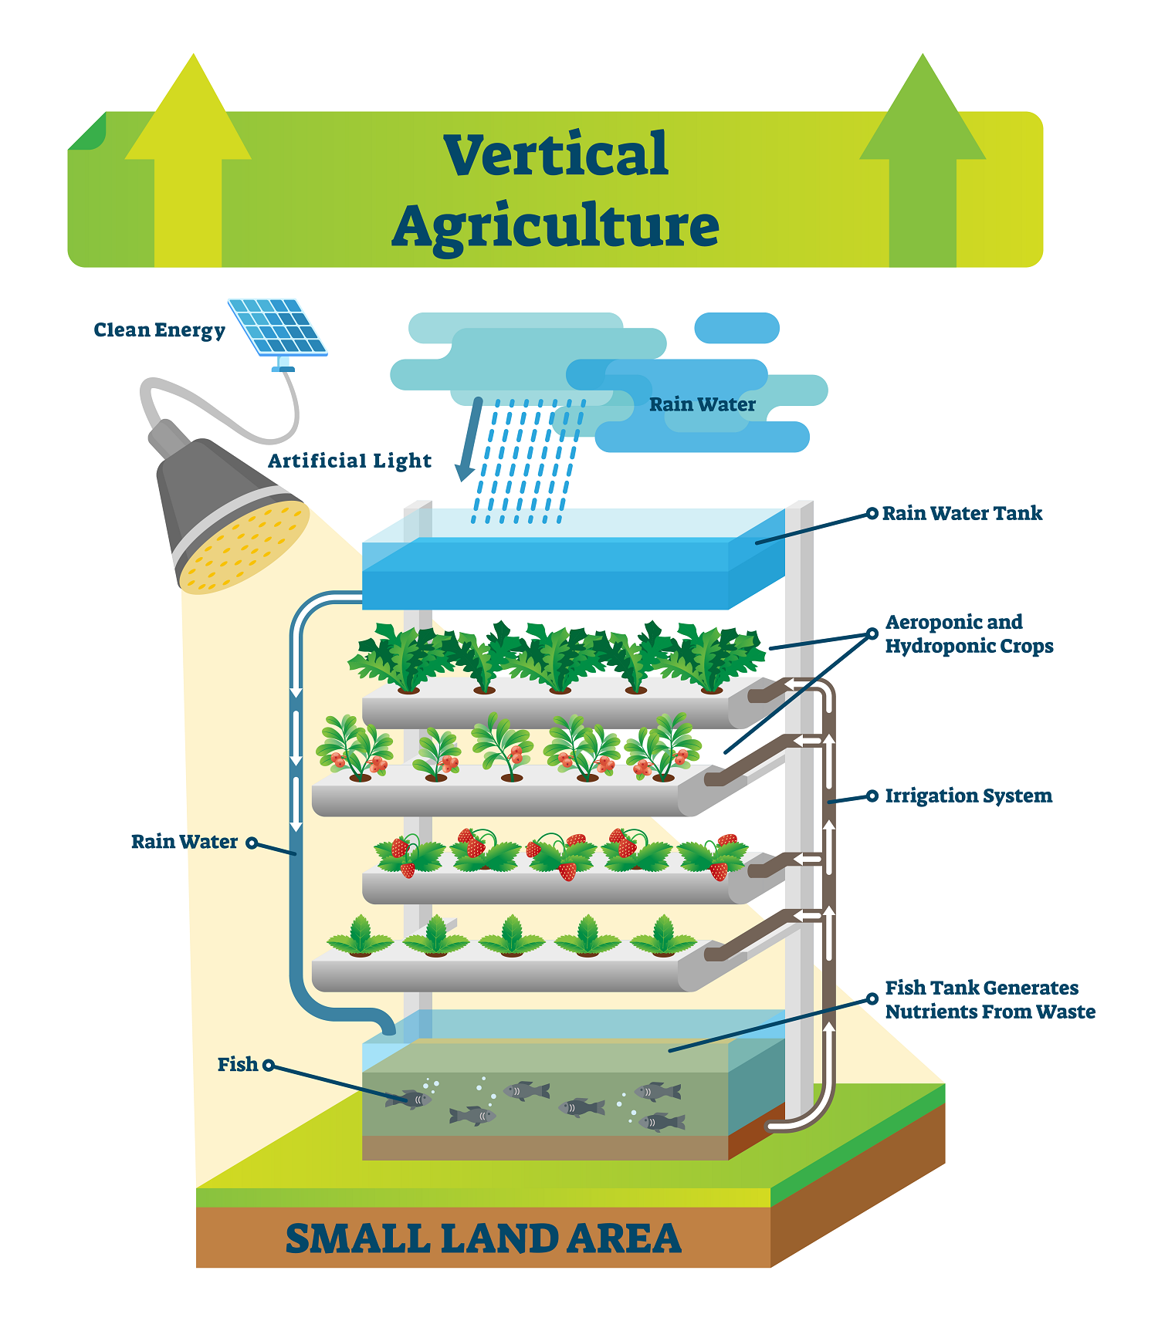
It’s time for you to contribute!
Now, it is your turn to design a vertical farm prototype for a specific plant
Source: VectorMine

Slide 28


Let’s Talk About It
What surprised you?
What do you like about vertical farms?
How would you improve vertical farms?

Slide 29
References
[1] – https://www.flaticon.com/ru/free-icon/global-warming_3993522
[2] – https://ionscience.com/en/news/celebrating-world-health-day-2024-how-ion-science-continues-to-champion-global-health-safety/
[3] – https://www.vecteezy.com/vector-art/21188767-green-and-polluted-city-for-diagram-web-design-brochure-template-layout-banner-vector-illustration
[4] – https://www.commondreams.org/views/2019/10/20/key-saving-family-farms-soil
[5] – https://www.arrowtruck.com/blog/the-best-trucking-routes-in-america-a-guide-for-long-haul-drivers
[6] – Ritchie Bros
[7] – Sprinklers irrigate a field in the Imperial County town of Holtville on Sept. 20, 2022. Photo by Aude Guerrucci, Reuters
[8] –https://vitabeam.com/what-problems-can-vertical-farming-help-solve/
[9] – Ritambhara, Shukla, S.K., Shukla, S. (2021). Automation, Modern Tools and Technique for Sustainable Agriculture – An Important Parameter Toward Advance Plant Biotechnology. In: Chakraborty, C. (eds) Green Technological Innovation for Sustainable Smart Societies. Springer, Cham. https://doi.org/10.1007/978-3-030-73295-0_13
[10] – https://makezine.com/projects/aquaponic-garden/
[11] – https://www.nasa.gov/image-detail/tech_transfer_program/
[12] – SweGreen
[13] – https://www.kickstarter.com/projects/1590005987/asparatm-the-smart-indoor-garden?ref=pr.go2.fund&utm_medium=referral&utm_source=pr.go2.fund
[14] – AdobeStock: Dominique
[15] – https://www.flickr.com/photos/188582043@N05/49934798866/
[16] – https://gardening.stackexchange.com/questions/233/how-are-wind-flattened-plants-realigned
[17] – https://agrotonomy.com/de/aeroponische-tomaten-auf-einem-tower-garden/

Slide 30
Thank you for your attention!

