Slide 1


EDU-CIRC
Rete transfrontaliera per la formazione sull’economia circolare e la decarbonizzazione nella produzione
Grenzübergreifendes Netzwerk zur Aus- und Weiterbildung in Kreislaufwirtschaft und Dekarbonisierung in der Produktion
Interreg VI – A Italia - Österreich
Europa noch näher
Un’Europa più vicina

Slide 2
Workshop
Vertical Farms

Slide 3




The Earth is getting hotter
One big reason: too much CO₂ (carbon dioxide) in the air
CO₂ comes from cars, factories… and farms too!

Slide 4


What is CO₂?
[2]
CO₂ is a gas, that traps heat, like a big blanket around the Earth
[1]
More CO₂ = a hotter planet
This is called global warming or climate change

Slide 5

What is Decarbonization?
Less fossil fuel
Absorb carbon
Using less carbon — or none at all
Cleaner, greener choices
Less pollution

Slide 6

Why Decarbonization Matters?
[3]
  🌍 The planet gets cooler
  🏘️ Cities become cleaner
    💡 We save energy
    🌿 Nature stays healthier

Slide 7
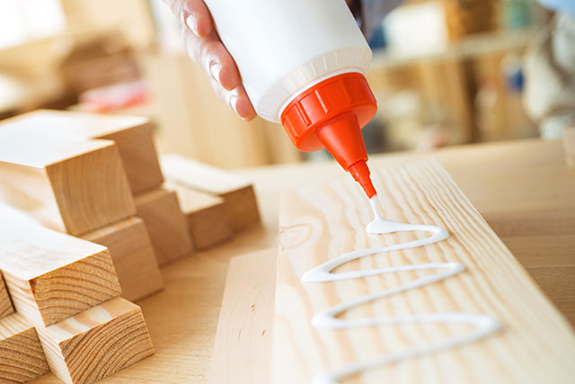
What Is Glue In Woodworking?
GLUE – Adhesive used to bond wood & wood-based products
Source: carbatec.com

Slide 8
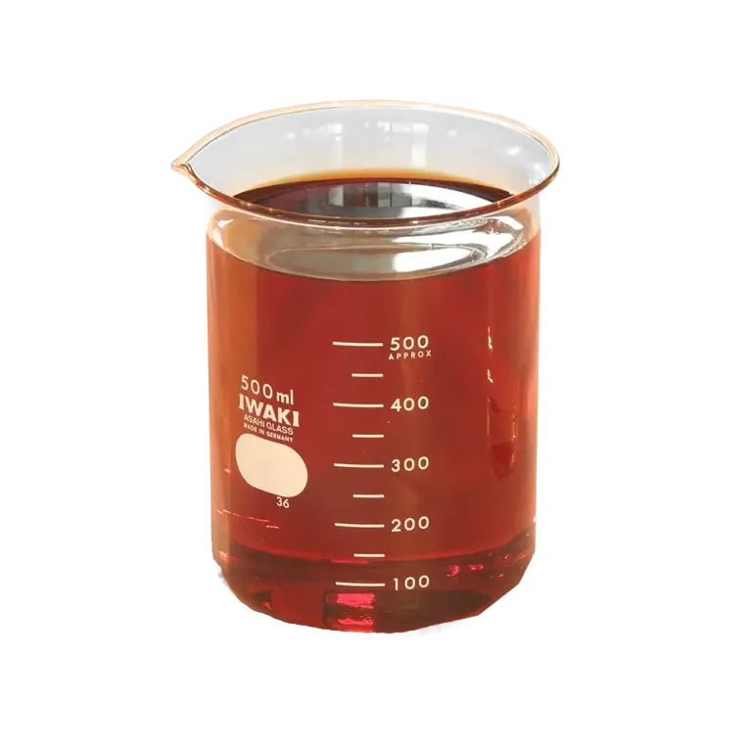
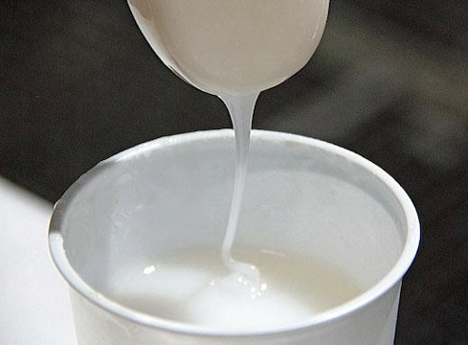
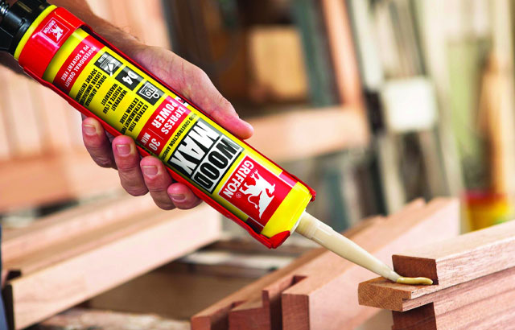
Common Types of Glues
[4]
[5]
[6]
Urea-formaldehyde
Phenol-formaldehyde
Polyurethane

Slide 9



What is The Environmental impact
Formaldehyde emissions (indoor air, health risks)
CO₂ during production
VOCs and end-of-life recycling complications

Slide 10
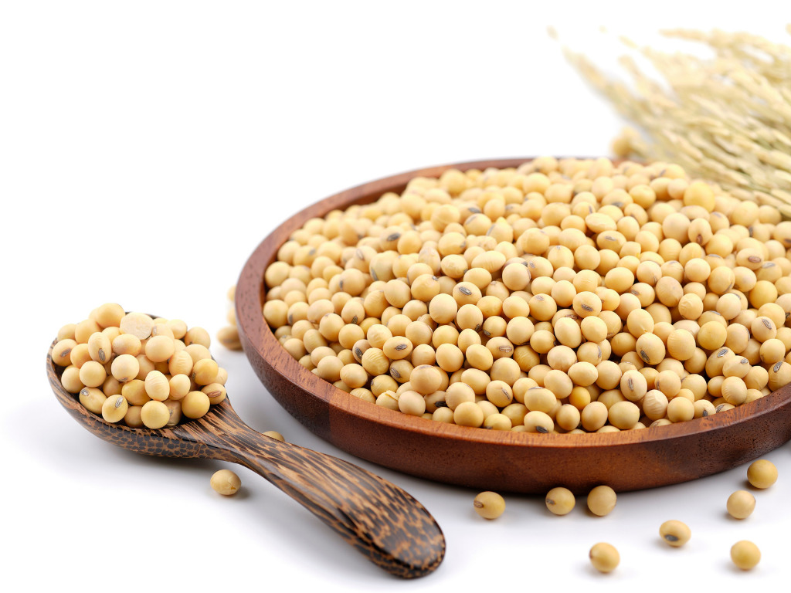
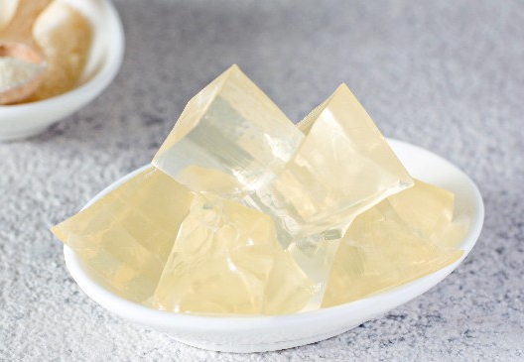
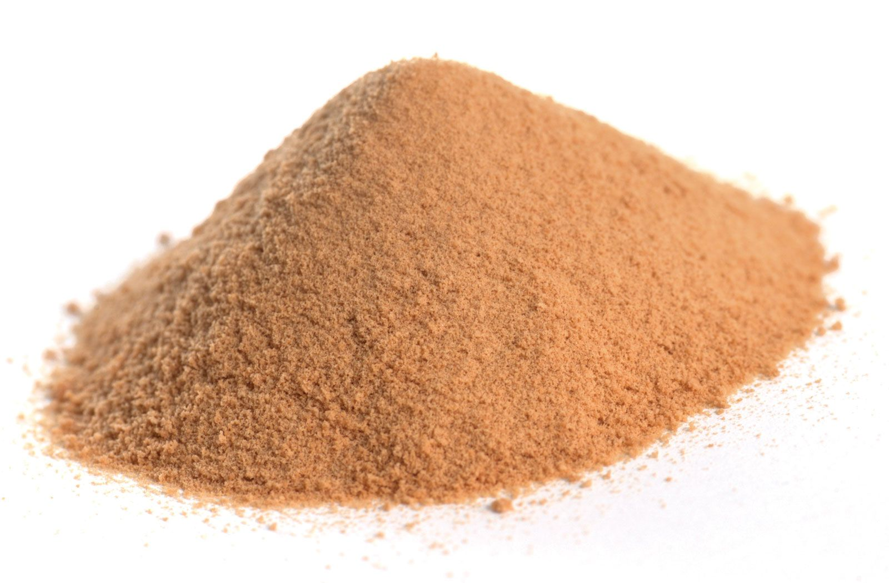
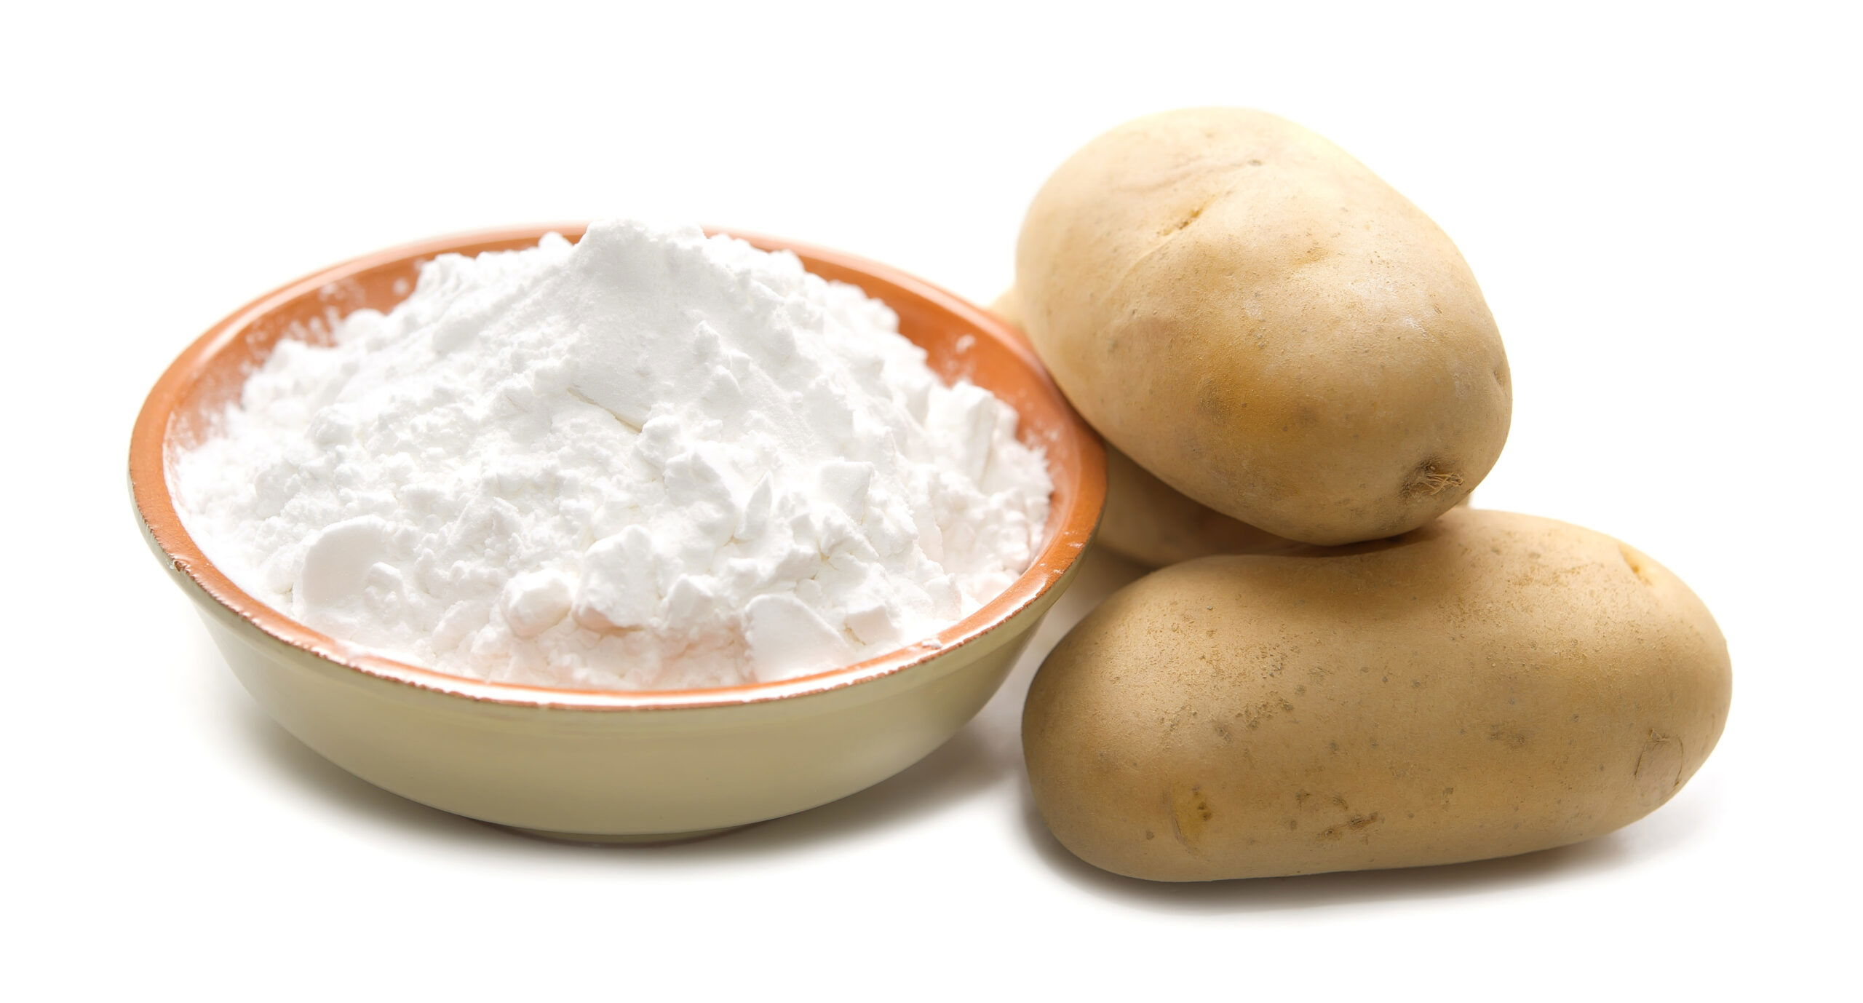
What Is BIO-Glue?
BIO-Glue is a glue produced wholly or partly from renewable bio-materials
[7]
[8]
Soy protein
Gelatin
[9]
[10]
Starch
Tannin

Slide 11

Advantages of bio-glues
Lower potential of fossil CO₂
Reduced/formaldehyde-free formulations
Reducing VOCs emissions
Better indoor air quality

Slide 12

Limitations And Challenges
Performance gaps
Cost & industry scale-up barriers
Some bio-routes need energy-intensive processing or chemical modifiers
Source: sellbrite.com

Slide 13
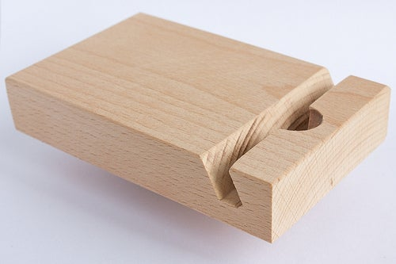
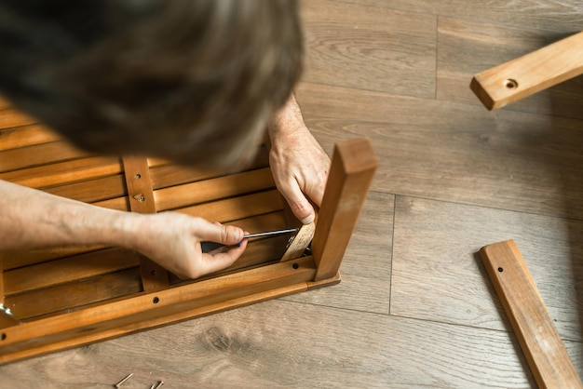
Where Bio-Glue Can Be Used
[11]
[12]
Woodworking projects
Repairment works

Slide 14

It’s time for you to contribute!
Now, you will learn, how to cook BIO-Glue by yourself!
[13]

Slide 15
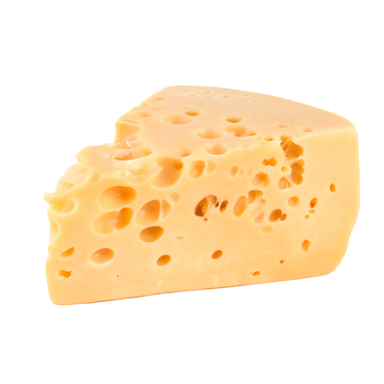
Homemade BIO-glue
Cheese glue - the most common wood glue prior to the 20th century

Slide 16
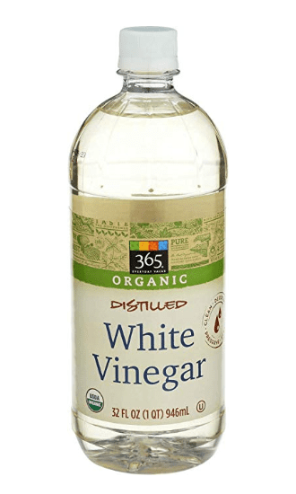
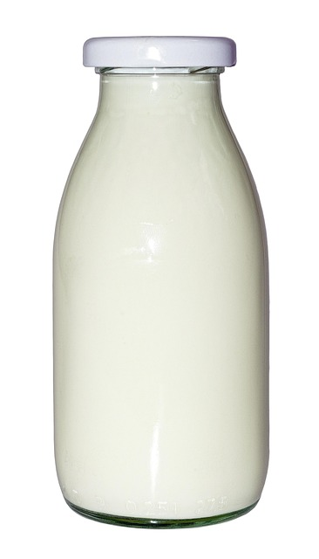
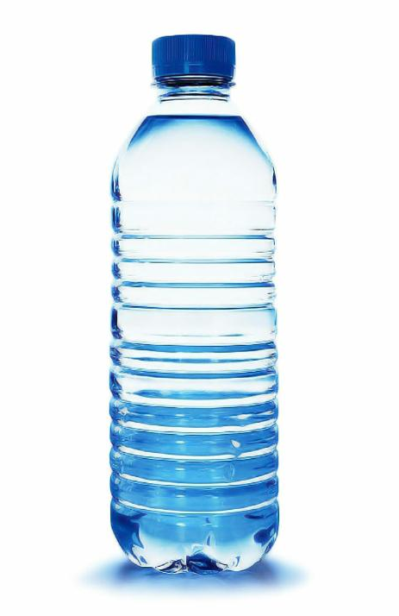
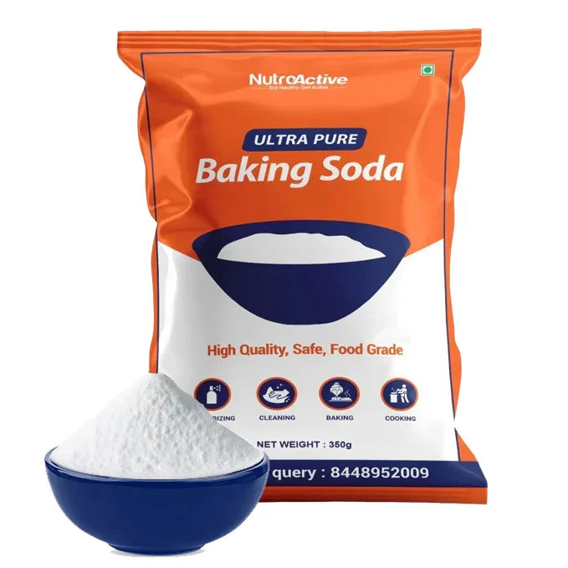
Homemade BIO-glue: Ingredients
15ml of white vinegar
100ml of milk
Water
Backing soda

Slide 17

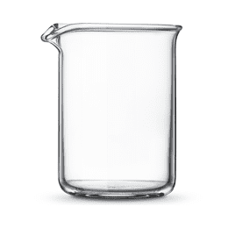
Homemade BIO-glue: Step 1
15ml of white vinegar
100ml of milk

Slide 18
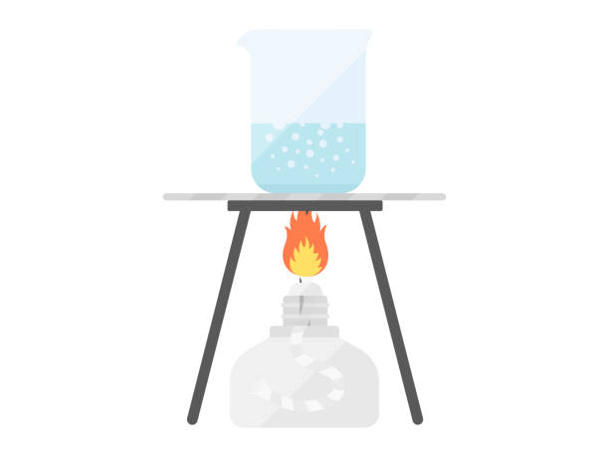
Homemade BIO-glue: Step 2
Place the mixture on heat and stir gently, until mixture begins to boil and curds are seen floating.
[14]

Slide 19
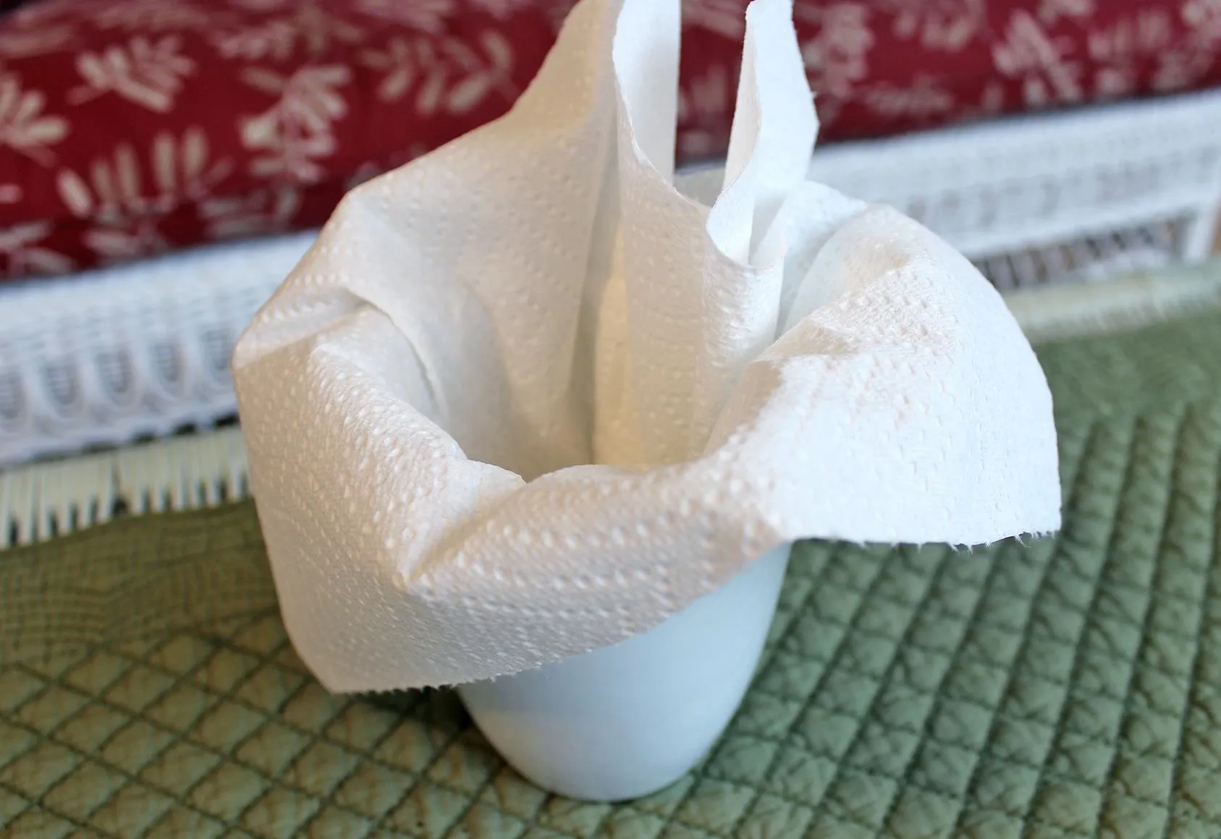
Homemade BIO-glue: Step 3
Filter the mixture, using a folded piece of paper towel. Then discard the liquid filtrate
[15]

Slide 20
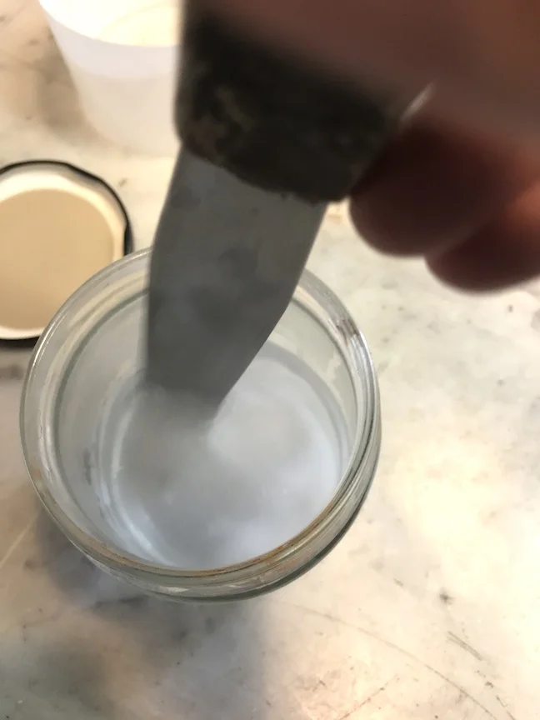
Homemade BIO-glue: Step 4
Scrape the curds from the paper towel into a small cup
Slowly add 1 tsp baking soda and stir
Carefully add drops of water, stirring periodically, until the consistency of white glue is obtained
[16]

Slide 21


Let’s Talk About It
What surprised you?
What do you like about bio-glue?
How would you glueing?

Slide 22
References
[1] – https://www.flaticon.com/ru/free-icon/global-warming_3993522
[2] – https://ionscience.com/en/news/celebrating-world-health-day-2024-how-ion-science-continues-to-champion-global-health-safety/
[3] – https://www.vecteezy.com/vector-art/21188767-green-and-polluted-city-for-diagram-web-design-brochure-template-layout-banner-vector-illustration
[4] – https://rigalit.lt/en/content/21-selection-of-glue-for-wood
[5] – https://www.alibaba.com/product-detail/Hot-Sale-Cooling-Pad-Phenolic-Resin_60579519361.html
[6] – https://www.protrade.co.uk/blog/ultimate-guide-to-polyurethane-glue-and-an-alternative/
[7] – Canva
[8] – https://cbdoileurope.com/developing-health-gummies-a-guide-to-ingredients-and-considerations/
[9] – https://www.tridge.com/intelligences/potato-starch/BY/supplier
[10] – https://www.cphi-online.com/product/porcine-gelatin-tannate/
[11] – https://www.instructables.com/DIY-wooden-5-iPad-Dock-Stand/
[12] – https://www.freepik.com/premium-photo/furniture-assembly-man-collects-wooden-furniture-furniture-assembler-with-screwdriver-master-with-tools-repairs-furniture-dad-collects-furniture-home_51177833.htm
[13] – https://www.pinterest.com/pin/1128855462819280340/
[14] – https://www.istockphoto.com/vector/alcohol-lamp-gm1219210254-356554394
[15] – https://food-hacks.wonderhowto.com/how-to/make-freakin-great-cup-joe-without-any-coffee-swag-0165927/
[16] – https://www.sinopiamilkpaint.com/recipe

Slide 23
Thank you for your attention!

