Slide 1


EDU-CIRC
Rete transfrontaliera per la formazione sull’economia circolare e la decarbonizzazione nella produzione
Grenzübergreifendes Netzwerk zur Aus- und Weiterbildung in Kreislaufwirtschaft und Dekarbonisierung in der Produktion
Interreg VI – A Italia - Österreich
Europa noch näher
Un’Europa più vicina

Slide 2
Light weighting for a Low-Carbon Ride
Notes:
Welcome, everyone. Today we’ll connect sustainability with practical engineering—specifically how reducing vehicle mass lowers fuel consumption and CO₂. We’ll move from the big picture to a hands-on workshop where you’ll redesign a baseline vehicle using provided data and constraints. Let’s start with why sustainability matters.

Slide 3
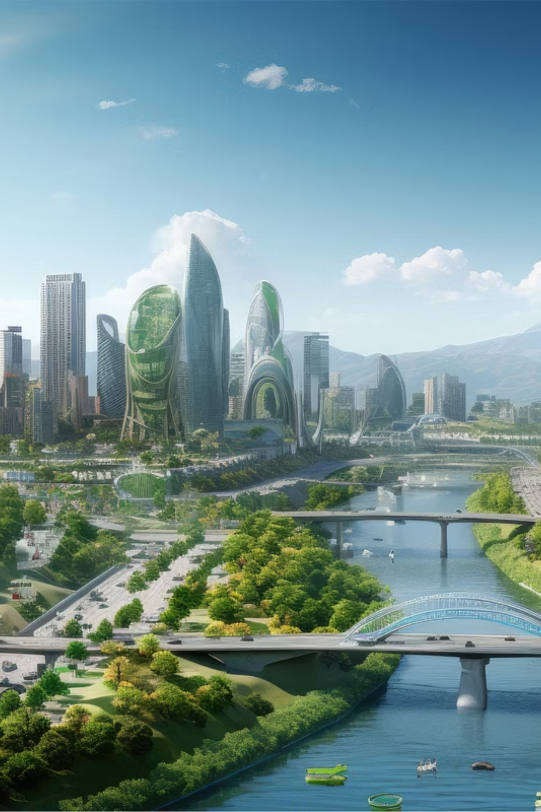
WHY SUSTAINABILITY MATTERS?

Slide 4
WHY SUSTAINABILITY MATTERS?
1
Limited Natural Resources
Meeting the needs of growing global population
Notes:
Our population and living standards keep rising, which increases demand for energy, materials, water, and land. That pressure challenges how we design and use products. Sustainability isn’t just ethical; it’s a design constraint that affects cost, risk, and resilience.
Those needs have historically been met by fossil fuels—let’s look at that challenge next.

Slide 5
WHY SUSTAINABILITY MATTERS?
1
2
Limited Natural Resources
Environmental Challenges
Meeting the needs of growing global population
Combating climate change, pollution, and biodiversity loss.
Notes:
Climate change, air pollution, and biodiversity loss are outcomes of how we produce and consume. Engineering choices—materials, processes, and product use—directly influence these impacts. Small improvements at scale can yield large benefits.
So what’s the engineering role in changing that trajectory?

Slide 6
1
2
3
Limited Natural Resources
Environmental Challenges
Engineering's Role
Meeting the needs of growing global population
Combating climate change, pollution, and biodiversity loss.
Designing for long-term viability and ecological balance
Notes:
Our job is to deliver function with less energy and fewer resources over the full lifecycle—manufacture, use, and end-of-life. That means efficiency, durability, reparability, and circularity. Today we’ll focus on one powerful lever in transport: mass reduction.

Slide 7
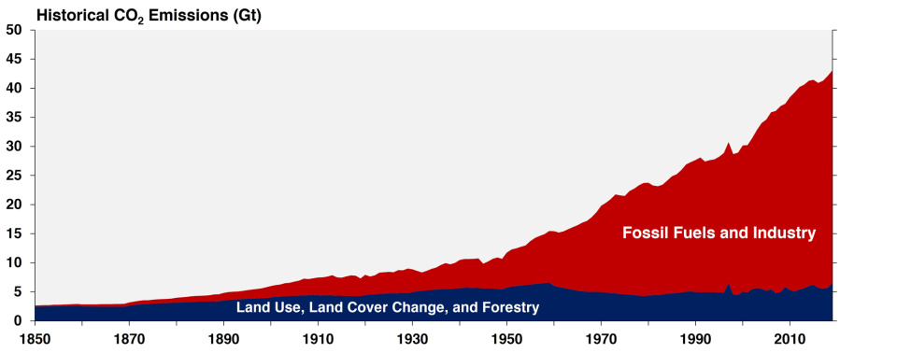
The Challenge with Fossil Fuels
https://www.epa.gov/ghgemissions/global-greenhouse-gas-overview#Reference%203
Notes:
Global CO₂ emissions from all sectors have significantly increased since 1850. The majority of this increase has resulted from increased fossil fuel consumption and industrial emissions. Globally, greenhouse gas emissions continued to rise across all sectors and subsectors, most rapidly in the transport and industry sectors.¹

Slide 8

Sustainability of
Natural
Sources
Notes:
It's a common narrative that our planet's natural ecosystems are under immense pressure to provide for the growing population. Therefore, the conservation and management of natural resources are crucial for maintaining sustainability.⁴

Slide 9
Renewable
Resources
Sustainability
of
Natural
Sources
1
Renewable Sources
Harnessing Solar
Wind
Hydro
Biomass energy
Notes:
Renewables like solar, wind, hydro, and sustainable biomass reduce operational emissions. But energy is only half the story—how efficiently we use materials determines total footprint. Efficient products need less energy and fewer raw inputs over time.

Slide 10
Sustainability
of
Natural
Sources
1
2
Sustainable Resource Management
Renewable Sources
Harnessing Solar
Wind
Hydro
Biomass energy
Managing material use to lower environmental impact
Notes:
Using the right amount of the right material—preferably recycled or recyclable—lowers embodied energy and risk. Smart design can deliver the same performance with less material, which also reduces the energy needed to move the product during use.

Slide 11
1
2
3
Sustainable Resource Management
Renewable Sources
Circular Economy
Harnessing Solar
Wind
Hydro
Biomass energy
Managing material use to lower environmental impact
Prioritizing reuse, recycling, and resource efficiency.
Notes:
Design for reuse, repair, and recycling keeps materials in loop and reduces virgin extraction. For vehicles, that means choosing materials that meet performance needs today and have a viable end-of-life pathway tomorrow.

Slide 12
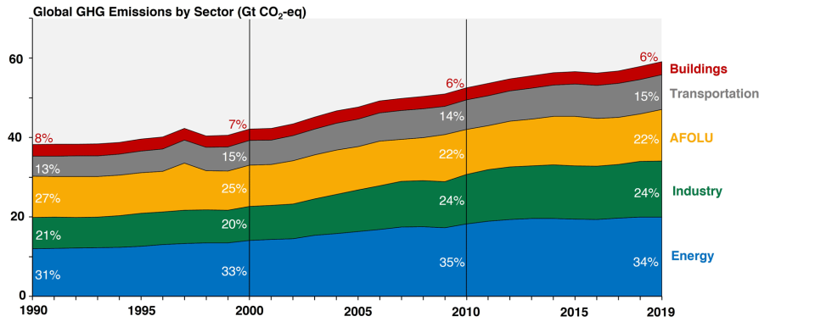
Leading Source of Emissions
https://www.epa.gov/ghgemissions/global-greenhouse-gas-overview#Reference%203
Notes:
Transportation (15% of 2019 global greenhouse gas emissions): Greenhouse gas emissions from this sector primarily involve fossil fuels burned for road, rail, air, and marine transportation. Almost all (95%) of the world's transportation energy comes from petroleum-based fuels, largely gasoline and diesel.^{[2]}

Slide 13
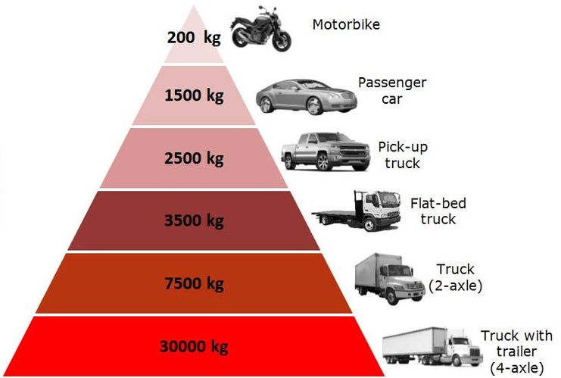
Why Vehicle Mass Matters?
Vehicle weight, size, and fuel consumption are all intimately connected. Assessing the prospects for fuel consumption reductions requires an understanding of the ways in which vehicle sizes and weights may evolve in the future.³
https://www.researchgate.net/figure/Weight-per-type-of-vehicle_fig3_330221013
Notes:
Physics is simple here: more mass requires more energy to accelerate and climb, and more braking energy is wasted as heat. Lighter vehicles typically consume less fuel or, for EVs, deliver more range for the same battery.

Slide 14


Vehicle Mass and Fuel Consumption
A vehicle with a significantly lower weight will consume less energy per kilometer traveled.
1% reduction in vehicle weight reduces per-kilometer fuel consumption by approximately 0.6%–0.7%, holding size and acceleration performance constant.³
Notes:
A useful rule of thumb is that for every 1% reduction in mass, there is a 0.6–0.7% reduction in fuel usage, provided that size and performance remain constant. Additionally, mass reduction lowers brake and tire wear, providing secondary environmental and cost benefits.

Slide 15
Strategies for Reducing Vehicle Mass³

Slide 16
Strategies for Reducing Vehicle Mass³
Architectural Choices
Body-on-frame → Unibody:
Unibody → Space frame
Rear-wheel drive → Front-wheel drive
Notes:
Body-on-frame → Unibody (~−280 kg): Integrates frame into body; architecture-only saving on matched cars.
Unibody → Space frame (~−156 kg): Tubular frame with non-structural panels; lighter but usually costlier/low-volume.
RWD → FWD (~−296 kg): Removes prop shaft & rear diff; tighter packaging yields large mass cut.

Slide 17
Strategies for Reducing Vehicle Mass³
Architectural Choices
Powertrain & Packaging
Body-on-frame → Unibody:
Unibody → Space frame
Rear-wheel drive → Front-wheel drive
Engine downsizing:
V8 → V6: −64 kg
V6 → I4: −67 kg
Notes:
Powertrain & Packaging: Engine downsizing (e.g., V8→V6, V6→I4) removes ~60–70 kg while modern power density preserves performance; packaging benefits reduce mass further.

Slide 18
Strategies for Reducing Vehicle Mass³
Architectural Choices
Powertrain & Packaging
Material Substitution
Body-on-frame → Unibody:
Unibody → Space frame
Rear-wheel drive → Front-wheel drive
Replace conventional steel/iron with AHSS, aluminum, magnesium, polymers, and composites
Engine downsizing:
V8 → V6: −64 kg
V6 → I4: −67 kg
Notes:
Material Substitution: Replacing steel/iron with AHSS, aluminum, magnesium, polymers, composites can lower mass; benefits vary by part and must be balanced with cost, repair, and recyclability.

Slide 19
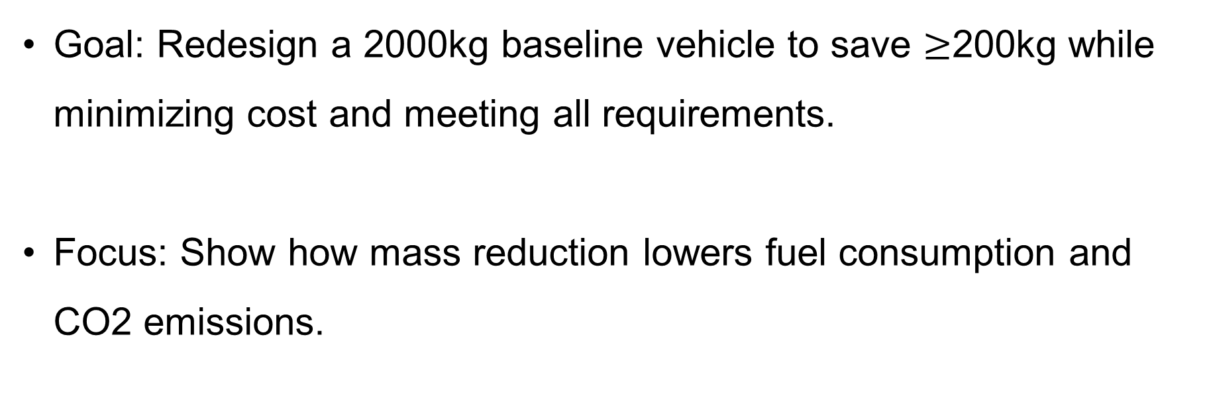
WORKSHOP
Goal: Redesign a 2000kg baseline vehicle to save $≥$200kg while minimizing cost and meeting all requirements.
Focus: Show how mass reduction lowers fuel consumption and CO2 emissions.
Notes:
You’ll start from a 2000 kg baseline vehicle. Your goals: save ≥200 kg, meet all subsystem requirements, and do it with minimum cost.

Slide 20
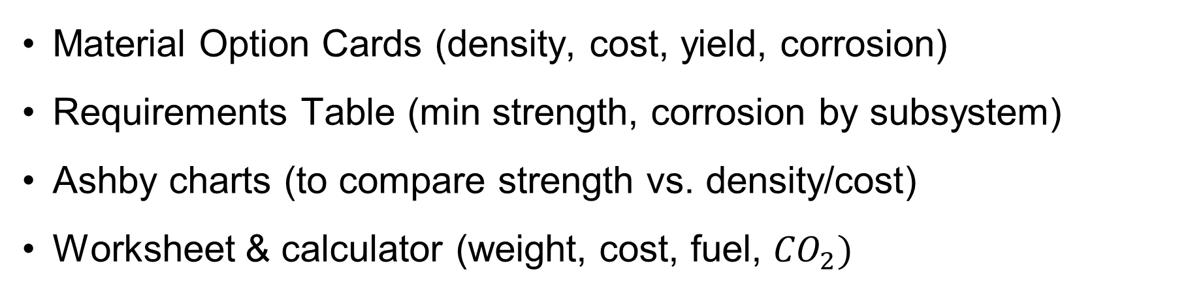
What you will use?
Material Option Cards (density, cost, yield, corrosion)
Requirements Table (min strength, corrosion by subsystem)
Ashby charts (to compare strength vs. density/cost)
Worksheet & calculator (weight, cost, fuel, ${CO}_{2})$
Time: 30 minutes (I am not sure about duration of activity)
Notes:
Use the Material Option Cards, the Requirements Table, the Ashby chart provided, and the worksheet to track mass, cost, and compliance.

Slide 21
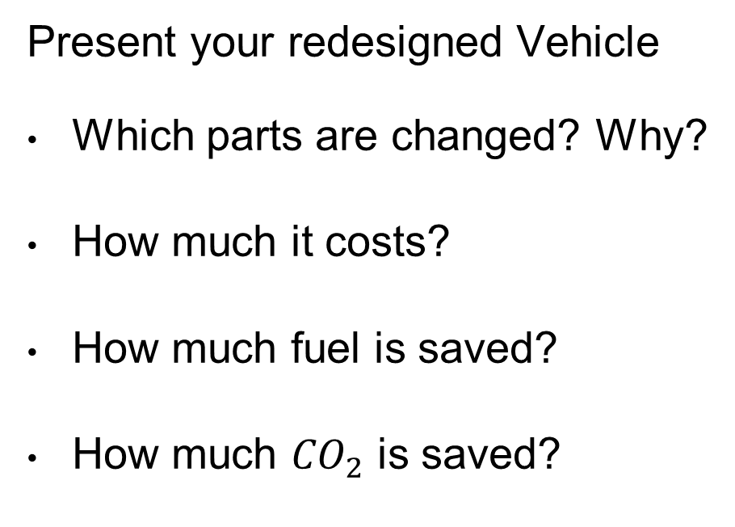
Presentation Phase
Present your redesigned Vehicle
Which parts are changed? Why?
How much it costs?
How much fuel is saved?
How much ${CO}_{2}$ is saved?
Notes:
In presentation phase please share your worksheet summary and answer these four questions clearly.
(Read the questions)

Slide 22
References
Intergovernmental Panel on Climate Change. (2022). Climate change 2022: Mitigation of climate change. Contribution of Working Group III to the Sixth Assessment Report of the IPCC. Cambridge University Press. (See chapter: “Emissions Trends and Drivers”.)
U.S. Energy Information Administration. (2021, February). Annual Energy Outlook 2021. https://www.eia.gov/aeo
Heywood, J., & MacKenzie, D. (Eds.). (2015, November). On the road toward 2050. Massachusetts Institute of Technology, Sloan Automotive Laboratory, Engineering Systems Division.
Testbook. (2024, March 2). Sustainability of natural resources—Importance and preservation methods. https://testbook.com/biology/sustainability-of-natural-resources

