Slide 1
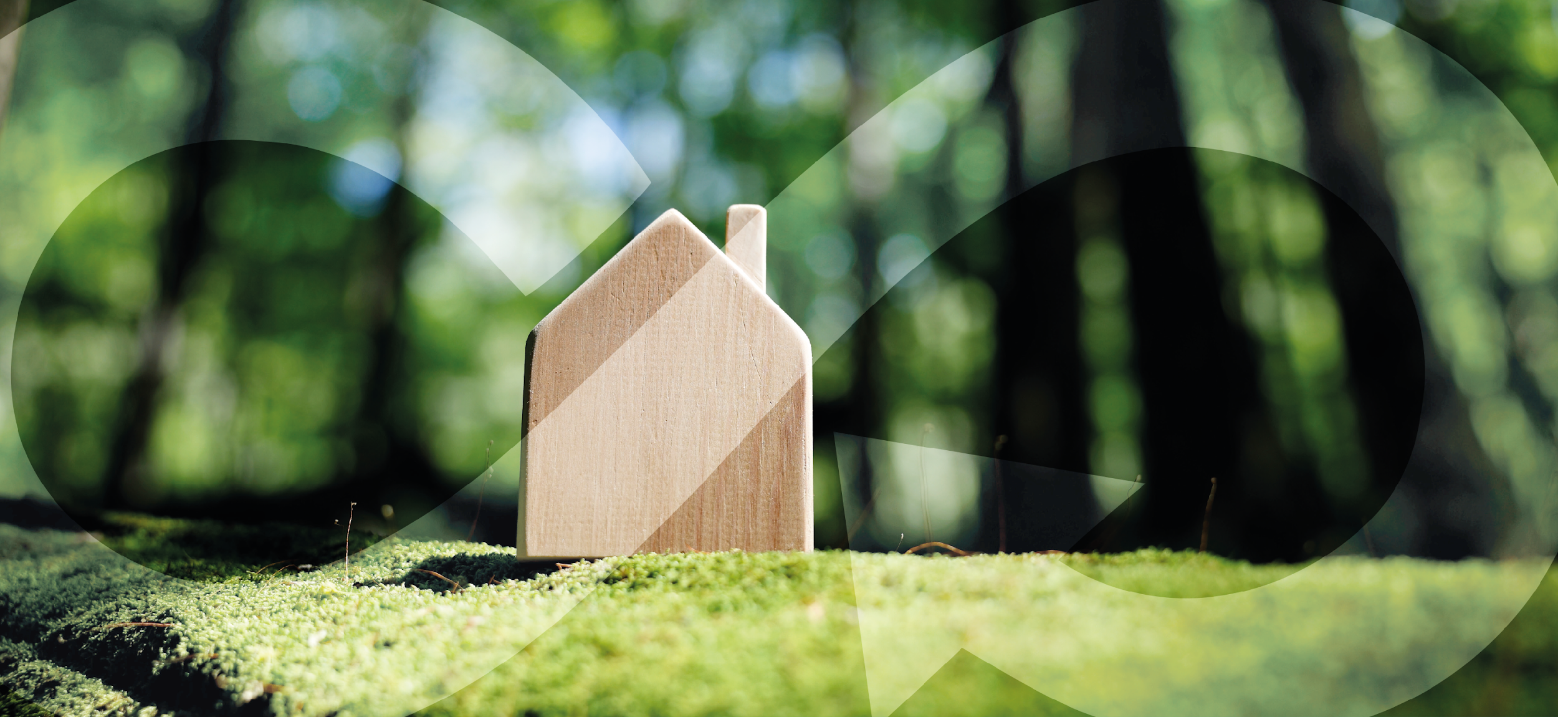

EDU-CIRC
Rete transfrontaliera per la formazione sull’economia circolare e la decarbonizzazione nella produzione
Grenzübergreifendes Netzwerk zur Aus- und Weiterbildung in Kreislaufwirtschaft und Dekarbonisierung in der Produktion
Interreg VI – A Italia - Österreich
Europa noch näher
Un’Europa più vicina

Slide 2
The Power of Wood

Slide 3
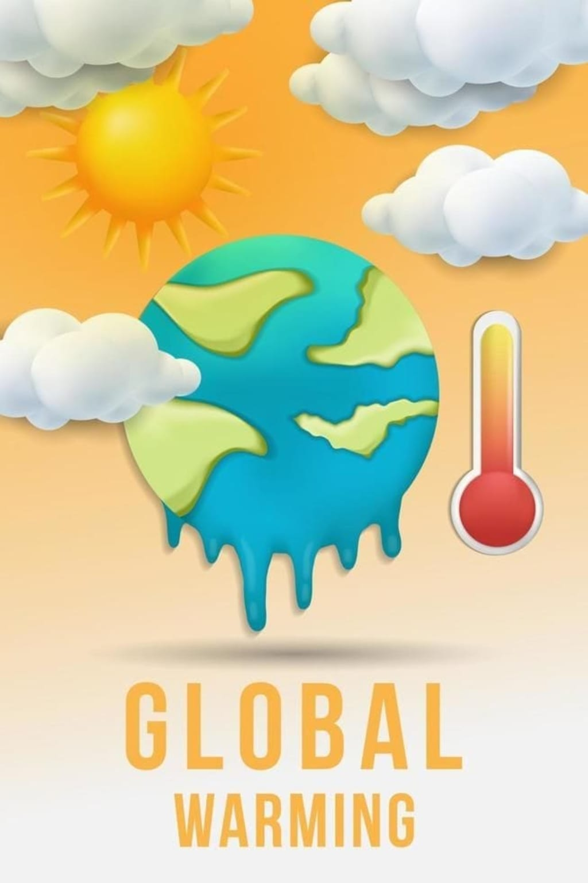
Global Warming
What is global warming? – The Earth’s temperature is rising because greenhouse gases trap too much heat.
Why is it happening? – Human activities like burning coal, oil, and gas, and cutting forests release too much CO₂ into the air.
What can we do? – Use renewable energy, protect forests, and store carbon in natural ways like trees and wood products.
Source: https://vocal.media/earth/global-warming-causes-effects-and-solutions-to-save-our-planet-5wg509xl
Notes:
Let’s start by understanding global warming.
First, what is it? Global warming means that the Earth’s average temperature is rising. This happens because greenhouse gases, like CO₂, trap too much heat in our atmosphere – like a blanket that’s getting too thick.
Second, why is it happening? The main reason is human activity. When we burn coal, oil, and gas for energy, or cut down forests, we release huge amounts of CO₂. This extra CO₂ builds up and makes the planet warmer.
And finally, what can we do? We actually have solutions. We can switch to renewable energy like solar and wind, we can protect and plant more forests, and we can store carbon naturally in things like trees and wooden products.
So global warming isn’t just a future problem – it’s happening now, but we also have the power to reduce it.”
Source of image: https://vocal.media/earth/global-warming-causes-effects-and-solutions-to-save-our-planet-5wg509xl

Slide 4
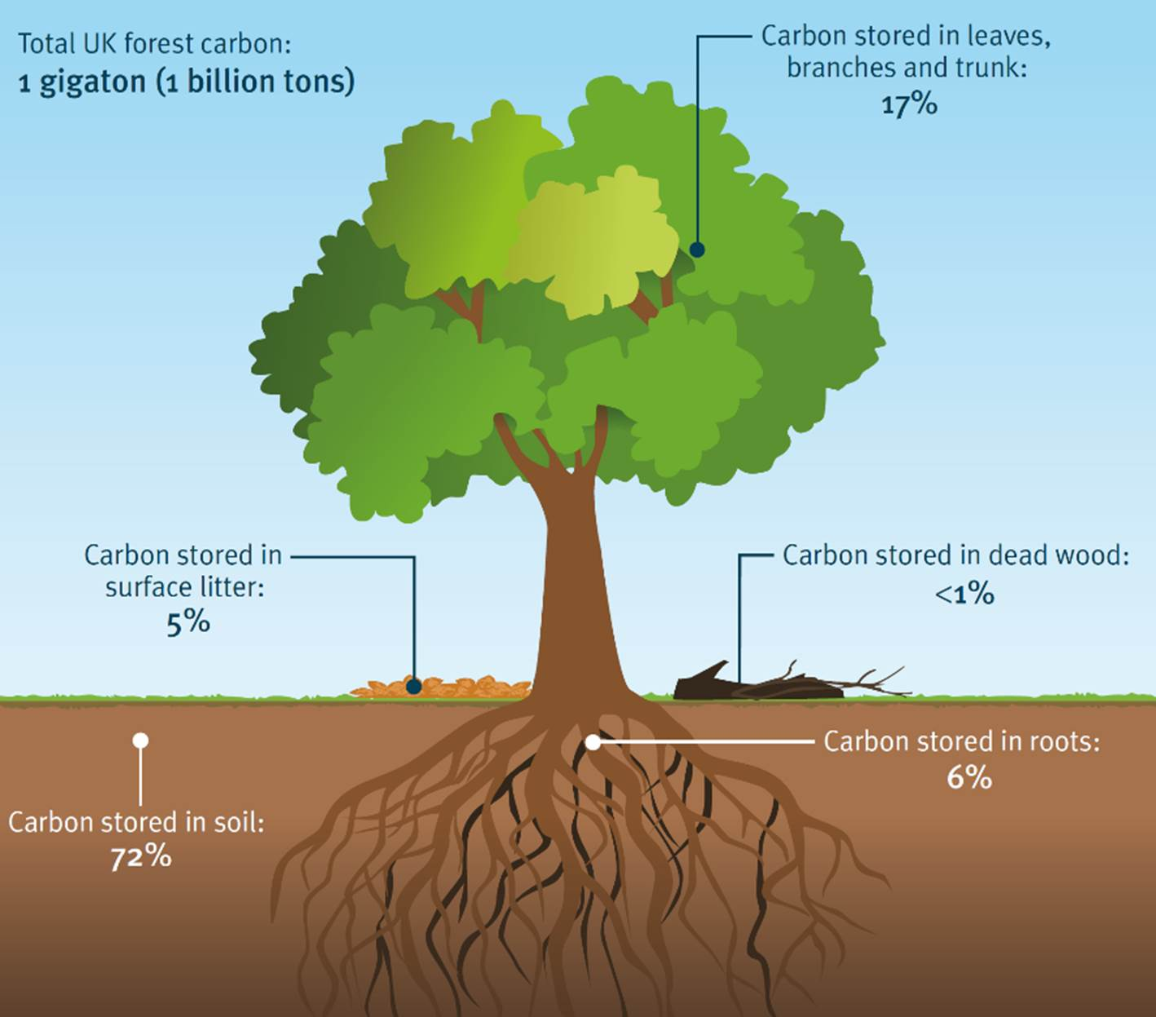


Trees as Carbon Stores
Trees absorb ${CO}_{2}$ from the air during growth
Carbon is stored in wood as long as the product exists
We must manage trees carefully when cutting
We should never cut down more trees than can grow back
Source: https://www.carboncommunity.org/carbon-community-updates/trees-and-carbon
Notes:
“Trees are amazing because they act like natural carbon stores. While they grow, they absorb CO₂ from the air and lock it away in their wood, leaves, and roots.
That carbon stays stored as long as the tree—or any product made from it—exists.
But we must be careful: if we cut down too many trees without replacing them, that balance is lost. The rule is simple—never cut more than can grow back. This way, forests keep working as powerful carbon banks that help fight climate change.”

Slide 5
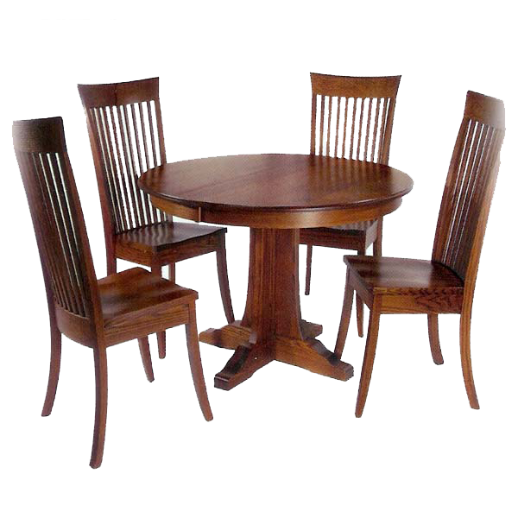
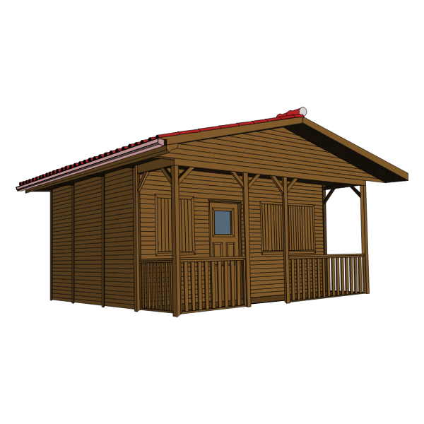
Wood Products as Carbon Banks
Wooden furniture, houses, and paper continue to hold carbon
The longer the product lasts, the longer CO₂ stays out of the atmosphere
Example:
A wooden house = decades of carbon storage
Notes:
“Wood doesn’t stop storing carbon once the tree is cut. Products like furniture, paper, and houses keep that carbon locked inside.
The longer a wooden product lasts, the longer CO₂ stays out of the air. For example, a wooden house can store carbon for many decades.
That’s why every wooden product acts like a carbon bank, helping fight climate change.”

Slide 6
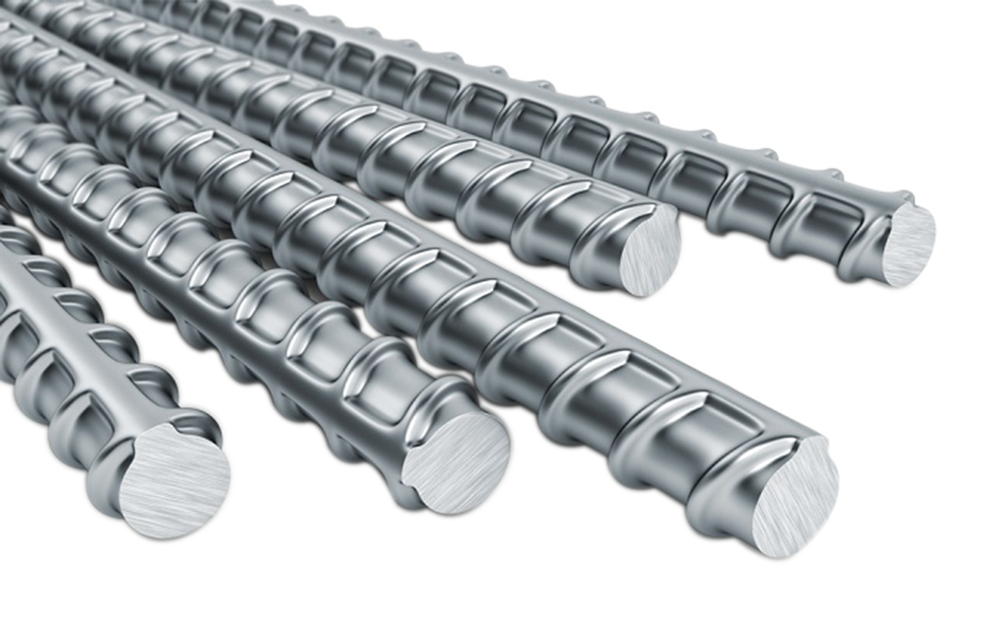
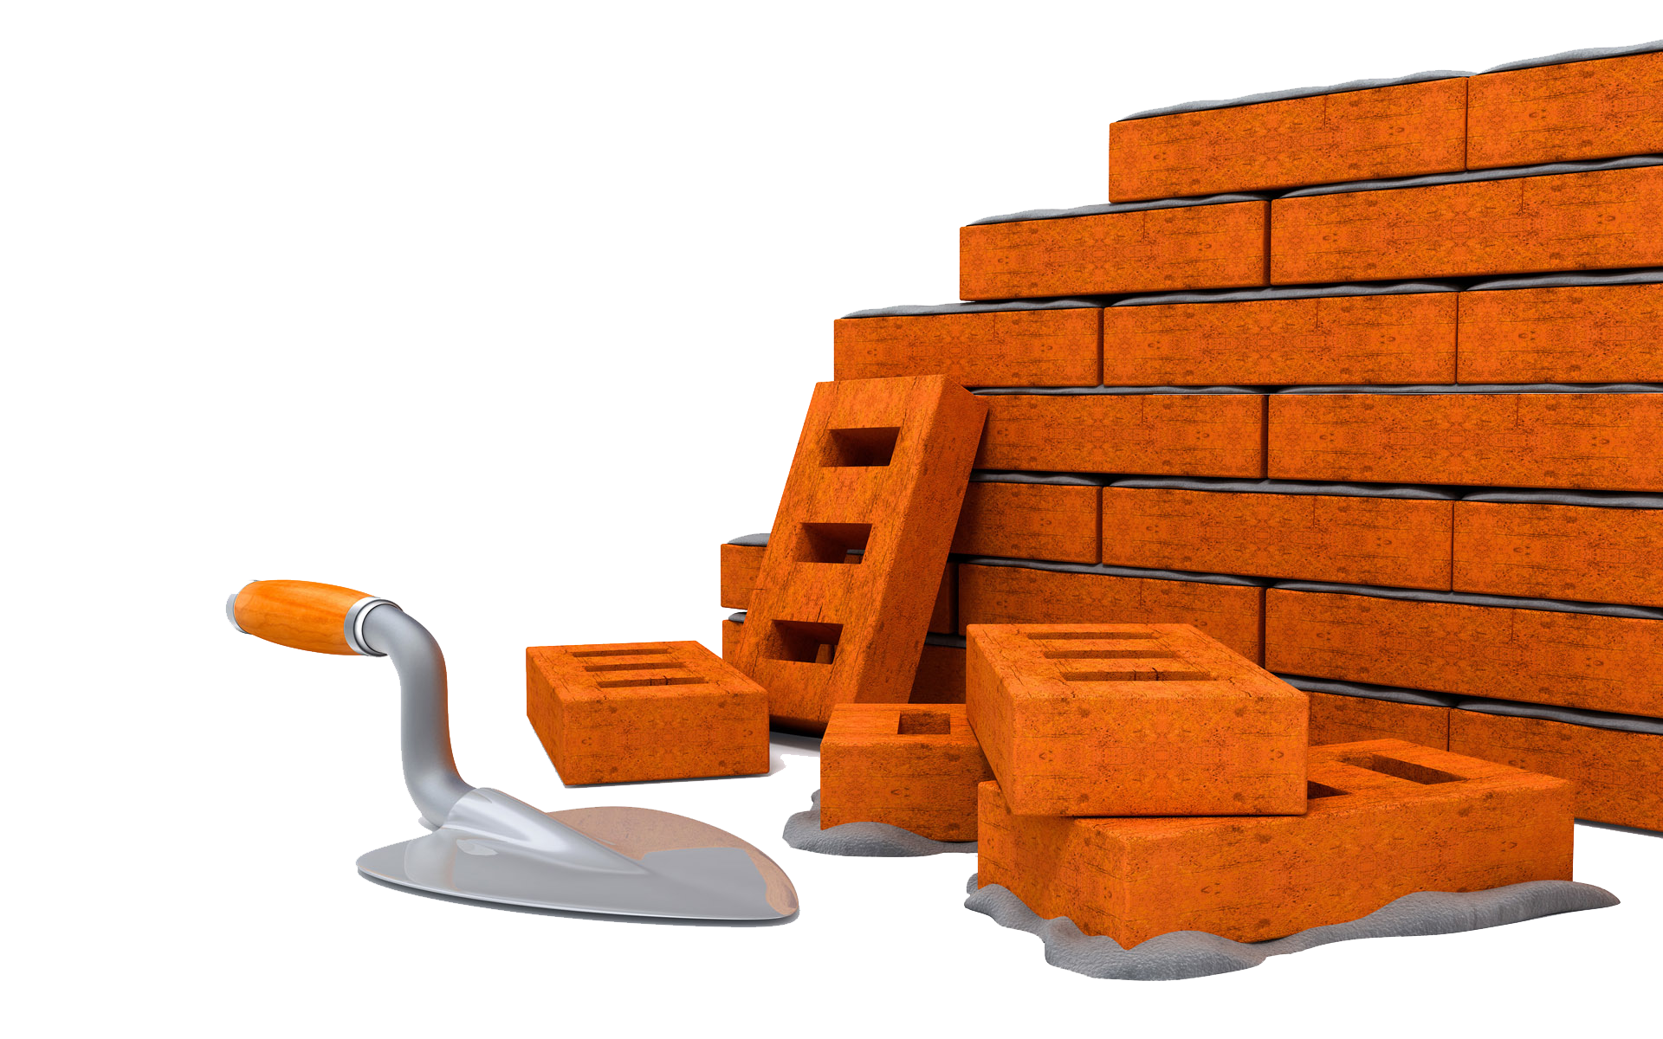
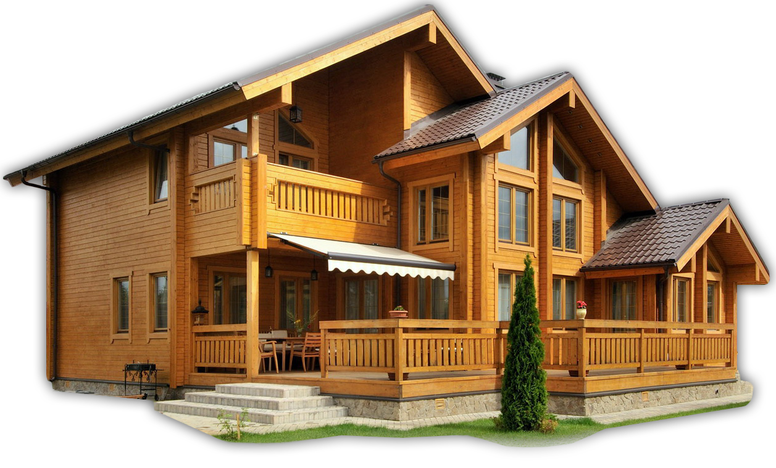
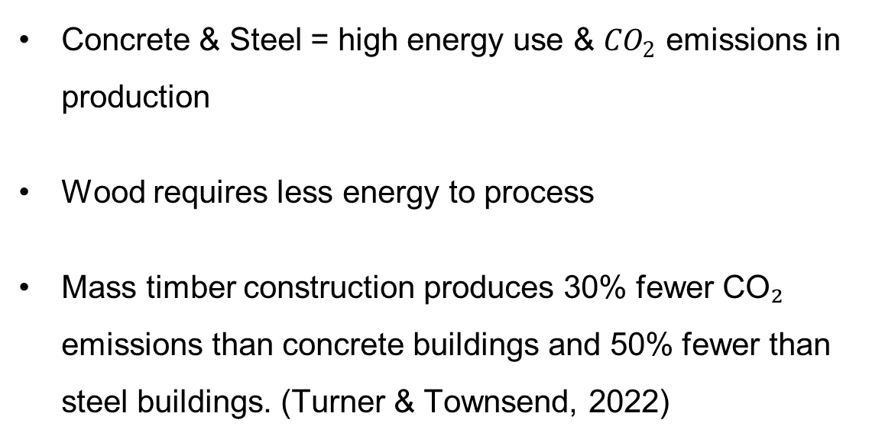
Material Impact: Wood vs. Concrete & Steel
Concrete & Steel = high energy use & ${CO}_{2}$ emissions in production
Wood requires less energy to process
Mass timber construction produces 30% fewer CO₂ emissions than concrete buildings and 50% fewer than steel buildings. (Turner & Townsend, 2022)
Notes:
“When we talk about building materials, it’s important to think about their environmental impact.
Concrete and steel are the most common materials, but they come with a cost. Producing them uses a lot of energy and releases huge amounts of CO₂ into the atmosphere. For example, cement production alone is responsible for about 8% of global CO₂ emissions. (World Economic Forum. (2024))
Wood, on the other hand, requires much less energy to process. It doesn’t need to be melted or fired at extreme temperatures like steel or cement, which makes it a much lower-carbon material.
This is where mass timber comes in. According to Turner & Townsend (2022), buildings made with mass timber can reduce CO₂ emissions by about 30% compared to concrete buildings and 50% compared to steel buildings.
So, when we choose wood for construction, we’re not only using a renewable material, but we’re also cutting down significantly on the greenhouse gases that warm our planet.”

Slide 7




End-of-Life Options
Recycle: Wood chips $→$ particle boards, paper
Reuse: beams, planks in new buildings
Bioenergy: burning waste wood releases carbon, but replaces fossil fuels
Notes:
“When a wooden product reaches the end of its life, it still has value. There are three main options:
First: Recycle. Wood can be chipped and turned into particle boards or paper. This keeps carbon stored and avoids using new raw materials. Wood recycling helps extend carbon storage time and reduces waste.
Second: Reuse. Large pieces like beams and planks can be used again in new buildings. This means we don’t need to produce as many new materials, saving both resources and emissions.
Third: Bioenergy. Waste wood that cannot be reused or recycled can be burned to produce energy. Yes, this releases carbon, but it replaces fossil fuels, which would have released even more emissions.
So, even at the end of their life, wooden products continue to play an important role in reducing emissions and supporting sustainability.”
Source of figure: https://mkpkataria.com/why-is-recycling-important/

Slide 8
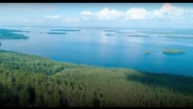
Sustainable wood: Building the Future
Notes:
Now let’s watch a short video about Sustainable wood and future of wood.

Slide 9
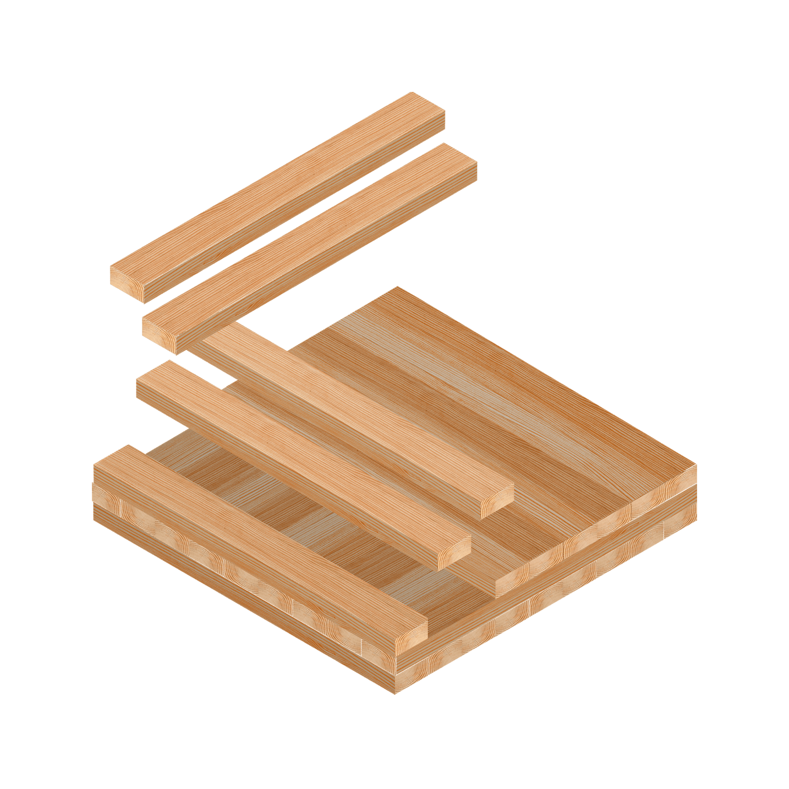
CLT Panels – Modern Wood Technology
What is CLT? – Cross-Laminated Timber (CLT) is made by gluing layers of wood together, each layer placed at 90°.
Why is it strong? – The cross pattern makes it very stable and stronger than normal wood boards.
Where is it used? – CLT is used in building houses, schools, and even tall wooden buildings because it is light, strong, and eco-friendly.
Notes:
What is CLT?
CLT stands for Cross-Laminated Timber.
Imagine stacking several wooden boards on top of each other, but each layer is turned 90 degrees before gluing.
This crisscross pattern is what gives CLT its name.
Why is it strong?
Normal wood can bend or crack along the grain.
But when we place layers in different directions, the weak points are balanced out.
That’s why CLT is more stable and doesn’t warp as easily.
It’s a bit like weaving – the cross pattern makes it stronger.
Where is it used?
CLT is a modern building material, often called “the concrete of the future.”
It’s used in houses, schools, sports halls, and even tall wooden skyscrapers.
Builders like it because it’s light to transport, quick to build with, and stores carbon, which is good for the environment.

Slide 10
References
Hidayatullah, M. (n.d.). Global warming: Causes, effects, and solutions to save our planet. Vocal Media.
https://vocal.media/earth/global-warming-causes-effects-and-solutions-to-save-our-planet-5wg509xl
Turner & Townsend. (2022, September 13). Mass timber: Reducing carbon in the built environment. Retrieved from Turner & Townsend website
The Carbon Community. (n.d.). Trees and Carbon. The Carbon Community. https://www.carboncommunity.org/carbon-community-updates/trees-and-carbon
Geng, A., Yang, H., Chen, J., & Hong, Y. (2017). Review of carbon storage function of harvested wood products and the potential of wood substitution in greenhouse gas mitigation. Forest Policy and Economics, 85(P1), 192–200. https://doi.org/10.1016/j.forpol.2017.08.007

Slide 11
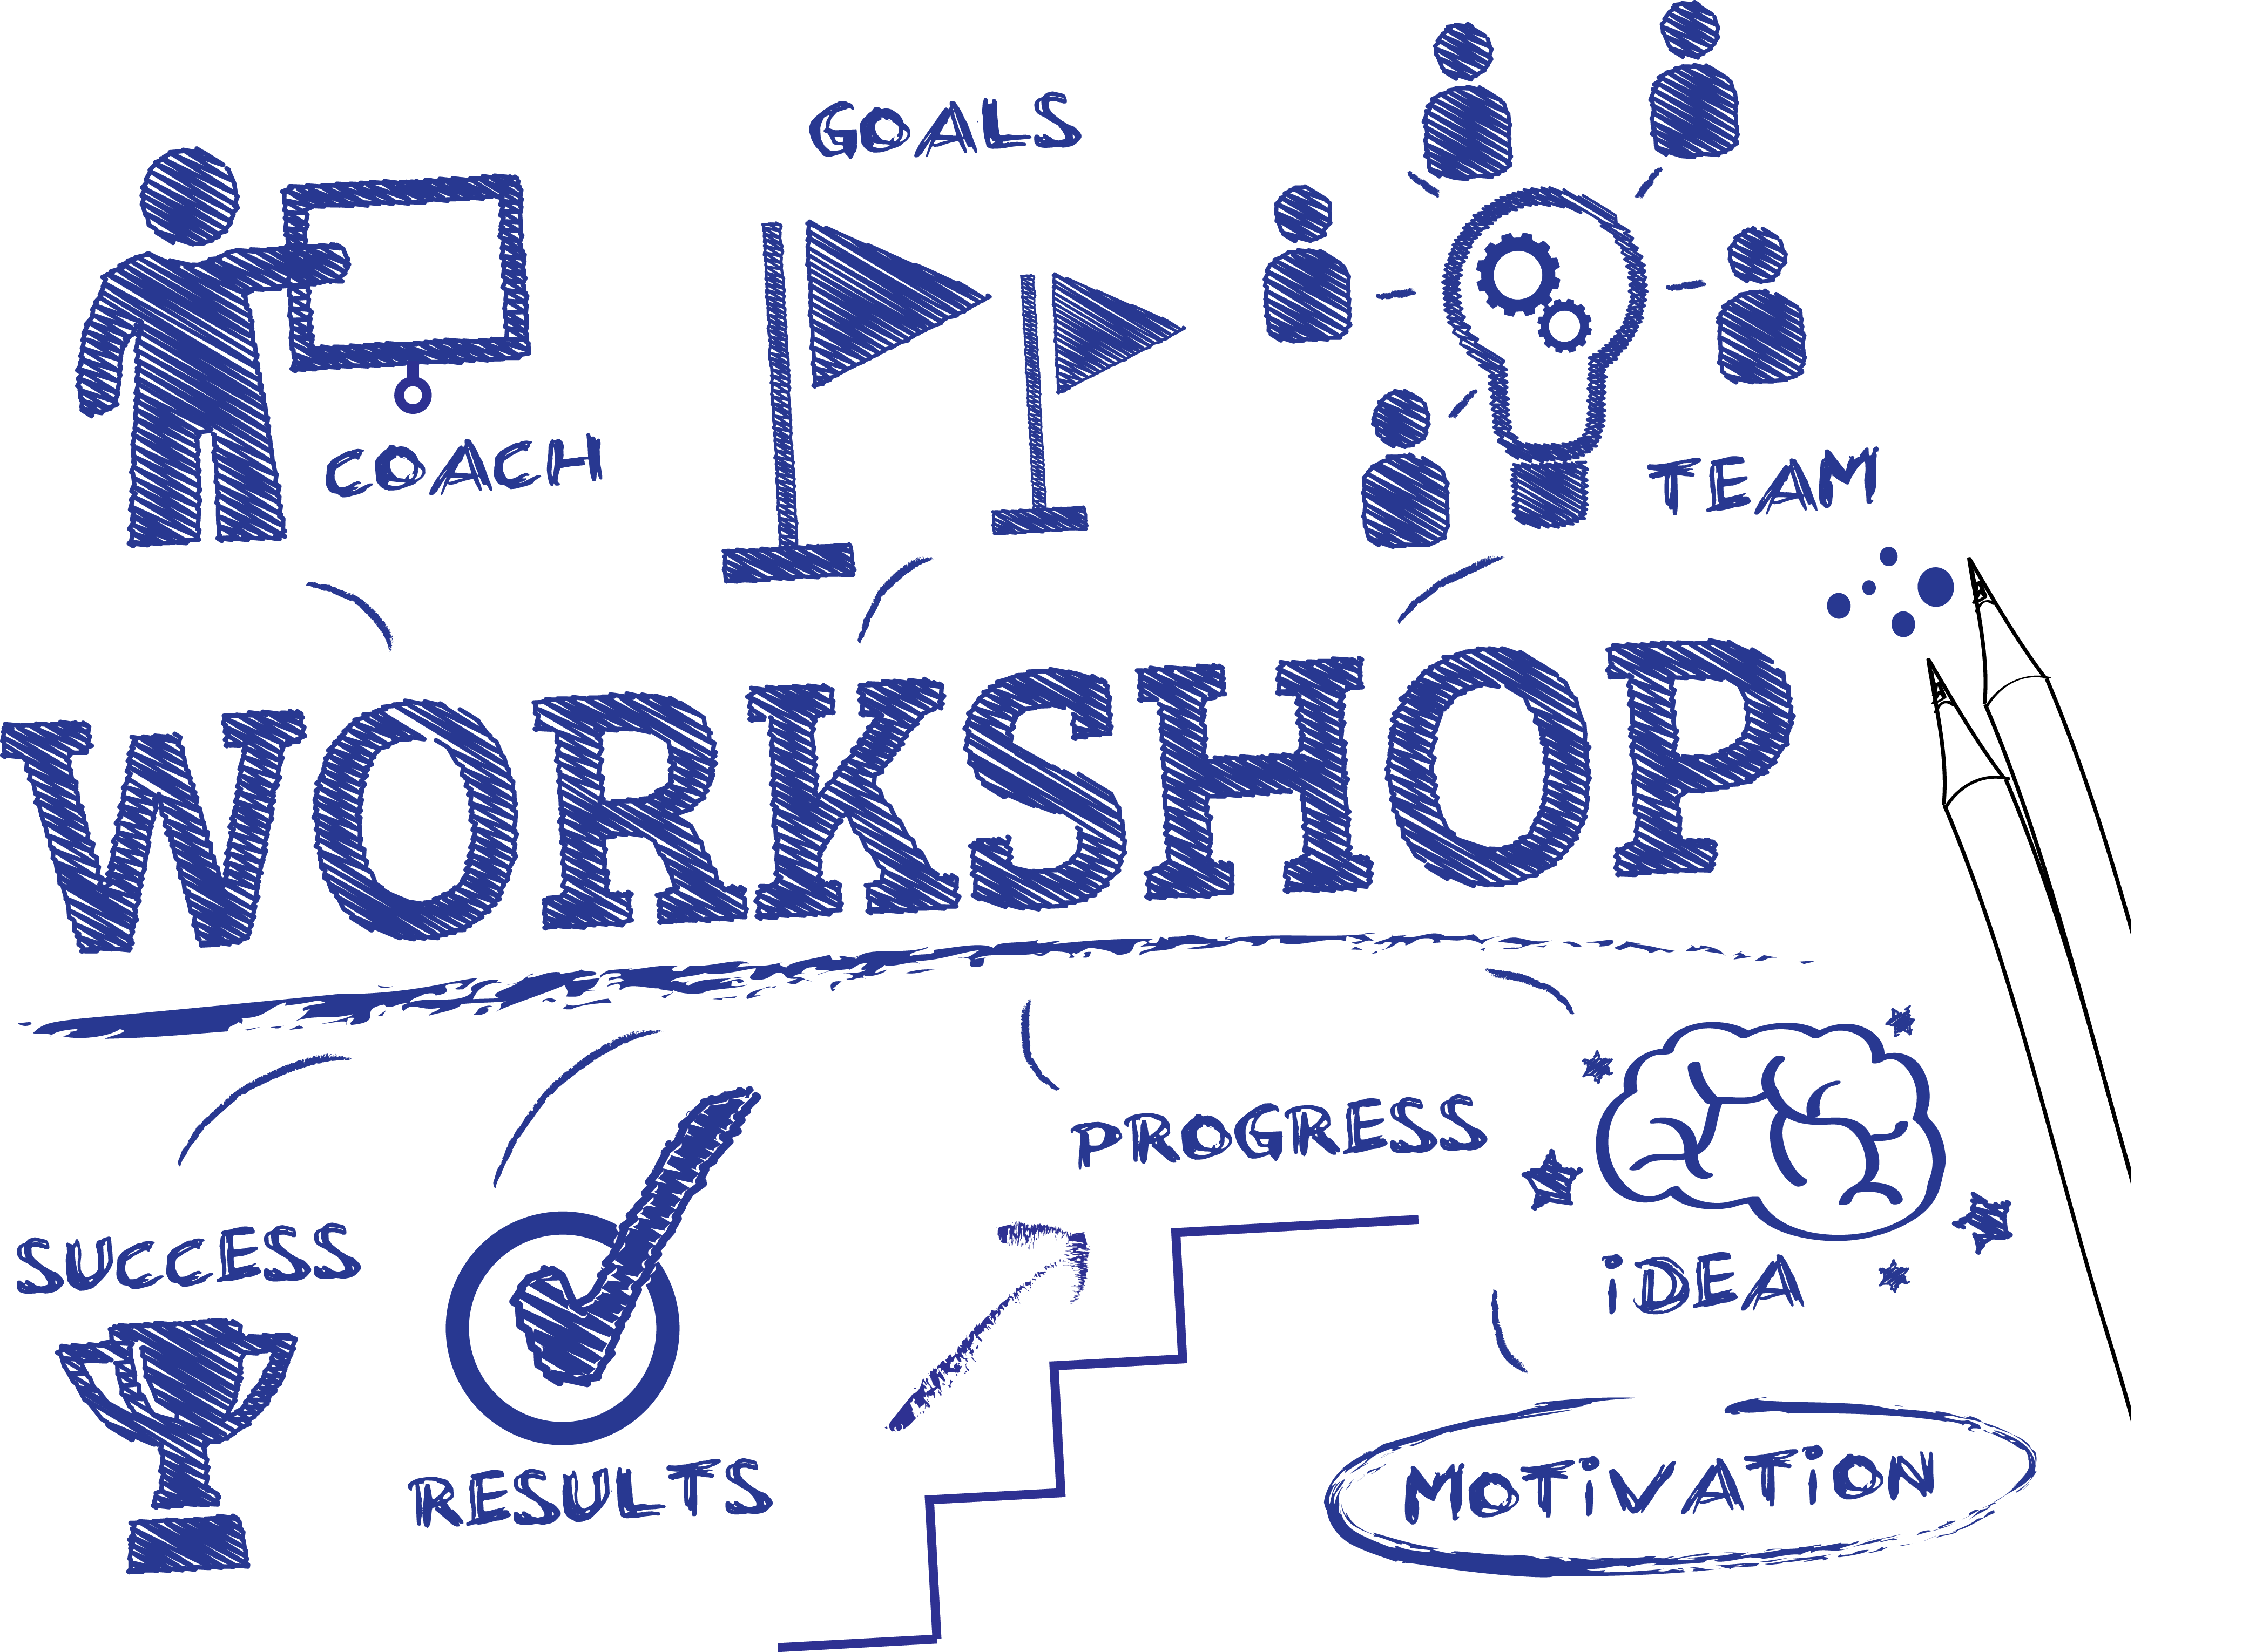
Notes:
Speaker Notes: “Now that we’ve learned about the importance of wood and its environmental impact, it’s time for our activity: making our own CLT panels.”

Slide 12
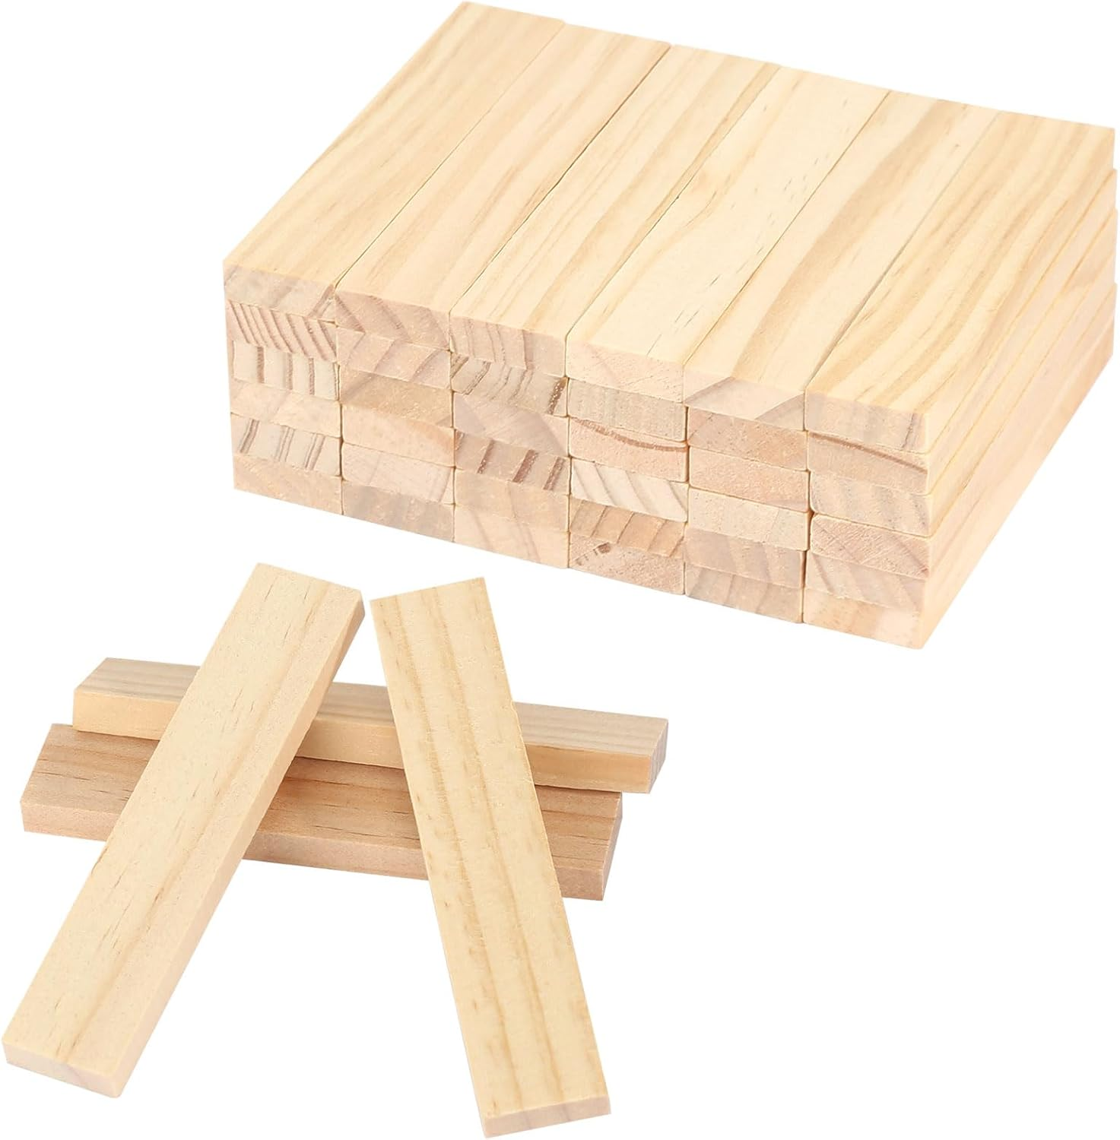
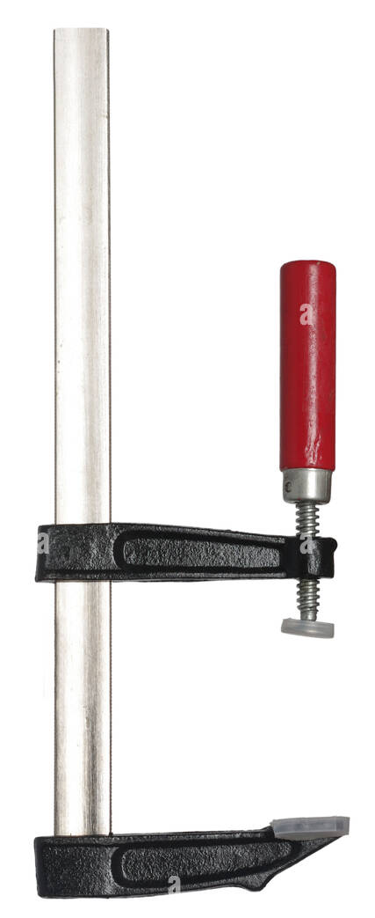
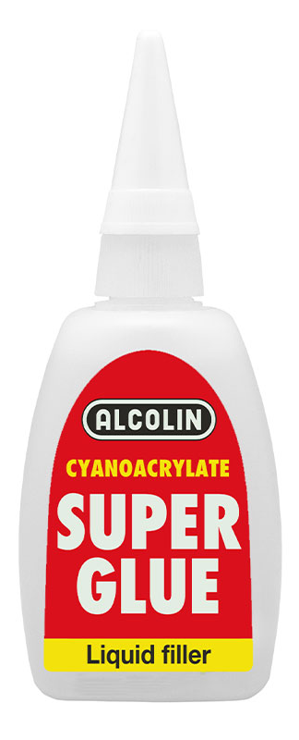
Activity: Produce CLT panel
Materials
Wood stick set
White PVA wood glue (we can use bio-glue of Victor’s workshop and explain it shortly)
Carpenter’s Vice or hand vice stock (or books for pressing)
Notes:
Speaker Notes:
Before we start, let me quickly introduce the materials we’ll use:
A set of wood sticks
Glue (or bio-glue for a sustainable option)
Hand vices to press the layers together

Slide 13
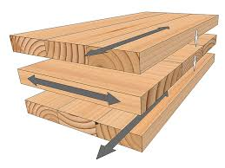
Activity: Produce CLT panel
Procedure
Students line up 5 sticks side by side to form one layer.
Apply glue, then place a second layer at 90° to the first.
Build 3-4 layers, press with hand vice stock or place a small weight on top, and let it dry.
Notes:
Here’s what we expect you to do:
Line up at least five sticks side by side to form your first layer.
Apply glue evenly across the surface.
Place a second layer of sticks perpendicular to the first one.
Repeat this process for 3–4 layers.
When you’re finished, use the hand vices to press the layers together and let them dry.
This way, you’ll see how CLT gains its strength from the cross-layered pattern.
At the end, we will also test the strength of your panels to compare them with single-layer sticks.
Before we begin: Are there any questions? or Is everything clear?

Slide 14
Activity: Test CLT panel
Test
Compare a single stick and the “CLT panel.” How to do it??
This visually demonstrates that cross-lamination increases stiffness/strength.

Slide 15
Notes:
Source of image: https://ww2.comsats.edu.pk/fda/WorkshopReports.aspx

Slide 16
Activity Idea 2: Redesign with wood
Preparation
Provide small wooden pieces of different sizes (sticks, blocks, slats, etc.).
Safe glue (PVA) and, if needed, rubber bands or clothespins for fixing.
Small pieces of sandpaper so students can smooth the edges if they like.
Process
Students first sketch their idea on paper.
2. Using the wooden pieces and glue, they assemble their chosen product.
3. Each group or individual presents their creation and explains why they chose that product

