Slide 1


EDU-CIRC
Rete transfrontaliera per la formazione sull’economia circolare e la decarbonizzazione nella produzione
Grenzübergreifendes Netzwerk zur Aus- und Weiterbildung in Kreislaufwirtschaft und Dekarbonisierung in der Produktion
Interreg VI – A Italia - Österreich
Europa noch näher
Un’Europa più vicina

Slide 2
Water-Smart Home: Saving Every Drop
Notes:
Welcome, everyone! Today, we’re starting our workshop with an important topic: water usage and sustainability. Water is the source of life, but most of us don’t think about how much we use every day or how our habits affect the world. In this session, we’ll discover where water comes from, how we use it, why saving it matters, and how science and technology can help us protect this precious resource for the future. I encourage you to ask questions and think about your own daily habits as we go along.

Slide 3





Why Is Water So Important?
Essential for Life
Water makes up about 60% of our bodies¹, functioning as
the foundation for all cellular activities.
Limited Resource
Only 2.5% of Earth's water is freshwater, with most locked
in glaciers and ice caps².
Universal Need
Water is essential for people, plants, and animals, supporting
all ecosystems on our planet.
Notes:
Let’s look at some interesting facts: Our bodies are made up of about 60% water, which means every cell in our body needs water to function properly. Water is also found all over our planet—about 71% of Earth’s surface is covered by water. However, almost all of that is salty ocean water, which we can’t drink or use for most everyday needs. Only about 2.5% of the world’s water is freshwater, and most of that is locked away in glaciers or deep underground. This means that the amount of water available for drinking, cooking, cleaning, and farming is actually very small. That’s why it’s so important for us to use the water we have carefully and not waste it.

Slide 4
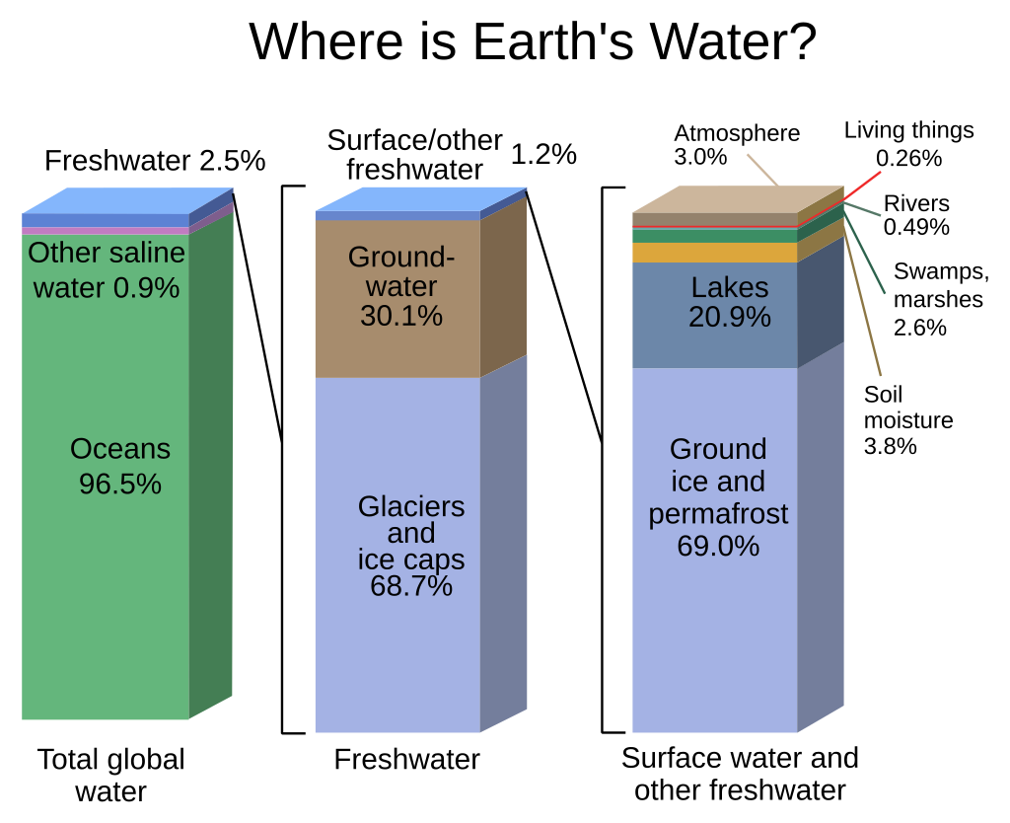
Where is Earth’s Water?
Source: https://web.archive.org/web/20120629055146/http://ga.water.usgs.gov/edu/waterdistribution.html
Notes:
“Let’s look at this picture to see where Earth’s water is.
The first big block shows almost all the water—about 97 out of every 100 drops—is salty, like in the oceans. We can’t drink it or use it for most plants.
The middle block is all the freshwater. But most of that—almost 7 out of every 10 drops—is frozen in ice or deep underground. Only a very small part is easy for us to use.
The last block shows surface freshwater—like lakes and rivers. But even here, most is frozen or underground. Only a tiny bit is in the lakes and rivers we see every day.
So, out of all the water on Earth, less than 1 out of every 100 drops is easy for people to use.
That’s why it’s so important to save and protect our water—every drop matters!”

Slide 5




Where Do We Use Water At Home?
Bathroom
Kitchen
Toilets, showers, and baths account
for nearly 47% of indoor water use
in typical homes.
Drinking, cooking, and washing dishes
comprise approximately 20% of house
hold water consumption.
Laundry
Garden
Washing machines use about 50–150
liters per load depending on efficiency
and settings.
Outdoor watering can account for
30-60% of total residential water use
during summer months.
Notes:
Now, let’s think about your own home. Water is everywhere: we flush toilets, take showers, wash our hands, do laundry, cook, and sometimes water the garden or wash the car. If you had to guess, which activity uses the most water in your home? (Let pupils respond.) In most homes, bathrooms use the most water, followed by laundry and the kitchen. Just being aware of where water goes is the first step in saving it.

Slide 6
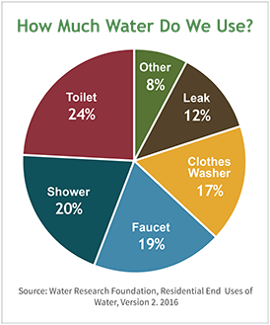
How Much Water Do We Use?
150L
12L
Daily Usage
Per Shower Minute
Average person in Europe uses 144 liters of water per day for personal and household needs.³
A standard shower releases 9–12 liters every minute, adding up to 90+ liters for a 10-minute shower.
15L
12L
Daily Leak Waste
Per Toilet Flush
A single leaky tap can waste up to 15 liters of water per day—that's 5,475 liters annually!
Each toilet flush consumes 6–12 liters of clean water, with older models using even more.
Source: Water Research Foundation, Residential End Uses of Water, Version 2. 2016
Notes:
Let’s put numbers to these activities. In Europe, the average person uses about 120 to 150 liters of water every day. Just one shower can use more than 60 liters if you shower for five minutes! Toilets also use a lot—sometimes over 10 liters in a single flush, if they’re not water-efficient. And even a small leak—a dripping tap—can waste over 5,000 liters in a year, enough to fill more than 60 bathtubs! These numbers show why every drop really does count.

Slide 7
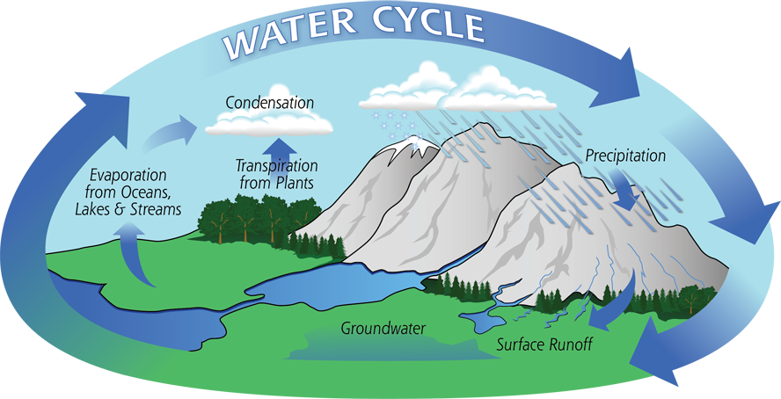
How Much Water Do We Use?
Evaporation
Condensation
Heat from the sun causes water to evaporate from oceans, lakes,
and rivers, turning into water vapor.
Water vapor cools and condenses into clouds as it rises into the atmosphere.
Human Intervention
Precipitation
We extract, use, treat, and
return water to nature,
sometimes disrupting the natural cycle.
Water falls back to Earth as rain, snow, or hail when clouds become saturated.
Source: http://gpm.nasa.gov/education/water-cycle
Notes:
Water is constantly moving in a cycle—evaporating from lakes and oceans, forming clouds, then falling as rain or snow. This is called the water cycle, and it has worked for millions of years. But when people take water from rivers and lakes, use it in cities, and sometimes pollute it, we change the natural cycle. Water treatment plants help clean used water before it goes back to nature, but this process takes energy and resources. If we use too much or pollute it, there may not be enough clean water for everyone or for the environment.

Slide 8
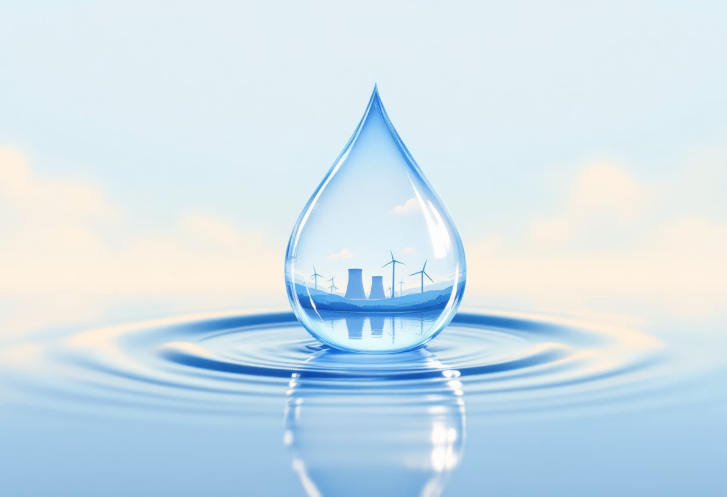
Why Saving Water Matters
Facing Real Shortages
Climate change is intensifying droughts and water scarcity worldwide. Many regions now experience severe water stress affecting millions of people.
Protecting Ecosystems
Rivers, wetlands, and aquatic habitats depend on adequate water flow. Excessive extraction threatens countless plant and animal species.
Energy Connection
Water systems require significant energy for pumping, heating, and treatment. Every gallon saved reduces carbon emissions and helps fight climate change.
AI-Generated Image by GAMMA App
Notes:
Some places in the world, and even parts of Europe, sometimes have water shortages or droughts—periods when it doesn’t rain much and rivers run low. This affects not just people, but also plants, animals, and entire ecosystems. Producing, transporting, and heating water all require energy, often from fossil fuels. So when we waste water, we also waste energy and contribute to climate change. Saving water means saving nature, saving energy, and making sure everyone, including animals and future generations, has enough.

Slide 9






What is Sustainable Water Use?
Preventing Waste & Pollution
Protecting water quality by properly disposing of chemicals and preventing runoff that can contaminate water sources.
Using Only What's Needed
Sustainable water use means consuming only what's necessary for our needs, avoiding excess and waste in all household activities.
Reusing Where Possible
Implementing systems to collect rainwater for gardens or using greywater from sinks and showers to flush toilets.
Notes:
Sustainability means using resources in a way that doesn’t harm the environment or run out for future generations. For water, this means only using as much as we need, not letting clean water go to waste, and making sure we don’t pollute it. Some smart solutions include collecting rainwater to water gardens, or using “greywater”—water from sinks or showers—for flushing toilets. Every small sustainable choice helps keep the water cycle healthy.

Slide 10
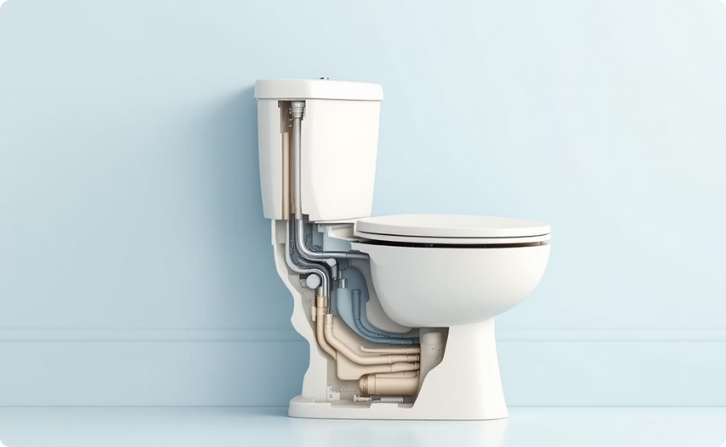
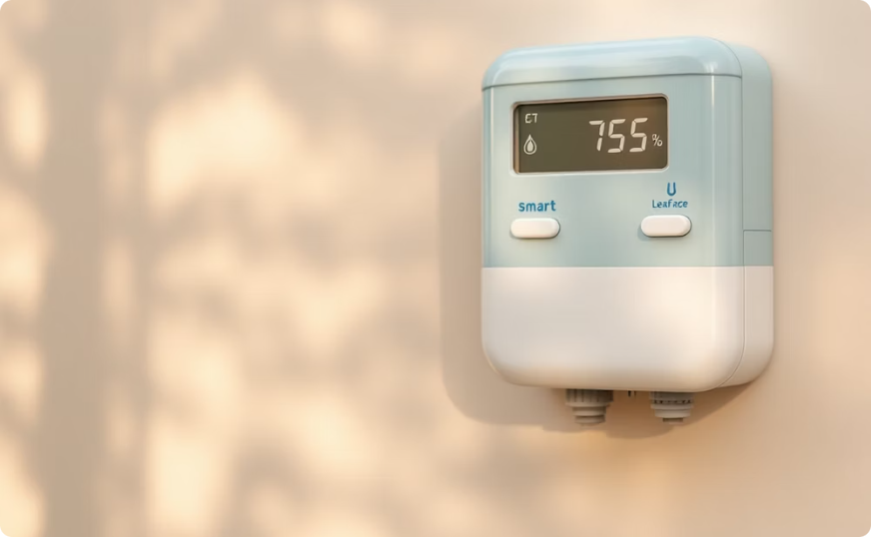
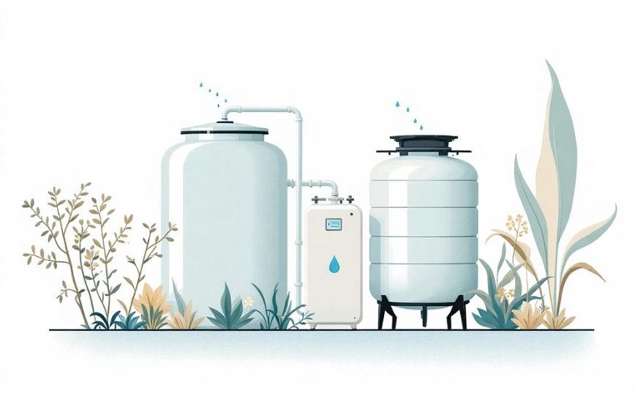
Science and Technology for Water Saving
Efficient Fixtures
Dual-flush toilets reduce water use by up to 67% compared to standard models.
Low-flow faucets and showerheads can cut water use by 30-50%.
AI-Generated Image by GAMMA App
Smart Monitoring
Advanced leak detectors and smart water meters provide real-time usage data and
automatic alerts when unusual flow patterns suggest leaks.
Water Recovery
AI-Generated Image by GAMMA App
Rainwater harvesting systems can collect up to 2,270 liters from 25 mm of
rain on a 93 m² roof, providing free water for gardens and outdoor use.
AI-Generated Image by GAMMA App
Notes:
Technology offers lots of ways to help us save water. For example, dual-flush toilets use less water for smaller flushes, while low-flow showerheads and taps limit how much water comes out without reducing comfort. Some homes now have smart meters that track how much water is used, helping spot leaks early. Rainwater harvesting systems collect rain from the roof and store it for use in the garden. Using technology wisely, we can make a big difference.

Slide 11

What Can You Do?
Shower Smarter
Taking 5-minute showers instead of 10-minute ones can save up to 60 liters of water daily. Consider installing a shower timer or water-efficient showerhead.
Mind the Tap
Turning off the tap while brushing teeth saves up to 12 liters per brushing. That's 8,760 liters per year for a family of four!
Address Leaks Promptly
Fix leaks as soon as you notice them or alert an adult. A leaking toilet can waste up to 200 gallons daily without making a sound.
Wash Wisely
Use a bucket instead of a running hose when washing cars or outdoor items. A hose uses 6 times more water than a bucket method.
AI-Generated Image by GAMMA App
Notes:
Even small actions add up! Try taking shorter showers, turning off the tap while brushing your teeth, and only using the washing machine for full loads. If you see a leak at home or school, tell an adult so it can be fixed. Use a bucket instead of a hose when washing your bike or the family car. If everyone in your class did just one of these things, imagine how much water you could save in a year!

Slide 12

Every Drop Counts!
Remember Water's Value
Freshwater is limited and precious, making up just 2.5% of all water on Earth with even less readily available for use.
Apply Science & Technology
Smart fixtures, leak detection, and water reuse systems provide powerful tools for conservation in every home.
Develop Water-Wise Habits
Small daily actions add up to significant water savings when practiced consistently by everyone in the household.
Notes:
To finish: Remember, water is precious and limited, but we can all help save it. Science and technology provide solutions, but your everyday choices are just as important. What’s one thing you’ll do differently after this session? [Let pupils share ideas.]
Thank you for your attention! Next, we’ll use your creativity and knowledge in the Water-Smart Home Design Challenge.

Slide 13
References
Perlman, H. (2016, December). The water in you. United States Geological Survey.
United States Geological Survey. (n.d.). Where is Earth's water?
Gleick, P. H. (1996). Water resources. In S. H. Schneider (Ed.), Encyclopedia of Climate and Weather (Vol. 2, pp. 817–823). Oxford University Press.
European Environment Agency. (2018, August 14). Water use in Europe — Quantity and quality face big challenges. https://www.eea.europa.eu/signals-archived/signals-2018-content-list/articles/water-use-in-europe-2014

